Slide 1







Fire/Building
Evacuation
Safety Equipment Shelter in Place
Oakland Scientific Facility (OSF) / 20th Street Building
Emergency Procedures “Handbook”
Emergency Notification
Building Contacts
Notes:
Created by Karen Hsi, UCOP Risk Services Analyst; revised by Jayne Dickson, CDL Floor Warden
September 2014

Slide 2










Fire/Building Evacuation
Unlike the Franklin and Kaiser buildings, the OSF does not have a public address (PA) system.
So… If an alarm sounds (not an announced drill), you must evacuate the building. If mobility impaired, stay in the “Safe Zone”.
Without fail or question,
begin evacuating the building immediately!!!
This is the single most important thing to remember!
Notes:
If an alarm sounds (not an announced drill), you must evacuate the building. If mobility impaired, stay in the “Safe Zone”.
Without fail or question, begin evacuating the building immediately!!!
This is the single most important thing to remember!

Slide 3

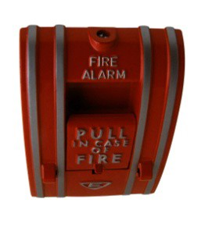

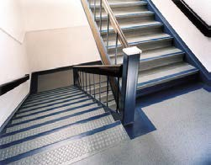
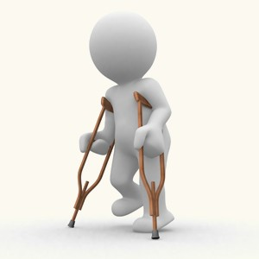
Fire/Building Evacuation
If you discover a fire of any size, activate your nearest fire alarm pull station and dial 9-911 to report the exact location and type of fire.
If safe to do so, call Security at 7-0020 to advise them of the
location/severity of the fire. Warn others in the immediate area.
Always evacuate using stairwells only. Go to assigned relocation site, located at the Union Bank parking lot across Franklin St.
The South stairwell, closest to the OSF parking lot, is the dedicated “Safe Zone” for all mobility impaired staff.
Notes:
Fire/Building Evacuation Procedures
First…
Activate the nearest fire alarm pull station located in elevator lobbies and stairwells.
Call 9-911. Report your exact location (floor/office #) and type of fire. Give your name and phone number – don’t hang up until the operator tells you to do so. Warn others in the immediate area.
Call Security at 7-0020.
Use an extinguisher only if the fire is small and it is safe to do so.
Next…
Begin evacuation procedures using the stairwells.
At the bottom of the stairs, proceed to the Union Bank parking lot across Franklin Street.
The South stairwell, closest to the OSF parking lot, is the dedicated “Safe Zone” for all mobility impaired staff.

Slide 4

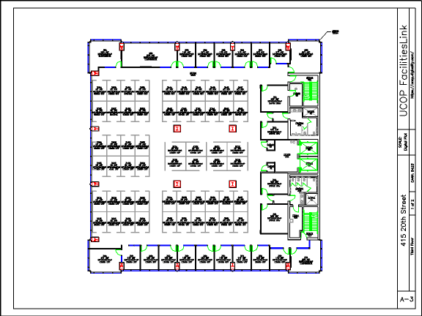



Fire/Building Evacuation
Notes:
Always use the stairwells to evacuate the building. Never, never, never attempt to use the elevators.

Slide 5
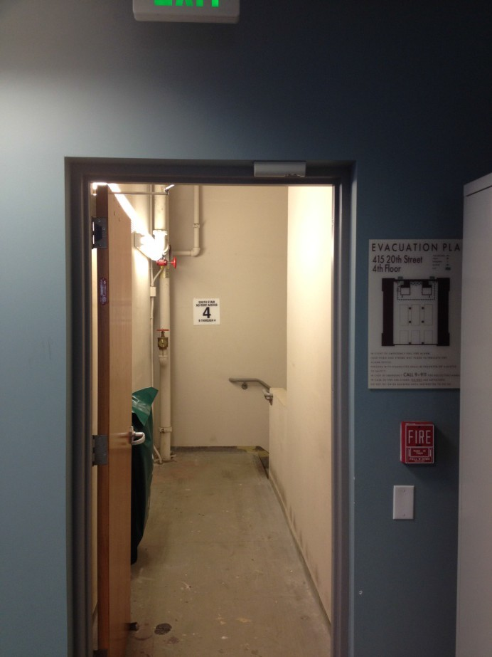
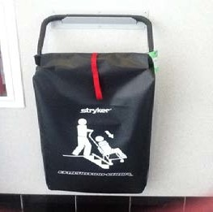
Fire/Building Evacuation
Mobility impaired people, who need assistance in evacuating, should use the…
Dedicated “Safe Zone” -- South
stairwell (closest to the OSF parking lot)
Remain in the small area past stairwell door, before the stairs begin
Floor Wardens will notify the OSF Building Manager of persons in the Safe Zone in need of assistance
Notes:
Any mobility impaired people, needing assistance to evacuate the building, should move to the dedicated “Safe Zone” at the top of the South stairwell. The safe zone is behind protective fire doors; people waiting for evacuation assistance will be safe here until Oakland Fire Department (OFD) personnel can safely evacuate them.

Slide 6
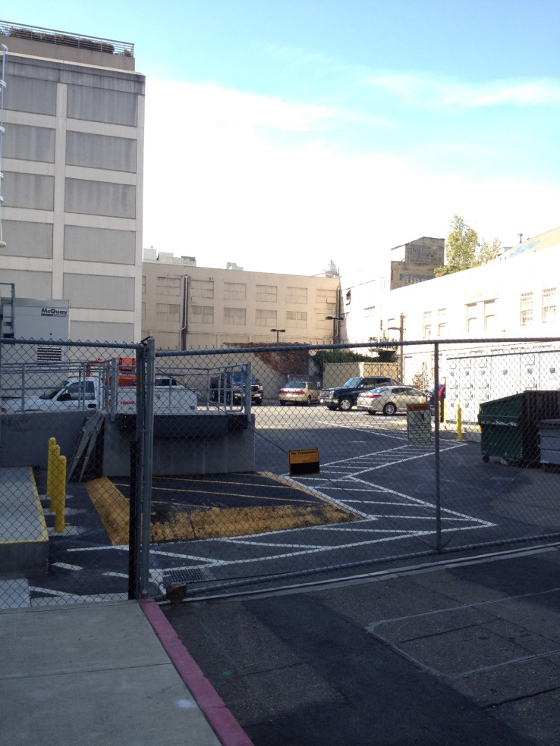
Fire/Building Evacuation
Gather in the Union Bank parking lot, grouped by floor
Floor Wardens
  Verify all persons on the floor have evacuated or are in the Safe Zone
  Report to OSF Building Mgr any trouble situation on the floor or if the floor is “All Clear”
Notes:
Gather in the Union Bank parking lot, grouped by floor
Floor Wardens
- Verify all persons on the floor have evacuated or are in the Safe Zone
Report to OSF Building Mgr any trouble situation on the floor or if the floor is “All Clear”

Slide 7

Pop Quiz # 1
Notes:
Pop Quiz #1

Slide 8
Never use the elevator when evacuating the building.
Notes:
And the answer is…?

Slide 9
Where is the assigned relocation area?
At Snow Park, 3 blocks down on 20th Street
In the OSF parking lot at the rear of this building
In the Union Bank parking lot across the street
At Donut Savant on Broadway
None of the above
Notes:
Click to reveal the answer.

Slide 10
Where is the “Safe Zone”?
At the top of the South stairwell
In the elevator lobby near the AED
At Donut Savant
At the top of the North stairwell
None of the above
Notes:
Click to reveal the correct answer.

Slide 11

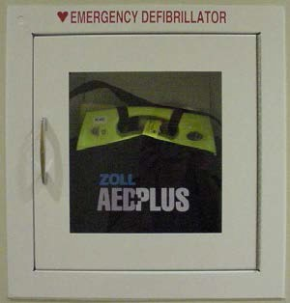
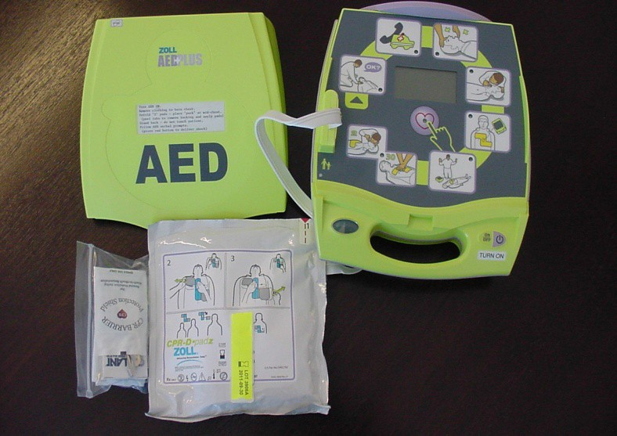
Cardiac “Chain of Survival” Four Links
Dial 9-911 (Alert Paramedics/EMS)
Perform CPR (buys time until…)
Defibrillation (AED) – each minute that passes without defibrillation reduces the victim’s chances of survival by 10%
(10 minutes)!
Advanced life support (Paramedic care)
Safety Equipment
AED
Electronic device that diagnoses cardiac arrhythmias
Delivers electric shock stops the arrhythmia and returns the heart to an effective rhythm
Anyone can use the AED; no special training is necessary
Notes:
Cardiac “Chain of Survival” Four Links
Dial 9-911 (Alert Paramedics/EMS) and then call Security (7-0020) so they can secure an elevator for the emergency medical responders and lead them to the exact location.
Perform CPR (buys time until…)
Defibrillation (AED) – each minute that passes without defibrillation reduces the victim’s chances of survival by 10% (10 minutes)!
Advanced life support (Paramedic care)

Slide 12
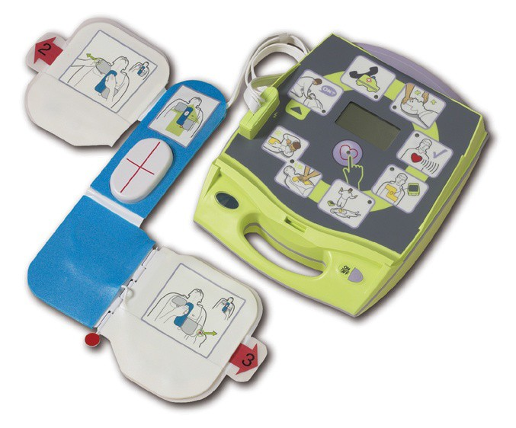
AED Locations for OSF Bldg:
2 AED units
Located on 4th floor, left of the elevators
Located on the Ground floor at the Security Desk, visible from elevators
Cardiac Medical Emergency
  Call 9-911
  Notify Security, 7-0020
  Send runner to retrieve nearest AED
  Direct nearby person to summon an AED- CPR trained staff member, if possible
Safety Equipment
Notes:
AED Locations for OSF Bldg: 2 AED units
Located on 4th floor, left of the elevators
Located on the Ground floor at the Security Desk, visible from elevators Cardiac Medical Emergency
Steps
Call 9-911
Notify Security, 7-0020
Send runner to retrieve nearest AED
Direct nearby person to summon an AED-CPR trained staff member, if possible
Note: If AED-trained personnel are not available…
In an emergency, any untrained bystander can turn on the AED and follow the voice prompts to use the device. Once the unit pads are attached to the patient, the AED will analyze the patient’s heart rhythm. The AED will not shock the patient unless it is necessary to restore the regular heart rhythm; the AED will not transmit the shock until bystanders have been warned to be ‘clear’ (not touching patient). ANYONE CAN AND SHOULD USE AN AED DEVICE – IT MAY BE THE ONLY CHANCE THE PATIENT HAS IF TRAINED MEDICAL PERSONNEL DO NOT ARRIVE QUICKLY!

Slide 13
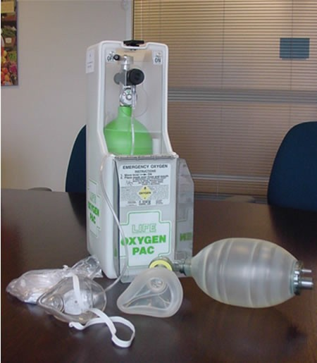
Portable Oxygen Unit
Administer Oxygen for persons having difficulty breathing/shortness of breath
Can be used to supplement rescue breathing for a non- breathing victim
Located on the 4th Floor
Safety Equipment
Notes:
Portable Oxygen Unit
Administer Oxygen for persons having difficulty breathing/shortness of breath
Can be used to supplement rescue breathing for a non-breathing victim
Located on the 4th Floor in the elevator lobby

Slide 14
Pop Quiz #2
Notes:
Pop Quiz #2

Slide 15
Match the steps in the proper order:
1
EMTs take over
2
Perform CPR
3
Call 9-911
4
Call 7-0020
5
Defibrillation
Notes:
Click to see the correct order.

Slide 16





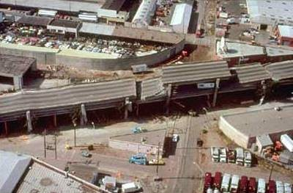

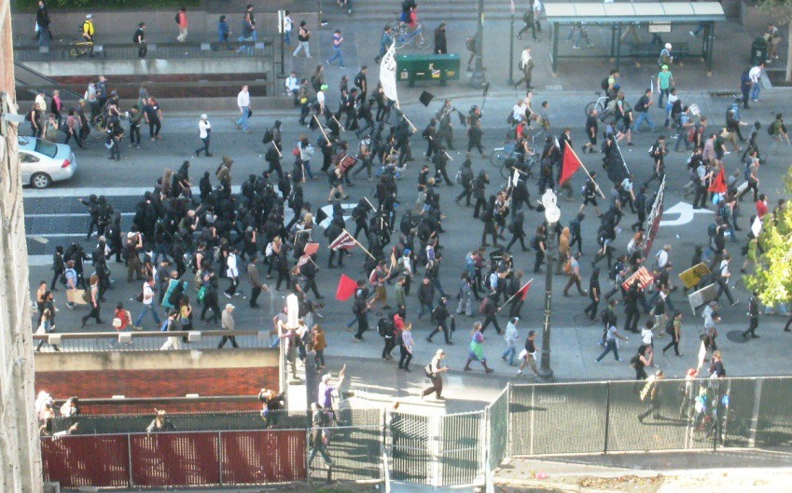


Following a large earthquake, we need to assess the safety of the building and any outside hazards in the immediate vicinity before releasing staff to the streets. Staff should be prepared to stay at work for 3 days, if necessary.
Around Oakland, our procedures for civil unrest or criminal activity outside in the vicinity are to go into “lockdown” mode – this might be considered a form of ‘sheltering in place’.
Shelter in Place
Notes:
For a ‘shelter in place’ or lockdown scenario, UCOP staff should be prepared to stay in the building for a maximum of 3 days.

Slide 17
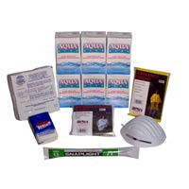

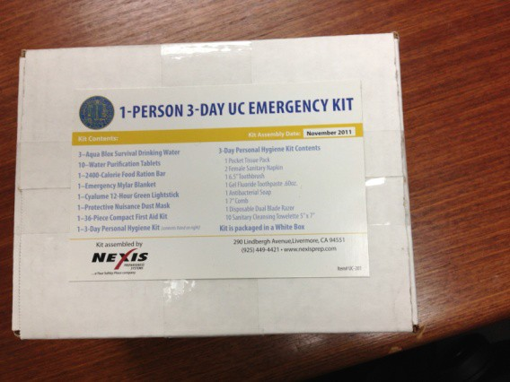
Each department stores enough 3-Day UC Emergency Kits for each staff member.
Kits include drinking water, 2,400 calorie food ration bar, emergency Mylar blanket, dust mask, first aid kit, personal hygiene kit, etc.
Shelter in Place
Notes:
The 1-Person 3-Day UC Emergency Kit includes:
1 Aqua Blox Survival Drinking Water 3-Day Personal Hygiene Kit includes:
10 Water Purification Tablets 1 Pocket Tissue Pack
1 2,400 Calorie Food Ration Bar 10 Sanitary Cleaning Towelettes
1 7” Cyalume 12-Hour Green Lightstick 1 6.5” Toothbrush
1 Emergency Mylar Blanket 1 Gel Fluoride Toothpaste
Protective Nuisance Dust Mask 1 Antibacterial Soap
1 36-Piece Compact First Aid Kit 1 Disposable Dual Blade Razor
1 3-Day Personal Hygiene Kit

Slide 18
Pop Quiz #3
Notes:
Pop Quiz #3

Slide 19
If necessary, for how many days should you be prepared to stay at work?
3 days
Notes:
Click to reveal answer.

Slide 20

Emergency messages to UCOP staff are disseminated in order of priority the following ways:
For emergency notifications, we rely on:
1. Broadcast email messages to ucop.edu email addresses
2. UCOPAlert: emergency notifications to your personal phones and personal email addresses (e.g., gmail.com) outside of normal business hours.
3. PA announcement (Franklin and Kaiser) if urgent
(Note: the OSF building does not have a PA system.)
4. UCOP website and the remote/out of area 866# message line
– typically, used in the event of an extended closure or
major disaster
Emergency Notification
Notes:
For the most part, emergency notifications are sent via email to ucop.edu email addresses. However, UCOPAlert is a new emergency notification system that allows UCOP employees to receive informational alerts on their personal phones or by personal email outside normal business hours about emergencies or other critical situations that affect the UCOP work environment. You can register for UCOP Alert at http://www.ucop.edu/risk-services/crisis-management/ucop-staff-emergency-procedures/ucop-alert.html.

Slide 21


Floor Wardens
3rd Floor – Albert Apolonio &
Patty Herkins
4th Floor – Jayne Dickson,
Renata Ewing &
Michael Thwaites
OSF Building Manager
Michael Annas, 510-987-0519
Security Guard 510-987-0020
Building Contacts
Notes:
Floor Wardens
3rd Floor – Albert Apolonio & Patty Herkins
4th Floor – Jayne Dickson, Renata Ewing & Michael Thwaites
OSF Building Manager – Michael Annas, 510-987-0519
Security Guard 510-987-0020

Slide 22
Pop Quiz #4
Notes:
Pop Quiz #4 – Final Pop Quiz

Slide 23
In the OSF, what’s the single most important thing to remember?
Without fail, if an alarm sounds you must begin to evacuate the building immediately!!!
Notes:
Click to reveal the answer.

