Slide 1
Left Behind:
A Closer Look at Tobacco-Related Health Disparities
Pebbles Fagan, Ph.D., M.P.H.
Professor and Director, Center for the Study of Tobacco
University of Arkansas for Medical Sciences
Fay W. Boozman College of Public Health
Department of Health Behavior and Health Education
Cancer Prevention and Control Program
UAMS Winthrop P. Rockefeller Cancer Institute
January 11, 2017
Notes:
Thank you for you attention today.

Slide 2
Goals for Today
Review definition of health disparities and tobacco-related health disparities.
Increase knowledge of specific tobacco related disparities.
  Burden of tobacco-caused cancers among racial/ethnic-gender, geographical groups
  Smoking among LGBTs
  Smoking by cigarette type
  Secondhand smoke exposure
  Quitting and cessation

Slide 3
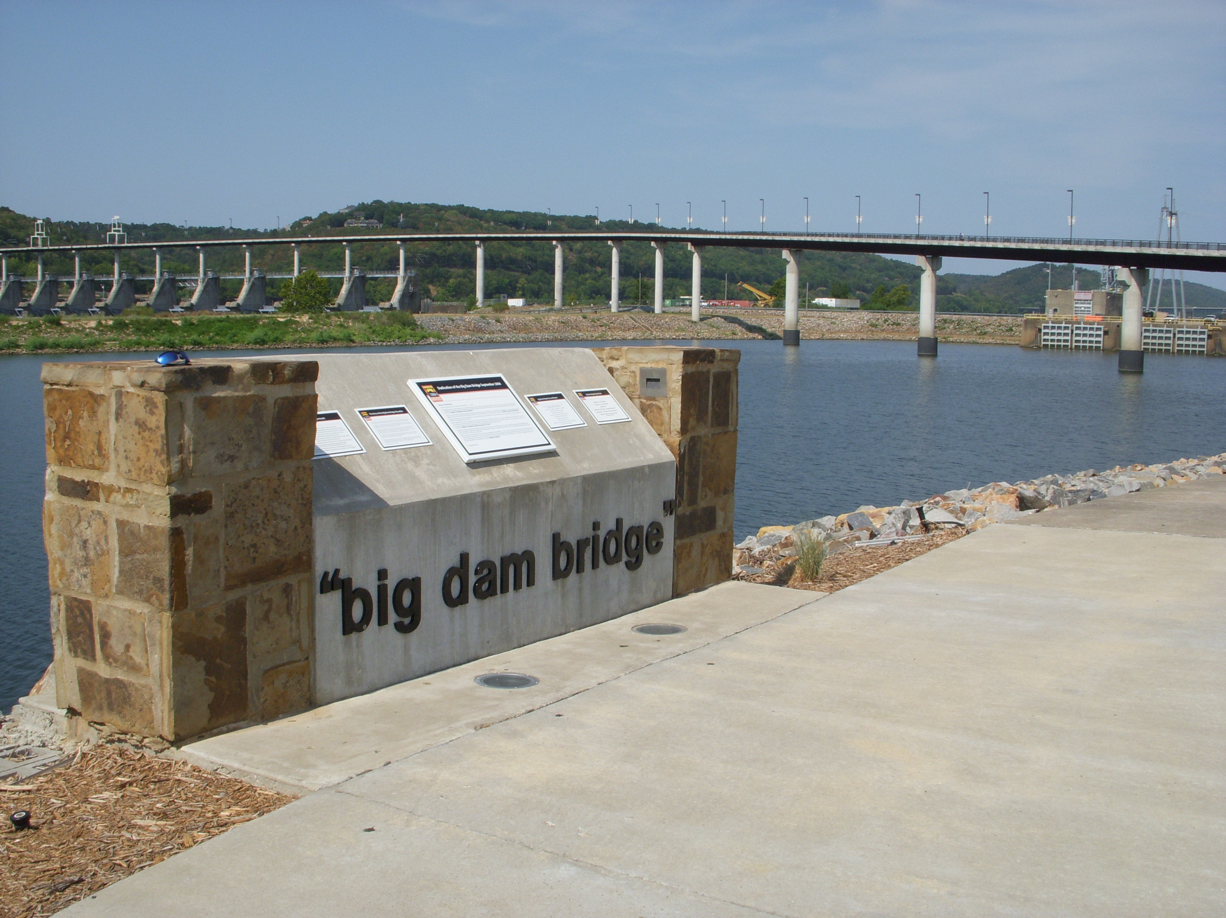
Disparities are not just differences in health indicators
Notes:
Its also about the undercurrents of the divides.
The speed at which those divides open and close.
And the our perception of those divides.
How we look at the divides matter.

Slide 4
What are Health Disparities, Inequalities, and Inequities?
During the early 1990’s researchers, government agencies, and practitioners began using the term “health disparities” to define differences in population groups in the United States (Carter-Pokras, 2002) and was part of a revolution to eliminate disparities at local, state, and national levels.
For the first time, Healthy People 2000 established the goal of eliminating health disparities by 2010.
Carter-Pokras suggested that health disparities should be viewed as a chain of events signified by differences in environment; access to, utilization of, and quality of care; health status; or a particular health outcome that deserves scrutiny.
Underlying her definition is the notion that health disparities have pathways, the environment plays a role, and that there are multiple health disparities outcomes beyond morbidity and mortality.
Carter-Pokras further suggests that the differences should be evaluated in terms of inequality and inequity since what is unequal is not necessarily inequitable.
Notes:
Its important to understand what we mean by health disparities because the definition of TRHD originated from these discussions.

Slide 5
What are Health Disparities, Inequalities, and Inequities?
Inequality refers to differences in health status or distribution of health determinants between population groups.
Braveman (2006) proposes that health disparity/inequality is a particular type of avoidable difference in health or in important influences on health that can be shaped by policies.
  Ex. Differences in tobacco-cause lung cancer mortality.
  Can be of biological origin, engagement in particular behaviors, or environmental conditions outside of the control of individuals.
Are the differences observed in lung cancer unjust, unfair, and avoidable?
  If so, then then the inequality observed in lung cancer lead to inequity in health.
Inequity refers to unfair, avoidable differences arising from poor governance, corruption or cultural exclusion.

Slide 6
Other Definitions of Disparities, Inequalities, and Inequity
Disparity
The quantity that separates a group from a reference point on a particular measure of health that is expressed in terms of a rate, proportion, mean, or some other quantitative measure (HP, 2010).
Inequity
Health equity is the fair distribution of health determinants, outcomes, and resources within and between segments of the population, regardless of social standing. Therefore, inequity is a difference in distribution or allocation of a resource between groups (usually expressed as group- specific rates) such as social, economic, or health care environment.
  Ex. Education, smokefree environments, health insurance, access to cessation services, access to cancer treatment services.
Inequality
Variations in rate of health indicators with the resources of the group.
Notes:
With the various definitions, you can 1) measure the speed at which the divides open and close 2) the undercurrents of these divides, and use this information to influence the perceptions of the divides.

Slide 7
Who Experiences Health Disparities?
Notes:
How we look at the divides matters.
Not looking at divides in certain ways can make some disparities not relevant.

Slide 8
Table 3. Population Growth Estimates for Racial/Ethnic Aggregate Groups in the United States
Racial/ethnicity | 2014¹ % or number | 2060 ² % or number
Total population (in millions) | 318,748 | 416,795
White alone | 77.7 | 68.5
White alone, not Hispanic or Latino | 62.6 | 43.6
Black or African American alone | 13.2 | 14.3
American Indian and Alaska Native alone | 1.2 | 1.3
Asian alone, percent | 5.4 | 9.3
Native Hawaiian and Other Pacific Islander | 0.2 | 0.3
Two or More Races | 2.5 | 6.2
Hispanic or Latino | 17.4 | 28.6
Colby and Ortman 2015
Notes:
We often examine disparities in racial/ethnic groups because in this country, race/ethnicity matters. This is both positive and negative.
Nearly 30% of the U.S. population is minority. That means a lot to many people.
From a health and social perspective, some minority group often bear a greater burden of health disparities. These demographics are changing, particularly as the % of
Hispanics increase and the proportion of Whites decrease.

Slide 9
Other Demographics that Matter
Gender
Age
LGBT
Geography
Notes:
Gender, age, LGBT, Geography matter- decision about resources and governance are made along these demographics and have so for many years.
Some of you may ask, what about the homeless, the mentally ill, the disabled persons with comorbid conditions?
They all matter too.

Slide 10
Social Determinants
The social determinants of health are the circumstances in which people are born, grow up, live, work, and age, as well as the systems put in place to deal with illness. These circumstances are in turn shaped by a wider set of forces: economics, social policies, and politics.
Notes:
What also matters are the determinants of the disparities we see in the demographic groups. Health disparities are also can be defined Social, economic and political forces.

Slide 11
Social Determinants or Resources in Environment
Availability of resources to meet daily needs (e.g., safe housing and local food markets)
Access to educational, economic, and job opportunities
Access to health care services
Quality of education and job training
Availability of community-based resources in support of community living and opportunities for recreational and leisure-time activities
Transportation options
Public safety
Social support
Social norms and attitudes (e.g., discrimination, racism, and distrust of government)
Exposure to crime, violence, and social disorder (e.g., presence of trash and lack of cooperation in a community)
Socioeconomic conditions (e.g., concentrated poverty and the stressful conditions that accompany it)
Residential segregation
Language/Literacy
Access to mass media and emerging technologies (e.g., cell phones, the Internet, and social media)
Culture

Slide 12
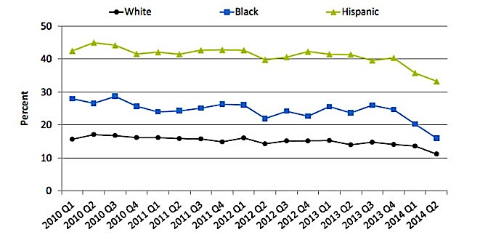
Adults ages 18-64 who were uninsured at the time of interview, by race/ethnicity, January 2010-June 2014
Notes:
Lets look at access to health care.

Slide 13
Social Determinants: Health Insurance
From 2000 to 2010, the percentage of adults ages 18-64 who reported they were without health insurance coverage at the time of interview increased from 18.7% to 22.3% (AHRQ, 2014).
From 2010 to 2013, the percentage without health insurance decreased from 22.3% to 20.4%. During the first half of 2014, the percentage without health insurance decreased to 15.6%.

Slide 14
Socioeconomic Conditions of Poverty and Stress
Poverty
Foreclosure
Unemployment
Public assistance
Proximity to employment
Housing and lack of

Slide 15
Weighted Average Poverty Threshold in 2015
Number of persons | Dollars
One | 12,082
Two | 15,391
Three | 18,871
Four | 24,257
Five | 28,741
Six | 32,542
Seven | 36,998
Eight | 41,029
Nine or more people | 49,177
Source: U.S. Census, Income and Poverty in the U.S. 2016
Notes:
Lets look at the conditions in which people live. Neighborhood level data is important because

Slide 16
Poverty Status of all people in U.S. By Race/Ethnicity, 2002-2015
%
Notes:
Poverty rates overall have not changed much in the past 13 years.

Slide 17
Notes:
Income and poverty are intertwined:
The income divides have not decreased, but increased.
The income divides are the undercurrent to disparities that we observe.

Slide 18
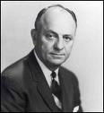
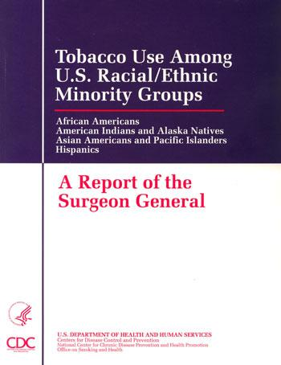
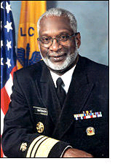
Surgeon General Reports
1964: Causal link between tobacco use and lung cancer, based on data which mostly included white males.
1980: a causal relationship between tobacco and lung cancer in women.
1985: Black workers have higher smoking rates than white workers, with black male blue-collar workers exhibiting the highest smoking rate. Black workers also have lower quit rates than white workers. In contrast, white workers of both sexes are more likely to be heavy smokers regardless of occupational category.
1998:Tobacco Use Among U.S. Racial/Ethnic Minority Groups stated:
“Few studies have examined the relationship between tobacco use and known health effects among minority racial/ethnic groups.”
“Few data sets have had sufficient numbers for minority racial/ethnic groups to conduct such analyses.”
Notes:
So, now that we have the context of tobacco-related disparities, I can provide examples.
The SG reports were instrumental in setting the stage for examining tobacco-related health disparities.
First SG focused on white males, then focus on females, then in 1998 when under the leadership of Dr. Satcher, the first SG on racial/ethnic minorities was produced.

Slide 19
Definition of Tobacco-Related Health Disparities
“Differences in the patterns, prevention, and treatment of tobacco use; the risk, incidence, morbidity, mortality, and burden of tobacco-related illness that exist among specific population groups in the United States; and related differences in capacity and infrastructure, access to resources, and environmental tobacco smoke exposure.”
-Fagan, King, Lawrence, Petruci, Robinson, Banks, Marable, & Grana
American Journal of Public Health, 2004
Notes:
The definition that was developed 13 years ago in 2002 was developed by a planning committee of over 20 people. The importance of understanding the background information on health disparities is that this definition encompasses the differences in resources that many describe as “inequities”.

Slide 20
Tobacco Disease Continuum
Initiation
SHS exposure
Current use
Type of cigarette smoked
Frequency and intensity of use
Quitting, cessation, treatment
Disease consequences

Slide 21
Burden of Tobacco-Caused Disease
By Racial/Ethnic and Gender
Notes:
Lets take a look at the morbidity and mortality burden which is why we even care about tobacco.

Slide 22
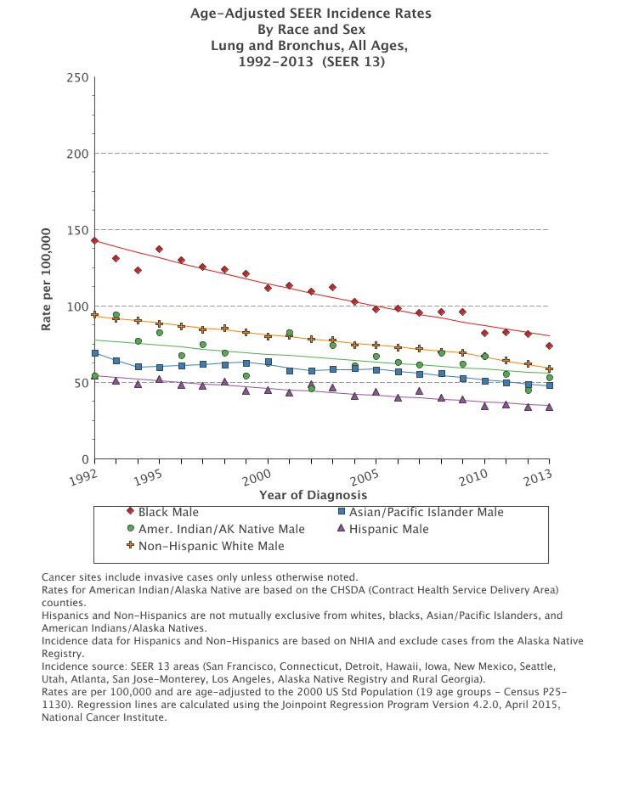
Notes:
One way of looking at who is left behind or not is looking at race and gender.
We are not able to compare all r/e groups of men as far back as 1975 because the data were not available. So, what you see here are data from 1992-201 for males for the aggregate groups, which is all we can report at the national levels.
What is evident?
Decline.
Rate of decline faster among some groups than others- AA males.
Gaps are closing, but not necessarily because all groups are making gains at the same rate.

Slide 23
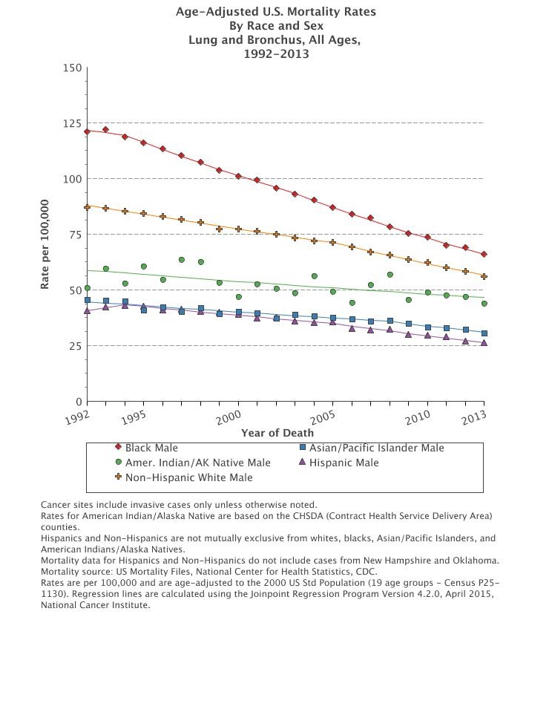
Notes:
So, what you see here are mortality data from 1992-2013 for males
What is evident?
Decline.
Rate of decline faster among some groups than others- AA males.
Gaps are closing, but not necessarily because all groups are making gains at the same rate.
Death rates among AI/AN males have not changed much in past 20 years.

Slide 24
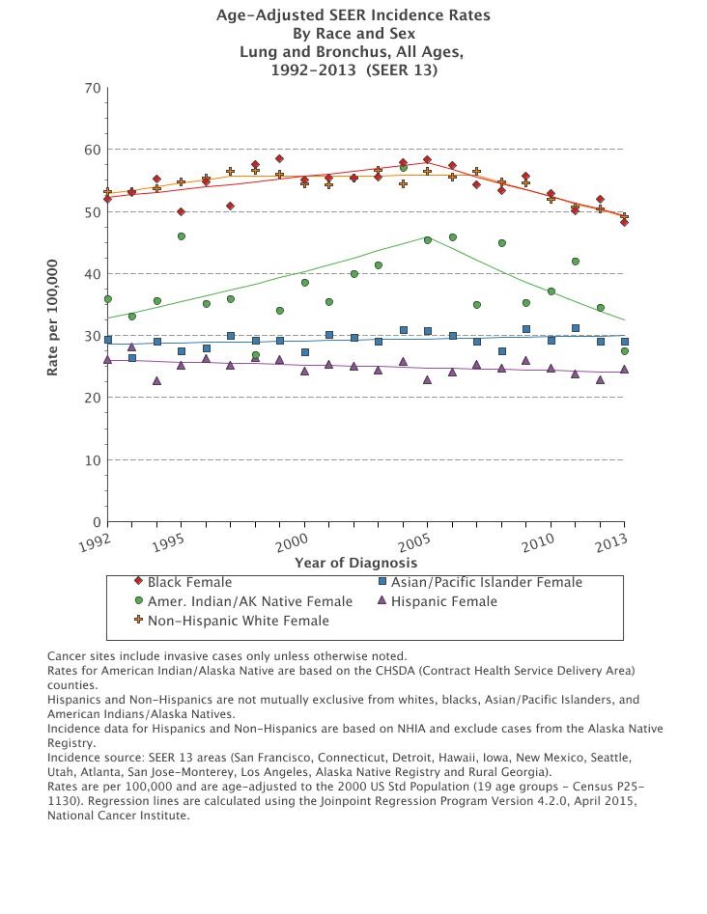
Notes:
We are not able to compare all r/e groups of women as far back as 1975 because the data were not available. So, what you see here are data from 1992-201 for female aggregate r/e groups
What is evident?
Declines- not much except among AI/AN women.
Not much changes among Asian/PI and Hispanic females.
We may see greater declines is subsequent years because of the lag in smoking among women.

Slide 25
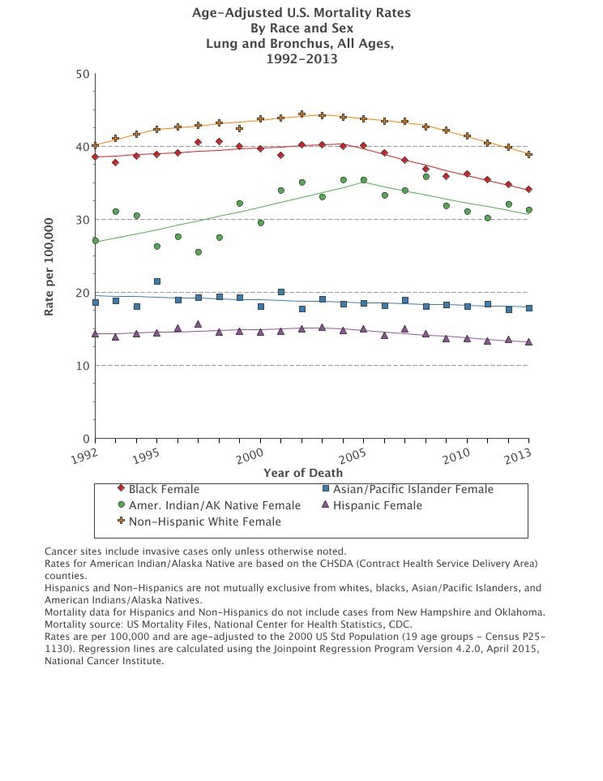
Notes:
Here are the mortality data:
What is evident?
Both increases and declines have been observed during this time period for White, AA, and AI/AN.
Not much changes among Asian/PI and Hispanic females.
We may see greater declines is subsequent years because of the lag in smoking among women.

Slide 26
Racial/Ethnic Differences in Age-Adjusted Lung Cancer Incidence, SEER
 | 1990-1995 |  |  |  | 1996-2001 |  |  |  | 2002-2008
Race/Ethnicity | Count | Rate | 95% CI |  | Count | Rate | 95% CI |  | Count | Rate | 95% CI
Males
White | 101781 | 95.7 | 95.1,96.3 |  | 96883 | 85.8 | 85.3,86.4 |  | 105743 | 75.5 | 75.1,76.0
Native Hawaiian | 417 | 103.4 | 93.1,114.4 |  | 460 | 98.6 | 89.3,108.5 |  | 545 | 78.7 | 72,85.8
Samoan | 69 | 120.4 | 90.8,155.9 |  | 79 | 100.6 | 77.6,127.9 |  | 108 | 98.9 | 79.0,121.8
Guamanian/ Chamorro | 27 | 37.9 | 23.9,56.9 |  | 34 | 37.7 | 25.2,53.9 |  | - | - | -
Female
White | 76529 | 55.4 | 55.0,55.8 |  | 83761 | 57.8 | 57.4,58.2 |  | 100847 | 56.9 | 56.6,57.3
Native Hawaiian | 267 | 61.2 | 53.8,69.3 |  | 333 | 64.5 | 57.6,71.9 |  | 466 | 51.6 | 47.0,56.5
Samoan | 29 | 48.4 | 31.1,70.8 |  | 45 | 52.9 | 37.6,71.6 |  | 60 | 43.6 | 32.6,56.7
Guamanian/ Chamorro | 21 | 26.6 | 15.7,41.7 |  | 26 | 26.1 | 16.6,38.6 |  | - | - | -
Adapted from Liu et al 2013, JNCI
Notes:
National data do not show lung cancer rates for many Native Hawaiian and Other Pacific Islander groups at the national level, and mask disparities within the Asian/Pacific Islander aggregate group.
For example, these data show that:
Samoan males have the highest lung cancer incidence rates followed by NH and White males.
Patterns differ for women where rates have fluctuated and show that from 2002-2008, rates were highest among white, followed by NH, and Samoan women.

Slide 27
Reasons for Racial/Ethnic Disparities In Tobacco-Cause Lung Cancer
Is it because:
  some groups smoke more cigarettes than others?
  Longer duration of smoking?
  Are there other factors within our control or beyond our control?
Notes:
We not only see disparities in lung cancer incidence and mortality, but in the relationship between smoking and lung cancer.

Slide 28
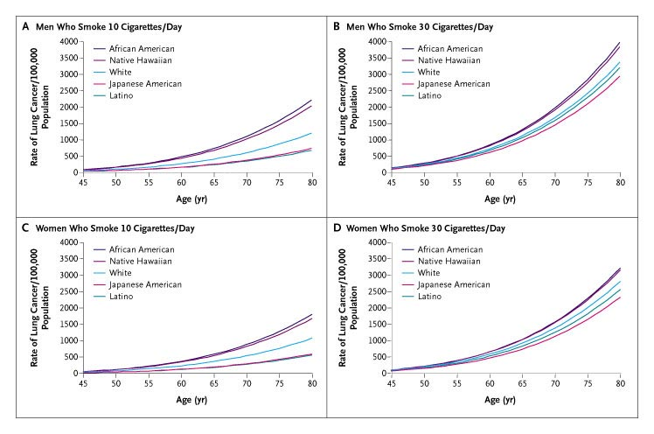
Predicted Rates of Lung Cancer Among Smokers Consuming 10 CPD or 30 CPD
Haiman, Strom, Wilkens, et al, NEJM, 2006
Notes:
Data from the University of Hawaii’s Multiethnic Cohort show that although persons who consume fewer cigarettes per day have lower rates of lung cancer, among those smoking less than 10cpd, we find significant elevated risk of lung cancer among African Americans and Native Hawaiians compared to the other racial/ethnic groups.
Disparities in lung cancer not observed among racial/ethnic groups who smoke heavily.
Much work to be done to resolve the smoking paradox as it related to Aas.

Slide 29
Burden of Tobacco-Caused Disease by Geography
Notes:
These reasons are all at social levels.
They do not take into consideration access to cessation treatment, access to cancer care and treatment, distance from care, co-morbidities, and

Slide 30
State Level Disparities: Number and Proportion of Cancer Deaths Attributable to Cigarette Smoking in 2014 in Adults Aged 35 Years and Older¹
 | Total |  |  | Men |  |  | Women
State | Rank | SA cancer deaths | SA proportion of cancer deaths % (95% CI) | Rank | SA cancer deaths | SA proportion of cancer deaths % (95% CI) | Rank | SA cancer deaths | SA proportion of cancer deaths % (95% CI)
Top ranking
U.S |  | 167,133 | 28.6(28.2-28.8) |  | 103,609 | 33.7(33.2-34.0) |  | 63,524 |  | 22.9(22.5-23.3)
Kentucky | 1 | 3452 | 34 (32.4-35.3) | 5 | 2104 | 38.2(35.9-40.3) | 1 | 1347 |  | 29.0(27.2-30.7)
Arkansas | 2 | 2175 | 33.5(31.9-35.0) | 1 | 1404 | 39.5 (36.9-41.7) | 4 | 771 |  | 26.3(24.4-28.1)
Tennessee | 3 | 4613 | 32.9(31.2-34.3) | 3 | 2919 | 38.5(36.0-40.7) | 5 | 1694 |  | 26.3(24.2-28.2)
West Virginia | 4 | 1581 | 32.6(31.2-33.9) | 4 | 10003 | 38.2(36.0-40.2) | 6 | 578 |  | 26.1(24.2-27.8)
Louisiana | 5 | 3044 | 32.6(31.0-34.0) | 2 | 1943 | 38.5(36.0-40.7) | 8 | 1101 |  | 25.5(23.7-27.2)
Lowest ranking
New York | 47 | 9296 | 26.5(25.0-28.0) | 45 | 5467 | 31.0(28.6-33.3) | 40 | 3830 |  | 22.0(20.0-23.8)
Hawaii | 48 | 642 | 26(24.2-27.7) | 35 | 427 | 31.9(29.2-34.2) | 50 | 214 |  | 19.0(16.5-21.2)
Colorado | 49 | 1876 | 25.7(24.5-26.8) | 50 | 1130 | 29.5(27.8-31.1) | 44 | 746 |  | 21.4(19.8-23.0)
California | 50 | 14689 | 25.5(24.0-26.9) | 40 | 9388 | 31.6 (29.2-33.7) | 49 | 5302 |  | 19.1(17.0-20.9
Utah | 51 | 495 | 16.6(15.4-17.7) | 51 | 337 | 21.8(19.9-23.5) | 51 | 158 |  | 11.1(9.6-12.3)
¹ Relative risk computed from 12 different cancers
Source: Lortet-Tieulent et al 2016, JAMA Internal Medicine
Notes:
We can also examine the disparities from another lens and that is geography.
This has become more important as we see clear divides among the states.
So, who is left behind?
The tables show the states with highest rates of SA cancer deaths and the lowest.

Slide 31
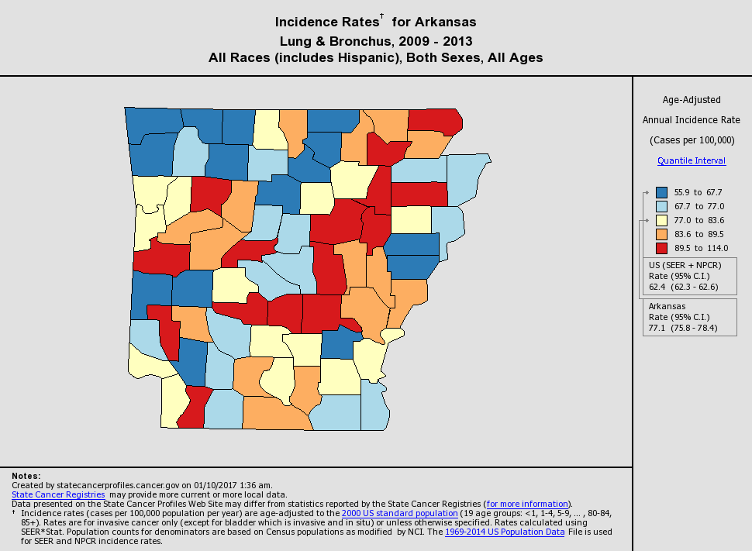
Pulaski County
Notes:
We could also go from the national data, to state, to local data, where more of tobacco prevention control interventions will occur.
Let’s look at state of Arkansas, since this is where I live:
Lung cancer incidence is higher in Arkansas than in U.S. with rates at 77.1 compared to 62.4 per 100,000.
Highest rates are in the red counties and see high pockets of the lowers rates in NW part of the state.

Slide 32
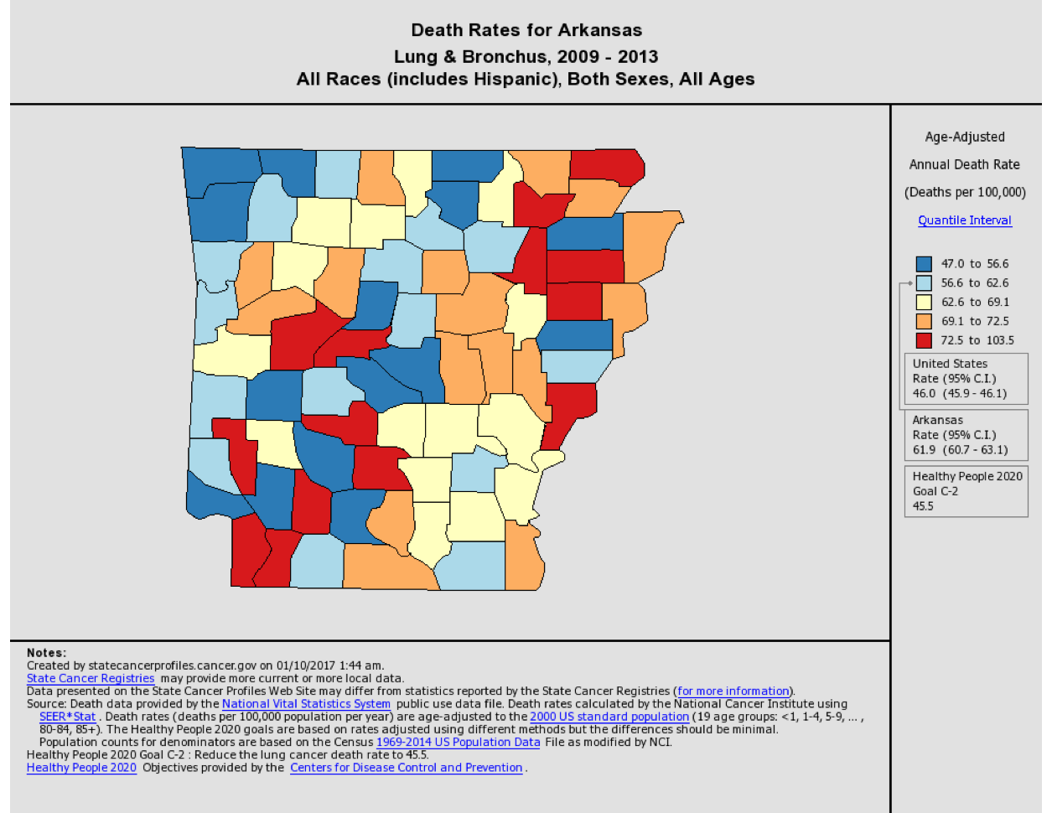
Pulaski County
Notes:
Lung cancer death rates are 61.9 in AR compared to 46.0 per 100,000 in US overall.
Highest rates are in the red counties and see high pockets of the lowers rates in NW part of the state.

Slide 33
Geographic Differences in Age-Adjusted Lung Cancer Incidence Among Native Hawaiians, SEER
 |  | 1990-1995 |  |  |  | 1996-2001 |  |  |  | 2002-2008
Gender | Location | Count | Rate | 95% CI |  | Count | Rate | 95% CI |  | Count | Rate | 95% CI
Male
 | Hawaii | 381 | 110.1 | 98.8,214.2 |  | 411 | 104.0 | 93.8,114.9 |  | 497 | 85.9 | 78.3,93.9
 | Mainland | 36 | 79.9 | 52,115.7 |  | 49 | 72.2 | 51,98.2 |  | 48 | 49.2 | 34.7,67
Female
 | Hawaii | 242 | 64.7 | 56.6,73.6 |  | 289 | 66.5 | 58.9,74.8 |  | 423 | 54.6 | 49.5,60.1
 | Mainland | 25 | 39.7 | 24.1,60.9 |  | 44 | 55.0 | 59,74.8 |  | 43 | 36.3 | 25.8,49.4
Adapted from Liu et al 2013, JNCI
Notes:
More than 80% of Native Hawaiians live in Hawaii. Thus, examining the geographical clustering of lung cancer is important.
We find that lung cancer incidence rates have declined among Native Hawaiian males in Hawaii and the Mainland, but rates are significantly higher among Native Hawaiians in Hawaii.
Lung cancer incidence rates among women were also significantly higher among Native Hawaiian women in Hawaii compared to those on the mainland.
There is a considerable amount of work to be done to tackle state and local disparities and its incumbent on communities to take back their communities

Slide 34
Cigarette Smoking and LGBT

Slide 35
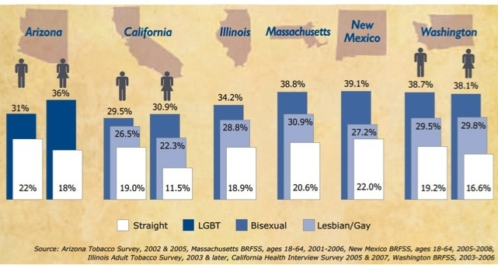
ALA. (2010). Smoking out a deadly threat: tobacco use in the LGBT community. Washington, DC: American Lung Association.
Notes:
LGBT populations have nearly double the rate of tobacco use compared to straight people.

Slide 36
Understanding Disparities Requires that you ask certain questions.
"It's not that they can't see the solution. They can't see the problem." - G.K. Chesterton

Slide 37
National data on smoking among LGB was first reported in 2013 NHIS survey
To determine sexual orientation, adult respondents were asked: “Which of the following best represents how you think of yourself?”
  “gay” (“lesbian or gay” for female respondents)
  “heterosexual,” that is, “not gay” (“not lesbian or gay” for female respondents),
  “bisexual,”
  “something else,” and
  “I don’t know the answer.”

Slide 38
Percentage of LGB Adults Who Were Current Smokers: NHIS, 2013, 2015
Notes:
Response options provided on the National Health Interview Survey were “straight, that is, not gay” for men, and “straight, that is, not gay or lesbian” for women.

Slide 39
LGBT and Tobacco
Little information exists on cigarette smoking prevalence among transgender people.
More than 30,000 LGBT persons die each year of tobacco-related diseases.
Gay men have high rates of HPV infection which, when coupled with tobacco use, increases their risk for anal and other cancers.
LGBT individuals often have risk factors for smoking that include daily stress related to prejudice and stigma.
Bartenders and servers in LGBT nightclubs are exposed to high levels of SHS.
Among women, SHS exposure is more common among non-smoking lesbian women than among non-smoking straight women.

Slide 40
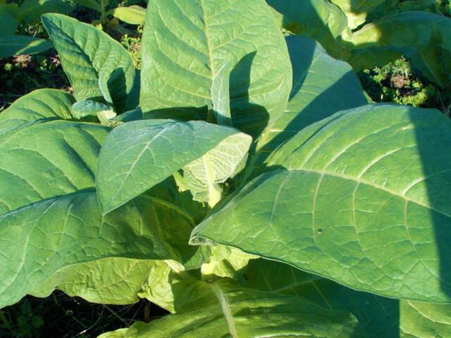
Type of Cigarette Smoked

Slide 41
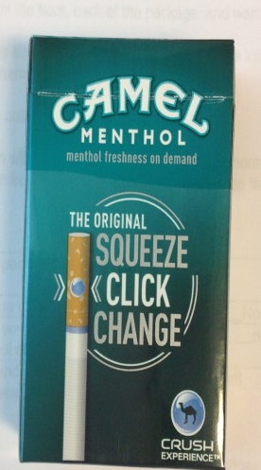

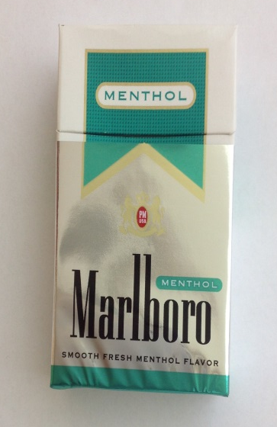

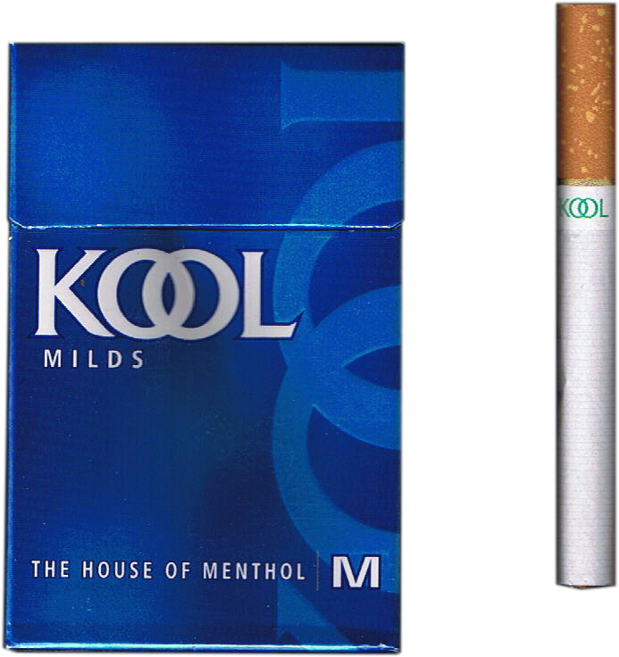
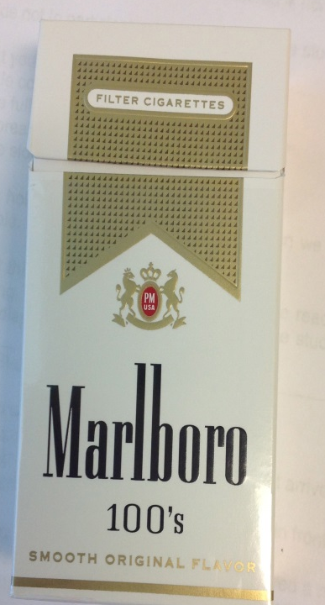
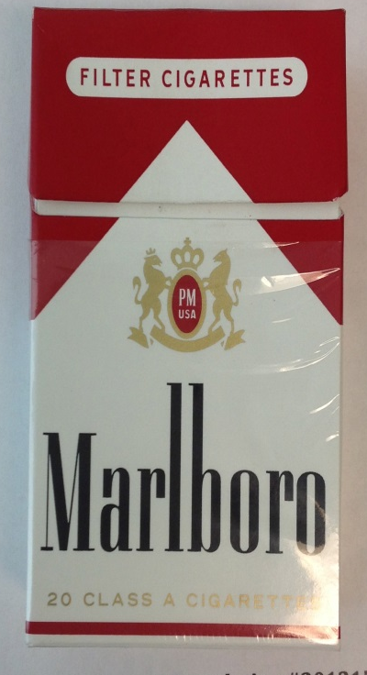

Notes:
Various brand and today only regular and menthol cigarettes exist due to the FSPTCA

Slide 42
Prevalence of Menthol Cigarette Use Among Past 30 Day Smokers: NSDUH, 2008-2010
%
Giovino et al. 2013
Notes:
Women are significantly more like to smoke menthol cigarettes at all ages. Menthol smoking declines as age increases.

Slide 43
Prevalence of Menthol Cigarette Smoking in Past 30 Days: NDSUH, 2008-2010
%
Giovino et al. 2013
Notes:
Blacks and Native Hawaiians higher rates, although rates among NH not shown.

Slide 44
Secondhand Smoke Exposure
Notes:
We know that SHS causes 41,000 deaths each year among nonsmokers and 400 deaths in infants each year.
Exposure to secondhand smoke (SHS)causes:
sudden infant death syndrome (SIDS)
respiratory infections
exacerbate conditions like asthma in children.
ear infections
coronary heart disease
stroke, and lung cancer in adult nonsmokers (1,2).
Nonsmokers remain exposed to SHS in workplaces, public places, homes, and vehicles.
.

Slide 45
Table 7. Percentage of the nonsmokers aged ≥3 years with serum cotinine levels 0.05 – 10 ng/mL, by selected characteristics --- National Health and Nutrition Examination Survey, United States, 1999—2012
Characteristic | 1999--2000 | 2011-2012
Total | 52.5 (47.1--57.9) | 25.3 (22.5-28.1)
Sex
Male | 58.5 (52.1--64.9) | 27.7 (24.7-30.6)
Female | 47.5 (42.5--52.5) | 23.3 (20.4-26.3)
Race/Ethnicity
White, non-Hispanic | 49.6 (42.4--56.7) | 21.8 (18.6-24.9)
Black, non-Hispanic | 74.2 (70.2--78.2) | 46.8 (30.8-55.6)
Mexican-American | 44.3 (37.4--51.1) | 23.9 (16.3-31.4)
Poverty status
Below poverty level | 71.6 (64.8--78.5) | 43.2 (37.3-49.0)
At or above poverty level | 48.8 (42.8--54.8) | 21.2 (18.8-23.6)
Unspecified | 53.5 (48.4--58.6) | 31.7(22.8-40.5)
Education aged 25 and older
≤ Grade 11 | 53.9 (48.7-59.0) | 27.6(23.0-32.2)
High school diploma or equivalent | 51.6(44.5-58.6) | 27.5(21.2-33.7)
Some college or associate degree | 48.2(40.8-55.6) | 21.2 (17.5-24.9)
≥ College diploma | 35.2 (27.5-43.0) | 11.8 (9.1-14.4)

Slide 46
FIGURE. Percentage of nonsmoking children aged 3–11 years with serum cotinine levels 0.05–10 ng/mL, by race/ethnicity* — National Health and Nutrition Examination Survey, United States, 1999–2012
Notes:
SHS exposure among nonsmokers was defined as a serum cotinine level (a metabolite of nicotine) of 0.05–10 ng/mL.
Among children aged 3–11 years, prevalence of SHS exposure declined comparably from 1999–2000 to 2011–2012 among non-Hispanic whites (percentage change = 41.2%) and Mexican Americans (percentage change = 39.0%); however, a lesser decline was observed among non-Hispanic blacks (percentage change = 19.8%)

Slide 47
Smoking Cessation and Access to Treatment

Slide 48
Quitting Smoking and Cessation Among Adults by Race/Ethnicity: NHIS, 2015
Source: CDC MMWR, Jan 2017
Notes:
Differences in quitting exist by race/ethnicity.
Blacks have highest interest in quitting, but lower success than other groups.
Hispanics less likely to receive advice to quit and/counseling and/or meds.

Slide 49
Quitting Smoking Among Adults by Health Insurance Status: NHIS 2015
Source: CDC MMWR, Jan 2017
Notes:
Early, you saw that the number of insured Americans of all race/ethnicities was increasing, largely do the Affordable Health Care.
Here you see how insurance is associated with quitting indicators.
So, Interest in quitting lowest among Medicare patients, but about 2/3 of all other groups included the uninsured are interested in quitting.
Past year quit attempt is lowest among Medicare, not the uninsured.
Notice that interest in quitting and past year quit attempt do not really difference for persons with private insurance and Medicaid.
Recent smoking cessation is low among all group, whether you have insurance or not.
Advice to quit and use of counseling or medication is lowest among the uninsured.

Slide 50
Strategies to Eliminate Tobacco Related Disparities
Disparities
in exposure to, use of, vulnerability, and consequences (e.g. morbidity, mortality, social conditions).
.
Diversity
need for diversity and empowerment in research and leadership to address inequities and disparities.
Inequities and Inequalities
in research, application, and translation.
Fagan et al. 2007, Addiction
Notes:
This model is based on a paper we published in 2007 through the Tobacco Research Network on Disparities.
Making progress in eliminating lung cancer disparities is more than just observing changes in various indicators.
Its also about the undercurrents of the divides.
The speed at which those divides open and close.
And the our perception of those divides.
How we look at the divides matter.

Slide 51
Tobacco Regulatory Policy Shifts Thinking on How We Approach Tobacco Control
Notes:
51
This evolving area of science is a challenging shift.
Lots of emerging products, flavored cigars, electronic cigarettes. None of which I presented today. These are all important and its critically important to examine differences in use among groups- particularly when we already know that AI/AN have significantly higher rates of e-cigarette use than other groups.
However, we should not forget that smoking and second-hand smoke are the main reasons that we see over 480,000 deaths per year.

Slide 52
Thank you!

