Slide 1
UC Tobacco fellows
Stanton A. Glantz, PhD

Slide 2
Early years
Nonsmokers’ rights movement
Propositions 5 and 10 in 1978 and 1980
Local ordinance strategy

Slide 3
Proposition 99 (1988)
25 cent tobacco tax
  5 cents for tobacco control
  2 cents for research
Tobacco control program
  Focuses on social norm change
  Directly confronts industry

Slide 4
Per capita cigarette consumption
Prop 99
Tax increase

Slide 5
Age Adjusted Heart Disease Mortality
Prop 99
Tax increase

Slide 6
Effect on Mortality
59,000 fewer deaths (9%)
1,500 unnecessary deaths

Slide 7
Effect on Industry Sales
2.9 billion packs not smoked ($4 billion)
1 billion extra packs ($1.4 billion)

Slide 8
Lung cancer incidence in SFO California
14% reduction
Anti-tobacco
program
In the first 10 years in SFO: 6% cases (2036 cases in SFO)
Statewide: 11,000 cases in 10 years

Slide 9
Annual Health Care Savings Attributable to Historical CA Tobacco Control Expenditures

Slide 10
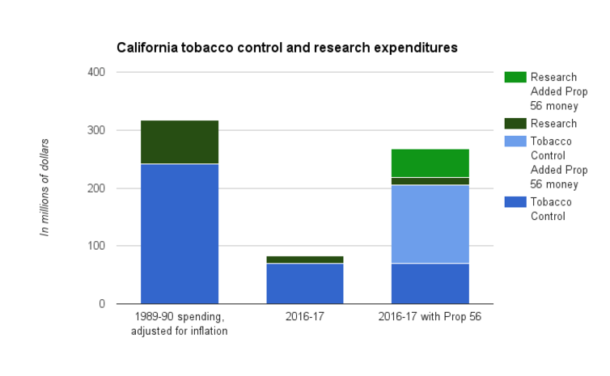
But it was fading
Inflation
Industry dominates legislature
Two failed initiatives
  Prop 29 in 2006
  Prop 86 in 2012

Slide 11
Litigation against industry
Mississippi, Florida, Texas
Minnesota
  Tobacco documents
Then other states
Washington and MSA
  $246 billion
  Little for tobacco control
  More documents
  American Legacy Foundation

Slide 12
RICO case
Same law used to prosecute organized crime
No money
Broke up industry
Restricted denials
Banned “light and mild”
Even more documents
They are “racketeers”

Slide 13
FCTC 2003
Global health treaty
180 parties
Followed by more
  Smokefree laws
  Health warning labels
  Taxes
But fading

Slide 14
FSPTCA/FDA 2009
Granted FDA authority over cigarettes and smokeless tobacco
Banned “characterizing flavors”
  Except menthol
Banned “light and mild”
Allowed “deeming” other tobacco products
  Finally happened in May 2016

Slide 15
FDA actions
Not much
Warning labels thrown out
  Underestimated effect
  Consumer surplus (“lost pleasure”)
Report but no action on menthol
Funding research
Strong educational campaigns
No meaningful product regulation
Now: “Comprehensive nicotine strategy
  Embraces industry’s “harm reduction” frame

Slide 16

Smokefree Movies
Movies are biggest reason kids smoke
Halfway to fixing the problem

Slide 17
Important 2016 California Legislation
E-cigarettes in clean indoor air law
Close loopholes in clean indoor air law
Tobacco 21
Increase tobacco license fee to cover costs
Local legislation on menthol and flavored tobacco products
  Because of failure of national FDA

Slide 18
Back to the Future
Proposition 56 in 2016
  $2 tax increase
  Includes e-cigs and other products
A smokefree society is within reach
  Price increase
  Reinvigorate tobacco control program

