Slide 1
The Triangulum:
The Future is Now!
Phillip S. Gardiner, Dr. P. H.
UC Smoke and Tobacco Free Fellowships Awards Program Officer, Tobacco Related Disease Research Program (TRDRP) University of California Office of the President and Co-Chair African American Tobacco Control Leadership Council (AATCLC)
UC Smoke and Tobacco Free Fellows Webinar Series
TRDRP/UCOP
Oakland , California
November 7, 2017

Slide 2

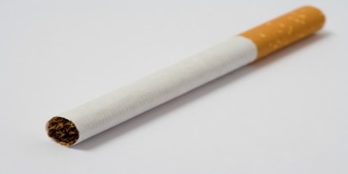
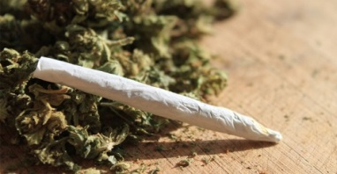
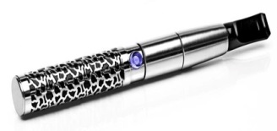
The Triangulum:
Tobacco, Marijuana and E-Cigarettes
The Future is Now!

Slide 3
The New Frontier
21st Century presents us with widely diverse array of new forms of “smoking” and “smoking” devices.
Radically altered landscape, especially for youths and young adults.

Slide 4
The Evolving “Smoking” Landscape
Hookah pens aerosolizing flavored liquids, with and without nicotine
Heat-not-burn products that produce an aerosol, but no fire or smoke
Colorfully packaged, flavored little cigars and cigarillos, both regular and electronic
Butane derived marijuana that you can dab
Liquid THC, which you can aerosolize.

Slide 5
Co-Mingling; Dual and Poly Use
Blunts
  Hollowed out Cigars filled with marijuana
Caviar
  Adding Crack cocaine or crystal meth to Blunts
Roll Your Own
  Spliffs
Mix Your Own
  Cocktails (assorted e-liquids, favors and nicotine)

Slide 6
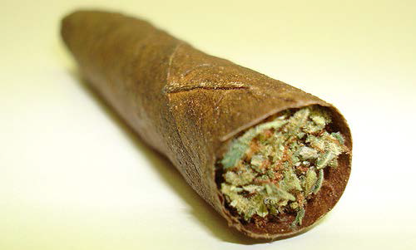
Blunts: Hollowed-out Cigars Filled with Marijuana

Slide 7
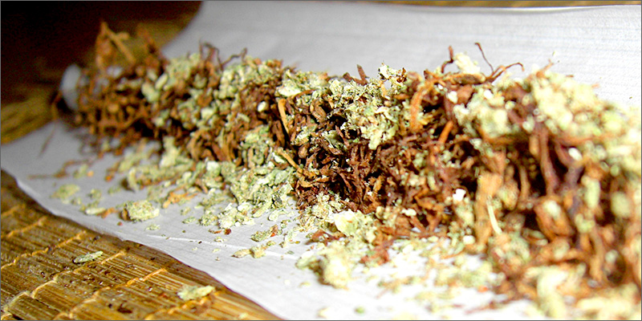
Spliffs

Slide 8
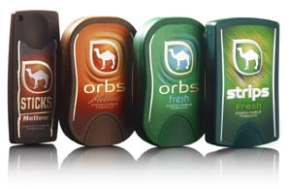
Reduced Exposure Products
Camel Dissolvables deliver between 0.0 to 3.1 milligrams of nicotine, while cigarette smokers typically inhale about 1mg per cigarette.
Emerging Products by R.J. Reynolds
Camel Dissolvable Sticks:
Camel Orbs:
Strips:

Slide 9
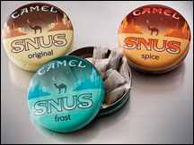

Camel Snus
Spit-less pouch
The juice can be swallowed
Notes:
No spitting required stamp,

Slide 10
Sherine El-Toukhy & Kelvin Choi,
N=3,202; 9-17year; 2012 NYTS
Cigarette Only Users
Non-cigarette Combustibles
  cigars, cigarillos, bidis, roll-your own, hookah, clove cigs
Non-Combustibles
  Chewing tobacco, snus, snuff, dip, dissolvables and e-cigarettes
Dual Use
Poly-tobacco Use

Slide 11
Youth Smoking Prevalence's
Dual Use 30.5%
Non-cigarette Combustibles 26.7%
Poly-tobacco Use 17.5%
Cigarettes Only 14.9%
Non-Combustibles Only 10.4%

Slide 12
The Downside of Dual Use
In a study of of 23 521 men and 19 201 women, aged 35–49 years, screened for cardiovascular disease risk factors in the mid 1970s and followed throughout 2002.
“smoking 1–4 cigarettes per day was associated with a significantly higher risk of dying from ischaemic heart disease and from all causes, and from lung cancer in women” (Bjartveit and Tverdal, 2005).

Slide 13
Racial & Ethnic Difference (http://ntr.oxfordjournals.org/content/early/2016/01/12/ntr.ntw008.full.pdf+html)
Tobacco-use pattern | Cigarettes only |  | Combustible only (other than cig) |  | Non-combustible |  | Dual only |  | Poly-tobacco only
 | N | % (95% CI) | N | % (95% CI) | N | % (95% CI) | N | % (95% CI) | N | % (95% CI)
Total | 466 | 14.9 (13.3-16.7) | 849 | 26.7 (24.2-29.3) | 329 | 10.4 (8.4-12.9) | 992 | 30.5 (28.1-32.9) | 566 | 17.5 (15.3-19.9)
Race/Ethnicity
Non-Hispanic White | 265 | 15.8 (13.6-18.3) | 332 | 19.7 (16.9-22.7) | 227 | 13.2 (10.3-16.7) | 556 | 32.3 (29.5-35.3) | 328 | 19.0 (16.2-22.3)
Non-Hispanic Black | 48 | 11.1 (7.2-16.7) | 216 | 50.9 (44.1-57.6) | 25 | 6.4 (3.4-11.6) | 110 | 26.9 (22.4-31.9) | 24 | 4.8 (2.7-8.2)
Hispanic | 119 | 15.2 (11.9-19.3) | 241 | 28.6 (25.2-32.4) | 56 | 6.6 (4.8-8.9) | 248 | 28.1 (24.2-32.4) | 168 | 21.4 (18.7-24.5)
Non-Hispanic Asian | 8 | 12.1 (4.4-29.3) | 24 | 38.9 (22.5-58.3) | 5 | 8.5 (3.0-21.7) | 18 | 26.4 (13.6-44.8) | 7 | 14.1 (7.2-25.6)
American Native | 10 | 9.9 (4.7-19.4) | 16 | 19.4 (11.3-31.3) | 8 | 8.5 (4.1-16.8) | 34 | 37.3 (27.1-48.7) | 23 | 25.0 (15.2-38.2)

Slide 14
Electronic Cigarettes
21st Century Nicotine Addiction

Slide 15
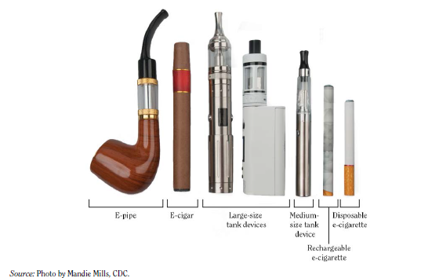
Diversity of E-Cigarette Products

Slide 16
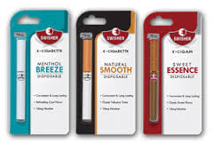
E-Cigars
Swisher Sweets E-cigars (Swisher International)

Slide 17
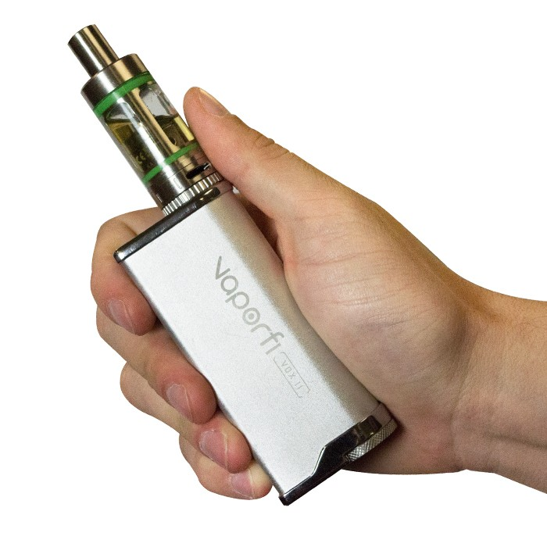

Slide 18
Association of Electronic Cigarette Use With Initiation of Combustible Tobacco Product Smoking in Early Adolescence
In Los Angeles over 2500 9th graders filled out baseline and follow-up surveys including questions about cigarette and e-cigarette use
  Those who had ever used e-cigarettes at baseline compared with nonusers were more likely to report initiation of combustible tobacco use over the next year. (Leventhal et al., 2015)

Slide 19
Youth Using E-Cigarettes More than Regular Cigarettes
8th Grade: 9% e-cigarette; 4% regular cigarettes
10th Grade: 16% e-cigarette; 7% regular cigrettes
12th-Grade: 17% e-cigarette; 14% regular cigarettes (MTF, 2014)

Slide 20
E-Cig Use Going Down and Changing
High School and Middle School students using electronic cigarettes:
  2015 3 million
  2016 2.2 million
      (CDC, 2017)

Slide 21
Tobacco Use* Among High School Students in 2016⁵ (MMWR, 2017)
Tobacco Product | Overall | Females | Males
Any tobacco product† | 20.2% | 17.0% | 23.5%
Electronic cigarettes | 11.3% | 9.5% | 13.1%
Cigarettes | 8.0% | 6.9% | 9.1%
Cigars | 7.7% | 5.6% | 9.0%
Smokeless tobacco | 5.8% | 3.3% | 8.3%
Hookahs | 4.8% | 5.1% | 4.5%
Pipe tobacco | 1.4% | 0.9% | 1.8%
Bidis | 0.5% | 0.3% | 0.7%

Slide 22
Tobacco Use* Among Middle School Students in 2016⁵ (MMWR, 2017)
Tobacco Product | Overall | Females | Males
Any tobacco product† | 7.2% | 5.9% | 8.3%
Electronic cigarettes | 4.3% | 3.4% | 5.1%
Cigarettes | 2.2% | 1.8% | 2.5%
Smokeless tobacco | 2.2% | 1.5% | 3.0%
Cigars | 2.2% | 1.7% | 2.7%
Hookahs | 2.0% | 1.9% | 2.1%
Pipe tobacco | 0.7% | 0.6% | 0.8%
Bidis | 0.3% | –§ | 0.4%

Slide 23

JUUL

Slide 24

The “I Phone” of E-Cigarettes

Slide 25
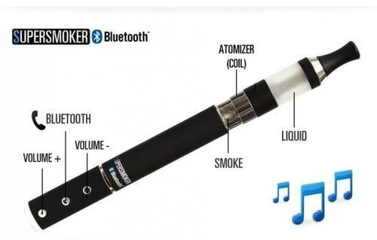
New Bluetooth E-Cigarette Lets You Vape AND Receive Calls, Listen to Music

Slide 26
Smokin Hoodies!!
http://gizmodo.com/a-vape-hoodie-for-the-casual-douche-1689937489
https://youtu.be/yUfrNNh1NDQ

Slide 27
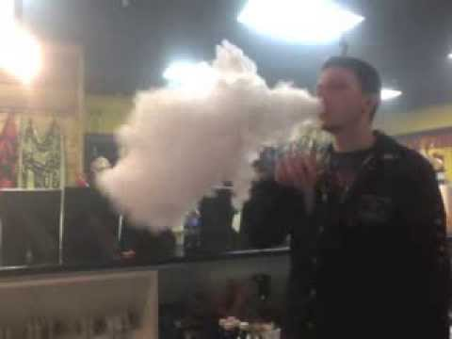
Cloud Contests

Slide 28
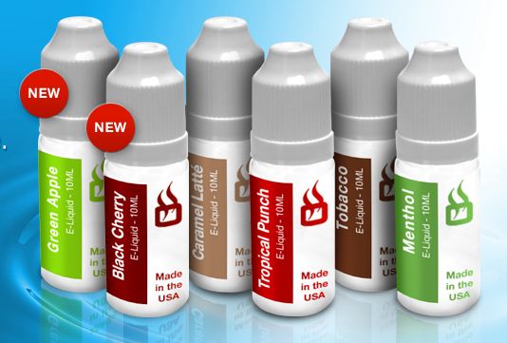
E-Cigarette Liquid: The “Juice”

Slide 29
E-Cigarette Liquid: The “Juice”
E-Cigarette Liquid contains:
  Nicotine, extracted from tobacco leaves
    Large variation in content between and within brands (Cheah et al 2012; Trtchounian et al 2011; Goniewicz et al 2013)
    Lethal if ingested; 60 mg Adult; 6 mg Children
    Detrimental to fetuses (Martz, 2009)
    Tobacco specific nitrosamines (TSNAs) (Laugesen, 2008; Westenberger, 2009; Goniewicz et al 2013)
    1.2mg of nicotine in each cigarette, or 24mg of nicotine per pack (1.2mg x 20 cigarettes)= ~ 1 e-cigarette

Slide 30
Nicotine Is Not Benign
Nicotine is acutely toxic; Poisonous and addictive
Nicotine activates multiple biological pathways through which smoking increases risk for cardiovascular disease
  Raise blood pressure
  Build-up of plaque
  Constrict blood vessels
  Inflammatory Response
  Damage to vascular tissue
  Elevate glucose levels
  Exacerbate existing heart disease
      RSG, 2014

Slide 31
E-Cigarette Liquid: The “Juice”
E-Cigarette Liquid contains:
  Propylene Glycol - the vapor; the fog
    FDA approved food additive (humectant, solvent for colors and flavors), cosmetics, and medicines.
    Short term exposure causes eye, throat, and airway irritation (Wieslander et al 2001; Vardavas et al 2012,)
    Long term exposure can result in children developing asthma. (Choi et al 2010)
    Chemical composition changes when heated (Henderson et al, 1981)

Slide 32
E-Cigarette Liquid: The “Juice”
E-Cigarette Liquid contains:
  Glycerin: A humectant used instead of or in combination with propylene glycol in EC fluids for aerosol production.
  FDA Approved for ingestion.
  Slightly hazardous in case of skin and eye contact, ingestion, and inhalation; prolonged exposure may cause organ damage.
  Metals
    Tin particles found in E-liquid (Williams et al., 2013)

Slide 33
E-Cigarette Liquid: The “Juice”
E-Cigarette Liquid contains:
  Flavorants. Key one Menthol; Candy flavoring
    Anesthetic effects,; promotes deeper inhalation; greater cell permeability
    Allows the poison to go down easier!
  Not GRAS! Ingestion vs. Inhalation
  7700+ flavors; appeals to kids (bubblegum, strawberry, gummy bears, etc.)
  Exotic for adults (Sex on the Beach, Aces and 8’s)
Mix your Own (ala roll your own)

Slide 34
The Aerosol: Its Not Just Water Vapor
E-Cigarette Aerosol Contains:
  Propylene glycol, glycerol, flavorings, and nicotine, which are found in the e-liquid, are also found in the e-Aerosol
  Propylene oxide
  Volatile Organic Compounds: Benzene and Toluene
  Menthol

Slide 35
The Aerosol: Its Not Just Water Vapor
E-Cigarette Aerosol Contains:
  Carbonyl Compounds: Formaldehyde, acetaldehyde, and acrolein
  Metals: tin, silver, iron, nickel aluminum, sodium, chromium, copper, magnesium, manganese, lead, potassium and silicate nanoparticles
  Tobacco Specific Nitrosamines (TSNAs) carcinogenic compounds found in tobacco and tobacco smoke.
    (Schripp et al, 2012: Westenberger 2009; Goniewicz et al, 2013; Williams et al, 2013; Henderson, 1981)

Slide 36
E-Cigarette Emit Metals used in Their Manufacturing
“Considering the potential adverse health effects associated with the inhalation of these metals (particularly Ni and Zn, and the emission observed both in our analysis as well as the study by Williams et al.13), attention should be directed toward eliminating the use of these metals in the cartridges during the manufacturing process of e-cigarettes.”
  (Saffari et al., 2014)

Slide 37
Flavorings GRAS? Not For Inhalation
Aldehydes toxicologically are primary irritants of the mucosa of the respiratory tract
The lungs have a different spectrum of toxicity than the intestinal tract, substances known to be safe when swallowed can still be dangerous when inhaled
      (Williams, James, and Robert, 2015)

Slide 38
Study Finds Aldehyde Levels Not Safe
Within the tested e-cigarette brands, thermal decomposition of flavoring compounds dominates formation of aldehydes during vaping, producing levels that exceed occupational safety standards
  Flavoring Compounds Dominate Toxic Aldehyde Production during E-Cigarette Vaping; Environmental Science & Technology, November, 2016; Andrey Khlystov and Vera Samburova

Slide 39
Evaluation of Electronic Cigarette Liquids and Aerosol for the Presence of Selected Inhalation Toxins
diacetyl (DA) and acetyl propionyl (AP) are chemicals approved for food use but are associated with respiratory disease when inhaled.
159 distinct liquids and aerosols were analyzed
  DA and AP were found in 74.2% of the samples (Farsalinios, et al 2014

Slide 40
Flavoring Chemicals in E-Cigarettes: Diacetyl, 2,3-Pentanedione, and Acetoin in a Sample of 51 Products, Including Fruit-, Candy-, and Cocktail-Flavored E-Cigarettes
51 types of flavored e-cigarettes sold by leading e-cigarette brands and flavors we deemed were appealing to youth.
Diacetyl was detected above the laboratory limit of detection in 39 of the 51 flavors tested
    (Allen et al., 2016; https://ehp.niehs.nih.gov/15-10185/

Slide 41
Diacetyl: Popcorn Lung
“Popcorn lung" comes from inhaling diacetyl, a chemical widely used in the flavor industry to simulate dairy (e.g. butter, cheese, yogurt), fruit flavors (e.g. strawberry, bananas), and so-called brown flavors (e.g. coffee, butterscotch)
In flavoring-induced lung disease, the tiny bronchiole passages located near the air exchanging alveoli become gradually scarred shut. One can become progressively shorter of breath due to poor oxygen absorption
Diacetyl has been found in many e-cigarette vapors, especially sweet flavors.
    (Tierney et al., 2015; Farsalinos, 2014)

Slide 42
E-Cigarettes: The Second Generation
1st Generation:
  Cig-a-likes; Most Toxins Emitted in the Aerosol Lower than Regular Cigarettes (Goniewicz et al., 2013)
  Aerosolizing Temperature 100 – 250c
2nd Generation
  Tank Systems; refillables
  Some Toxins Emitted Approaching Levels found in Regular Cigarettes
  Aerosolizing Temperatures >250*

Slide 43
As Battery Voltage Increase, Toxins Increase
On Average, Toxins were 13 – 807 Fold Lower than Tobacco Cigarettes
However, when voltage was increased from 3.2 to 4.8V:
  4 to over 200 times increase in formaldehyde, acetaldehyde, and acetone levels
  The levels of formaldehyde were in the range of levels reported in tobacco smoke
      (Kosmider et al., 2014)

Slide 44
Platelet Activation: Same as Regular Cigarettes
Hemostatic System most sensitive to fine particulate matter
The fine particulate matter found in electronic cigarette aerosol is in the same range as mainstream and side-stream tobacco smoke.
      (Hom et al., 2016)

Slide 45
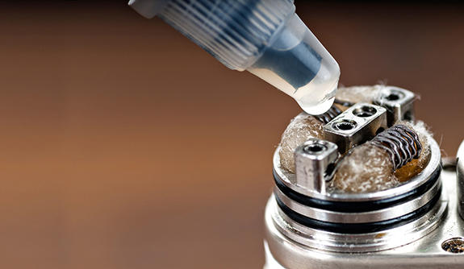
“Dripping”

Slide 46
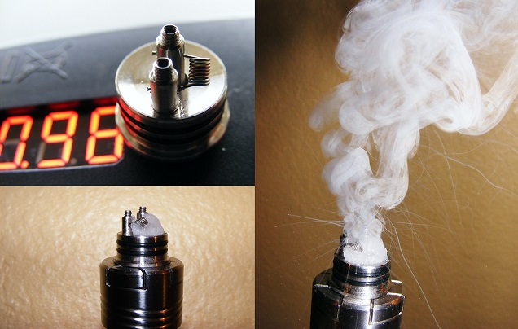
“Dripping”

Slide 47
“Dripping”
Dripping: Dripping e-liquids directly onto heated atomizers (metal coil filament)
Among 1080 ever e-cigarette users, 26.1% of students reported ever using e-cigarettes for dripping.
  produced thicker clouds of vapor (63.5%)
  made flavors taste better (38.7%)
  produced a stronger throat hit (27.7%)
      (Krishnan-Sarin, et al., 2017)

Slide 48
Dripping and Formaldehyde Formation
“Volatile aldehyde emissions, including formaldehyde, greatly exceeded values previously reported for conventional ECIGs and combustible cigarettes . . .”
  Increasing the inter-drip interval resulted in greater VA emissions
  the higher temperatures attained while Dripping are inherently likely to produce high toxicant emissions
      (Talih et al., 2016)

Slide 49
Secondhand Vaping and Nicotine
The levels of airborne nicotine and cotinine concentrations in the homes with e-cigarette users were significantly higher than control homes. “Our results show that non-smokers passively exposed to e-cigarettes absorb nicotine.”
  (Fernandez et al., 2014)

Slide 50
E-Cigarettes Source of Thirdhand Smoke Exposure
Conclusions: This study indicates that there is a risk of thirdhand exposure to nicotine from e-cigarettes. Thirdhand exposure levels differ depending on the surface and e-cigarette brand.
Future research should explore the potential risks of thirdhand exposure to carcinogens formed from nicotine released from e-cigarettes (Goniewicz and Lee, 2014)

Slide 51
Vaping:
The Take Home Message
“Overall, the e-cigarette is a new source of VOCs and ultrafine/fine particles in the indoor environment. Therefore, the question of “passive vaping” can be answered in the affirmative. However, with regard to a health-related evaluation of e-cigarette consumption, the impact of vapor inhalation into the human lung should be of primary concern” (Schripp, et al., 2012).

Slide 52
The Aerosol This Time? Precaution Advised
E-Cigarette Aerosol
  Concentrations of toxins and carcinogens less than in cigarettes
  Great variation within and between products; no product standards
  Renormalization; youth uptake on the rise
  Intermediate and long term health effects unknown
  Maybe safer, but this doesn’t mean safe!

Slide 53
Marijuana
Widely Used; Recreationally legal in 8 states; Medically adopted in 18 other States

Slide 54
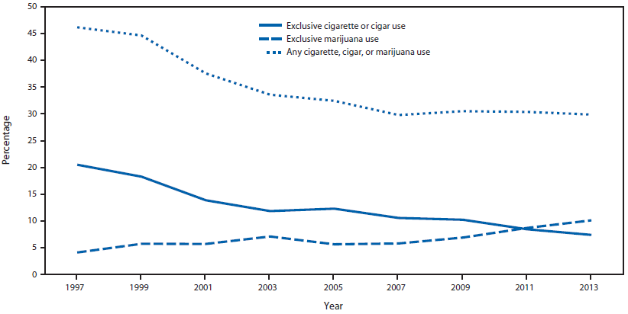
Prevalence of exclusive cigarette or cigar use, exclusive marijuana use, and any cigarette, cigar, or marijuana use (MMWR, 2015) (High School)

Slide 55
High School Students’ Use of Electronic Cigarettes to Vaporize Cannabis
Nearly 4000 High School Students in Connecticut completed an anonymous survey
  27% who have used both marijuana and e-cigarettes reported using e-cigarette aerosolizers to vaporize cannabis including hash oil, and wax THC. (Morean et al., 2015)

Slide 56
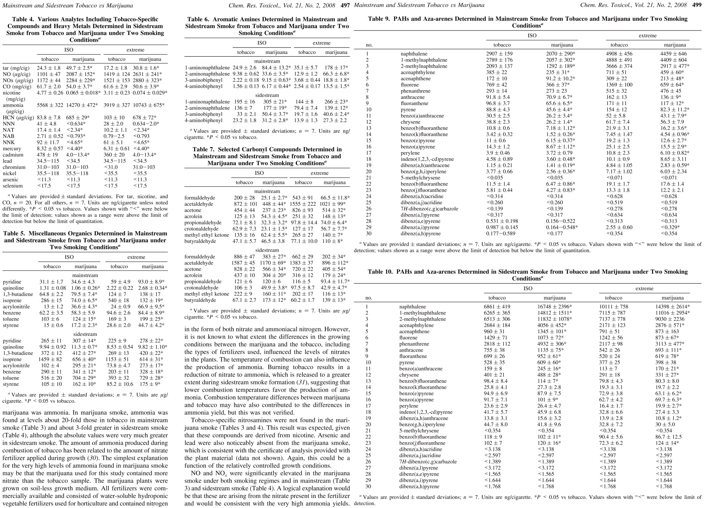
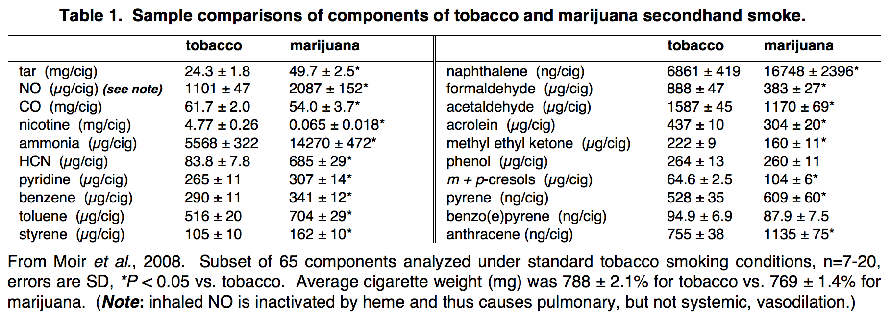
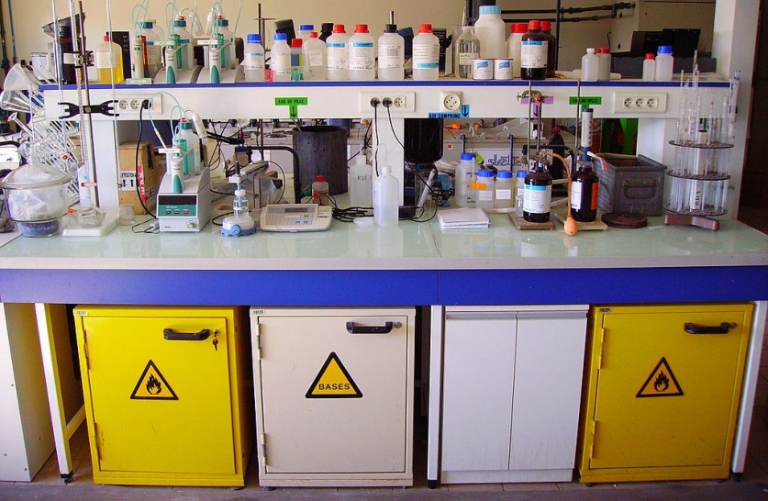
Dried plant smoke:
similar chemicals in varied proportions
Sample comparisons of components of tobacco and marijuana secondhand smoke
Inhaling a whole chemistry lab...

Slide 57
Marijuana and SHS (Springer, 2014)
Marijuana SHS for one minute substantially impairs blood vessel function in rats.
Neither THC nor paper smoke are required for marijuana SHS to impair blood vessel function.
...nicotine is not required for impairment of blood vessel function by smoke.
One minute of marijuana SHS exposure impairs blood vessel function for at least 90 minutes.

Slide 58
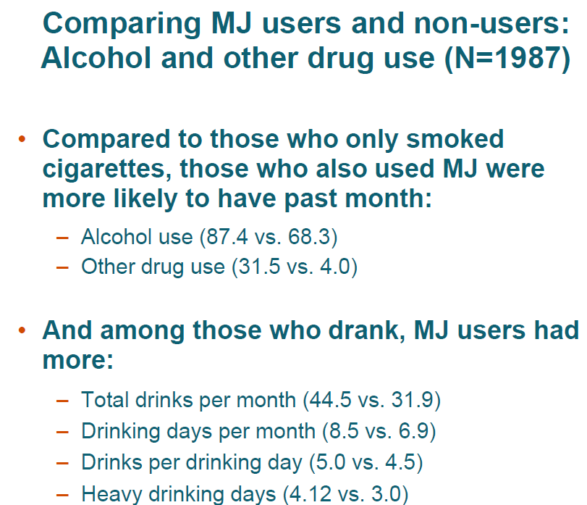

Slide 59
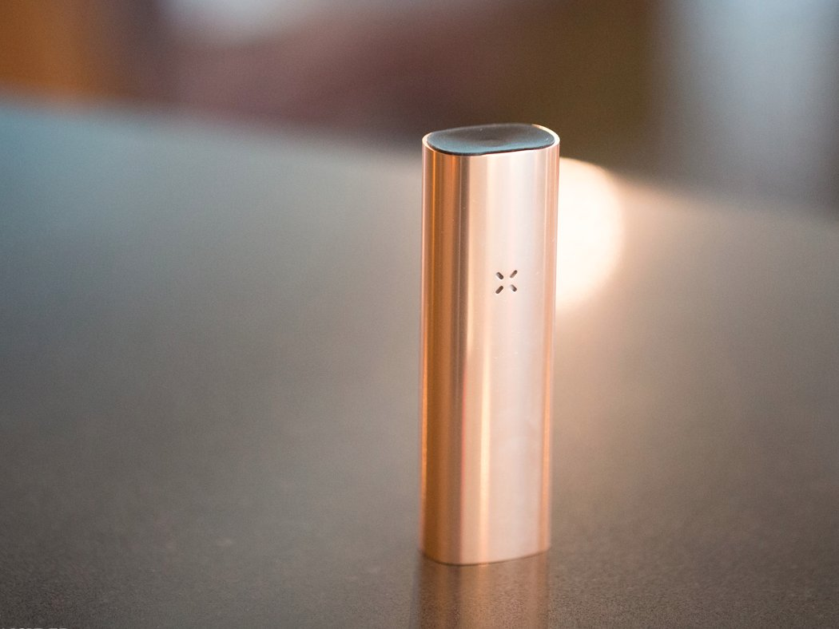

Slide 60
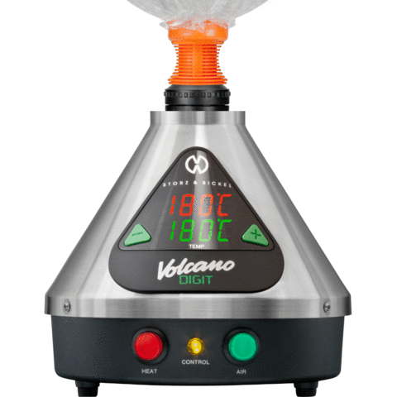
Volcano

Slide 61
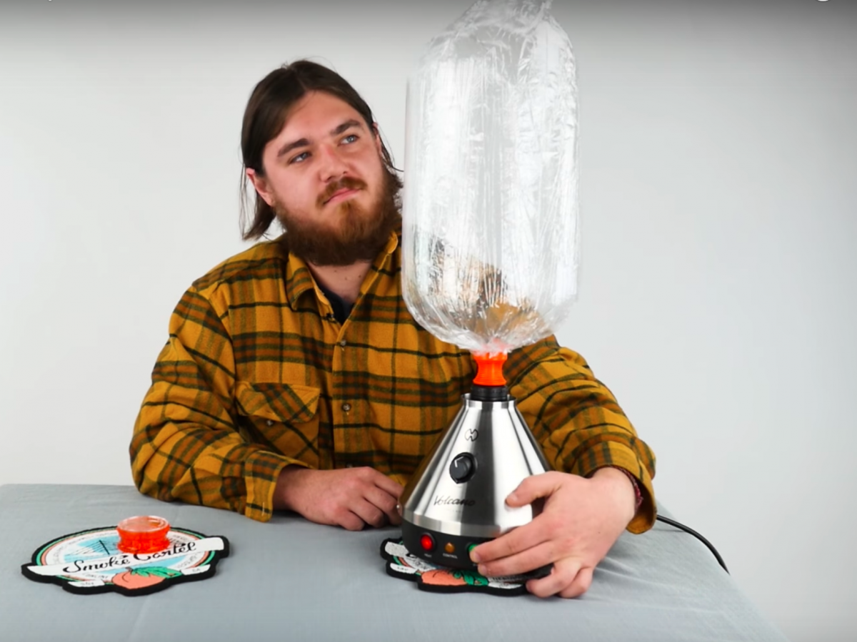

Slide 62

Dabbing

Slide 63
Dabbing
Dabbing: Inhaling the vapors from a concentrated form of marijuana made by an extracting THC using butane gas.
Dabs, also known as butane hash oil BHO) — "bladder," "honeycomb" or "earwax"

Slide 64
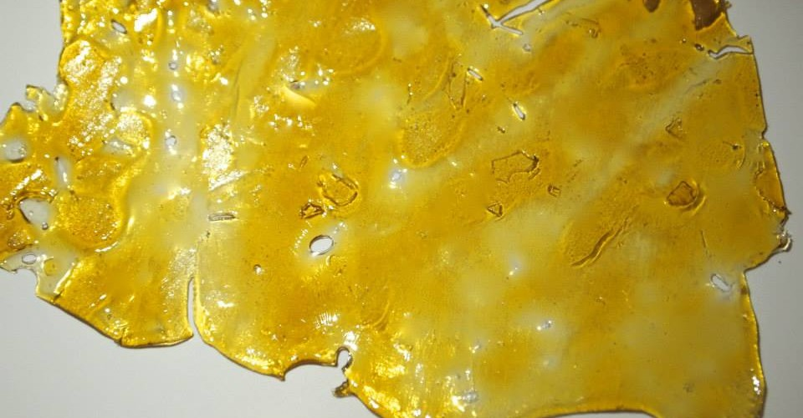
THC Concentrate (BHO)

Slide 65
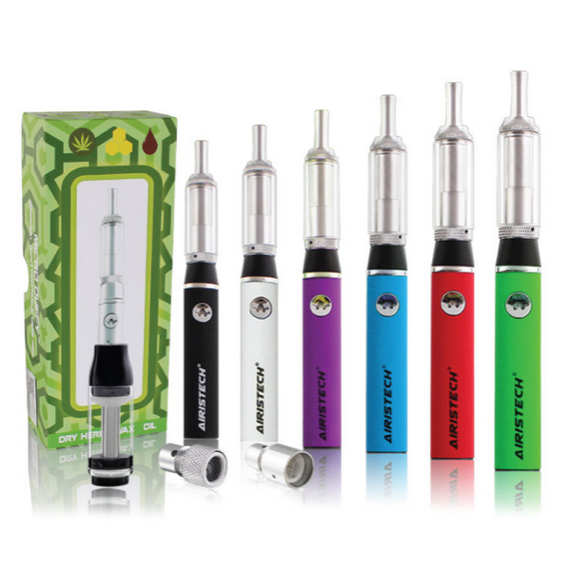
3 in 1: Herb, Liquid or
Wax

Slide 66
Smokeless Tobacco Use
2 out of every 100 Middle Schoolers (1.8%)
6 out of every 100 High Schoolers (6.0)
  Males 10%
  Females 1.8%
  Whites 7.8%
  Blacks 1.9%
  Hispanic 3.0%
    (CDC, 2015)

Slide 67
Hookah
Its More Than Flavored Tobacco in Water

Slide 68
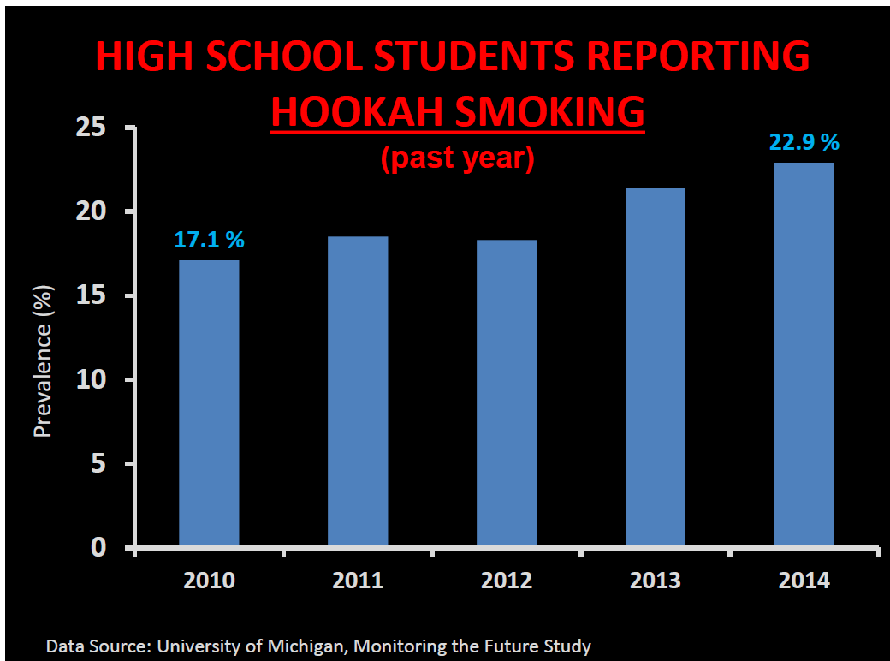
Hookah Use on the Rise Among Youth

Slide 69
Hookahs
From 2011 to 2016, current use of hookahs increased among middle and high school students.^{5,6}
  2 of every 100 middle school students (2.0%) reported in 2016 that they had used hookah in the past 30 days—an increase from 1.0% in 2011.
  Nearly 5 of every 100 high school students (4.8%) reported in 2016 that they had used hookah in the past 30 days—an increase from 4.1% in 2011.
      (CDC, 2017)

Slide 70
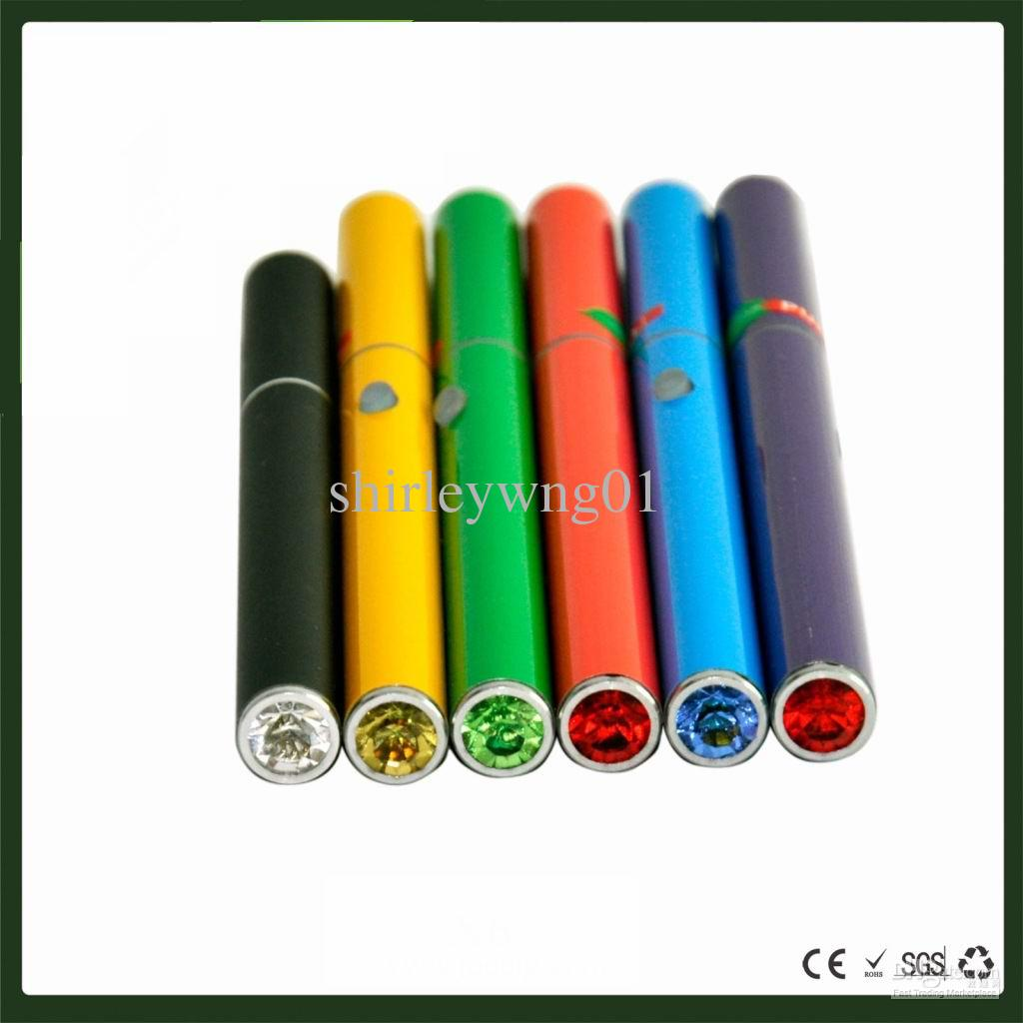
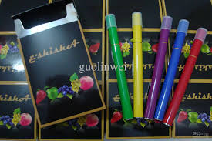
E-Pens; E-Hookah Pens
Cherry, Chocolate,
Vanilla, Bubblegum

Slide 71
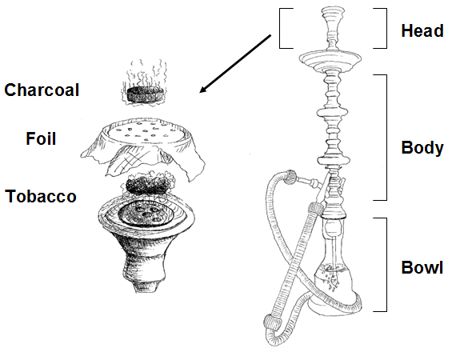
Schematic Showing The Major Components of a Hookah

Slide 72
In Comparison
A single hookah tobacco smoking session (40 to 45 minutes) exposes its users to:
  25 times the tar
  125 times the smoke
  2.5 times the nicotine
  10 times the carbon monoxide
As Compared to a single cigarette!
(Primack et al., 2016)

Slide 73
E-Cigarettes are Sooo Last Year!
Enter: Heat not Burn

Slide 74
Emerging Tobacco Industry Philosophy
E-cigs a niche product
Need a product that
  Tastes like tobacco
  “Smokes” like tobacco
  Has the throat grab (feels like tobacco)
But, is also 90% safer than conventional cigarettes

Slide 75
Reduced Risk Products: Harm Reduction and Regulation
RRPs are a fundamental complement to regulatory efforts to reduce smoking prevalence
Our ambition is to convince all adult smokers that intend to continue smoking to switch to RRPs as soon as possible
The principle of harm reduction through RRPs needs to be embraced and appropriate regulatory frameworks implemented (Catantzopoulos, 2016)

Slide 76
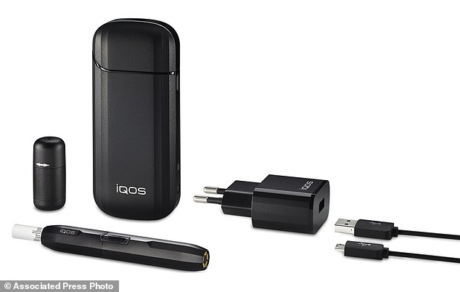
The IQOS Heating System

Slide 77
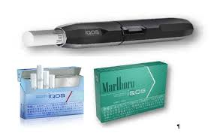
Marlboro Heatstick
Heat not Burn

Slide 78
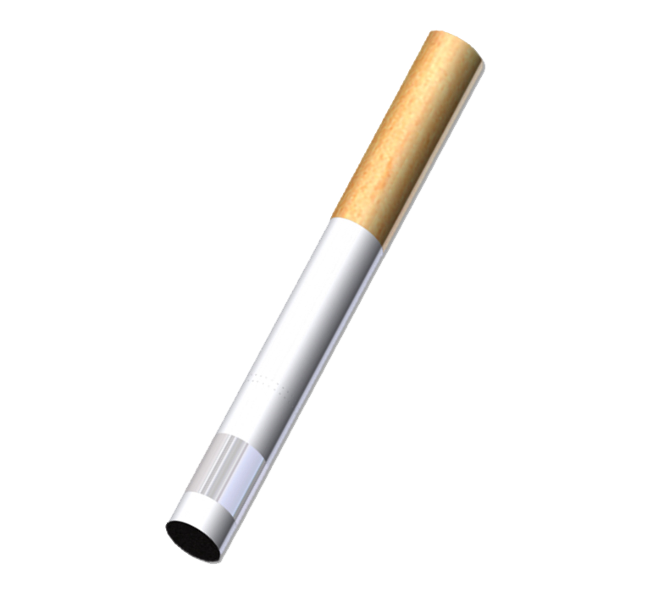
Platform 2
Platform 2

Slide 79
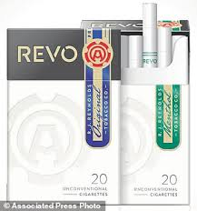
Reynolds Revo
Heat not Burn

Slide 80
Heat not Burn
31 Countries
FDA Application for Reduced Risk Product
No Independent Research*
Investors “bullish”
Coming to a town near your in 2018
Lounges

Slide 81
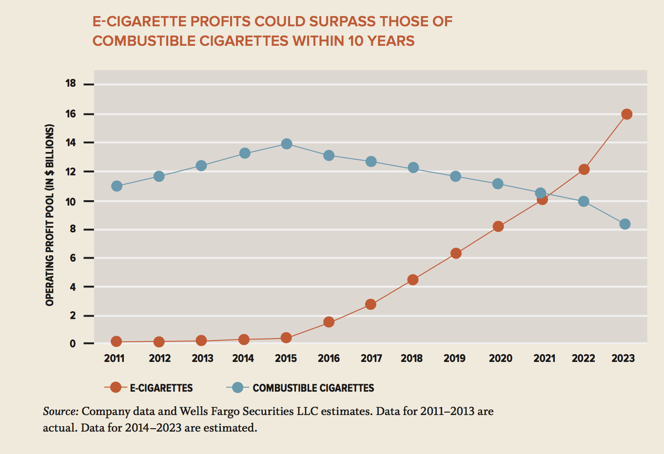

Slide 82

Japan Lounge

Slide 83

Switzerland Lounge

Slide 84
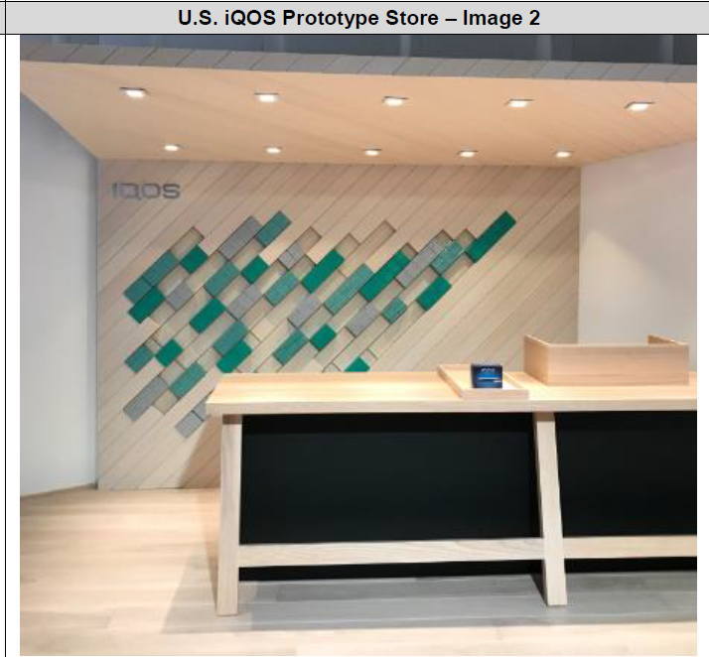

Slide 85
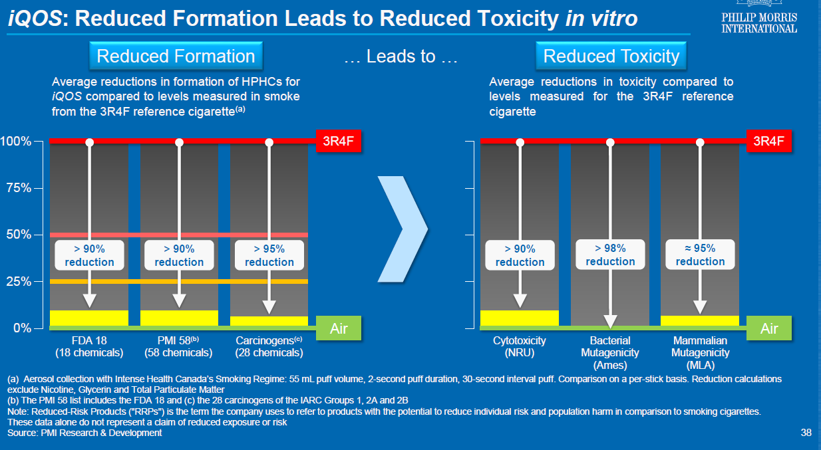

Slide 86
Japan 3 Month Study
Adults Smokers Used Products Ad Libitum
  Randomized to Cigarettes or IQOS
  5 days Clinic
  85 days on their own
  N=?

Slide 87
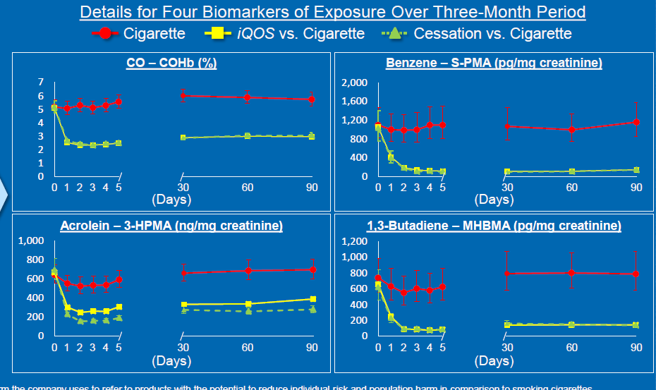

Slide 88
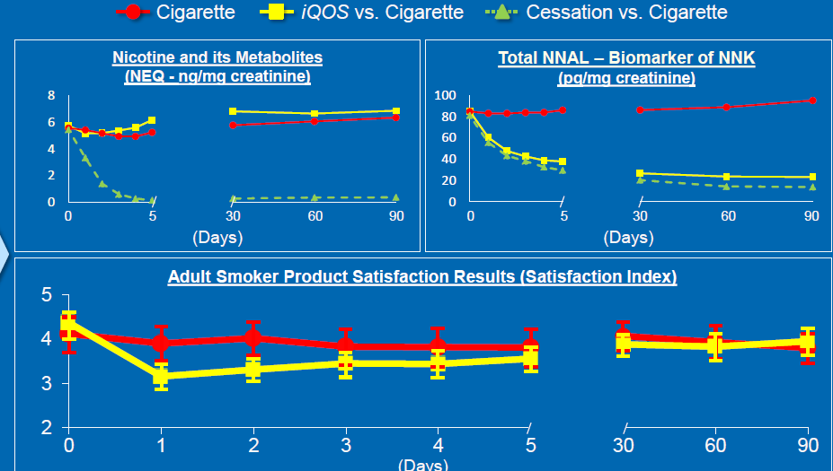

Slide 89
The Triangulum:
Tobacco, Marijuana and E-Cigarettes
The Future is Now!

Slide 90
The 21st Century: A New
“Smoking” Landscape
Combustible Tobacco Products
E-Cigs; Aerosolized Nicotine
Heat Not Burn
Dabbing; Dripping
Hookah
Dual and Poly Use
Gums, Strips, Orbs, Patches, et al.
Did I mention Marijuana?
We are only 17 years into the Century!

Slide 91
Thank You!
TRDRP
Research for a Healthier California
www.trdrp.org
phillip.gardiner@ucop.edu
Grant Funding
Cutting Edge Research
Scientific Conferences
Dissemination of Research Findings

