Slide 1
Tobacco Policies: Yesterday, Today and Tomorrow
UC Smoke and Tobacco Free Fellows Webinar
October 3, 2017

Slide 2
Webinar Series Goal
Familiarize UC Smoke and Tobacco Free Fellows and other Task Force members with the broad contours the current tobacco control and tobacco research landscape

Slide 3
Webinar Series At-A-Glance
September Fellows Orientation
Michael Ong, Julie Chobdee, Phil Gardiner
October Tobacco Polices
Stan Glantz, Kim Vagadori, and Phil Gardiner
November The Triangulum
Phil Gardiner
December Nicotine Pharmacology
Neal Benowitz

Slide 4
Webinar Series At-A-Glance
January Tobacco Health Disparities
Pebbles Fagan
February 2nd and 3rdhand Smoke
Susan Schick
March Cessation
Elisa Tong
April The Tobacco Industry
Pamela Ling

Slide 5
Tobacco Policy Webinar Goal
To introduce Fellows and Task Forces members to the laws governing the use and sale of tobacco products:
Nationally and Internationally
On Campus(s)
Menthol: Local regulation on the rise

Slide 6
Introductions
Fellows Mentor
Patton Nguyen UCB Katharine Hammond
Marissa Greenband UCD Diana Cassady
Anna Pushkin UCLI Christie Fowler
Vennis Hong UCLA William McCarthy
Andrea Lopez UCM Nancy Burke

Slide 7
Introductions
Fellows Mentor
Robert Bailey UCR Rickerby Hinds
Yelena Ionova UCSF Robin Corelli
Natalie Yates “ “
Althea Han UCSD Timothy Chin
Khristine Doppelt UCSB Laury Oaks
Crysta Bullard UCSC Judit Moschkovich

Slide 8
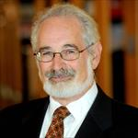
Presenters
Stan Glantz, Ph.D., School of Medicine and the Center for Tobacco Control Research and Education, University of California, San Francisco

Slide 9
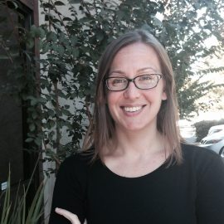
Presenters
Kimberlee Homer Vagadori, Program Director. California Youth Advocacy Network

Slide 10
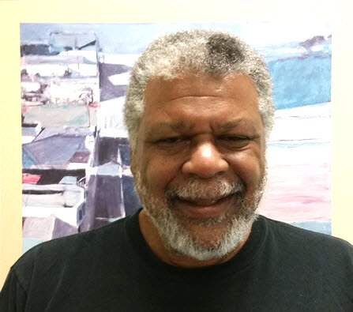
Presenters
Phil Gardiner, Dr. P.H., UC Smoke and Tobacco Free Fellows Program Officer; Tobacco Related Disease Research Program, University of California Office of the President

Slide 11
Ground Rules
Stan’s presentation will be approximately 40 minutes
Kim’s presentation will be 10 minutes
Phil’s presentation will be 15 minutes
Q&A after the final presentation
Voice
Written
Closing Thoughts and Lessons for next time

Slide 12
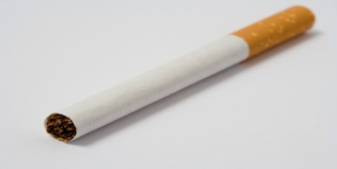
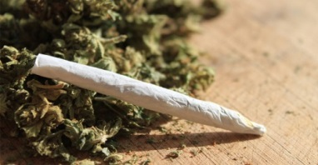
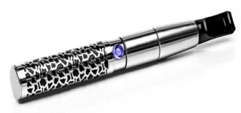
The Triangulum: Tobacco, Marijuana and E-Cigarettes
The Future is Now!

