Slide 1
Menthol: Moving Center Stage!
Phillip S. Gardiner, Dr. P. H.
UC Smoke and Tobacco Free Fellowships Program Officer, Tobacco Related Disease Research Program (TRDRP) University of California Office of the President and Co-Chair African American Tobacco Control Leadership Council (AATCLC)
UC Smoke and Tobacco Free Webinar Series
University of California Office of the President / TRDRP
October 3, 2017

Slide 2
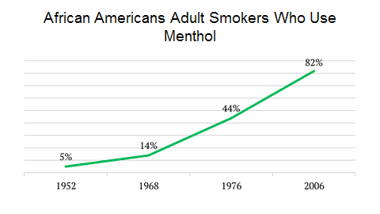
African American Menthol Use Skyrockets!
Roper, B.W. (1953). A Study of People’s Cigarette Smoking Habits and Attitudes Volume I. Philip Morris, Bates No. 2022239249. MSA, Inc. (1978) The Growth of Menthols, 1933 -1977. Brown & Williamson, Bates No. 670586709-785. NSDUH, 2004-2008.

Slide 3
Predatory Marketing Patterns (Henriksen, 2011)
As the % African American students increased, proportion menthol ads increased:

Slide 4
Storefront Cigarette Advertising Differs by Racial/Ethnic Community
Brookline Dorchester p-value
n= 42 56
% %
Retailer w/ Ads 42.9 85.7 <0.001
Small Ads 56.8 20.1 “
Large Ads 2.0 23.7 “
Menthol Ads 17.9 53.9 “
Average Price $4.94 $4.55 “
(Seidenberg, et al., 2010)

Slide 5
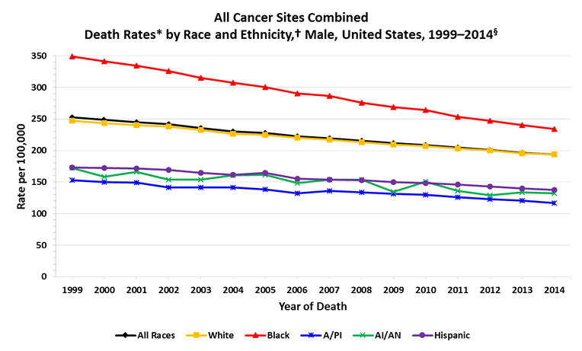
Health Disparities https://www.cdc.gov/cancer/dcpc/data/race.htm

Slide 6
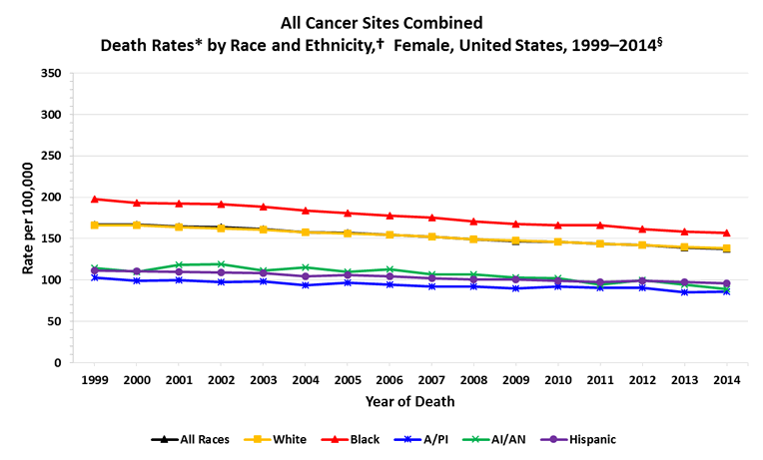
Health Disparities https://www.cdc.gov/cancer/dcpc/data/race.htm

Slide 7
Early Fights Against Branding
Still A Burning Issue

Slide 8
Early Fights Against Branding
UpTown Cigarettes
Philadelphia, 1989
Brand X
Boston, 1995
Kool Mixx Campaign
Chicago, 2004

Slide 9
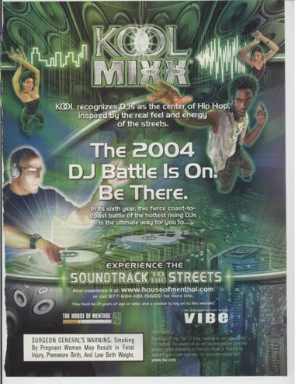

Slide 10
KOOL Cigarette Packs
Retailer Promotion
Notes:
PRODUCT INFORMATION:
Limited time availability
Unique packaging, developed by artist familiar with Hip Hop culture
Consumers are encouraged to collect the four different packs which, when put together, make a hip hop “mural”
Images include familiar hip-hop images: a rapper, 2 DJs, dancers, concert/partygoers.Point of Sale Poster
Package messaging: each of the four different packs contains information
The special cigarette package markets the event which by design appeals to youth. The new colorful KOOL cigarette packs feature images of hip-hop DJ’s, performers and dancers designed to attract the attention of young black and other hip hop and rap fans. Kool has also announced that it will market and distribute other “point of sale” hip-hop products and material. Previous studies have shown that 75 percent of adolescents shop at convenience stores at least once a week, and they are more likely than adults to be influenced by convenience store promotions.

Slide 11
Menthol A Sacrificial Lamb

Slide 12
A Deal with the Devil!
Family Smoking Prevention and Tobacco Control Act
Proposed in 2008; Enacted in 2009
Dealers: Philip Morris, Southern Senators and representatives of the tobacco control movement
Eliminate 13 flavors in cigarettes
Excluded Menthol
African Americans, Women, Youth, Native Hawaiians, Filipinos, LGBTQ folks, Puerto Ricans, Behavioral Health issues

Slide 13
Push Back: Amended FDA Bill
NY Times, May 2008
Califano and Sullivan Letter, July, 2008
Donna Christensen, D-V.I., Amendment, August 2008
TPSAC 1st order of business issue a report of the impact of the use of menthol in cigarettes on the public health, including such use among African Americans, Hispanics, and other racial and ethnic minorities. (HR 1256, Sec. 907 (e) (1)

Slide 14
Federal Inaction
2011 TPSAC Report “the removal of menthol products from the marketplace would be beneficial to the public’s health.” The OMB sat on this report until early 2013.
2013/2014 FDA CTP Report Same conclusion as the TPSAC; still no action

Slide 15
Stirring?
2014 The tobacco industry sued; thus effectively blocking the use of the TPSAC report.
2015 Ruling was overturned
2016 FDA CTP took the bold step of including restrictions on the selling of menthol and all other flavors in the new “deeming regulations” for e-cigs, hookah, cigars, cigarillos and the like.

Slide 16
Same Old, Same Old!
However, to add insult to 7 years of inaction and injury, 16 pages of the new deeming regulations were red-lined / deleted by the OMB that pertained to flavors and menthol, thus again exempting menthol.
(FDA, May, 2016)

Slide 17
Snake in the Grass (aka the tobacco industry)
Andrew Perraut White House's Office of Information and Regulatory Affairs in the OMB from 2008 to 2014. He supervised FDA and USDA policies relating among other things, tobacco.
Hired by the Cigar Industry and NJOY in 2014
Re-hired by the White house to serve in the OMB in 2015 (NY Times, September 2, 2016)

Slide 18
But Wait: Snake in Charge?
Trump owns 500,001 and $1,000,000 worth of Altria Stock http://www.fool.com/investing/general/2016/01/31/3-surprisingly-controversial-stocks-in-donald-trum.aspx
(No, this isn’t a picture of donald trump smoking a cigarette, but it might as well be)

Slide 19
Implications for Menthol Regulation During Trump Reign
OMB will continue to be staffed with tobacco industry surrogates
Unlikely the 16 pages of the deeming regulations on menthol and flavors will be re-instated
HHS Secretary Tom Price has taken Tobacco Money; Now Don Wright(hope?)
FDA Head Gottlieb has ties to the Vaping Industry
New FDA CTP Harm Reduction Proposal sees flavors and Menthol as helping to reduce harm??

Slide 20
Jones Day / Reynolds (BAT) is in the White House
Solicitor General Noel Francisco
White House Counsel Don McGahn
Deputy Counsel Greg Katsas
Cabinet Secretary William McGinley

Slide 21
The Fight To Ban Menthol
Moving to the Center of Local Tobacco Control Coalitions Agendas

Slide 22
Existing Menthol Restrictions
Chicago 2013 500ft Buffer zone around Schools
Tobacco industry sues
Merchants rebel
No ongoing community engagement
City Council and Mayor cave
2016/2017 Buffer zone removed around Middle Schools

Slide 23
Existing Menthol Restrictions
Berkeley; 600ft Barrier around Schools and Parks January 2017
Contra Costa County; 1000ft Barrier around Schools, Parks and Libraries 2017; unincorporated areas
Los Gatos; Tobacco Shops Only; January 2018
Santa Clara County; Tobacco Shops Only; July 2017; unincorporated areas

Slide 24
Existing Menthol Restrictions
El Cerrito, City-wide restrictions on menthol sales, 2018
Hayward, 500ft buffer zone
San Leandro, the jury is still out
Many other cities have adopted Flavor Restrictions, but they don’t include menthol
http://www.publichealthlawcenter.org/sites/default/files/resources/US-Sales-Restrictions-Flavored-Tobacco-Products-2017.pdf

Slide 25
Existing Menthol Restrictions
West Hollywood; 600 Barrier around Youth Oriented areas; November 2016
Yolo County; No exemptions; May 2017, unincorporated areas
Palo Alto; Tobacco Shops Only; January 2018
Passed Last night!!
All include restrictions on E-cigarette juices and all other tobacco products

Slide 26
Existing Menthol Restrictions
Minneapolis Menthol included in existing flavors ordinance; adult only liquor stores exempted; 2017
Oakland Menthol sales restricted to adult only tobacco shops; 2017 – 2018
St. Paul Menthol sales restricted to adult only tobacco shops; vote postponed until October 25, 2017
Richmond California; City wide restrictions Ordinance to be written for November, 2017

Slide 27
All-in: San Francisco
Total City-wide sales restrictions
Unanimous Board of Supervisors vote
tobacco industry Referendum
19,000+ signatures needed; 34,000 collected and verified
Over $700,000 spent by the t.i. in July alone
Peoples Campaign Committee Established
$500,000 to start

Slide 28
Take Home Message: Menthol is a Social Justice Issue!
The disproportionate marketing and targeting candy-flavored poison to African Americans and other specially oppressed sectors of our society, is out-right discriminatory and genocidal.
Poorest; least informed; fewest resources; indeed the definition of preying on the most vulnerable sections of our society.

Slide 29
If Menthol Were Banned 100,000s of Lives would be saved
2010 – 2050
All Menthol Smokers Black Menthol Smokers
10% 323,107 91,744
20% 478,154 164,465
30% 633,252 237,317
(Levy, et al., 2011)

Slide 30
What’s at Stake?

Slide 32
Thank You!
UC Smoke and Tobacco Free Task Force
http://www.ucop.edu/risk-services/loss-prevention-control/uc-smoke-tobacco-free.html
TRDRP
Research for a Healthier California
www.trdrp.org
phillip.gardiner@ucop.edu
Grant Funding
Cutting Edge Research
Scientific Conferences
Dissemination of Research Findings

