Slide 1
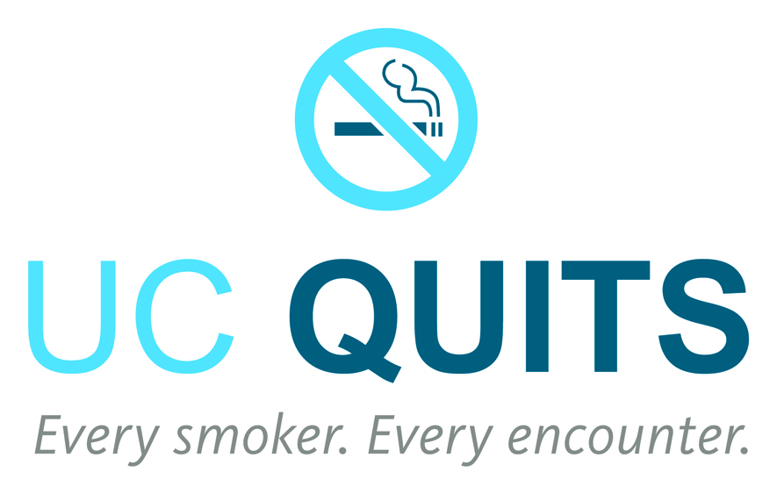

Tobacco Cessation:
The 5 A’s and UC
Elisa Tong, MD, MA
Associate Professor of Internal Medicine
University of California, Davis
March 8, 2017
Webinar for UC Smoke and Tobacco-Free Presidential Fellows

Slide 2
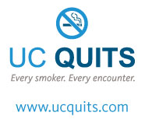
Objectives
Tobacco Impact on Health
Tobacco Cessation: The 5 A’s
UC and Cessation
  California Smokers’ Helpline
  UC Quits
  Smoking Cessation Leadership Center
UC Smoke and Tobacco-Free Policy
Notes:
1. Describe the context and development of UC Quits, the UC-wide Tobacco Cessation Network
2. Compare how the 5 UC medical centers are implementing systems change on tobacco with multidisciplinary teams and the electronic medical record
3. Identify opportunities for systems change on tobacco cessation including lung cancer screening and quality measures

Slide 3

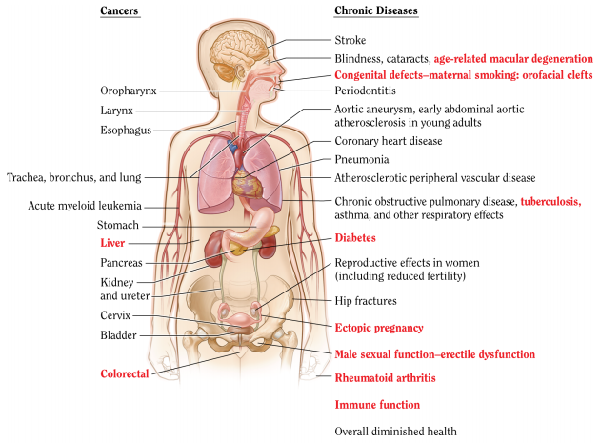
Tobacco Causes & Worsens Disease
Leading preventable cause of disease and death (Surgeon General 2014)
  About 480,000 deaths annually
    Over 41,000 nonsmokers
  Cardiovascular > cancer
Causes more disease
  Cancer: liver, colorectal
  Diabetes (type 2)
  Rheumatoid arthritis
Worsens treatment
  Poor surgical healing
  Increases infections
  Medication control of disease including psychiatric meds
www.cdc.gov; www.surgeongeneral.gov

Slide 4

“No Safe Level of Smoke Exposure”
Secondhand smoke effect is nearly as large as smoking for heart disease
  Curvilinear dose response
  Rapid mechanisms of action
    Endothelial dysfunction
    Platelet aggregation
    Inflammation
Smoke gets up to 16x more toxic as it ages and changes
  “Thirdhand smoke”
Ventilation is not a solution
www.surgeongeneral.gov

Slide 5
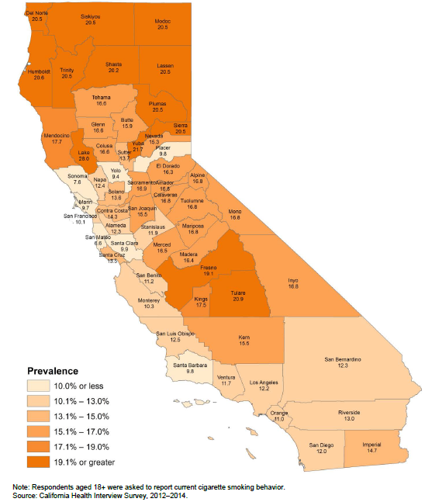
Over 3 Million Smokers in California
CA prevalence: 11.6% (CHIS 2012-4)
  Sacramento: 16.9%
  Higher in subgroups (CHIS 2009)
  Low SES (white/African Am): 24%
  Am Indian, Asian men: 20-30%
  LGBT: 19%
  Mental health/alcohol/drug: 24%
  Cancer*: 16% (any), 22% (tob-rel)
Light and passive smoking
  1 in 3 CA smokers: not daily
  53% nonsmokers recent exposure
http://tobaccofreeca.com/wp-content/uploads/2016/10/2016-California-Tobacco-Facts-Figures.pdf;
* Among 29% CCR data available; http://bit.ly/CDOC_CalltoAction
Notes:
CA adult smoking rates have dropped by more than 50% since the California Tobacco Control Program began in 1989.
CHIS 2009: American Indian/Alaskan Native: 30.6%, African American Men 24%, African American Women 19.4%, white men 18.7%, Asian men 17.7%, Hispanic men 16.8%
Low SES < 200% below federal poverty limit
Poor mental health: needing to see professional because of mental health emotions or nerves or use of alcohol or drugs in past year
http://www.cdph.ca.gov/programs/tobacco/Documents/Resources/Fact%20Sheets/Health%20Equity%20Summit%20Data%20Charts%2006.21.2013%20v2.pdf
http://www.cdph.ca.gov/programs/tobacco/Documents/Resources/Publications/HealthEquitySum-Web.pdf

Slide 6
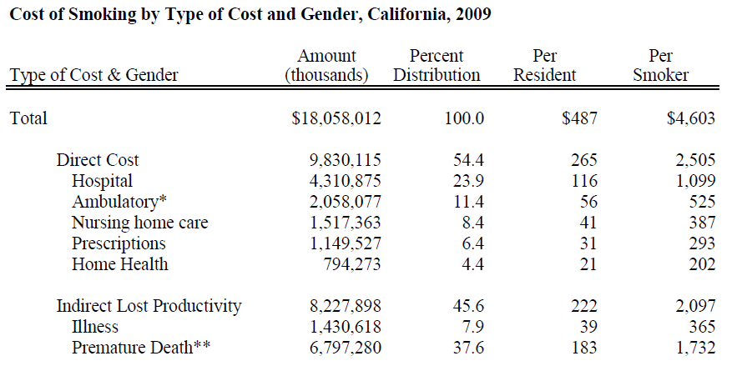
$18 Billion in Smoking Costs in California
Max et al, TRDRP Costs of Smoking Report, 2014
Max et al. Nicotine Tob Res (2015)
Notes:
Abstract
Introduction:
The economic impact of smoking, including healthcare costs and the value of lost productivity due to illness and mortality, was estimated for California for 2009.
Methods:
Smoking-attributable healthcare costs were estimated using a series of econometric models that estimate expenditures for hospital care, ambulatory care, prescriptions, home health care, and nursing home care. Lost productivity due to illness was estimated using an econometric model predicting how smoking status affects the number of days lost from work or other activities. The value of lives lost from premature mortality due to smoking was estimated using an epidemiological approach.
Results:
Almost 4 million Californians still smoke, including 146 000 adolescents. The cost of smoking in 2009 totaled $18.1 billion, including $9.8 billion in healthcare costs, $1.4 billion in lost productivity from illness, and $6.8 billion in lost productivity from premature mortality. This amounts to $487 per California resident and $4603 per smoker. Costs were greater for men than for women. Hospital costs comprised 44% of healthcare costs.
Conclusions:
Despite extensive efforts at tobacco control in California, healthcare and lost productivity costs attributable to smoking remain high. Compared to costs for 1999, the total cost was 15% greater in 2009. However, after adjusting for inflation, real costs have fallen by 13% over the past decade, indicating that efforts have been successful in reducing the economic burden of smoking in the state.
*$2280 difference between smoker and nonsmoker

Slide 7

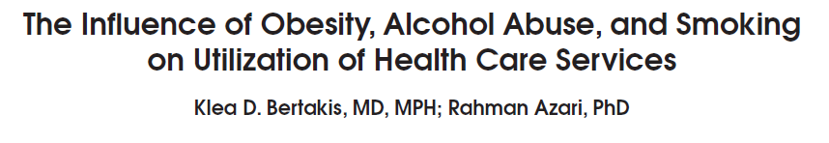
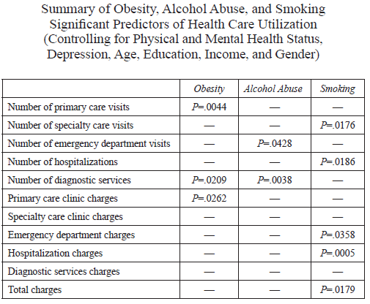
Significant economic burden of smoking at 1 year
509 new UCD adult patients randomly assigned to PCP and measured medical service utilization for 1 year
10% higher total charges than nonsmokers
Notes:
Abstract
Background and Objectives: There is extensive evidence relating individual behavioral risk factors to adverse health outcomes and associated costs; however, more-comprehensive assessments have been limited. Our objective was to examine the relative effects of obesity, alcohol abuse, and smoking on health care use and associated charges. Methods: New adult patients (n=509) were randomly assigned to primary care physicians, and their utilization of medical services was monitored for 1 year. Variables measured included sociodemographics, self-reported health status, Beck Depression Index, measured body mass index, Michigan Alcohol Screening Test results, and smoking history. Results: Controlling for health status, depression, age, education, income, and gender, obesity was associated with the mean number of primary care visits, diagnostic services, and primary care clinic charges. Alcohol abuse was related to the mean number of emergency department visits and diagnostic services. Smoking was associated with the mean number of specialty clinic visits and hospitalizations. Smoking also predicted charges for emergency department visits, hospitalizations, and total health care charges. Conclusions: The economic burden of smoking is significant, even after only 1 year. Health care providers should focus attention on smoking prevention and cessation programs as an approach for managing medical costs.

Slide 8
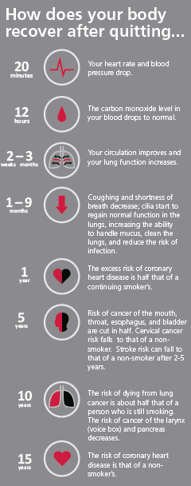
Quitting Benefits
Cardiovascular and pulmonary benefits are immediate
Cancer risk lowered after a few years
Reducing cigarettes not enough
  Nicotine compensation
  Stable nondaily pattern

Slide 9
Objectives
Tobacco Impact on Health
Tobacco Cessation: The 5 A’s
UC and Cessation
  California Smokers’ Helpline
  UC Quits
  Smoking Cessation Leadership Center
UC Smoke and Tobacco-Free Policy
Notes:
1. Describe the context and development of UC Quits, the UC-wide Tobacco Cessation Network
2. Compare how the 5 UC medical centers are implementing systems change on tobacco with multidisciplinary teams and the electronic medical record
3. Identify opportunities for systems change on tobacco cessation including lung cancer screening and quality measures

Slide 10
Tobacco Dependence: A 2-part Problem
Tobacco Dependence
Physiological
Behavioral
The addiction to nicotine
The habit of using tobacco
Treatment
Treatment
Medications for cessation
Behavior change program
Adapted from rxforchange.ucsf.edu
Notes:
And why it can be challenging sometimes for people to quit? Because tobacco dependence is a chronic brain disease that has a physiological and a behavioral component. Smoking cessation interventions that address both will be the most effective. Prolonged tobacco use of tobacco results in tobacco dependence, which is characterized as a physiological dependence (addiction to nicotine) and behavioral habit of using tobacco. While medication can help with the addiction to nicotine, as is discussed in another webcast, the behavioral component can be treated through behavior change programs, such as individualized counseling, group cessation programs, or support through a telephone quitline such as the California Smokers’ Helpline 1-800-NoButts.
The Clinical Practice Guideline for treating tobacco use and dependence (Fiore et al., 2000), which summarizes more than 6,000 published articles, advocates the combination of behavioral counseling with pharmacotherapy in treating patients who smoke. The components of this intervention is also known as the 5As.
Fiore MC, Bailey WC, Cohen SJ, et al. (2000). Treating Tobacco Use and Dependence. Clinical Practice Guideline. Rockville, MD: U.S. Department of Health and Human Services, Public Health Service.

Slide 11
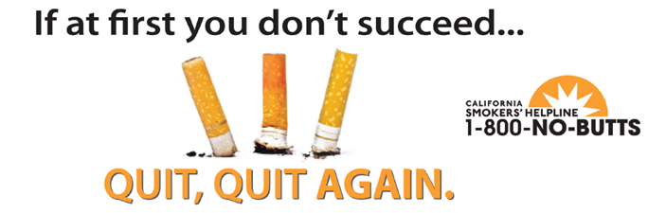
Quitting Can Take Multiple Tries
70% smokers want to quit
Can take 8-12 tries before quit for good
Every clinical encounter is an opportunity
www.ucquits.com
California Department of Public Health

Slide 12
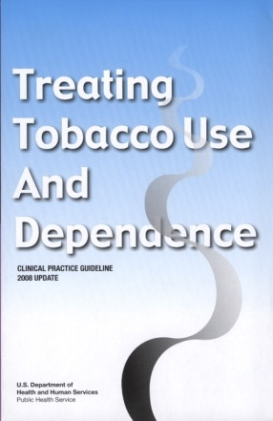
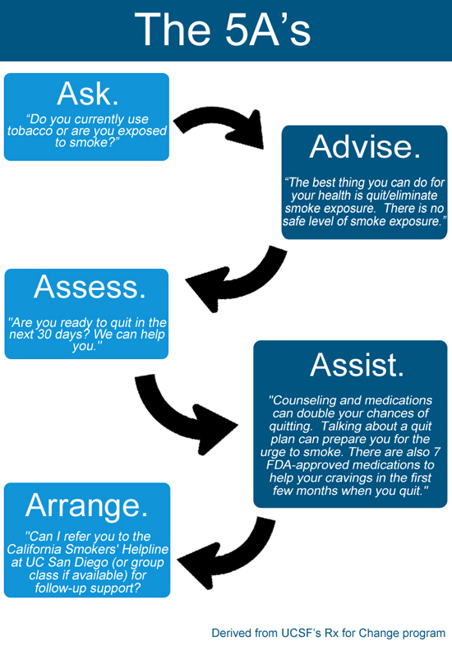
The 5 A’s of Tobacco Treatment
ASK
about tobacco USE and EXPOSURE
ADVISE
tobacco users to QUIT
ASSESS
READINESS to make a quit attempt
ASSIST
with the QUIT ATTEMPT
ARRANGE
FOLLOW-UP care
Adapted from rxforchange.ucsf.edu
Notes:
12
The majority of those people who have ever smoked have quit. It is not uncommon for smokers to make several attempts to quit smoking before they are finally free of their nicotine addiction However too few smokers use evidence-based methods that increase the likelihood of staying quit. The 5 A’s are summarized in this slide:
Ask about tobacco use; systematically identify all tobacco users at every visit
Advise tobacco users to quit
Assess readiness, or willingness to make a quit attempt
Assist with the quit attempt (provide counseling and medication)
Arrange follow-up care
Each of these is a key component of comprehensive tobacco cessation counseling interventions.
Fiore MC, Jaén CR, Baker TB, et al. (2008). Treating Tobacco Use and Dependence: 2008 Update. Clinical Practice Guideline. Rockville, MD: U.S. Department of Health and Human Services. Public Health Service.

Slide 13

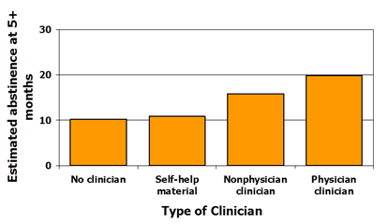
Health Professional Advice Helps
Health professional advice doubles the odds of quitting
Patient satisfaction increases (Conroy et al, Nicotine Tob Res 2005)
Need to help household smokers, especially parents or caregivers
(Winickoff et al. Pediatrics 2013)
2.2
1.7
1.0
1.1
Fiore et al. (2008). Treating Tobacco Use and Dependence: 2008 Update.
Clinical Practice Guideline. Rockville, MD: USDHHS, PHS, May 2008.
www.rxforchange.ucsf.edu

Slide 14
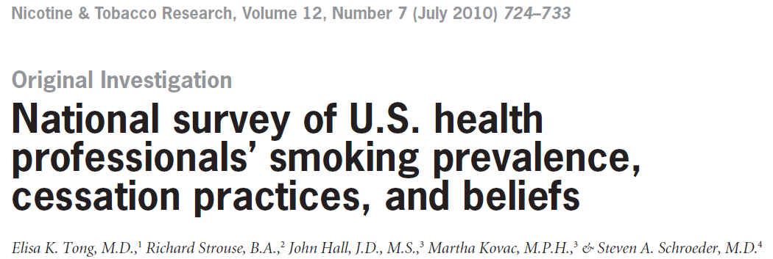
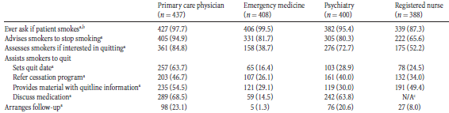
Barriers to 5 A’s
Competing priorities
Believing counseling not appropriate service
Uncomfortable asking if smoke
Not being a PCP
Smoker
*68% PCPs agree limited or no reimbursement
Facilitators of 5 A’s
Believing treatment important as a professional responsibility
Awareness of PHS Guidelines
Had cessation training

Slide 15
Ask, Advise, Refer
ASK
about tobacco USE
ADVISE
tobacco users to QUIT
REFER
to other resources
REFER:
California Smokers’ Helpline
Community Resources
ASSIST
ARRANGE
Adapted from rxforchange.ucsf.edu
Notes:
15
Brief interventions have been shown to be effective (Fiore et al., 2008). When time or logistics do not permit comprehensive tobacco cessation counseling during a patient visit, clinicians are encouraged to apply brief interventions, just a few minutes, whereby they Ask about tobacco use, Advise tobacco users to quit, and Refer patients who are willing to quit to the California Smokers’ telephone helpline (1-800-No-Buts) or other community-based resource for tobacco cessation.
♪ Note to instructor(s): It has been recognized for many years now that clinicians can play an important role in helping patients quit smoking (Fiore et al., 2008). There have been efforts to train especially providers in tobacco cessation and how to intervene, hoping that these providers will incorporate these interventions as a part of their practices. For the most part, these efforts have failed, because most clinicians do not have the expertise or the time to provide extending counseling to their patients. Thus, the tobacco control community has moved towards asking clinicians to apply this ask-advise-refer strategy, rather than expecting clinicians to do it all themselves. The idea is that we can simply and quickly ask patients about their smoking and advise them to quit, but that few of us are tobacco cessation specialists. Thus, we refer our patients to the experts who can help them quit smoking – and fortunately, the services of these experts are now readily available to all Americans through tobacco “quitlines” and other resources.
Fiore MC, Jaén CR, Baker TB, et al. (2008). Treating Tobacco Use and Dependence: 2008 Update. Clinical Practice Guideline. Rockville, MD: U.S. Department of Health and Human Services. Public Health Service.

Slide 16
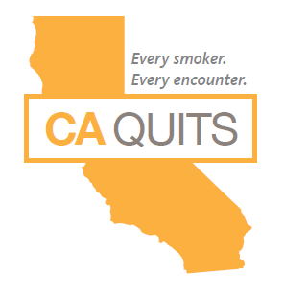
Objectives
Tobacco Impact on Health
Tobacco Cessation: The 5 A’s
  7 FDA-approved Medications
UC and Cessation
  California Smokers’ Helpline
  UC Quits
  Smoking Cessation Leadership Center
UC Smoke and Tobacco-Free Policy
Notes:
1. Describe the context and development of UC Quits, the UC-wide Tobacco Cessation Network
2. Compare how the 5 UC medical centers are implementing systems change on tobacco with multidisciplinary teams and the electronic medical record
3. Identify opportunities for systems change on tobacco cessation including lung cancer screening and quality measures

Slide 17
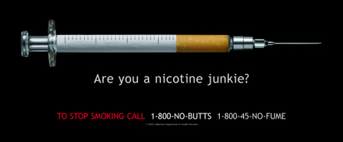

Nicotine Withdrawal Effects
Irritability/frustration/anger
Anxiety
Difficulty concentrating
Restlessness/impatience
Depressed mood/depression
Insomnia
Impaired performance
Increased appetite/weight gain
Cravings
Notes:
17
17
♪ Note to instructor(s): Refer students to the Withdrawal Symptoms Information Sheet handout. This handout describes several symptoms, when they occur postcessation, and how to cope with withdrawal. In addition to being an educational aid for students, it can be copied and distributed to patients who are quitting.
When nicotine is discontinued abruptly, the following withdrawal symptoms develop (Hughes, 2007):
Irritability/frustration/anger
Anxiety
Difficulty concentrating
Restlessness/impatience
Depressed mood/depression
Insomnia
Impaired performance
Increased appetite/weight gain
Cravings
♪ Note to instructor(s): Other symptoms of quitting have been described in the literature. Please refer to Hughes, 2007 for further details.
Tobacco users usually experience a strong desire or craving for tobacco. In general, withdrawal symptoms manifest within the first 1–2 days, peak within the first week, and gradually dissipate over the next 2–4 weeks (Hughes, 2007). Strong cravings for tobacco may persist for months to years after cessation (Benowitz, 1992).
Benowitz NL. (1992). Cigarette smoking and nicotine addiction. Med Clin N Am 76:415–437.
Hughes JR. (2007). Effects of abstinence from tobacco: valid symptoms and time course. Nicotine Tob Res 9:315–327.

Slide 18
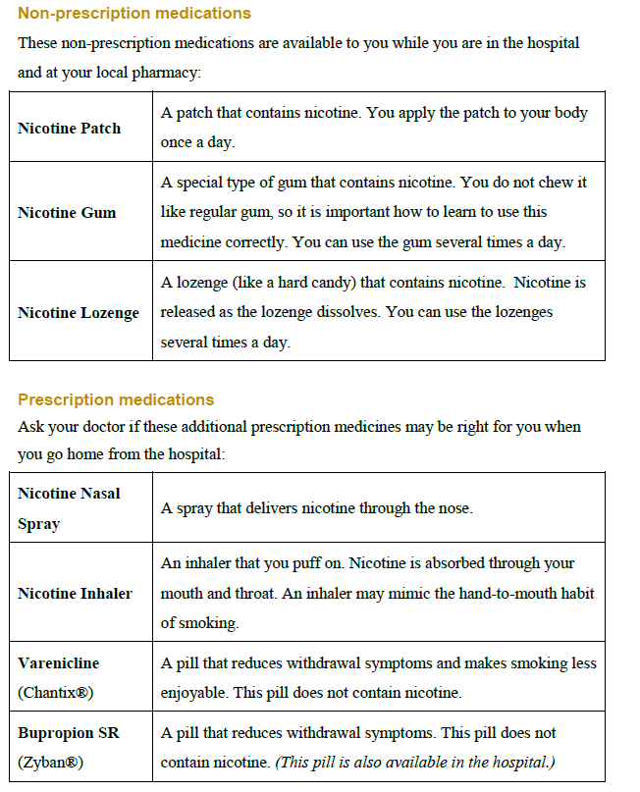

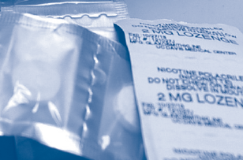
Medications
  Use over 2-3 months
  Combination therapy
  Different considerations for selection

Slide 19
7 FDA-approved Medications Double Long-term (> 6 month) Quit Rates
23.9
20.2
18.0
19.0
15.8
16.1
17.1
Percent quit
11.3
11.8
11.2
10.3
9.9
8.1
9.1
Data adapted from Cahill et al. (2008). Cochrane Database Syst Rev; Stead et al. (2008).
Cochrane Database Syst Rev; Hughes et al. (2007). Cochrane Database Syst Rev
Adapted from rxforchange.ucsf.edu
Notes:
19
19
This bar chart summarizes the long-term (≥6-month) quit rates observed with the different NRT products, bupropion SR and varenicline (Cahill et al., 2008; Stead et al., 2008; Hughes et al., 2007). These data derive from 145 different randomized-controlled trials; therefore, it is inappropriate to compare the active medications with respect to clinical efficacy. What this chart does illustrate, however, is that the quit rates from each of the methods is approximately twice that of its corresponding placebo control treatment arm.
Each of the pharmacotherapy options depicted in the chart is considered effective. When patients ask for assistance with their quit attempt, any product can be recommended, if not contraindicated. However, when assisting patients in choosing a product, clinicians should consider additional factors. The number of cigarettes smoked per day (or time to first cigarette, for the nicotine lozenge), level of dependence, advantages and disadvantages of each product, methods used for prior quit attempts and reasons for relapse, and the patient’s own product preference need to be considered. Behavioral counseling should be used in conjunction with all pharmacologic therapies.
Cahill K, Stead LF, Lancaster T. Nicotine receptor partial agonists for smoking cessation. (2008). Cochrane Database Syst Rev 3:CD006103.
Hughes JR, Stead LF, Lancaster. (2007). Antidepressants for smoking cessation. Cochrane Database Syst Rev 4:CD000031.
Stead LF, Perera R, Bullen C, Mant D, Lancaster T. (2008). Nicotine replacement therapy for smoking cessation. Cochrane Database Syst Rev 1:CD000146.

Slide 20
Plasma Nicotine Concentrations:
Tobacco Products vs. NRT
Cigarette
Moist snuff
0 10 20 30 40 50 60
Time (minutes)
Adapted from rxforchange.ucsf.edu
Notes:
20
20
This graph depicts the plasma venous nicotine concentrations achieved with the various nicotine delivery systems. Peak plasma concentrations are higher and are achieved more rapidly when nicotine is delivered via cigarette smoke compared to the available NRT formulations.
Among the NRT formulations, the nasal spray has the most rapid absorption, followed by the gum, lozenge, and inhaler; absorption is slowest with the transdermal formulations. The concentration time curves in this slide depict levels achieved after administration of a single dose of nicotine following a period of overnight abstinence. The administration of nicotine varied across the studies as follows: the cigarette was smoked over 5 minutes, the moist snuff (2 grams Copenhagen) was placed between the check and gum for 30 minutes, the inhaler was used over 20 minutes (80 puffs), the gum was chewed over 30 minutes, the lozenge was held in the mouth for approximately 30 minutes, and the patch was applied to the skin for 1 hour. The data presented in the graph derive from multiple studies and are meant to illustrate the differences between nicotine absorption from tobacco and NRT (Choi et al., 2003; Fant et al., 1999; Schneider et al., 2001).
Because NRT formulations deliver nicotine more slowly and at lower levels (e.g., 30–75% of those achieved by smoking), these agents are far less likely to be associated with dependence when compared to tobacco products.
Choi JH, Dresler CM, Norton MR, Strahs KR. (2003). Pharmacokinetics of a nicotine polacrilex lozenge. Nicotine Tob Res 5:635–644.
Fant RV, Henningfield JE, Nelson RA, Pickworth WB. (1999). Pharmacokinetics and pharmacodynamics of moist snuff in humans. Tob Control 8:387–392.
Schneider NG, Olmstead RE, Franzon MA, Lunell E. (2001). The nicotine inhaler. Clinical pharmacokinetics and comparison with other nicotine treatments. Clin Pharmacokinet 40:661–684.

Slide 21
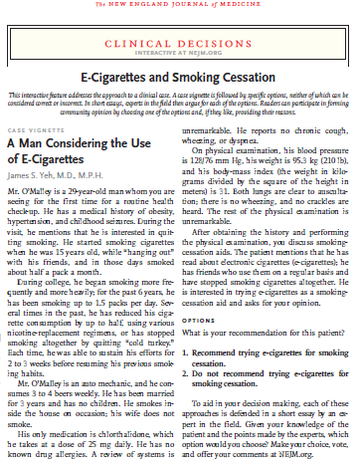
Electronic Nicotine Delivery Devices
Recommend?
Not recommend?
NEJM 2016

Slide 22



US: Not recommend e-cigs for cessation
US (10/15): No recommendation
UK (8/15): Support
“In a nutshell, best estimates show e-cigarettes are 95% less harmful to your health than normal cigarettes, and when supported by a smoking cessation service, help most smokers to quit tobacco altogether.”
“Inadequate evidence on the benefit of ENDS to achieve tobacco cessation in adults or improve perinatal outcomes in infants…balance of benefits and harms cannot be determined”

Slide 23
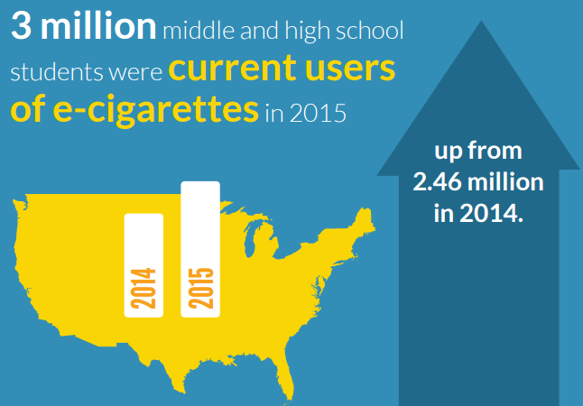
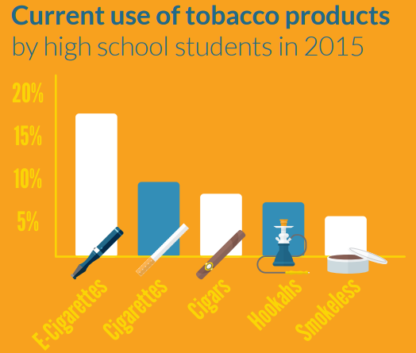
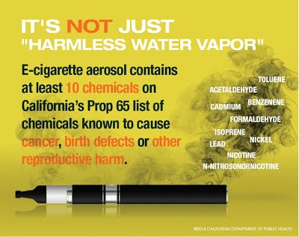
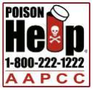
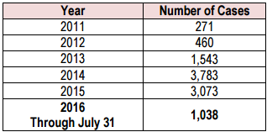
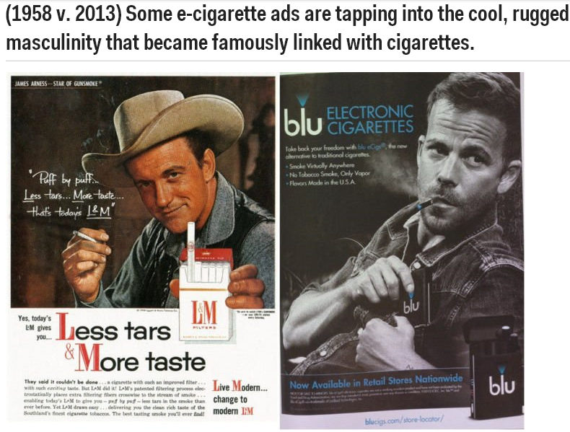
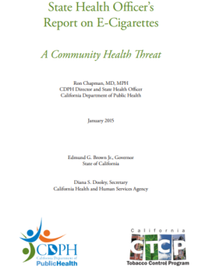

Public Health Concerns: ECigs
Only recent FDA regulation authority (5/2016)
Adolescent uptake
Nicotine poisonings
  “No nicotine” mislabelling
Vapor chemicals
    Propylene glycol not water
    Carcinogens, heavy metals
Exposure from secondhand vapor
Lithium battery explosions
Marketing tactics
Long-term health effects

Slide 24
Objectives
Tobacco Impact on Health
Tobacco Cessation: The 5 A’s
UC and Cessation
  California Smokers’ Helpline
  UC Quits
  Smoking Cessation Leadership Center
UC Smoke and Tobacco-Free Policy
Notes:
1. Describe the context and development of UC Quits, the UC-wide Tobacco Cessation Network
2. Compare how the 5 UC medical centers are implementing systems change on tobacco with multidisciplinary teams and the electronic medical record
3. Identify opportunities for systems change on tobacco cessation including lung cancer screening and quality measures

Slide 25
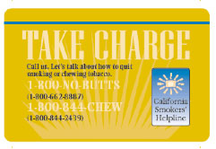


California Smokers’ Helpline
  Free telephone counseling to develop a quit plan
  Operated by UC San Diego
  Free nicotine patch offers: First 5, Asian languages
  Services:
  Self-help materials, referral to local resources, certificate for med coverage
  Clients receive up to six follow-up sessions with a counselor
  Languages: English, Spanish, Chinese, Korean, Vietnamese
  M-F 7am-9pm; Sat/Sun 9am-5pm

Slide 26

www.nobutts.org

Slide 27
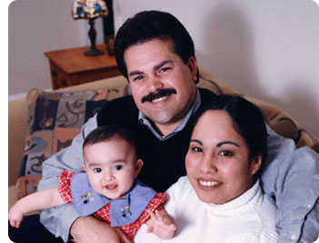

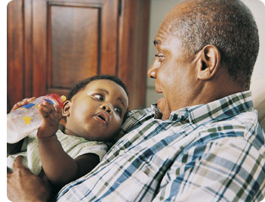
Who Can Call the Helpline?
Smokers
  Teens
  Pregnant
  Chew
  Thinking about quitting
Friends or families of smokers
Parents or guardians of child exposed to secondhand smoke

Slide 28


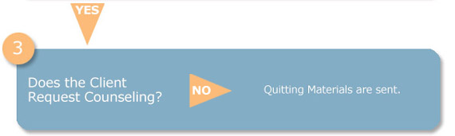
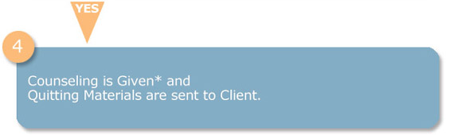
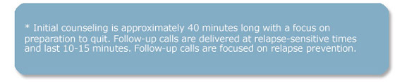
What Happens When You Call?
Certificate of enrollment available after completing one counseling session

Slide 29
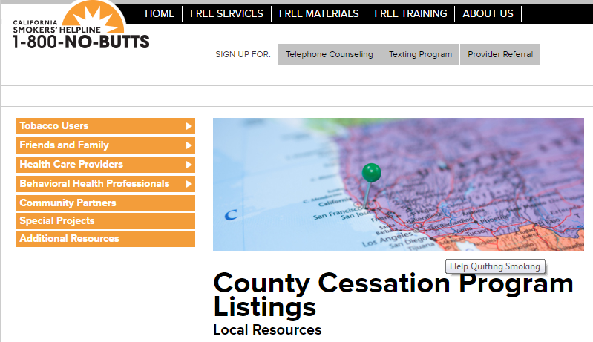
Local Resources
Every county has a Local Lead Agency for tobacco
Medi-Cal managed care plan health educators
Listing of cessation classes in county www.nobutts.org/county-listing

Slide 30
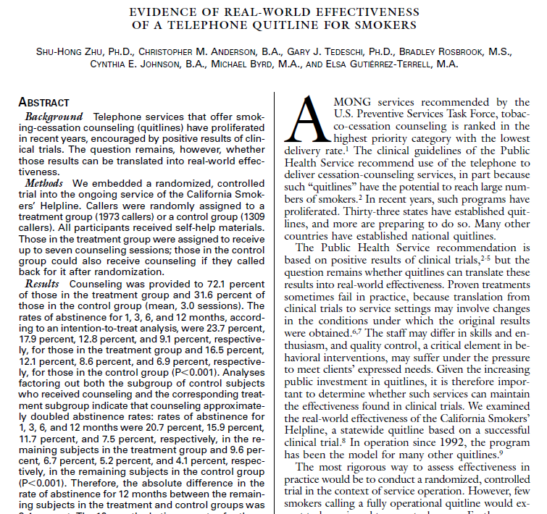

Real-world Effectiveness
  Double a smoker’s chances of long-term quitting (Zhu et al. NEJM 2002)
  Randomized controlled trial with delayed counseling for control group
  No smoking (abstinence)
  1 month: 21%
  3 months: 16%
  6 months: 12%
  12 months: 7.5%
Zhu S et al. N Engl J Med 2002;347:1087-1093.
Notes:
BACKGROUND
Telephone services that offer smoking-cessation counseling (quitlines) have proliferated in recent years, encouraged by positive results of clinical trials. The question remains, however, whether those results can be translated into real-world effectiveness.
METHODS
We embedded a randomized, controlled trial into the ongoing service of the California Smokers' Helpline. Callers were randomly assigned to a treatment group (1973 callers) or a control group (1309 callers). All participants received self-help materials. Those in the treatment group were assigned to receive up to seven counseling sessions; those in the control group could also receive counseling if they called back for it after randomization.
RESULTS
Counseling was provided to 72.1 percent of those in the treatment group and 31.6 percent of those in the control group (mean, 3.0 sessions). The rates of abstinence for 1, 3, 6, and 12 months, according to an intention-to-treat analysis, were 23.7 percent, 17.9 percent, 12.8 percent, and 9.1 percent, respectively, for those in the treatment group and 16.5 percent, 12.1 percent, 8.6 percent, and 6.9 percent, respectively, for those in the control group (P<0.001).
Analyses factoring out both the subgroup of control subjects who received counseling and the corresponding treatment subgroup indicate that counseling approximately doubled abstinence rates: rates of abstinence for 1, 3, 6, and 12 months were 20.7 percent, 15.9 percent, 11.7 percent, and 7.5 percent, respectively, in the remaining subjects in the treatment group and 9.6 percent, 6.7 percent, 5.2 percent, and 4.1 percent, respectively, in the remaining subjects in the control group (P<0.001). Therefore, the absolute difference in the rate of abstinence for 12 months between the remaining subjects in the treatment and control groups was 3.4 percent. The 12-month abstinence rates for those who made at least one attempt to quit were 23.3 percent in the treatment group and 18.4 percent in the control group (P<0.001).
CONCLUSIONS
A telephone counseling protocol for smoking cessation, previously proven efficacious, was effective when translated to a real-world setting. Its success supports Public Health Service guidelines calling for greater availability of quitlines.

Slide 31
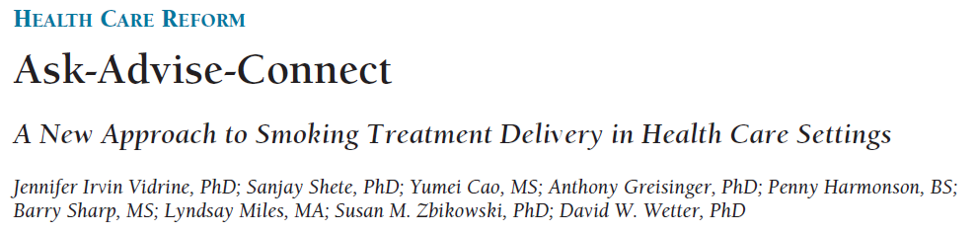
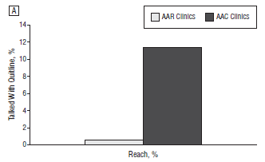
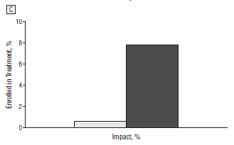
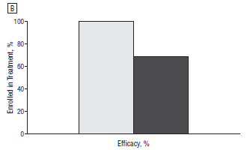

13-fold increase in cessation treatment enrollment with Ask Advise Connect
(7.8% Ask Advise Connect vs. 0.6% Ask Advise Refer)
Vidrine J et al., JAMA Int Med, 2013; 173(6):458-464
Notes:
OBJECTIVE:
To evaluate a new approach--Ask-Advise-Connect (AAC)--designed to address barriers to linking smokers with treatment.
DESIGN:
A pair-matched, 2-treatment-arm, group-randomized design in 10 family practice clinics in a single metropolitan area. Five clinics were randomized to the AAC (intervention) and 5 to the AAR (control) conditions. In both conditions, clinic staff were trained to assess and record the smoking status of all patients at all visits in the electronic health record, and smokers were given brief advice to quit. In the AAC clinics, the names and telephone numbers of smokers who agreed to be connected were sent electronically to the quitline daily, and patients were called proactively by the quitline within 48 hours. In the AAR clinics, smokers were offered a quitline referral card and encouraged to call on their own. All data were collected from February 8 through December 27, 2011.
SETTING:
Ten clinics in Houston, Texas.
PARTICIPANTS:
Smoking status assessments were completed for 42,277 patients; 2052 unique smokers were identified at AAC clinics, and 1611 smokers were identified at AAR clinics.
INTERVENTIONS:
Linking smokers with quitline-delivered treatment.
MAIN OUTCOME MEASURE:
Impact was based on the RE-AIM (Reach, Efficacy, Adoption, Implementation, and Maintenance) conceptual framework and defined as the proportion of all identified smokers who enrolled in treatment.
RESULTS:
In the AAC clinics, 7.8% of all identified smokers enrolled in treatment vs 0.6% in the AAR clinics (t4 = 9.19 [P < .001]; odds ratio, 11.60 [95% CI, 5.53-24.32]), a 13-fold increase in the proportion of smokers enrolling in treatment.
CONCLUSIONS AND RELEVANCE:
The system changes implemented in the AAC approach could be adopted broadly by other health care systems and have tremendous potential to reduce tobacco-related morbidity and mortality.

Slide 32
Objectives
Tobacco Impact on Health
Tobacco Cessation: The 5 A’s
UC and Cessation
  California Smokers’ Helpline
  UC Quits
  Smoking Cessation Leadership Center
UC Smoke and Tobacco-Free Policy
Notes:
1. Describe the context and development of UC Quits, the UC-wide Tobacco Cessation Network
2. Compare how the 5 UC medical centers are implementing systems change on tobacco with multidisciplinary teams and the electronic medical record
3. Identify opportunities for systems change on tobacco cessation including lung cancer screening and quality measures

Slide 33
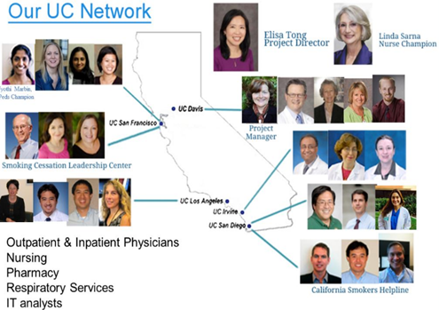
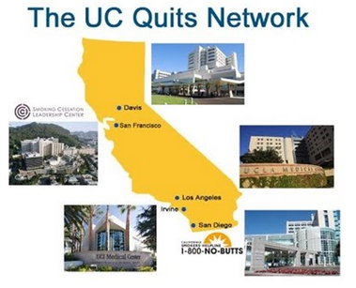
UC QUITS VISION
To address tobacco cessation
at every UC Health encounter
Funding: UC Health’s Center for Health Quality & Innovation, UC Office of the President

Slide 34



Aims of UC Quits
To build capacity through a UC-wide Tobacco Cessation Network
To create technological modifications to each UC EMR
  Yr 1: eReferral to California Smokers’ Helpline
  Yr 2: Order sets and alerts
To conduct outreach and education across departments and nursing staff
  UC Quits website resource
  UC Quits brief training modules

Slide 35






Engage All Providers
Nursing
  Documents tobacco status intake
  Assist nicotine withdrawal during hospital stay
Peds and obstetrics
  Passive smoking and helping household smoker
Anesthesia and Surgery
  Access to pre-op clinic, pain clinic, peri-op for surgical lines
  “There is no sweet spot to quit before surgery”
Psychiatry
  Behavioral health has high smoking rates
Health Professional Team
  Pharmacists, Respiratory Therapists, Social Work
Linda Sarna, RN, PhD
Dean, UCLA School of Nursing
Jyothi Marbin, MD
UCSF Benioff Oakland
Maxime Cannesson, MD
Vice-Chair Peri-op Med
UCLA Anesthesia
Tim Fong, MD
UCLA Psychiatry
Lisa Kroon, PharmD
Chair, UCSF Clinical Pharmacy

Slide 36
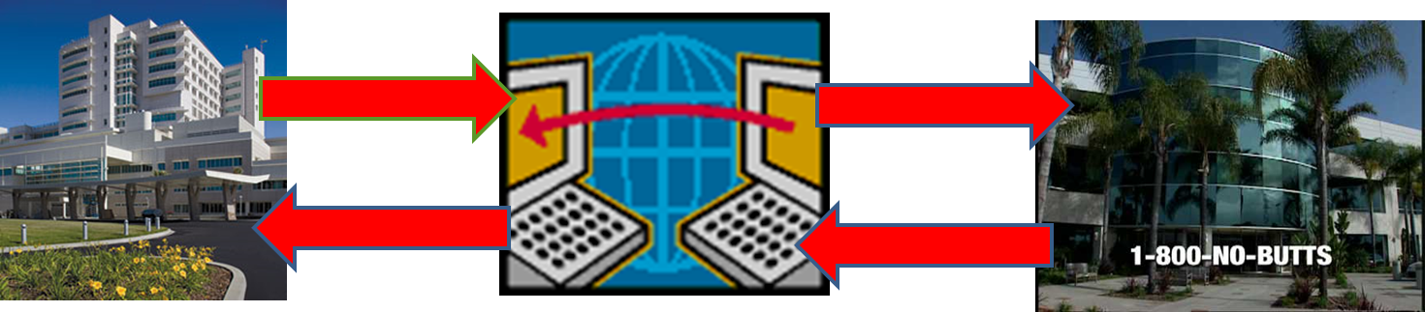
Two-way eReferral to Helpline
Provider enters quitline eReferral order (outpatient or inpatient)
Helpline calls patient in 1-2 business days
Provider receives ongoing Results message about Helpline calls and smoking status (at time of call)

Slide 37
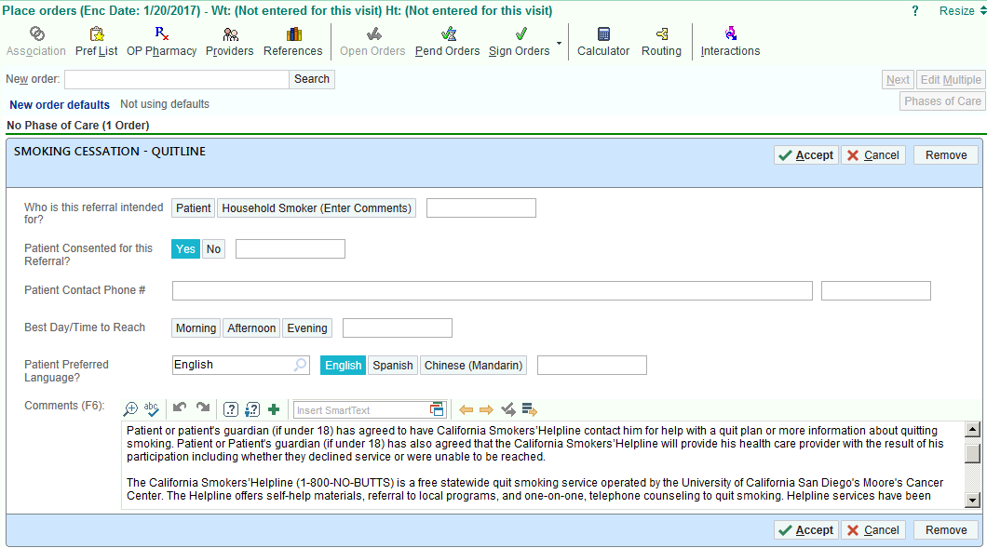
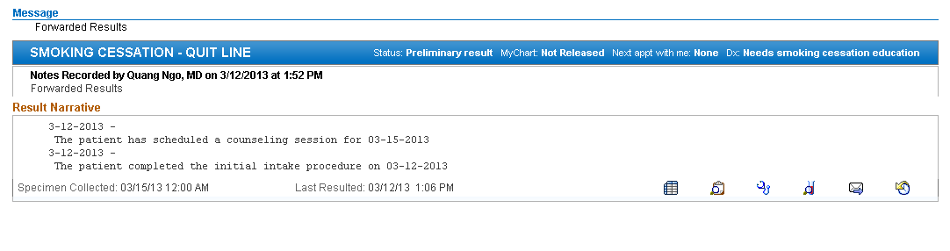
1) Provider Enters Order
2) Provider Gets Results Message

Slide 38
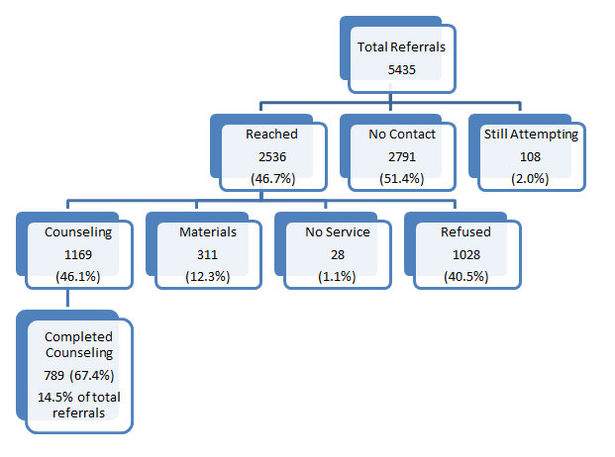
5 UCs: 5000+ eReferrals 2013-2015
UCD live 3/2013; Other UCs after 11/2014
*Reflects hospital discharge orders too

Slide 39
EMR modifications across UCs
 | UCD | UCSF | UCLA | UCI | UCSD
eReferral to Helpline | X | X | X | X | X
Outpatient order set | X | X | X | X | X
Outpatient HM alert | X |  |  | X
Outpatient class | X | X |  | X (pharm)
Inpatient order set | X | X | X | X | P
Inpatient alert/links | X | RT report | X | X | P
Inpatient education | Nursing Pharm (IM) RT (some) | RT (all) | Nursing, RT (Santa Monica) | Nursing | Nursing RT (some)

Slide 40
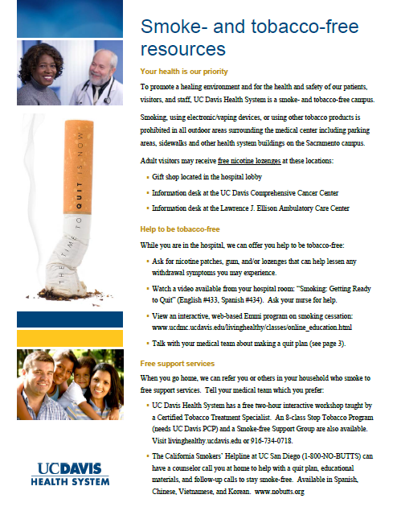
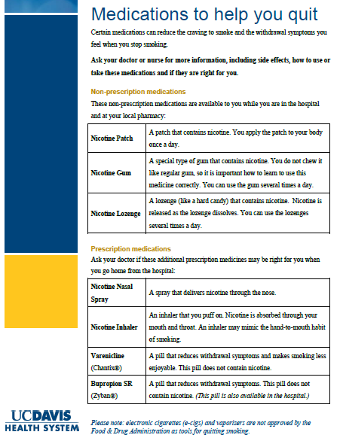
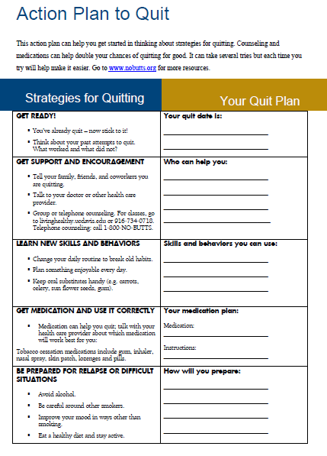
UC Patient Education Flyer (3 pgs)

Slide 41
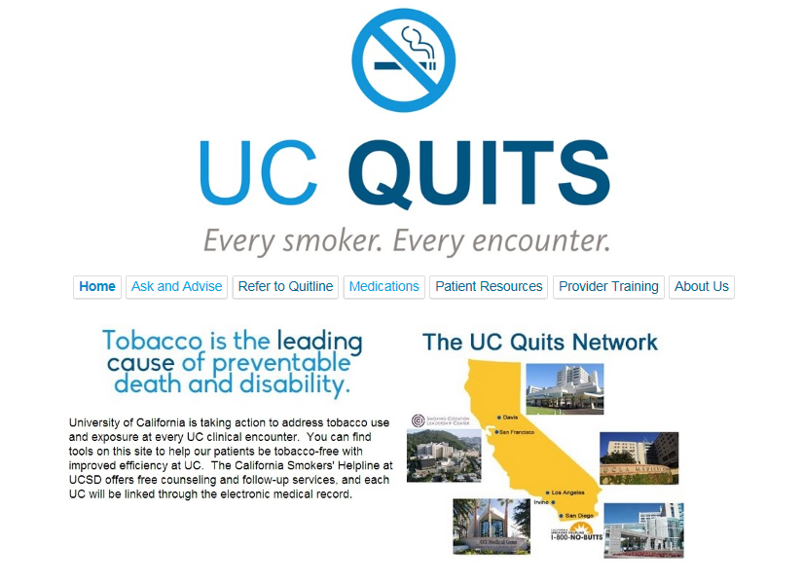
www.ucquits.com

Slide 42

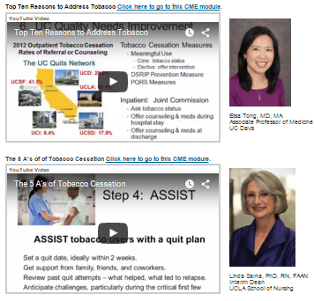
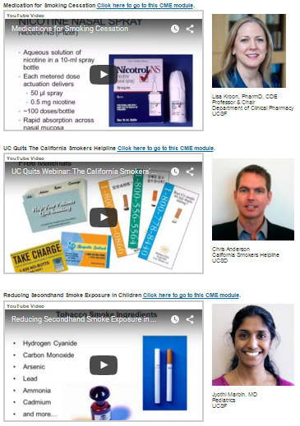

UC Quits’ Brief Provider Training Webinars
Available for free CME/CEU credit for 3 years
  YouTube links on www.ucquits.com/training
  CMECalifornia
15-30 minutes on topics by UC experts
  Top 10 reasons to get your patient to quit smoking
  The 5As
  Overview of the California Smokers Helpline
  Pharmacotherapy in Smoking Cessation
  Addressing Secondhand Smoke Exposure
  Smoking Cessation in the Perioperative Period
  How Nurses at UC Can Address Tobacco
Full curriculum options: www.rxforchange.ucsf.edu

Slide 43

First Statewide Specialized Registry
UCI requested having Helpline eReferral for a MU Specialized Registry.
Potential for:
Tracking
Re-engagement

Slide 44




Sustainability: Tobacco as Quality
CLINICS
HOSPITALS
California Department of Public Health

Slide 45


Tobacco Quality Metrics: 2012 to 2016
DSRIP 2012
PRIME Baseline 2016

Slide 46







Cindy Vela
CA Quits project manager
cynthia.vela@dhcs.ca.gov

Slide 47

LA Department of Health Services
LA DHS eConsult web portal
PCP enters patient info for specialist and receives feedback
Helpline added in summer 2016
Email notification to all users by Dr. Paul Giboney in October 2016
162 eConsult referrals to the Helpline to date!
July/Aug (4), Oct (8), Nov (78), Dec (41),Jan (31)
Funding: Tobacco-Related Disease Research Program 25CP-0003 (PIs: E Tong and Hal Yee)

Slide 48
Objectives
Tobacco Impact on Health
Tobacco Cessation: The 5 A’s
UC and Cessation
  California Smokers’ Helpline
  UC Quits
  Smoking Cessation Leadership Center
UC Smoke and Tobacco-Free Policy
Notes:
1. Describe the context and development of UC Quits, the UC-wide Tobacco Cessation Network
2. Compare how the 5 UC medical centers are implementing systems change on tobacco with multidisciplinary teams and the electronic medical record
3. Identify opportunities for systems change on tobacco cessation including lung cancer screening and quality measures

Slide 49




Smoking Cessation Leadership Center
National program office of the Robert Wood Johnson Foundation
  Additional funding from Truth Initiative, CDC, VA, and SAMHSA
  Founded in 2003; Steve Schroeder, MD, Director
What does SCLC do?
  Creates partnerships
  Provides technical assistance
  Offers small grants

Slide 50


SCLC: SAMHSA
SAMHSA’s Tobacco-free Initiative
Staff training at SAMHSA’s headquarters
100 Pioneers for Smoking Cessation
State Leadership Academies for Wellness and Smoking Cessation
State Policy Academies on Tobacco Control in Behavioral Health

Slide 51


SCLC: Natl Roundtable Behavioral Health
American Cancer Society & SCLC co-hosted historic multi-sectorial summit at ACS Atlanta headquarters in October 2016
Group goal “30 x 20”: reduce smoking prevalence among persons with behavioral health issues to 30% by 2020
Strategies: provider education, peer education, tobacco control & cessation policies, health systems change, data/research

Slide 52
Objectives
Tobacco Impact on Health
Tobacco Cessation: The 5 A’s
UC and Cessation
  California Smokers’ Helpline
  UC Quits
  Smoking Cessation Leadership Center
UC Smoke and Tobacco-Free Policy
Notes:
1. Describe the context and development of UC Quits, the UC-wide Tobacco Cessation Network
2. Compare how the 5 UC medical centers are implementing systems change on tobacco with multidisciplinary teams and the electronic medical record
3. Identify opportunities for systems change on tobacco cessation including lung cancer screening and quality measures

Slide 53


UC Smoke & Tobacco-free Policy
Campus grounds are smoke & tobacco-free for health
  E-cigarettes included
  Videos on talking to smokers:
  www.ucop.edu/risk-services/loss-prevention-control/uc-smoke-tobacco-free-videos.html
Offer nicotine medication to hospitalized smokers
  Reduce withdrawal symptoms
  Pain treatment analogy
    Gum/lozenge (short-acting)
    Patch (long-acting)
California Department of Public Health
www.ucquits.com

Slide 54


UC STF Policy: Cessation
Patients
Students
Staff
Visitors
Contractors
Continuum of community college and CSU students

Slide 55

Take-Home Points
1) Tobacco cessation is one of the best things to improve health immediately
2) National guidelines for evidence-based tobacco cessation
3) California Smokers’ Helpline is a free evidence-based resource to help with quitting
4) “UC Quits” systems change on tobacco with connection to Helpline. Now growing into “CA Quits.”
5) Priority populations like people with behavioral health issues can be helped with systems change
6) Our UC Systemwide Smoke & Tobacco-Free Policy is an opportunity to support tobacco cessation
Questions? Elisa Tong, ektong@ucdavis.edu

