Slide 1
History of California smoke/tobacco-free college policies
Smoke and Tobacco Free Webinar Series
Kim Homer Vagadori, MPH
October 3, 2017

Slide 2
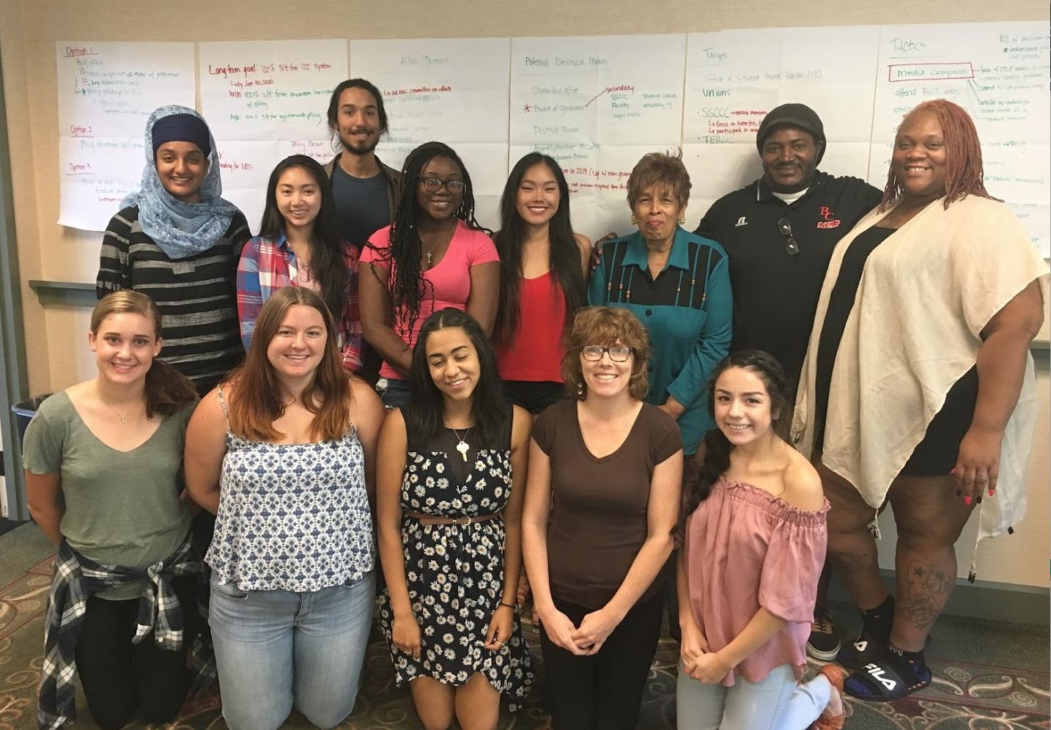


Slide 4
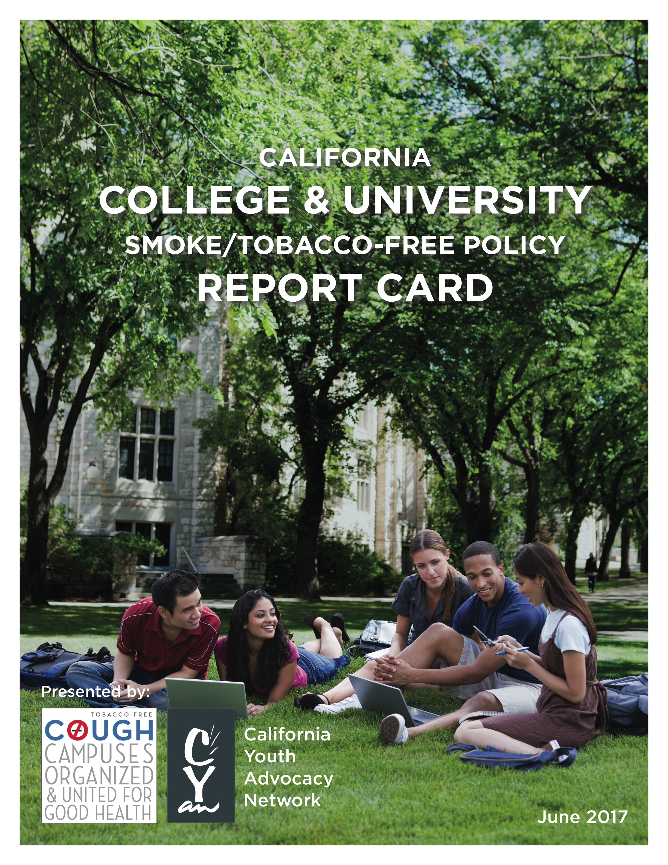
California Policy Trends
Report Card:
Reviewed and scored all 146 public college and university tobacco use policies
Grades based on current written policy
Receive bonus points for including e-cigarettes

Slide 5
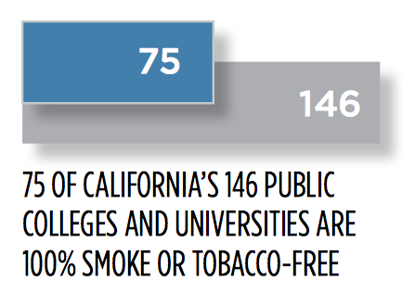

Slide 6
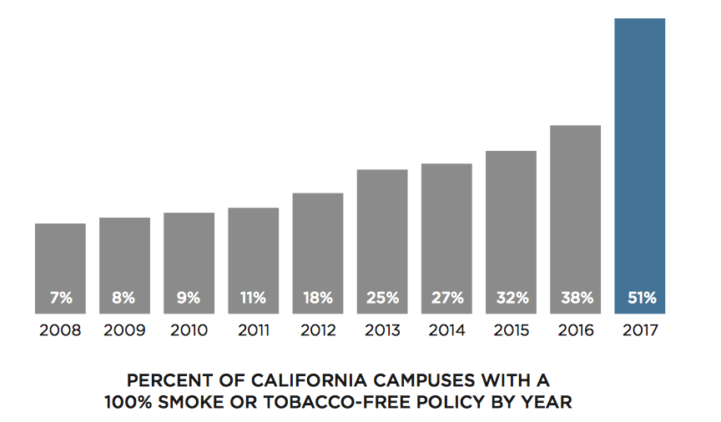

Slide 7
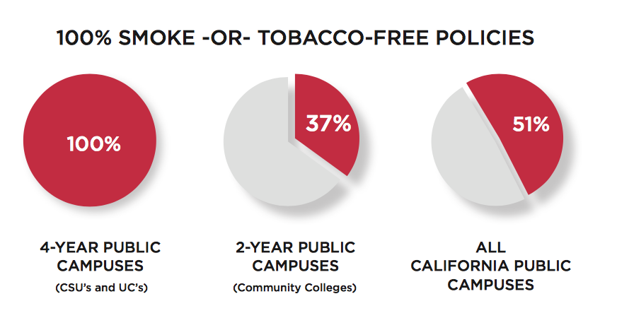

Slide 8
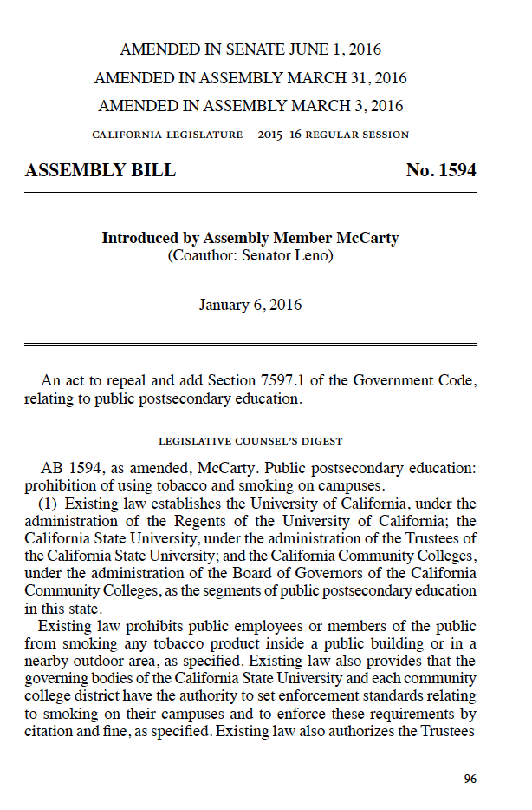
Assembly Bill 1594
Bill would have prohibited smoking and the use of tobacco products on all public colleges and universities in California
  Includes electronic smoking devices
Watered-down enforcement language making citations more difficult

Slide 9
CYAN and COUGH Next Steps
Focus on smoke/tobacco-free policy adoption at community colleges and trade/technical schools
Support policy implementation at California State University campuses
Support policy compliance activities at University of California campuses

Slide 10

More Information
Katie Moose
katie@cyanonline.org
(916) 339-3424 x25
Kim Homer Vagadori
kim@cyanonline.org
(916) 339-3424 x22
catobaccofreecolleges.org

