Slide 1
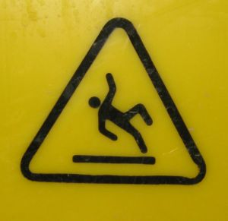
Slips, Trips, and Falls!
November 2010 Safety Meeting Presentation
Developed by: Karen Hsi , EH&S Student Intern
Notes:
In this month’s safety meeting, we will be covering slips, trips, and falls and how to prevent them at work. Remember that it is now the start of winter, so it is important to be extra cautious of wet, and slippery surfaces!

Slide 2
Why is prevention of slips, trips, and falls important?
Constitutes majority of accidents in industries
Causes great economical loss
Amounts for a lot of pain and suffering
All which would be avoided if we:
- understand how fall accidents happen
- identify trouble areas
- eliminate or minimize hazards of falling
Notes:
You might ask, why is the prevention of slips, trips, and falls important? Slips, trips, and falls actually constitutes the majority of accidents in industries. These time-loss injuries become a great economical loss, and it amounts for a lot of pain and suffering, sometimes even death. All these, do not need to happen and can be easily prevented by understanding how fall accidents happen, identifying trouble areas, and eliminating or minimizing hazards of falling.

Slide 3

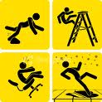
How do falls happen?
60% of falls happen on the same level resulting from slips and trips
Slips → too little friction or traction between the footwear and walking surface
Trips→ when foot collides with an object causing you to lose balance and fall
Notes:
Statistics show that 60% of falls happen on the same level resulting from slips and trips. Slips happen when there is too little friction or traction between the footwear and the walking surface. Trips can happen when your foot collides, strikes, or hits, an object causing you to lose balance and eventually fall.

Slide 4
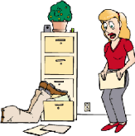

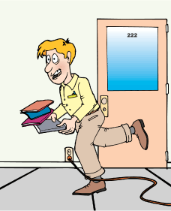
Common Causes…
For Slips:
Wet or Oily surfaces
Occasional spills
Weather hazards
Loose, unanchored rugs or mats
Flooring or other walking surfaces that do not have same degree of traction in all areas
For Trips:
Obstructed view
Poor lighting
Clutter in your way
Wrinkled carpeting
Uncovered cables
Bottom drawers not being closed
Uneven walking surfaces
Notes:
Common causes of slips are wet or oily surfaces, occasional spills, weather hazards, loose, unanchored rugs or mats, and flooring or other walking surfaces that do not have same degree of traction in all areas. Common causes of tripping are obstructed view, poor lighting, clutter in your way, wrinkled carpeting, uncovered cables, bottom drawers not being closed, and uneven walking surfaces like steps or thresholds.

Slide 5
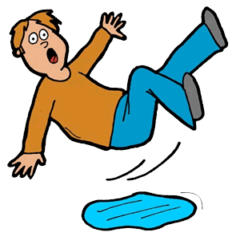
How to prevent falls due to slips and trips?
Good Housekeeping
Quality of walking surfaces (flooring)
Selection of proper footwear
Appropriate pace of walking
Critical for preventing
slips, trips, and falls
Notes:
Both slips and trips result from some kind of unintended or unexpected change in the contact between the feet and the ground or walking surface. This shows that good housekeeping, quality of walking surfaces and flooring, selection of proper footwear, and appropriate pace of walking are critical for preventing fall accidents.

Slide 6
Recent Slips, Trips, and Falls
3 slips, trips, and falls this year
Fall on UCOP sidewalk near BART station due to perforated tile
Trip on unsecure plastic floor covers
during remodeling/construction
Spaghetti wire trips causing rug burns, Xerox printer oil causing people to slip, Kitchen spills
After Hours… Be Cautious of Custodial Cleaning
Notes:
In our February safety presentation on injuries for the year, 3 slips, trips and falls were recorded for 2009. Recently, there has been a fall on sidewalk right outside the BART station near UCOP due to a perforated tile. At the Treasurer’s Office, there was also a reported injury due to a trip on some unsecured flooring covers used by the construction workers during the remodeling of new office spaces. Make sure to secure by tacking or taping down all mats, rugs, carpets, or plastic coverings that do not lay flat. Also spaghetti wires, spilled printer oil, and kitchen spills have led to people tripping and slipping. Please be cautious and watch your step around and outside of the office to help prevent slips, trips, and falls. If you are in the building after hours, be cautious of custodial cleaning. Sometimes signs are not properly put up, be extra cautious when walking around areas be cleaned for wet and slippery floors.

Slide 7
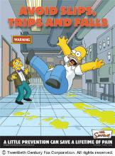
What can you do to avoid falling at work?
Employers responsibility to provide safe environment
Employees can improve own safety:
Taking your time and paying attention
walking with feet pointed slightly outward
making wide turns at corners
having sufficient lighting for tasks
ensuring that things you are carrying/pushing do not prevent you from seeing obstructions and spills
Notes:
It is important to remember that safety is everybody’s business. It is the employer’s responsibility to provide safe work environment for all employees. Employees can improve their own safety too by reducing the risk of slipping on wet flooring and reducing the risk of tripping. You can reduce the risk of slipping on the wet floor by taking your time and paying attention to where you are going, adjusting your stride to a pace that is suitable for the walking surface and tasks that you are doing, walking with your feet pointed slightly outward, and making wider turns at corners. You can reduce the risk of tripping by always using installed light sources that provide sufficient light for your tasks, or using a flashlight when you are in dark rooms, and ensuring that things you are carrying or pushing do not prevent you from seeing any obstructions or spills.

