Slide 1
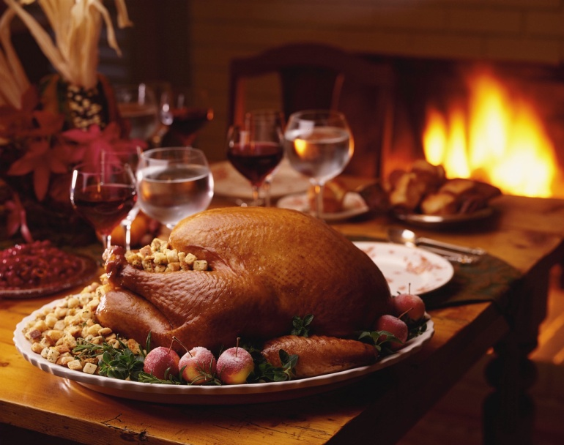
Food Safety 101
UCOP November 2011 Safety Meeting

Slide 2
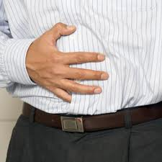
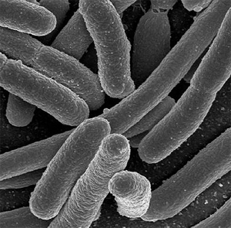
Foodborne Illness
Flu-like symptoms:
Nausea
Vomiting
Diarrhea
Fever
Caused by Bacteria or other pathogens in food
Notes:
Foodborne Illnesses:
Foodborne illness often presents itself as flu-like symptoms such as nausea, vomiting, diarrhea, or fever. Many people may not recognize the illness they are experiencing is caused by bacteria or other pathogens in food. Thousands of types of bacteria are naturally present in our environment. Not all bacteria cause disease in humans. For example, some bacteria are used beneficially in making cheese and yogurt. Bacteria that cause disease are called pathogens. When certain pathogens enter the food supply, they can cause foodborne illness. Millions of cases of foodborne illness occur each year. Most cases of foodborne illness can be prevented. Proper cooking or processing of food destroys bacteria.

Slide 3

Wash Those Hands!
Soap and Warm Water
Rub for 15-20 Secs.
Remember to wash under finger nails, between fingers and exposed portions of wrists and arms
Rinse & Dry with Paper Towels
Wash Hands Again After Any Act of Contamination
Notes:
Before Handling Food or Utensils
Use Liquid Soap and Warm Water
Rub for 15 to 20 Seconds
Wash Under Finger Nails, Between Fingers and Exposed Portions of Wrists & Arms
Rinse & Dry With Paper Towels – Not with Common Cloth Towel – May Be Contaminated
Wash Hands Again After Any Act of Contamination (Raw Animal Food, Bathroom)

Slide 4


Clean and Sanitize
Use Clean & Sanitized Equipment & Utensils When Preparing Food
Use Wipes After Washing & Rinsing for Optimal Effectiveness
Notes:
Clean and Sanitize
Use clean and sanitized equipment and utensils when preparing food. Washing alone is not enough to control microorganisms that cause foodborne illness. Sanitizer wipes made by manufacturers like Lysol and Clorox contain ingredients that reduce the levels of harmful bacteria to safer levels. Use these after washing and rinsing for optimal effectiveness.

Slide 5
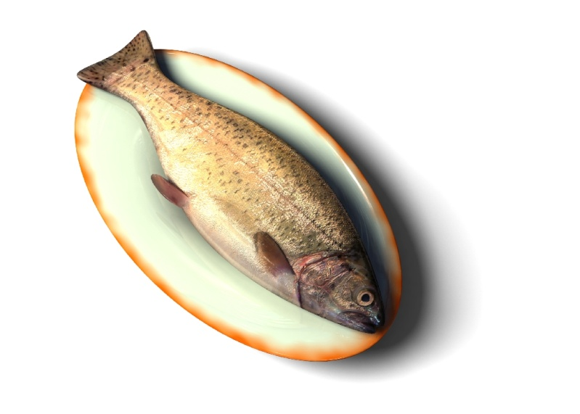

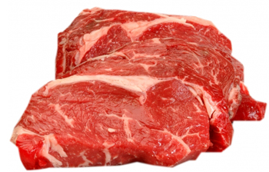
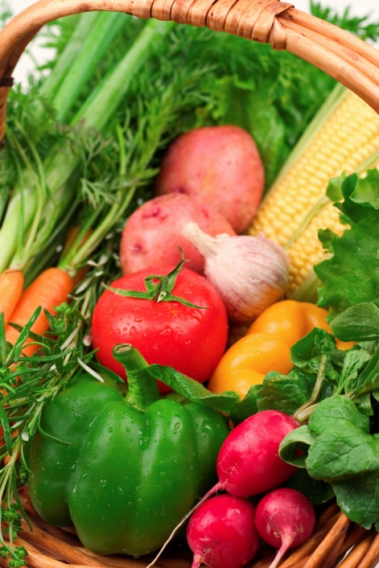
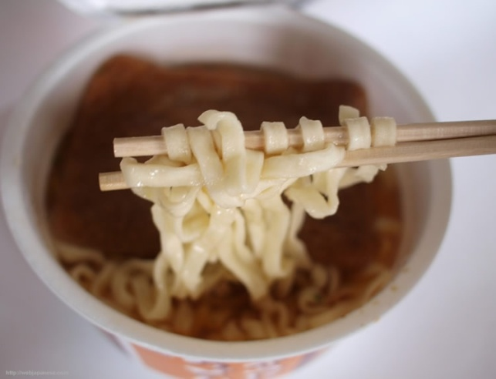
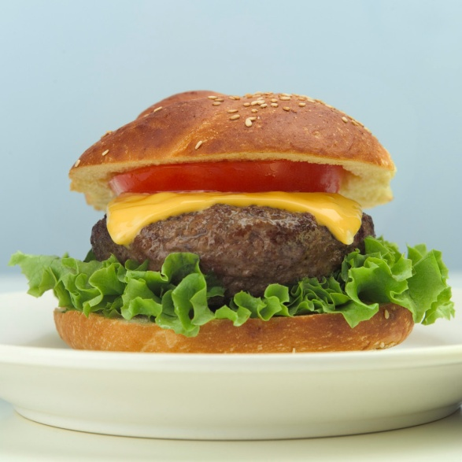
Which of these are safe from bacteria?
Notes:
Bacteria Transferred to Food:
Raw Foods: Bacteria may be present on products when you purchase them. Plastic-wrapped boneless chicken breasts and ground meat, for example, were once part of live chickens or cattle. Raw meat, poultry, seafood, and eggs are not sterile. Neither is fresh produce such as lettuce, tomatoes, sprouts, and melons. Cross-Contamination: Foods, including safely cooked, ready-to-eat foods, can become cross-contaminated with bacteria transferred from raw products, meat juices, other contaminated products, or from food handlers with poor personal hygiene.

Slide 6
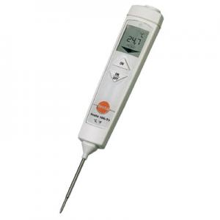
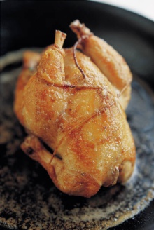
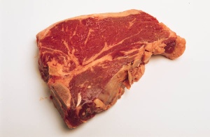
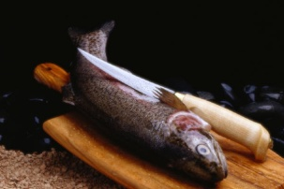
Keep Hot Foods Above ___ºF
57 ºF
100 ºF
120 ºF
135 ºF
Use Food Probe Thermometer to Ensure:
Raw Poultry is Cooked to At Least 165ºF
Ground Beef is Cooked to At Least 155ºF
Pork, Fish, Steak, and Eggs are Cooked to At Least 145ºF
Notes:
Cook Food to Safe Internal Temperatures:
Use a food probe thermometer to ensure that raw poultry is cooked to a minimum internal temperature of 165ºF; ground beef to at least 155ºF; pork, fish, steak, and eggs to at least 145ºF.

Slide 7
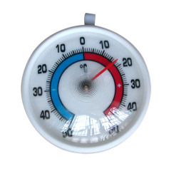
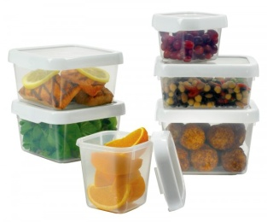
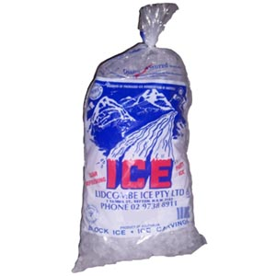
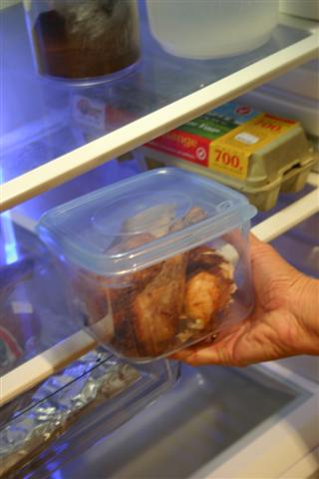
Keep Cold Foods Below ___ºF
60 ºF
51 ºF
41 ºF
25 ºF
Cool Hot Food Rapidly From 135ºF to 41ºF within 4 Hours By:
Dividing into Smaller Portions; Placing into Shallow Containers
Add Ice as an Ingredient and/or Frequent Stirring
Refrigerate
Notes:
Cooling Food:
Working Thermometer - Be sure your refrigerator has a working thermometer and can keep cold food at 41ºF or below.
Cool Hot Food Rapidly - When cooling hot food, cool the food rapidly from 135ºF to 41ºF within 4 hours by dividing large food portions to smaller portions. Place the food into shallow containers. Thick foods, such as stews, should be no more than 2 inches deep; thinner foods, such as soups, should be no more than 3 inches deep. The food could be cooled by adding ice as an ingredient, and/or frequent stirring. Then place the food in the refrigerator.

Slide 8


Limit time food is exposed to Room Temperature to:
Less than 6 hours
Less than 4 hours
Less than 2 hours
Discard Food Left Out Beyond the 4-Hour.
Dairy products, eggs, and mayonnaise should be kept at room temperature a maximum of 2 hours.
Notes:
Limit the time these foods are exposed to room temperatures to less than 4 hours. Dairy products, eggs, and mayonnaise should be kept at room temperature a maximum of 2 hours. Use your judgment – These are only recommended guidelines. If it is extremely warm, shorten the time.
Discard food left out beyond the 4-hour/2-hour time period.

Slide 9
Let’s Talk Turkey!!
Thawing Frozen – 24 Hours for Every 4-5 Pounds (In Refrigerator 40ºF or Below)
Oven Temperature No Lower Than 325ºF
Cooked to 165ºF Internal Temperature
Innermost Part of Thigh & Wing and Thickest Part of the Breast
Refrigerate Leftovers within 2 Hours
Use Gravy within 1 to 2 Days
Use Turkey & Stuffing within 3 to 4 Days
Notes:
Let’s Talk Turkey!! – Information from USDA Fact Sheets on Preparing Turkey
If you have a frozen turkey, it should be thawed in a refrigerator (40ºF or below). The thaw time should be 24 hours for every 4-5 pounds.
The oven temperature to roast a turkey should be no lower than 325ºF. The turkey should be cooked to a minimum 165ºF internal temperature. The temperature should be checked with a food probe thermometer. The parts of the turkey where you check the internal temperature are the innermost part of the thigh & wing, and the thickest part of the breast.
Any leftovers should be refrigerated within 2 hours. Leftover gravy should be eaten within 1 or 2 days. Leftover turkey and stuffing should be eaten within 3 to 4 days.

Slide 10

In Case of Suspected Foodborne Illness
Preserve the evidence
Seek treatment as necessary
Contact local Health Department
Contact the USDA Meat & Poultry Hotline at:
1-888-MPHotline
e-mail Address: mphotline.fsis@usda.gov
Notes:
In Case of Suspected Foodborne Illnesshigh temperatu Follow these general guidelines:
Preserve the evidence – There is a large or severe incident, try to preserve the evidence. If a portion of the suspect food is available, wrap it securely, mark "DANGER" and freeze it. Save all the packaging materials, such as cans or cartons. Write down the food type, the date, other identifying marks on the package, the time consumed, and when the onset of symptoms occurred. Save any identical unopened products.
Seek treatment as necessary - If the victim is in an "at risk" group, seek medical care immediately. Likewise, if symptoms persist or are severe (such as bloody diarrhea, excessive nausea and vomiting, or re), call your doctor.
Contact the local health department if the suspect food was served at a large gathering, from a restaurant or other food service facility, or if it is a commercial product.
Call the USDA Meat and Poultry Hotline if the suspect food is a USDA-inspected product and you have all the packaging at:
1-888-MPHotline (1-888-674-6854) e-mail address: mphotline.fsis@usda.gov

