Slide 1
PACSW – Using Social Media to Advance Your UC Career
LinkedIn, Twitter and Facebook
July 13, 2010
Notes:
Carolyn
Introductions
We’ll be asking for input
Please hold questions until the end
We’ll make sure to keep 30 minutes for q&A

Slide 2
Purpose, Process, Pay-off
Purpose
Learn about big three in social media
Process
We’ll cover:
Social media growth
Networking and building your brand
LinkedIn profile
Posting tweets on Twitter
Network updates
Pay-off
You’ll leave with an understanding of social media and how it can help you identify career opportunities at the UC.
Notes:
Carolyn
Purpose – Learn about big three in social media. Social Media can provide a rich source of input on ‘who’, ‘what’ and ‘where’ that can lead to new sources of information, collaboration, and identifying UC career opportunities.
Process
We’ll cover:
Social media growth
Networking and building your brand
LinkedIn profile completeness
Expanding your connections
Handling recommendations
Joining Groups
Learning about events
Posting tweets on Twitter
Keeping your network updated
Pay-off
You’ll leave with an understanding of social media and how it can help you identify career opportunities at the UC.

Slide 3
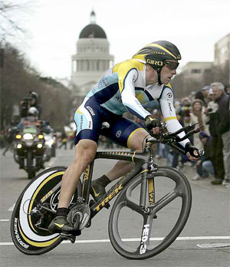
Social Media: Hub and Spoke
Notes:
Carolyn
Hub and spoke
1) He’s won the tour 7 times but never on his own.
3) Trivia – 3 degrees of separation

Slide 4
Social Media: The Twitter Post
Notes:
Carolyn
Twitter helps recovery of Lance Armstrong's stolen bicycle - http://twitter.com/lancearmstrong/status/1212645744
Armstrong alerted his 140,000 Twitter followers to the theft on Sunday, and four days later police in Sacremento, California took receipt of the Trek bicycle.
On Sunday morning, Armstrong also used Twitter to break the news about the theft, writing: “Whoa! They just came to my room and said our truck was broken into and someone stole my time trial bike! Wtf?!? APB out to the twitterati.” A Facebook group called '1 Million Citizens Looking for Lance Armstrong's Stolen Bike' was also created, and police admitted the online campaigns made life difficult for the thieves.
"All the technology involved really kept the story alive and moving," said Sergeant Norm Leong of the Sacramento police force.
"It was clear that most of the people in the community were looking for this bike. It makes it hard to transport the thing; you can't ride it or sell it because it is that hot of an item.“ The man who delivered Armstrong's bicycle to police is not a theft suspect and no arrests have been made. Two other bicycles stolen from Armstrong's team are still missing. And news of the bicycle’s return soon spread throughout the online community. "Score one for the good guys," wrote a Twitter user using the screen name 'Kraftmstr'. Armstrong's bicycle was one of several stolen from an Astana team truck parked behind a hotel in Sacramento. The Tour of California is Armstrong's second race of 2009, after the Tour Down Under in Australia last month. Armstrong, the seven-time Tour de France winner, is currently fourth overall after Wednesday's fourth stage was won by Britain Mark Cavendish. "It was a hard race," Armstrong said. "It was aggressive in the beginning, guys wanted to get away and get a break going, then they just made our lives tough on those first couple of climbs.”

Slide 5
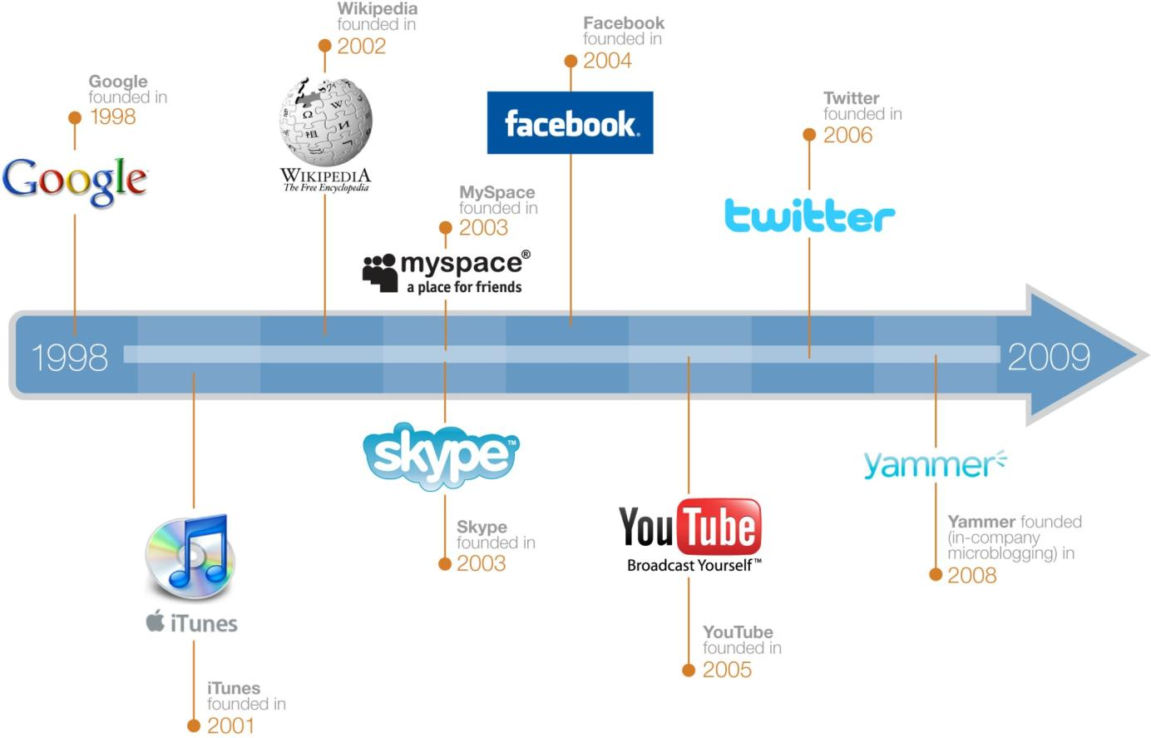
Rapid Growth in Social Technologies
LinkedIn
founded in
2002
5
Notes:
5
5
Karen
1) A January 2009 study said the fastest growing demographic on Facebook was 18-34 years old? FALSE. 35-54 years old
2) Communication through email still exceeds that of social media sites such as Facebook and Twitter? FALSE. In February 2009, social network communications exceeds that of email (Nielsen Netview)
3) 50% of companies use LinkedIn as their primary source of finding new employees. FALSE. It’s 80%

Slide 6
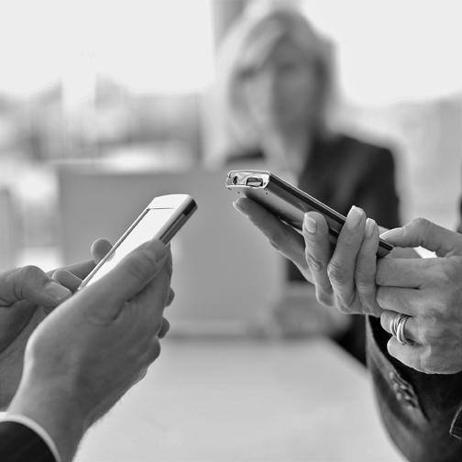
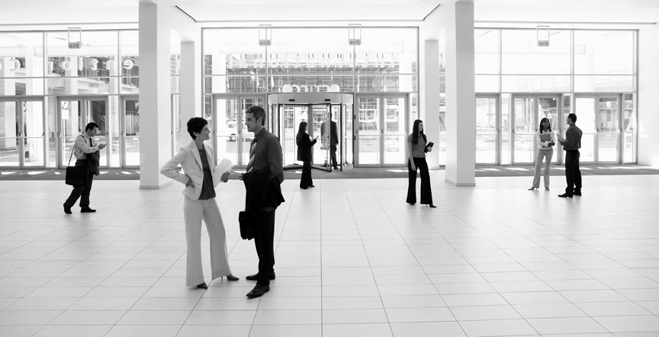
It’s All About Networking…
Sharing Information
Mutual Benefit
Exploring Common Interests
Connecting People You Know
Notes:
Karen
Virtual collaboration

Slide 7
Build Your Brand
Stand Out: Stand for Something
Be your own Boss; Take charge of your career
Forget the Ladder; It’s a Ramp
Position Yourself: what’s your value and how does it support your organization’s goals
Revise resume, maintain networking contacts, seek out activities that will move you toward your goals
Think Like a Brand
You are your own 24/7 billboard
Notes:
Karen

Slide 8
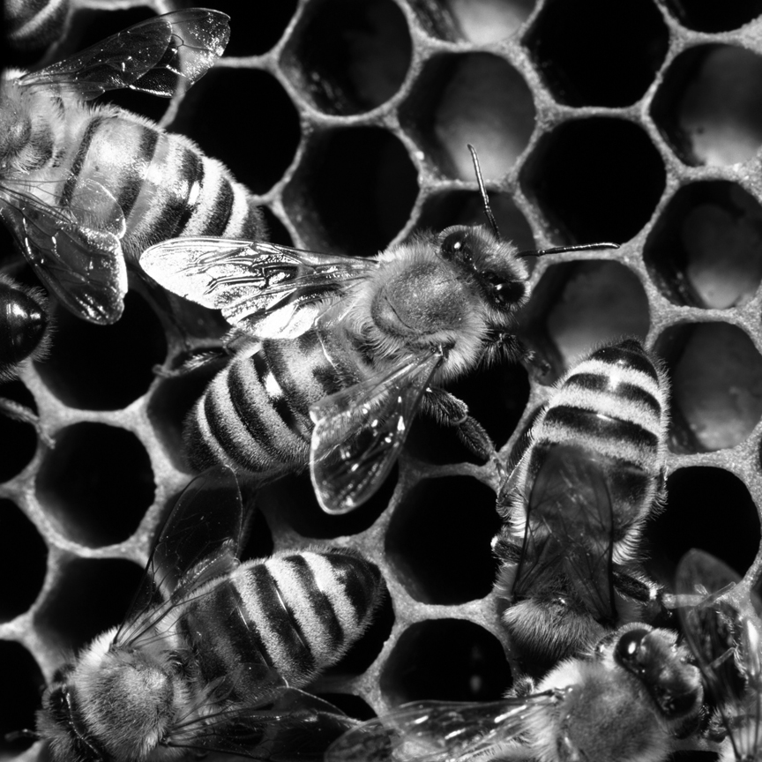
How do Social Media Tools Help?
Effectiveness
Efficiency
Transparency
Global Reach
Fun!
Notes:
Karen

Slide 9
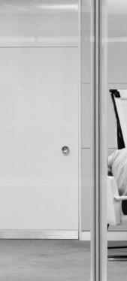
LinkedIn
Build and Manage Professional Relationships
Personalize
Professionalize
Publicize
Notes:
Karen

Slide 10
Twitter
Build Your Brand Globally
Show Specialties
Provide Value
Be Constructive
Notes:
Carolyn

Slide 11
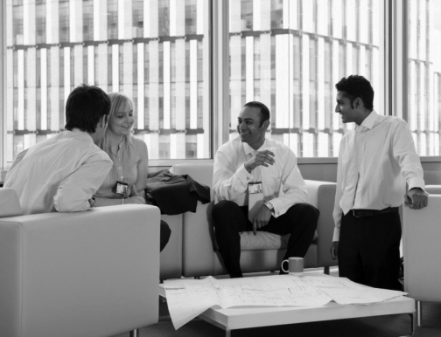
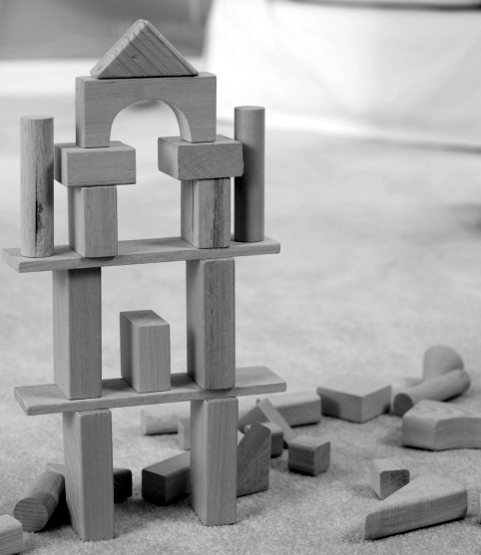
Facebook
Build and Manage Social Relationships
Show Character
Build on Common Interests
Be Careful
Notes:
Carolyn

Slide 12
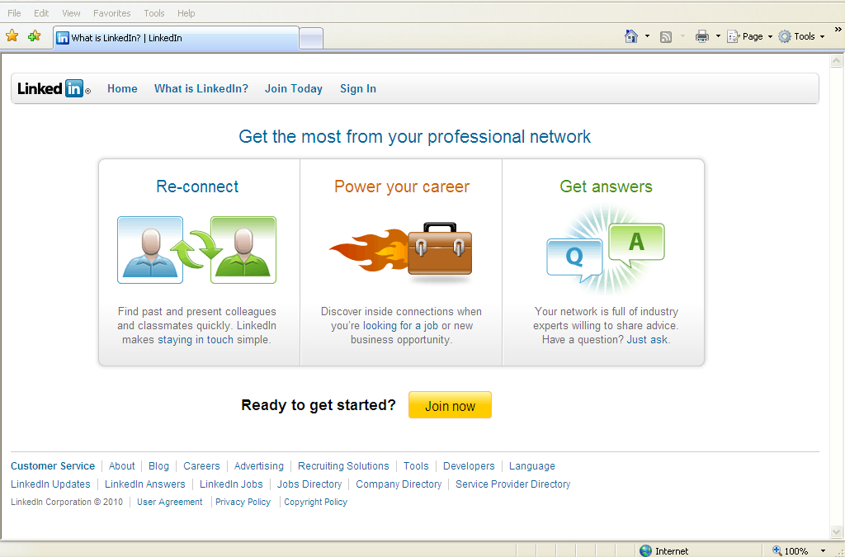
Let’s go into LinkedIn for more detail
Notes:
Karen

Slide 13
Resource Links
LinkedIn Learning Center - http://learn.linkedin.com/
Social Media Revolution -http://www.youtube.com/watch?v=sIFYPQjYhv8&feature=player_embedded
Handouts:
LinkedIn Step-by-Step Guide
Ten Tips on Building a Stronger Profile

Slide 14
Questions?
Thank you!
Carolyn Robertson
VP, Client Services Consultant
415-271-2595
Carolyn.robertson@right.com

