Slide 1
Regents Reporting Requirements and Instructions for Significant IT Projects
10/1/18

Slide 2
Regents Reporting Requirements for Significant IT Projects
To ensure that the University of California Board of Regents is able to exercise necessary oversight for the university's significant IT projects, all University locations are required per Regents Policy 5103 to provide a status update to the Regents three times per calendar year on IT projects with an estimated or actual cumulative cost of $5M or more.
Two types of reports are to be submitted to UCOP for reporting to the Regents:
Summary report for each project with an estimated/actual cumulative cost between $5M and $25M.
Comprehensive report for each project with an estimated/actual cumulative cost of $25M or more.
Each location is responsible for preparing its own reports. Completed reports must be submitted using the templates provided and are sent to the Office of the President for consolidation and submission to the Regents.
Reporting samples, instructions, and templates are contained in the pages that follow.
Send completed reports to: RegentsStatusReport@spmail.ucop.edu
Questions? Contact Halina Wojnicz, Director, UC IT Project Management Office, at 510-987-0808 or Halina.Wojnicz@ucop.edu
Report Submission Timelines
Report Period Ending Date | Date Report Due to UCOP | Regents Presentation Date
Dec 31 | Feb 1 | Mar 14/15
Apr 31 | Jun 15 | Jul 31
Aug 31 | Oct 15 | Nov 30
$5M Threshold:
Includes in-kind labor (e.g., existing staff) and billable labor (e.g., contractors, UC recharge labor)
Excludes ongoing cost of operations
Excludes savings projections

Slide 3
Summary Report Sample
The Summary Report format is used for projects with an estimated or actual cumulative budget between $5M and $25M.
Location | Project Name | Budget ($MM) | Start Date | End Date
UC-wide | UCPath | $ 504 | Oct 2011 | Jun 2019
UC Irvine Health | UCePic - UC electronic Patient Information Collaboration | $ 82 | Jul 2016 | Nov 2017
UC Irvine | UCI Student Information System Replacement Project | $ 70 | Jan 2015 | Jul 2020
UC-wide | Redwood | $ 51 | Jan 2015 | Apr 2020
UC-wide | FireEye Cybersecurity Threat Detection & Intelligence | $ 23 | May 2016 | Dec 2017
UC Merced | Capital Projects (Downtown Campus Center & Project 2020): FF&E for active electronics & AV | $ 22 | Sep 2017 | Sep 2020
UC Davis Health | EHR Hosting - Marshall Medical Center | $ 22 | Jul 2016 | Nov 2017
UC San Diego | Student Information System renewal | $ 19 | Jan 2019 | Jun 2020
UC Davis Health | ePic Beaker | $ 18 | Jul 2015 | Feb 2018
UC Davis Health | Materials Management | $ 16 | Jan 2015 | Mar 2018
UC San Francisco Health | Precision Cancer Medical Building (PCMB) | $ 16 | Jun 2016 | Apr 2019
UC Merced | Next Gen Network Upgrade | $ 12 | Sep 2014 | Sep 2020
UC Riverside | Banner: Student System Upgrade from IBM based to Oracle based platform | $ 11 | Sep 2012 | Oct 2016
UC San Francisco Health | UCSF Data Center Migration | $ 11 | Nov 2015 | Jun 2018
UC San Diego | Financial Information System renewal | $ 10 | Apr 2016 | Jun 2019
UC San Diego Health | ePic EMR Module additions | $ 8 | Jul 2016 | May 2018
UC Santa Cruz | Telecommunications Infrastructure Upgrade | $ 7 | Apr 2016 | Sep 2020
UC Health | Enterprise Imaging (VNA: Vendor Neutral Archive) | $ 6 | Feb 2017 | Apr 2018
UC-wide | Consolidated Financial Reporting replacement project | $ 5 | Oct 2017 | Dec 2019
UC Merced | ENABLE: Campus data store & data warehouse to support campus-wide reporting strategy | $ 5 | TBD | TBD
UC Merced | eProcurement | in planning | Dec 2017 | TBD
UCLA/UCM/UCOP | Financial System Replacement | in planning | Jan 2018 | Jul 2020
Templates are on slides 9 and 10

Slide 4
UCOP – Pension Administration Modernization Project (Redwood), Sponsor: Dwaine B. Duckett
Description & Purpose | Risk Medium | Overall Health
The Redwood project seeks to modernize the University’s pension administration technology, and with that, adapt it to the changing landscape of retirement programs and enhance the member experience. Maintaining the current 35-year old system into the future represents a significant risk to the execution of our fiduciary responsibilities and for the timely delivery of benefits. Project funded by restricted monies (UCRP trust). | Budget | Schedule
 | Original Budget: $50.7M Current Budget: $50.7M Est. Completion Cost: $50.7M | Start Date: 01/2015 Original Completion Date: 04/2020 Current Completion Date: 04/2020
Top Issues, Risks & Scope Changes | Mitigation Plan/Status
Currently within budget and schedule for the original scope of work. Change order preparation is underway to include functionality in Redwood to support mandates approved by Regents after the RFP was released. These scope changes are necessary because of collective bargaining agreements (e.g. introduction of the 2013 Modified Tier) and a new retirement program approved by the Regents (the Retirement Choice Program (RCP)). These changes must be implemented by the go-live date, and with some functionality requiring re-programming and testing of work that had already been done. In addition, cybersecurity functionality are being aligned with new UC standards and need to be included into the development of the new system. | As part of the strategy to deliver the project on time, all necessary at-go-live scope will be included in the initial release of Redwood, to be followed by an incremental release.
Recent Accomplishments | Planned Accomplishments for Next Reporting Period
Completed design, development, and system testing of 2 major groups of functionality: System Administration & Membership and Benefit Calculations & Payments. Completed 2 Redwood Lab sessions and 3 organizational change management events where end users were able to preview Redwood and gain initial hands-on experience with the new system. | Complete design of the Member Portal and associated functionality. Continue development and system testing of Member Portal and associated functionality. Begin planning of System Integration Testing. Begin planning of the first monthly pension parallel run. Develop schedule for the end user training and knowledge base materials.
Comprehensive Report SAMPLE
Prepared by: Esther Cheung Hill; Esther.Cheung@ucop.edu
Reporting Period Ending: Sept 30, 2017

Slide 5
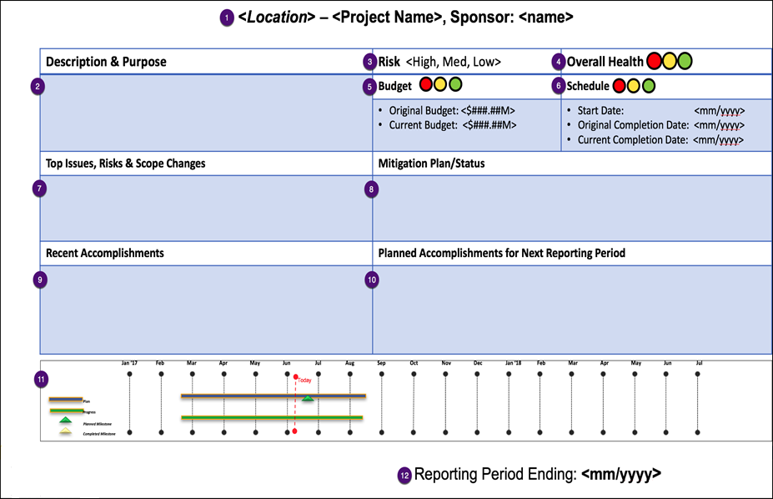
Comprehensive Report Template Instructions
 | Enter the campus location, project name, and sponsor.
 | Enter brief project description & purpose.
 | Keep the correct project risk level indicator, delete the 2 remaining. Refer to slide #6 for additional instructions.
 | Keep the correct stoplight, delete the 2 remaining. Refer to slide #7 for additional instructions.
 | Current approved budget. Keep the correct stoplight, delete the 2 remaining. Refer to slide #7 for additional instructions.
 | Current approved schedule. Keep the correct stoplight, delete the 2 remaining. Replace MM/YYYY with appropriate dates.
 | List top issues, risks and scope changes.
 | Describe mitigation plans/status for top issues, risks and scope changes.
 | Summary of accomplishments during this reporting period.
 | Summary of planned accomplishments for next reporting period.
 | Show timeline for entire project. Adjust bars to show planned versus actual/progress. Move “Today” to appropriate month. Change month/year if needed.
 | Include Reporting Period Ending MM/YYYY.
Prepared by: <name>; <email>
5

Slide 6
Comprehensive Report Template Instructions, continued
To determine the project RISK level use the matrix and thresholds below.
Assess risk to meeting latest approved budget, schedule and outcomes. Map each risk individually and set the overall project risk to equal the highest level risk mapped. Provide a description in the risk section of the report.
 |  | Risk Probability
 |  | Unlikely (1-33%) | Likely (34 – 65%) | Highly Likely (66% - 99%)
 | Major | MED | HIGH | HIGH
Risk Impact
 | Moderate | LOW | MED | MED
 | Negligible | LOW | LOW | LOW
f
Risk Impact to the project budget, schedule and outcomes
Major Risk presents a significant impact
Cost increase 11% or more over current budget
Schedule increase more than 11% over current schedule
Significant discrepancies in desired outcomes
Moderate Risk presents a moderate impact
Cost increase between 5 – 10% over current budget
Schedule increase between 5 – 10% over current schedule
Moderate discrepancies in desired outcomes
Negligible Risk does not present a material impact
Cost increase less than 5% over current budget
Schedule increase less than 5% over current schedule
Minor discrepancies in desired outcomes
Risk Probability or likelihood of occurrence
Unlikely Will probably not (1% - 33%) occur
Likely Moderately likely (34% - 65%) to occur
Highly Likely Almost certain (66% - 99%) to occur
Example – Setting Project Risk Indicator
Budget risk = HIGH if impact is major & probability is highly likely
Schedule risk = MED if impact is moderate & probability is likely
Outcome risk = LOW if impact is moderate & probability is unlikely
Project Risk = HIGH since this is the highest level risk mapped

Slide 7
Comprehensive Report Template Instructions, continued
Use Common weighted average formula to set OVERALL HEALTH indicator:
Assign weights to Budget and Schedule Health Indicators:
Green = 5
Yellow = 10
Red = 15
Determine the weighted average by totaling the Budget and Health indicator weights and dividing by 2
Set overall health based on weighted average:
Green, when weighted average is equal to 5 or 7.5
Yellow, when weighted average, equal to 10
Red, when weighted average, is equal to 12.5 or 15
Example: Setting Overall Health Indicator
Schedule is green = 5
Budget is red = 15
Weighted average = 20 / 2 = 10
Overall Health Indicator = Yellow
Weighted Average Color/Values
Use the following thresholds to set BUDGET HEALTH and SCHEDULE HEALTH indicators. When variance occurs provide one-time explanation in section 7. One-time means no need to repeat explanation in future reports.
Green less than 5% over current approved budget or schedule
Yellow 5 -10% over current approved budget or schedule
Red 11% or more over current approved budget or schedule

Slide 8
Report Templates are provided on the following 2 pages
Slide 9 – Summary Report
Slide 10 – Comprehensive Report

Slide 9
Summary Report Template
Use the Summary Report template for projects with an estimated or actual cumulative budget between $5M and $25M.
Location | Project Name | Budget ($MM) | Start Date | End Date
See next slide for the Comprehensive Report template for projects with an estimated or actual cumulative budget over $25M.

Slide 10
<Location> – <Project Name>, Sponsor: <name>
Description & Purpose | Risk <High, Medium, Low> | Overall Health
<Brief description of project and purpose/benefit> | Budget | Schedule
 | Original Budget: <$###.##M> Current Budget: <$###.##M> Est. Completion Cost: <$###.##M> | Start Date: <mm/yyyy> Original Completion Date: <mm/yyyy> Current Completion Date: <mm/yyyy>
Top Issues, Risks & Scope Changes | Mitigation Plan/Status
<Include the following components: Overview of project performance Changes in project scope Changes in project cost Changes in schedule Significant project risks/issues>
Recent Accomplishments | Planned Accomplishments for Next Reporting Period
Jan ‘17
Feb
Mar
Apr
May
Jun
Jul
Aug
Sep
Oct
Nov
Dec
Jan ‘18
Feb
Mar
Apr
May
Jun
Jul
Timeline
Today
Plan
Progress
Planned Milestone
Completed Milestone
Prepared by: <name>; <email>
Reporting Period Ending: <mm/dd/yyyy>

Slide 11
Document Revision History
12/07/18 – Initial Publication
10/01/18 – Revised to include updated comprehensive report template. Template revised to include Est. Completion Cost in Budget box; Report Period Ending format also revised to include the day (previously only included month and year.)

