Slide 1


Managers’ Town Hall
July 22, 2011
Franklin Lobby Conference Room
2:00-3:30 p.m.

Slide 2
Agenda
 | 2:00 – 2:15 | Welcome
 | 2:15 – 3:00 | CFO Division’s Role in UCOP LDP
 | 3:00 – 3:25 | CFO Division Customers Discussion
 | 3:25 – 3:30 | Wrap-Up

Slide 3
Welcome

Slide 4
  General announcements…
      Brief announcement from our UCOP Local HR Business Partner, Isabel Chen…

Slide 5
  CFO Division
  Announcements…
Erike Young!
UCRP Issuance!
Rich Powell!
Jennifer Ha!
Alan Moloney!
MOP Loan Sale!
Connexxus!
Amal Smith!
Mike Riley!
Notes:
Connexxus article (see reverse)! Shout out to Central Travel Mgmt.!
$1.2 billion UCRP issuance! Shout out to Yoon/Pikka/Allen/Maria/Peggy/Irene!
$27.5 million MOP loan sale on June 29! Shout out to OLP!
Jennifer Ha – Congrats on promotion from Accountant to Analyst!
Rich Powell – Congrats on retirement!
Alan Moloney – Congrats on 25 years!
Erike Young – 2010-2011 Safety Professional of the Year! (American Society of Safety Engineers, Region 1)
Amal Smith – Joined BRC, taking over Ginny’s Accountability Mgr. role!

Slide 6
Follow-up from May 13th division-wide town hall…
5/26 COVC
Presentation
Performance Appraisals
  Positive Reaction
  Normalizing to “3”

Slide 7
“Employee Role in Performance Appraisal”…
Only 2 workshops left!
8/4, 9:00-11:00 a.m. @ 512 Kaiser
8/9, 1:00-3:00 p.m. @ 5320 Franklin

Slide 8

  Why are we here?
Values

Slide 9
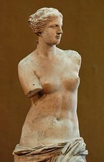
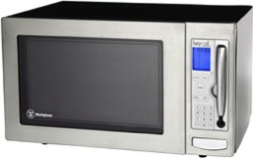
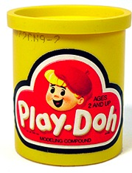


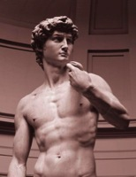
  Because…
We can help shape change
(i.e., future leaders of UCOP)

Slide 10

  Also here to talk about…
Values
Customer groups
(and possible customer service survey)

Slide 11
CFO Division’s Role in UCOP Leadership Development Program
Linda Klink
Learning & Development Coordinator
UCOP Local HR

Slide 12
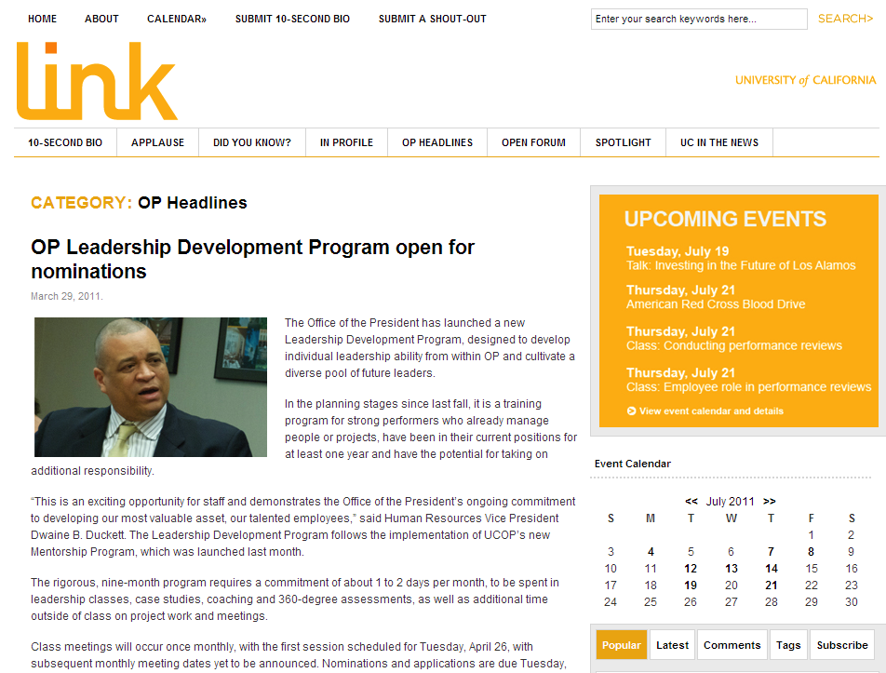
  What’s LDP?
Values

Slide 13
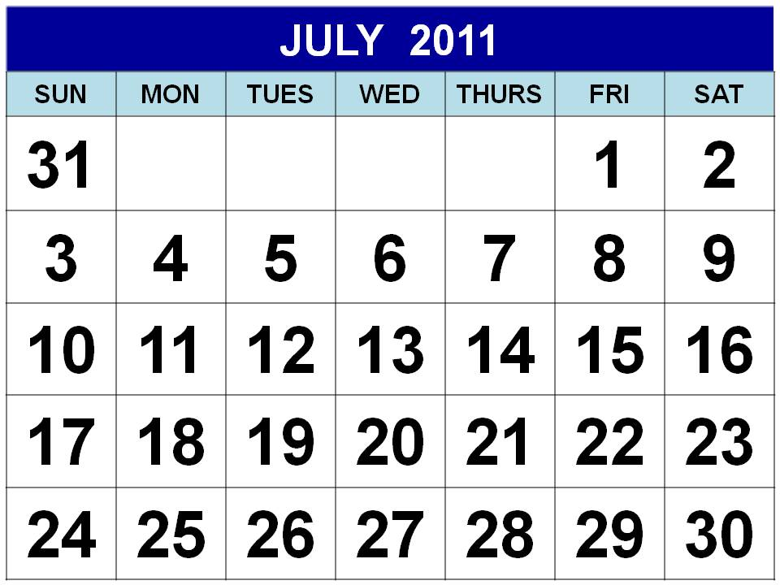
  Why are we talking about LDP today?
  What’s the question we’re trying to answer?

Slide 14

  Do you ever feel like you are…
Values
  What frustrations do we have with the rest of OP?

Slide 15

  Let’s brainstorm…
Values
  What are the Top 5 things OP’ers should know?

Slide 16
  Verbal case studies: 3 parts
Values
      Situation from YOUR perspective
      Situation from THEIR perspective
      Two layers of learning:
        a. General lesson
        b. Technical lesson
  “Right answer” less important than thought process…

Slide 17




  Game time in 4 steps
  Breakout by
  department
  (or unit)…
  Take 5 minutes
  to identify typical problem/situation
  (in 3 parts)…
  Take 15 minutes
  for everyone
  to report out…
  We will turn the
  information into
  case studies for LDP.
  1.
  2.
  3.
  4.

Slide 18

  Wrap-up…
Values
  Is this just going into the black hole?

Slide 19
  LDP Panel…
Values
  Next week, LDP’ers will work on these case studies for a couple hours in small groups
  Then they will do “present-backs” to OP leadership
  Chance for you to see how they approach/solve your typical problems
  LDP Panel Present-Backs:
  Thursday, July 28
  3:30 – 4:00 p.m.
  Franklin Lobby Conference Room

Slide 20
CFO Division Customer Discussion

Slide 21
Customer groups… are these the right categories?
 | Micro | Macro
Internal | Each other! (CFO Division) Other OP Divisions Other OP Departments OP Senior Leadership Other OP staffers UC President | Regents Faculty Staff Students Healthcare Patients Retirees Alumnae Foundations/Clubs
External | Campuses Medical Centers Nat’l. Labs Individuals at each of the above Business offices at each of the above | Donors Taxpayers Bondholders Rating Agencies Underwriters Major vendors/suppliers External auditors State/Federal governments

Slide 22


  If we did a CFO Division Customer Service Survey…
Complex?
Simple?
  Vs.

Slide 23
Wrap-Up

Slide 24


  Future meetings
Values
      Senior Staff Retreat on 9/9
      Managers’ Town Hall on 10/27 *
      Stay tuned for BASEBALL…
      * Hopefully… (it might change)

Slide 26
  Follow-Ups: we came up with 7 case studies during town hall
Values
      Capital Markets Finance: The constant, high-pressure world of the Regental cycle and the University’s use of debt financing
      Financial Services & Controls (Connexxus): The use of mandates at UC and driving volume to the UC-wide travel program
      Financial Services & Controls (BRC): The difference between contractors and consultants and relevant state laws that affect choices
      Procurement Services: Delivering the best possible strategic sourcing program for UC while also delivering the best deal for campus
      Risk Services: The ever-expanding universe of risk and the specific tools available online through Enterprise Risk Management
      Financial Accounting (Endowment & Investment Accounting): Transferring gift funds to campuses and the responsibility transition
      Financial Accounting (Payroll Coordination & Tax Services): Using resources and information wisely and complying with IRS

Slide 27
  Follow-Ups: we chose 3 case studies for LDP
Values
      Capital Markets Finance: The constant, high-pressure world of the Regental cycle and the University’s use of debt financing
      Financial Services & Controls (Connexxus): The use of mandates at UC and driving volume to the UC-wide travel program
      Risk Services: The ever-expanding universe of risk and the specific tools available online through Enterprise Risk Management
  And we changed the format slightly from a three-part case study to a five-part case study, as shown on the following slides that were given to the LDP class…

Slide 28
Presentation to UCOP Leadership Development Program
July 28, 2011

Slide 29
  Case studies: structured in 5 parts
      The BACKGROUND story
      The situation from CFO DIVISION’S perspective as well as the CUSTOMER’S perspective
      Two layers of learning:
        a. GENERAL lesson
        b. TECHNICAL lesson
      How might this case relate to YOUR area?
      As a leader, what can YOU do?
  “Right answer” less important than thought process…

Slide 30
  Case Study A: Day in the life of Risk Services
Risk
Services
Enterprise Risk Management (ERM) Solution Set
Recall what the Office of Risk Services does…

Slide 31
  Case Study A: Part 1 – Background Story
Risk
Services
      Division XYZ at the Office of the President has historically done a fairly good job of consolidating its approach to risk services
      Therefore, they haven’t needed as much consulting from the Office of Risk Services compared to other divisions, departments, and campuses
      For a new venture they’re undertaking, they went through extensive due diligence with the Office of General Counsel
      After receiving OGC’s advice, they began to implement the new venture

Slide 32
  Case Study A: Part 2 – Two Perspectives
Risk
Services
Situation from Our Perspective
Situation from Their Perspective
There are so many risk aspects to this new venture, not all of them legal
Yes, this division handles risk management well, but that doesn’t negate the need for consultation with folks who live and breathe risk everyday
There are so many great tools applicable to this particular venture that this division doesn’t even know about
We have a great track record; after all, we are one of the few divisions out there that has already consolidated its approach to risk management
OGC is conservative; whatever they say must be a safe route. They are lawyers after all!
Why should we loop in yet another office, when that is probably just going to slow down the whole implementation?

Slide 33
  Case Study A: Part 3 – Two Layers of Learning
Risk
Services
General
No one will ever know all the risk; it’s a huge universe
Technical
ERM has many powerful tools, namely the Risk Assessment

Slide 34
  Case Study A: Part 3 – General Lesson (in detail)
Risk
Services
The expanding universe of risk…
Directors &
Officers
Recognized
Sports Club*
Fiduciary
Camps &
Clinics*
Foundations,
Alumni, &
Support Groups
Recreation &
Club Sports*
Terrorism
– GL & PL
Human Subject
Injury
Travel
(Enhanced Program)
Threat &
Security
(Enhanced)
Workers’
Compensation
Crime
Property
Be Smart About
Safety (WC)
Mortgage
Impairment
Employment
Practices
Indentured
Property
Threat & Security
(Special Risk)
Marine
Library
2004
2010
Fine Arts
Marine
Pollution
Builders
Risk
Foreign
Liability
(Enhanced)
Cargo
Aviation
Tenant Users
Event Liability*
General
Liability
Auto
(Bodily Injury)
Boiler &
Machine
Auto
(First Party)
Environmental
Pollution Liability
Professional
Liability
Be Smart
About Safety
(GL, Prop, Auto)
Licensing Board
Representation
Terrorism –
Property
Registered Student
Organizations*
Cyber & Privacy
Liability
University Controlled
Insurance Program
(Construction)
Vendors &
Contractors*
*Part of CampusConnexions

Slide 35
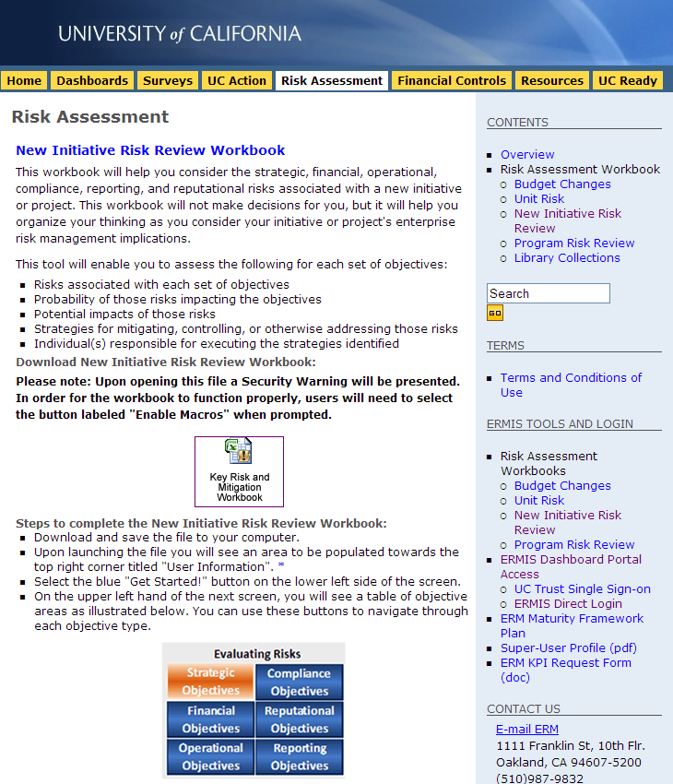
  Case Study A: Part 3 – Technical Lesson (in detail)
Risk
Services
      http://www.ucop.edu/riskmgt/erm/riskmitwb.html
      Activity:
        Complete a practice Risk Assessment at the link above, using this case study as the premise, and filling in details based on reasonable assumptions
        Report out on the experience and results

Slide 36
  Case Study A: Part 4 – How might this relate to your area?
Risk
Services
      Operationally?
      Financially?
      Describe an example – either one that has actually happened, or one that you anticipate happening
      What could/would you do?
      What creative ideas or solutions might you be able to offer to the CFO Division?

Slide 37
  Case Study A: Part 5 – What can you do as a leader?
Risk
Services
      Make the case that there are strategic, financial, operational, compliance, reporting and reputational risks associated with any new venture, and that these risks cost money (sometimes ALOT) when not addressed upfront
      Recommend a “New Initiative Risk Assessment”!
      http://www.ucop.edu/riskmgt/erm/riskmitwb.html
      Assure colleagues that the point is not to say “no” to the venture, but to say “yes”. The Risk Assessment does not make decisions for you, but helps you organize your thinking

Slide 38
  Case Study B: Day in the life of Central Travel Mgmt.
Connexxus
Financial Services & Controls
Recall what Central Travel Mgmt. does…

Slide 39
  Case Study B: Part 1 – Background Story
Connexxus
      UC spends approximately $200 million each year on travel and travel‐related expenses
      Historically, there was little effort to organize a managed travel program to leverage the University’s volume, but in 2006 at the Regents’ request, UCOP initiated a study of travel spend, and in 2007 Connexxus was born
      Connexxus has now achieved ~30% utilization across the UC system… but the goal is 80% systemwide
      Resistance to change has been the primary hurdle
      People don’t realize they can use it for personal travel, too!

Slide 40
  Case Study B: Part 2 – Two Perspectives
Connexxus
Situation from Our Perspective
Situation from Their Perspective
This program is a no-brainer! Even at 20% utilization, the University saves $3 million/yr. At 80% utilization, UC would save $15 million/yr.!
Some campuses have adopted Connexxus full-throttle, but others have hardly touched it…
What’s missing? Are we doing enough communication? Enough training? Something else?
Yet another “new program” from OP; if I just wait it out, this program will probably go away
I do not have time to learn how to use this new thing; even if I did, it doesn’t have the travel options that I need anyway
The savings don’t accrue to me, so why should I do it?
Connexxus? What’s that?

Slide 41
  Case Study B: Part 3 – Two Layers of Learning
Connexxus
General
Lofty administrative goals often require some form of mandate; and we have one!
Technical
$15 million is nothing to sneeze at! Savings are generated by volume, and training is available.

Slide 42
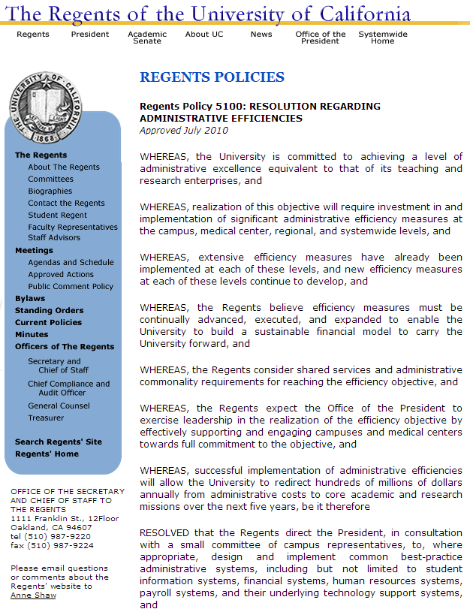
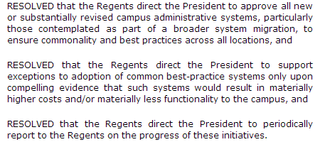
  Case Study B: Part 3 – General Lesson (in detail)
Connexxus
      http://www.universityofcalifornia.edu/regents/policies/5100.html
The times, they are
a-changin’…
We now have more ability to drive common solutions than ever before, thanks to Regents’ Policy 5100, which was adopted in July 2010

Slide 43
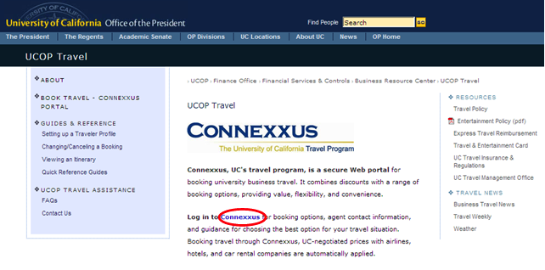
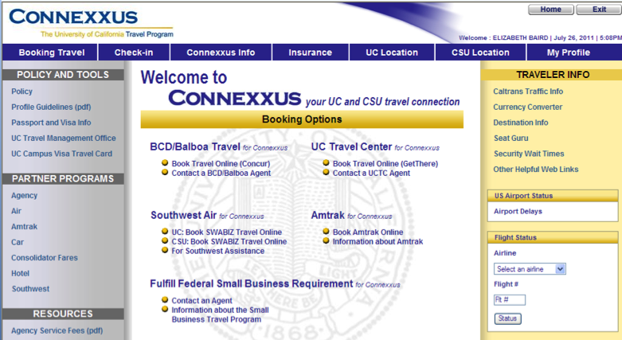
  Case Study B: Part 3 – Technical Lesson (in detail)
Connexxus
      http://www.ucop.edu/ucoptravel/
      Activity:
          Log into Connexxus!
          Surf around, and try to come up with at least three user questions
          Email your questions to UCTravel@ucop.edu
          Learn from it, and pass it on!

Slide 44
  Case Study B: Part 4 – How might this relate to your area?
Connexxus
      Operationally?
      Financially?
      Describe an example – either one that has actually happened, or one that you anticipate happening
      What could/would you do?
      What creative ideas or solutions might you be able to offer to the CFO Division?

Slide 45
  Case Study B: Part 5 – What can you do as a leader?
Connexxus
      Make the case that using Connexxus for business travel (and personal travel, too!) is worth everybody’s time and attention – it saves UC some serious dough
      Recommend that folks visit the UCOP travel site:
      http://www.ucop.edu/ucoptravel/
      Assure colleagues that the UCOP Central Travel Management office is committed to making Connexxus work for everyone. They can be contacted at UCTravel@ucop.edu

Slide 46
  Case Study C: Day in the life of Capital Markets Finance
Capital Markets Finance
Recall what Capital Markets Finance does…

Slide 47
  Case Study C: Part 1 – Background story
Capital Markets Finance
      When a campus needs to expand its physical presence (classrooms, office buildings, hospitals, dorms, parking garages, etc.), it almost always needs financing from the bond market
      The Regents have to approve not only the project itself, but also the authority to issue bonds
      This means two offices are involved: Budget & Capital Resources and Capital Markets Finance
      Analyzing the campus’s ability to repay bonds is a tricky matter – it takes time and due diligence. But the Capital Markets Finance office sometimes doesn’t find out until the week that Regents’ items are due

Slide 48
  Case Study C: Part 2 – Two perspectives
Capital Markets Finance
Situation from Our Perspective
Situation from Their Perspective
Unlike a corporation, UC can’t raise money by issuing both equity and bonds; it can only issue bonds
Entering the capital markets is a serious thing! If a campus can’t repay, it is a BIG problem
The analysis goes way beyond UC/UCOP – we have to involve rating agencies, investors, banks, legal counsel, and we have to be able to talk to campus folks
What is the big deal? We just need a red light or green light from CMF
There have been times in the past when CMF has been able to turn around their analysis in a day or two… so 1-2 days is probably sufficient this time, too
The bond financing is just ancillary to this project – the real meat has to do with the construction itself

Slide 49
  Case Study C: Part 3 – Two layers of learning
Capital Markets Finance
General
Regents meet 6 times per year; very little time between meetings
Technical
Borrowing money from the bond market is how we finance things at UC

Slide 50
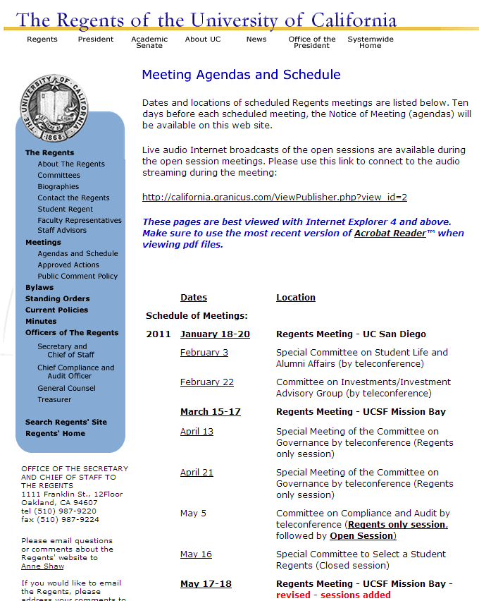
  Case Study C: Part 3 – General Lesson (in detail)
Capital Markets Finance
      http://www.universityofcalifornia.edu/regents/meetings.html
      The Regents’ website always contains a detailed schedule of meetings

Slide 51
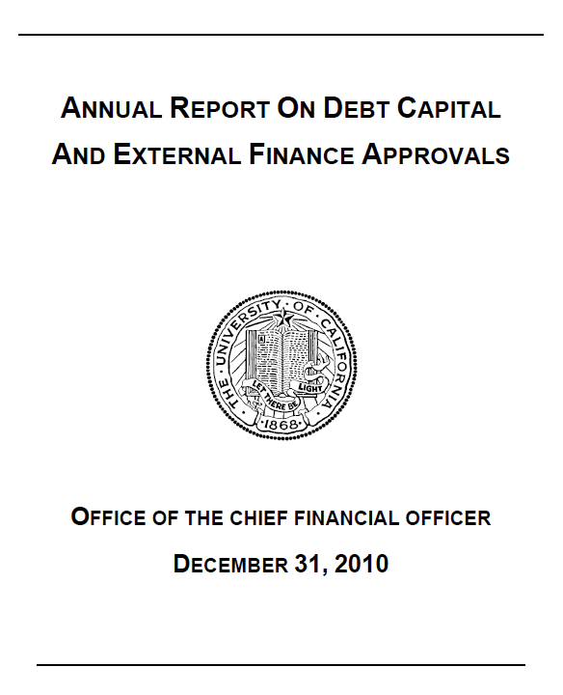
  Case Study C: Part 3 – Technical Lesson (in detail)
Capital Markets Finance
      http://www.universityofcalifornia.edu/finreports/index.php?file=debtcapital/debtcapital_2010.pdf
      Take 15 minutes to review the CMF’s “Annual Report on Debt Capital and External Finance Approvals”
      Come up with three questions – broad or specific!
        Email your questions to Allen.Yin@ucop.edu
        Learn from it, and pass it on!

Slide 52
  Case Study C: Part 4 – How might this relate to your area?
Capital Markets Finance
      Operationally?
      Financially?
      Describe an example – either one that has actually happened, or one that you anticipate happening
      What could/would you do?
      What creative ideas or solutions might you be able to offer to the CFO Division?

Slide 53
  Case Study C: Part 5 – What can you do as a leader?
Capital Markets Finance
      Make the case that entering the capital markets is a serious thing! And the Regental approval process that comes before it should be given ample time and attention
      Recommend that folks visit the CMF online guide:
      http://www.ucop.edu/capmarketsfin/documents/capital-markets-finance-guide.pdf
      Assure campus colleagues that the financing approval process is clearly defined, and that a little advance communication goes a long way!

