Slide 1




Town Hall
May 13, 2011

Slide 2
Agenda
Part I: | Welcome & Introduction (Peter Taylor)
 | Staff Announcements
 | Why are we here? Desired outcome?
Part II: | Introducing UCOP Local HR (Isabel Chen)
 | Structure & Services
 | Performance Appraisals
Part III: | Mini-Retreats and SWOT Recap (Lisanne Sison)
 | Observations
 | Survey Highlights
Part IV: | CFO Division Value-Added (Peter Taylor)
 | “What Have You Done For Me Lately?”
 | The Importance of Staff Development
Part V: | Q&A + Wrap-Up (Peter Taylor)
Part VI: | Party Time!

Slide 3
Part ii:
Introducing ucop local hr

Slide 4
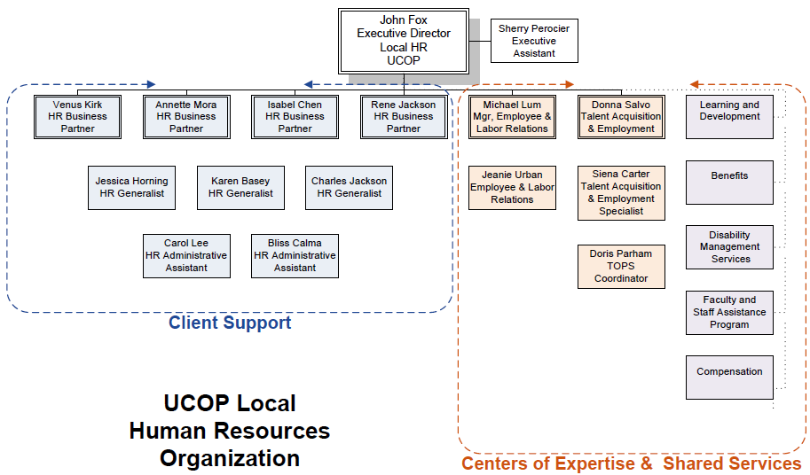
  Introducing… UCOP Local HR
Isabel Chen – HR Business Partner
Franklin, 6th Floor
510-987-0572
isabel.chen@ucop.edu

Slide 5
Part iIi:
Mini-retreats & swot recap

Slide 6
Department response rates: improved across the board!

Slide 7

  5 strategic goals
#2
Showcase our Value-Add
#1
#3
Reexamine the Day-to-Day
Engage with the Customer
#5
Be Action-Oriented
#4
Develop our Staff

Slide 8
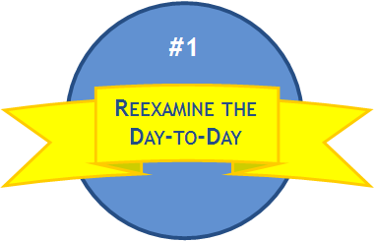
SWOT Process
Strengths
Weaknesses
Opportunities
Threats
Focus Area 1
Focus Area 2
Focus Area 3
Focus Area 1
Focus Area 2
Focus Area 3
Focus Area 1
Focus Area 2
Focus Area 3
Focus Area 1
Focus Area 2
Focus Area 3
Action Item 1
Action Item 2
Action Item 3

Slide 9
Comments on “Re-examine the Day-to-Day”
#1
  Culture / Tone at the top
    Strong support at top of organization
    Need to not only talk-the-talk, but also walk-the-walk at all levels of the organization
    Ensure both vertical and horizontal communication is supported
  No authority to mandate
    Develop a policy which is endorsed by campuses / medical centers on how/when we can mandate, and the clear methods that the mandate can be implemented
    If we can't mandate, do a better job of marketing the value of compliance (both system and local)
    CFO Division Units have enabled campuses and medical centers to be inconsistent
    Empower staff at multiple levels of the organization to reduce the number of hands something needs to go through prior to approval

Slide 10
Comments on “Re-examine the Day-to-Day”
#1
  Lack of standard processes
    Ambiguity around the difference between a policy and a procedure
    Need to revise policy database to be more user friendly, and enable easy access to information
  Nothing is off limits
    Explain the "why" behind mandates and initiatives (Make it so it is not just a rule, but a tool)
    Resist "scope creep“
    Some of the tasks we do is a duplication of effort performed at a campus or medical center. Need to be willing to talk about where these activities should reside, and change accordingly.

Slide 11
Comments on “Re-examine the Day-to-Day”
#1
  IT Infrastructure
    Centralized systems, centralized systems, centralized systems
    Encourage IT support to assign a specific individual to a specific department / unit so that person can develop familiarity with the relevant business systems of that unit, increasing efficiency and competency.
  Lack of data
    Too many sources, resulting in inconsistencies and inaccuracies
    Information in the Data Warehouse would be more useful if updated on a frequent (e.g. - daily) basis

Slide 12
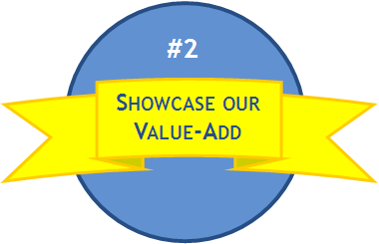
Comments on “Showcase Our Value-Add”
IT Infrastructure
Improve Communication
Lack of centralized data and systems contributes to an inability to calculate value
Improve ability to calculate return on investment (ROI) of various UCOP programs and initiatives, and ensure appropriate mechanisms are in place to effectively communicate this value to stakeholders inside and outside the organization
Lack of adequate IT infrastructure impairs transparency
CFO Division Newsletter
Overcome a lack of Consequences
Increase venues of communication
Strictly enforce policies and other requirements (No loopholes and policy applies equally to everyone)
Address fear of change by both staff and customers

Slide 13
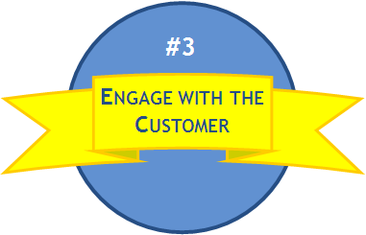
Comments on “Engage with the Customer”
Engage with the Customer
Encourage "sister" functional groups to form UC-Wide teams tasked with standardizing and improving operational efficiency
Encourage direct dialogue, including face-time whenever possible
Provide training on standards for customer care that individuals must meet
Encourage a culture of basic courtesy, and work to build relationships
Conduct customer surveys on a periodic basis
Work to improve UCOP understanding of campus and medical center operations and issues

Slide 14
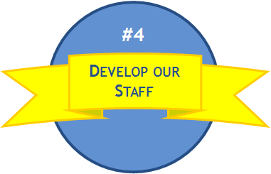
Comments on “Develop Our Staff”
Cross-training
Promotions / Recognition
Establish a shared website where people can obtain advice or post questions about training and professional development inquiries. (e.g. - Anyone know of a good Project Management book / manual?)
General belief that staff has to leave the division in order to progress up in the organization. Need to address this
Improve career path structure
Hold more e-course trainings
Mentorship Programs / Professional Development
Leverage internal knowledge experts, and ask them to conduct periodic training
Consistent value needs to be placed on staff development throughout the organization (Department, Division, and UCOP)
Conduct periodic "lessons learned" meetings to help improve solutions to common challenges
Encourage partnership with private companies or other universities to foster new ideas
Encourage networking between departments at UCOP to get people outside their own "bubble"

Slide 15
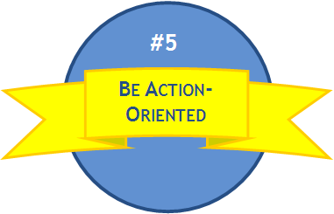
Comments on “Be Action-Oriented”
Be Action Oriented
Work together as a team
Proactively identify opportunities for improved efficiency and/or reduced cost, and effectively communicate the reason and method of change to all impacted parties
Work to understand the reasons behind resistance to change, and try to address those first
Work to identify creative solutions to systemic problems (Designated "Project" day)

Slide 16
  Next Steps
  Round two of Surveys
    For the questions on the survey where we collected action items, we will distribute another survey to identify most popular action items
  Finalize Department /Unit Action Plans
    Survey results will be provided to Department Heads to finalize department action plans and determine next steps

Slide 17
Part iv: cfo division value-added

Slide 18


  HUGE thank you to Lisanne Sison…
  Lisanne has carried us through the last 9 months
  She has now delivered our strategic planning “baby”
  It is now up to us as managers and stewards to take this work, implement actions, and make it happen!
Strategic Planning:
Born May 13, 2011
800 lbs. 3 oz.
154 inches

Slide 19
Sneak Preview!
Value-Added and Budget Detail
May 2011

Slide 20
Agenda
 | Part I: | Who We Are
 |  | Org chart
 |  | Mission / Vision / Values
 |  | 5 Strategic Goals
 |  | CFO Division Budget
 | Part II: | Our Value-Add
 |  | CFO Division Departments
 |  | Departmental Budgets
 |  | Departmental Value-Add to Campuses

Slide 21
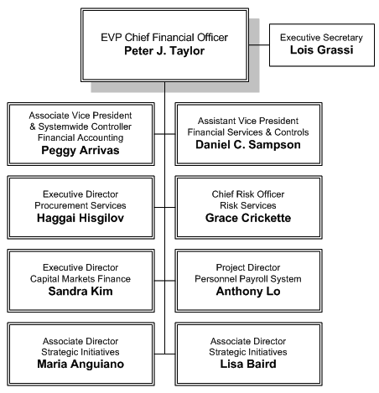
  CFO Division: who we are
Corporate and Benefit Plan Acctng.
Endowment & Investment Acctng.
Costing Policy & Analysis
Payroll Coordination & Tax Svcs.
Banking & Treasury Services
Office of Loan Programs
Business Resource Center
Central Travel Mgmt.
IT Procurement Services
Strategic Sourcing
Systemwide Vendor Negotiations
Inventory Management
Crisis & Consequence Mgmt.
Loss Prevention & Loss Control
Risk Financing, Claims Mgmt.
Enterprise Risk Mgmt.
Bond Financing
Commercial Paper Program
Special Financing Structures
CapEquip/C3/STARs Programs
Common Systemwide PPS
HRIS Exploration
Time & Attendance Exploration
Systemwide Policy Analysis
Internal Consultants
CFO Division Strategic Planning
Special Finance Projects
PEB Analysis, Cashflow Mgmt.
NPV Analysis, IRR Analysis

Slide 22
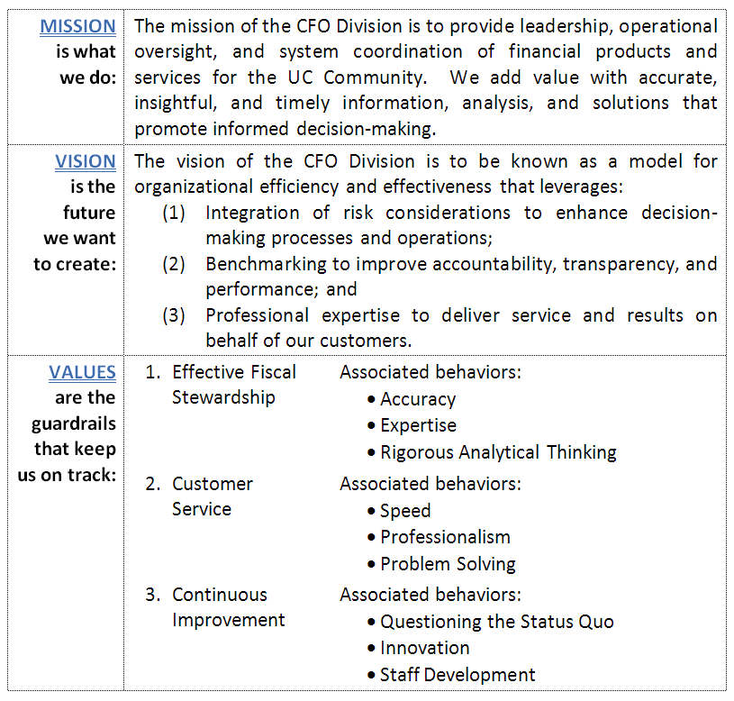
  CFO Division MISSION, VISION, and VALUES:

Slide 23
  Our 5 strategic goals
#2
Showcase our Value-Add
#1
#3
Reexamine the Day-to-Day
Engage with the Customer
#5
Be Action-Oriented
#4
Develop our Staff

Slide 24
CFO Division: Budget Statistics (summary)
Summary of Budget
Total | Amount
Personnel Costs | 15,918,643
S&E | 3,714,110
Total Gross | 19,632,753
Recharge | (4,155,572)
Total | 15,477,181
By Fund Type
Full Time Employees = 145

Slide 25
Financial Accounting

Slide 26

  Financial Accounting: 30,000-ft. View
30,000-foot
view
Corporate
Endowment/Investments
Costing
Payroll & Tax
Benefit Plans

Slide 27
Financial Accounting: Value-Added
 | Detailed Ledgers and Systems | Reporting and Regulatory Filings | Transaction Processing/Support | Audit Coordination
Capital Assets | Depreciation database |  | Calculation of annual depreciation and write-off of accumulated depreciation
Contracts & Grants |  | Indirect cost proposals | Rate proposal negotiations | Federal and state agency audit coordination
Debt | Long-term debt and commercial paper ledgers | Debt compliance reporting | Debt accounting and debt service processing | Bond compliance audits
Endowment | Endowment ledgers; recordkeeping for endowments and trusts. | State regulatory filings; Fund statements | Pool income distribution, purchases and sales, calculation and distribution of endowment payout
Investments | Investment portfolio information |  | Investment accounting
Retirement & Benefit Plans | Participant recordkeeping for benefit plans; pension and retiree health trust ledgers | Plan annual financial reports; Actuarial valuations; quarterly census reports | Benefit payments and refunds; health and welfare premiums and claims processing | Annual external audit
Consolidated Reporting | Corporate financial reporting system | University annual financial statements; medical center financial statements | Accounting instructions; implementation of all new accounting rules; support for complex transactions | Annual external audit
Payroll & Tax Filings | Payroll tax tables and system | Consolidated income tax returns and Forms W-2 and 1042-S | Implementation of new tax requirements | IRS examinations

Slide 28
Financial Accounting: Budget Summary
Summary of Total Budget
 | Amount
Personnel Costs | 4,503,942
S&E | 1,937,312
Total | 6,441,254
By Fund | Amount | %
Restricted
Asset Management | 1,661,118 | 19%
Bond Management | 365,479 | 6%
UCRP | 610,120 | 9%
Benefits Admin | 830,774 | 13%
Lab Funds | 44,637 | 1%
DCMF | 277,547 | 4%
Small Accounts | 120,578 | 2%
Unrestricted
General Funds | 1,634,556 | 22%
Common | 897,298 | 13%
Off-the-top | 252,725 | 4%
Total | 6,441,255 | 100%

Slide 29
Financial Accounting: Budget Statistics (by type of expense)
Personnel by Department
Supplies and Expense
 | Amount
Systemwide Controller | 556,973
Corporate Accounting | 1,007,063
HR Fin. Services | 1,308,445
Payroll & Tax Services | 540,988
Endowment & Inv. Acctg. | 819,313
Costing Policy and Analysis | 271,160
Total | 4,503,942
 | Amount
Computer/Office Equip + Svc. Maint. | 31,465
Consultants + Prof. Services | 552,554
External Svcs: Computer + other | 133,202
Insurance | 6,500
Legal costs | 14,804
Library | 28,168
Meetings | 15,769
Travel | 54,000
Other Office/Misc | 90,639
Utilities + Facilities | 25,211
Auditing | 985,000
Total | 1,937,312

Slide 30
Financial Services & Controls

Slide 31
  Financial Services & Controls: 30,000-ft. View
30,000-foot
view
Banking & Treasury Services
Office of Loan Programs
Business Resource Center
Central Travel Management

Slide 32
Financial Services & Controls: Value-Added
Banking & Treasury Services Manages $45 billion of UC cash flow annually New cash mgmt. system will save $750,000 per year in reduced fees P-Card program generates $7.2 million annually in incentives New reduction in merchant card fees, saving up to $800,000 annually | Office of Loan Programs Originates approx. $200 million of new faculty and staff loans per year Since inception, over 5,100 loans totaling $2.14 billion have been originated Self-supporting program – no public funds used
Central Travel Management Comprehensive, web based system to book air, hotel, car and rail services 2010 actual savings of $4.5 million, with potential of up to $12 million at full utilization | Business Resource Center Consolidated administrative service center saved approximately 100 FTE across UCOP BRC processes over $120 million in payroll and $185 million in purchases annually for UCOP

Slide 33
Financial Services & Controls: Budget Summary
Summary of Total Budget
 | Amount
Personnel Costs | 6,348,788
S&E | 1,224,383
Total | 7,573,171
By Fund | Amount | %
Restricted
Asset Management | 1,229,232 | 16%
LANS LLC | 65,744 | 1%
BRC | 2,081,543 | 27%
UCMOP | 1,428,678 | 19%
Unrestricted
General Funds | 256,351 | 3%
Common | 2,511,623 | 33%
Total | 7,573,171 | 100%

Slide 34
Financial Services & Controls: Budget Statistics (by type of expense)
Personnel by Department
Supplies and Expense
 | Amount
Fin. Services & Controls | 339,259
Banking & Treasury | 592,856
Travel | 307,715
Office of Loan Programs | 1,050,178
BRC | 4,058,780
Total | 6,348,788
 | Amount
Computer/Office Equip + Svc. Maint. | 36,459
Consultants + Prof. Services | 449,450
External Svcs: Computer + other | 22,753
Insurance | 24,893
Legal costs | 20,000
Library | 32,750
Meetings | 14,061
Travel | 35,000
Other Office/Misc | 291,007
Utilities + Facilities | 298,387
Total | 1,224,760

Slide 35
Risk Services

Slide 36
  Risk Services: 30,000-ft. View
30,000-foot
view
Crisis & Consequence Mgmt.
Loss Prevention & Loss Control
Risk Financing, Claims Mgmt., Insurance
Enterprise Risk Mgmt.

Slide 37
Risk Services: Value-Added
Enterprise Risk Management (ERM) Solution Set
 |  |  | ERM Systemwide Panel
 | Environmental Due Diligence Program | Workers’ Compensation | Risk Assessments
 | Be Smart About Safety | Professional Med & Hospital Liability | Risk Ranking Tools
Crisis Communications | Environment, Health & Safety | Human Subject Injury | Risk Management Leadership Council
Public Safety | Threat & Security Services | General Liability | Risk Management Tools and Training
UC Ready Panel | 6% Prescription | Employment Practices Liability | Enterprise Data Mgmt./Analysis
UC Ready Forum | Travel Assistance | Property | Enterprise Response Enablement
UC Ready Software | Occupational & Employee Health Advisory Coalition | Fine Arts | UC Tracker
Emergency Management | EH&S Leadership Council | Construction | UC Action
Incident Command Centers | Employment Practices Improve- ment Committee | Auto | ERMIS
UCOP Crisis Mgmt. Response Team | Web-based incident reporting | Auxiliary Groups | Risk Summit
Crisis & Consequence Management | Loss Prevention and Loss Control | Risk Financing/ Claims Mgmt./ Insurance | Enterprise Risk Management Program
Strategic View of Risk
Create Efficiency
Reduce
Cost of Risk
Improve Cost of Borrowing
Reduce IT and Operational Redundancy
Cost of Risk
reduced from $18.46 in FY04 to $13.43 in FY10*
*per $1,000 of systemwide
operating budget

Slide 38
Risk Services: Budget Summary
Summary of Total Budget
 | Amount
Personnel Costs | 1,803,152
S&E | 652,000
Total | 2,455,152
By Fund | Amount | %
Restricted
Risk Services | 2,455,152 | 100%
Total | 2,455,152 | 100%

Slide 39
Risk Services: Budget Statistics (by type of expense)
Personnel by Department
Supplies and Expense
 | Amount
Managers | 1,524,683
Analysts/ Administrators | 278,469
Total | 1,803,152
 | Amount
Computer/Office Equip + Svc. Maint. | 1,751
Consultants + Prof. Services | 16,770
External Svcs: Computer + other | 2,724
Insurance | 3,554
Legal costs | 821
Library | 93
Meetings | 8,481
Travel | 8,000
Other Office/Misc | 456,143
Utilities + Facilities | 103,253
Temp Labor | 50,410
Total | 652,000

Slide 40
Procurement Services

Slide 41
  Procurement Services: 30,000-ft. View
30,000-foot
view
IT Procurement Services
Strategic Sourcing
Systemwide Vendor Negotiations
Inventory Management

Slide 42
Procurement Services: Value-Added
$260 million
actual cost savings since inception
Mission
Harness collective buying power to improve costs/service
208
UC agreements (146 strateg- ically sourced + 62 pricing schedules)
UCOP Procurement Services
Sourcing Strategies
best-in-class procurement processes
Infra- structure
for Strategic Sourcing established at UCOP
e-Procurement
Consortium Program, SciQuest, Perfect Commerce

Slide 43
Procurement Services: Budget Summary
Summary of Total Budget
 | Amount
Personnel Costs | 1,529,256
S&E | 389,600
Total | 1,918,856
By Fund | Amount | %
Restricted
Strategic Sourcing | 1,674,098 | 87%
Unrestricted
General Funds | 115,679 | 6%
Common | 129,079 | 7%
Total | 1,918,856 | 100%

Slide 44
Procurement Services: Budget Statistics (by type of expense)
Personnel by Department
Supplies and Expense
 | Amount
Managers | 828,519
Analysts/ Administrators | 700,737
Total | 1,529,256
 | Amount
Computer/Office Equip + Svc. Maint. | 225,000
Consultants + Prof. Services | 0
External Svcs: Computer + other | 92,000
Insurance | 2,856
Legal costs
Library | 400
Meetings | 40,000
Travel
Other Office/Misc | 14,000
Utilities + Facilities | 15,344
Temp Labor | 0
Total | 389,600

Slide 45
Capital Markets finance

Slide 46
  Capital Markets Finance: 30,000-ft. View
30,000-foot
view
Bond Financing
Commercial Paper Program
Special Financing Structures
CapEquip/C3/STARs Programs

Slide 47
      Capital Markets Finance: Value-Added
    Capital Markets Finance has saved the University over $88 million in debt service through refinancing transactions since the beginning of 2009.
    Despite financial market and state of California turmoil, the University has maintained “AA” ratings on its core revenue credits (General Revenue Bonds, Limited Project Revenue Bonds, Medical Center Revenue Bonds).
    Since the inception of Build America Bonds, the University has issued over $3 billion in BABs with estimated present value savings of over $600 million compared to traditional tax-exempt bonds.
    Since 2009, Capital Markets Finance has saved the University over $360,000 in professional fees by bringing rating agency and investor relations in house.
    Securing the University’s bonds with a pooled, multi-campus credit allows the University to issue bonds secured by broad and diverse revenues. General Revenue Bonds are secured by $7.66 billion in revenues which contributes to its “AA” category ratings and decreased security requirements, such as no requirement for mortgage or debt service reserve funds.
Refunding Savings
Maintain Credit Ratings
Build America Bonds
Professional
Fees
Pooled
Systemwide
Credit

Slide 48
Capital Markets Finance: Budget Summary
Summary of Total Budget
Supplies and Expense
 | Amount | FTE
Personnel Costs | 766,273 | 5
S&E | 39,995
Total | 806,269
 | Amount
Computer/Office Equip + Svc. Maint. | 3,929
Consultants + Prof. Services | -
External Svcs: Computer + other | 2,395
Insurance | 2,153
Legal costs | 0
Library | 4,975
Meetings | 5,422
Travel | 10,000
Other Office/Misc | 1,802
Utilities + Facilities | 9,320
Total | 39,995

Slide 49
BONUS VALUE-ADDed

Slide 50
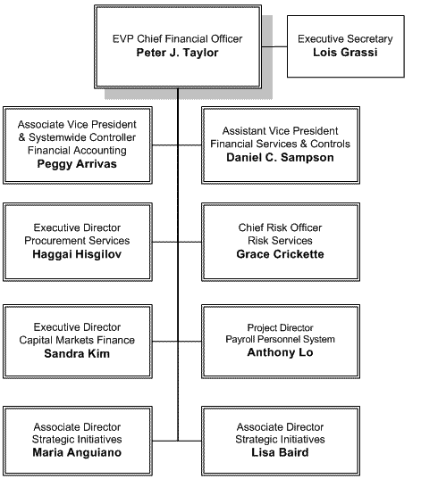
  PPS Initiative: 30,000-ft. View
30,000-foot
view
Common Systemwide Payroll System
Common Systemwide HR System
Common Time and Attendance Solution(s) in Phase 2
Systemwide Process/Practice Standardization
Policy Analysis
FTE: 2

Slide 51
  Strategic Initiatives: 30,000-ft. View
30,000-foot
view
Internal Consultants
CFO Division Strategic Planning
Special Finance Projects
Post-Employment Benefits Analysis, Cashflow Management
NPV Analysis, IRR Analysis
FTE: 2

Slide 52


Concluding remarks
The CFO Division adds significant value to campuses and to the University as a whole.

Slide 54
Part v:
Q&A + Wrap-Up

Slide 55
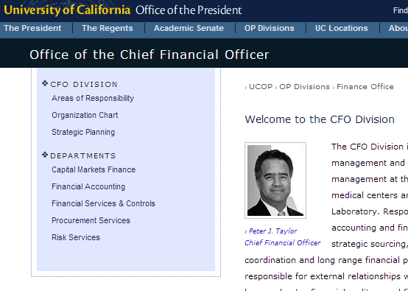
  If we want to add value to our campuses, we must first add value to our staff…
      Staff Development Menu
        It’s online; everything is linked!
        This is a starting place
        It never hurts to just ask
        “Make it count” with teach-backs

Slide 56
  Q&A
      Questions?
      Comments?
      Feedback?
      Funny stories or jokes?

Slide 57
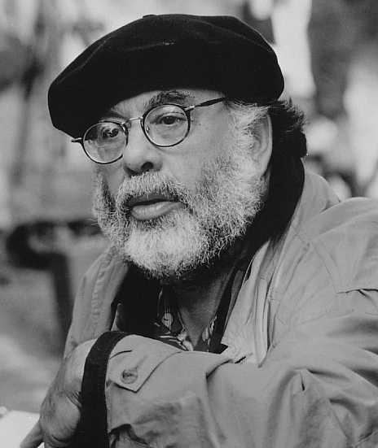
  Parting words…
      “If he wants to make a movie, he just starts making the movie. He doesn’t wait for permission or for even the money. He just starts making the movie. And he figures, if I start making the movie, people will start joining along. And that’s how I’ve done everything since then. Just start making it and give it a life.”
      — Comedian Louis C.K. on Francis Ford Coppola
Francis Ford Coppola

Slide 58
Part vI:
Party time

Slide 59

After Party !
906 Washington Street
Between 9th and 10th
3:30 – 5:00 p.m.

Slide 60
Key Take-aways

Slide 61
  Key Take-Away #1: UCOP Local HR
      Isabel Chen introduced herself to the CFO Division. She described the new organizational structure, where John Fox is the head of UCOP Local HR, and she reports directly to John. Her contact information and a visual outline of the UCOP Local HR org chart can be found embedded in the Town Hall PowerPoint online (scroll to bottom): http://www.ucop.edu/finance/stratplan.html
      Isabel is the “HR Business Partner” for the entire CFO Division. Thus, any HR issue that we have can and should be routed through Isabel. She will serve as the outward facing “customer service rep” for our Division on all things HR. Always feel free to pick up the phone or email her.

Slide 62
  Key Take-Away #2: Mini-Retreats & SWOT Recap
      Consultant Lisanne Sison recapped the departmental mini-retreats held in March/April. She then provided high-level observations on the feedback collected via the SWOT surveys distributed in early May. Her recap and observations can be found embedded in the Town Hall PowerPoint online (scroll to bottom): http://www.ucop.edu/finance/stratplan.html
      Lisanne explained that the next step is a second round of departmental SWOT surveys in mid-May in order to fine-tune some of the detailed feedback gathered in the first survey.
      After the results of both surveys are collected and shared with department heads, Lisanne will officially “hand over the reins” to Peter Taylor and each of his direct reports to carry on with implementation of action plans.

Slide 63
  Key Take-Away #3: Value-Added
      On May 26, Peter Taylor will be giving a presentation to the Council of Vice Chancellors (COVC) regarding the “value added” that the CFO Division delivers to campuses every day.
      This audience of campus Provosts is most interested in learning exactly what services we deliver and the level of resources (both staff and fiscal) that we utilize in order to deliver those services.
      A “sneak preview” of this presentation was shown at the Town Hall and can be found embedded in the Town Hall PowerPoint online (scroll to bottom):
      http://www.ucop.edu/finance/stratplan.html

Slide 64
  Key Take-Away #4: Staff Development
      If we want to continue adding value to our campuses, then we must continue adding value to our staff. Peter Taylor expressed his long-held, strong belief in ongoing staff development as the path towards excellence.
      Peter Taylor explained that in keeping with our Strategic Goal #4 (“Develop Our Staff”), every single person in the division including himself and his direct reports will be required to embark upon at least two staff development opportunities this calendar year. Success in this endeavor will be noted on all performance appraisals going forward.
      The CFO Division Staff Development Menu was unveiled. This menu is a starting point for staff and managers as they decide which development opportunities to pursue this calendar year. The menu can be found online (scroll to bottom): http://www.ucop.edu/finance/stratplan.html

