Slide 1


Town Hall
January 28, 2011
CSU Conference Room #2
2:00-3:30 p.m.

Slide 2
Agenda
 | 2:00 – 2:15 | Welcome & Values Recap
 | 2:15 – 2:30 | The Only Thing Constant Is Change
 | 2:30 – 3:25 | SWOT Exercise
 | 3:25 – 3:30 | Wrap-Up

Slide 3
Welcome & Values Recap

Slide 4
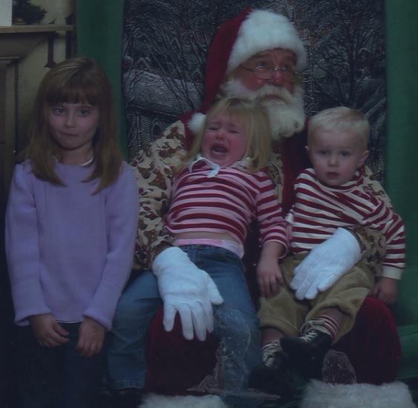
  Holiday photos…
Notes:
Erike Young’s kids

Slide 5
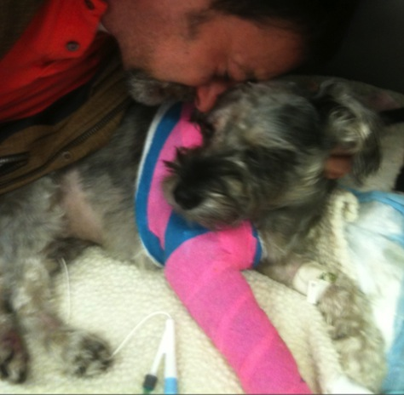
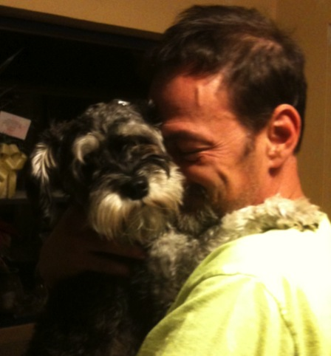
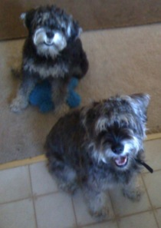
Notes:
Brad Niess + found pups

Slide 6
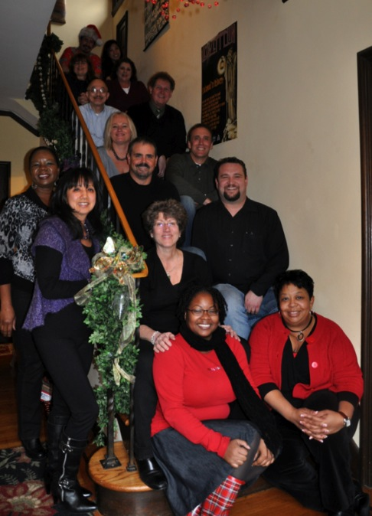
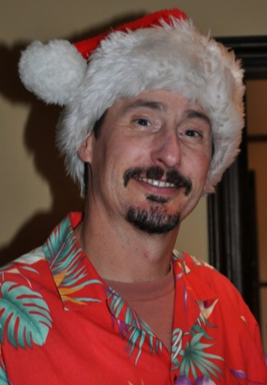
Notes:
Risk Services holiday party + Bob Charbonneau close-up

Slide 7
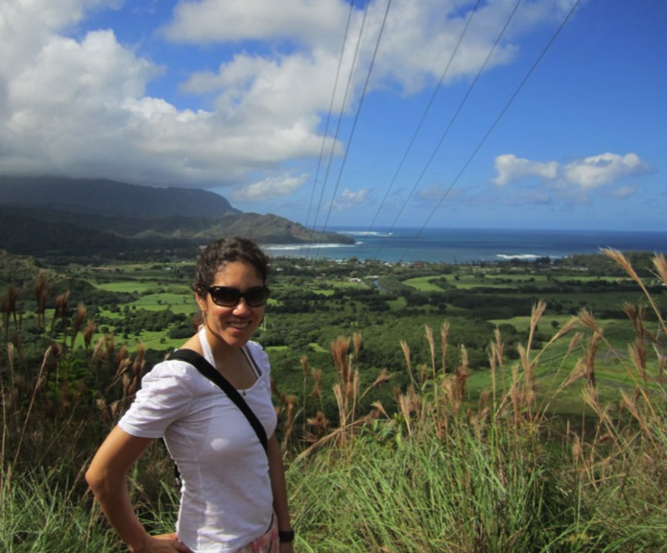
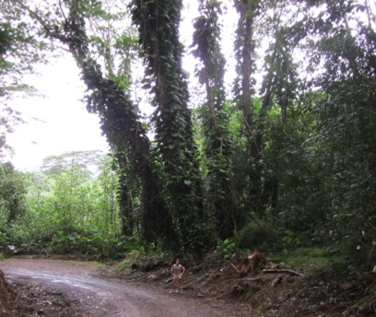
Notes:
Maria Anguiano in Hawaii

Slide 8
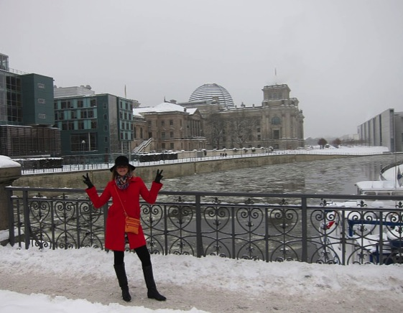
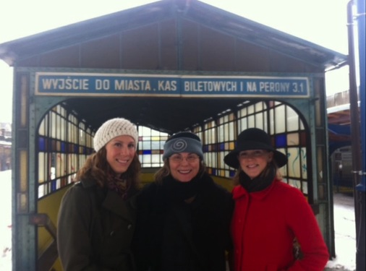
Notes:
Lisa Baird in Germany and Poland

Slide 9
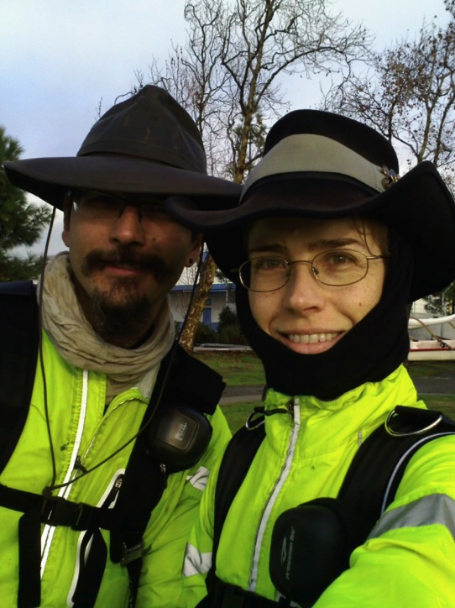
Notes:
Emily Breed + husband on winter solstice bike ride around the Bay

Slide 10
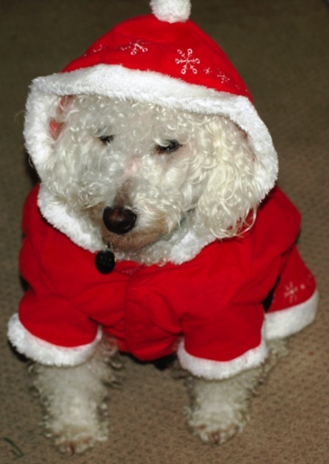
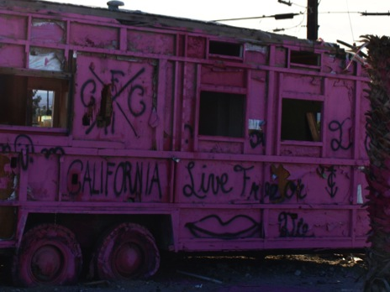
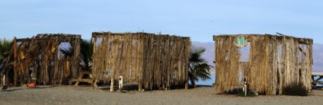
Notes:
Alan Moloney’s pup + Salton Sea pics

Slide 11
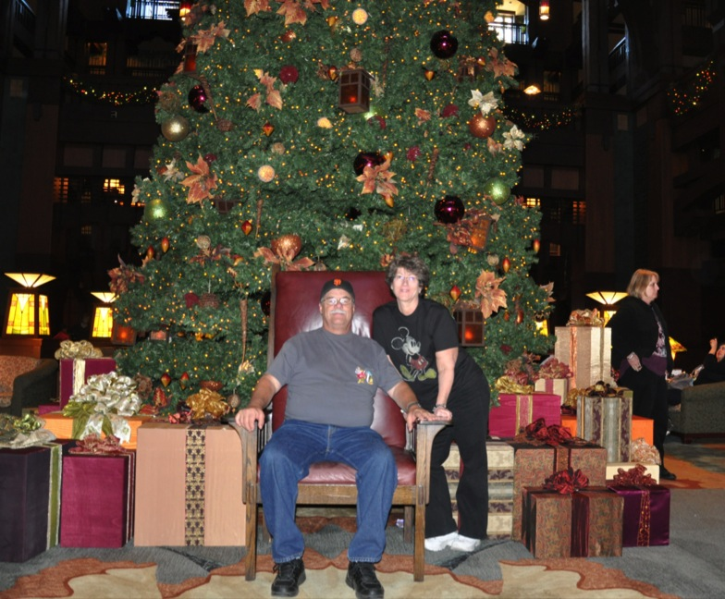
Notes:
Terry Kielhorn + hubby at Disneyland

Slide 12
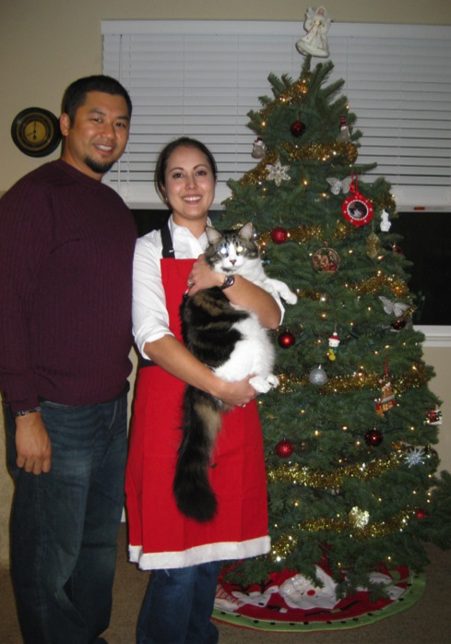
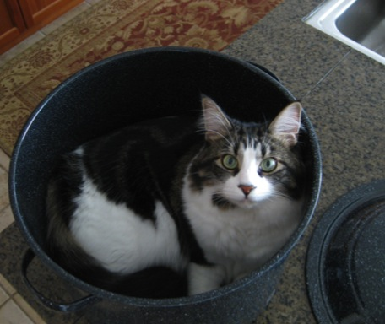
Notes:
Lisanne Sison + hubby + their huge cat

Slide 13
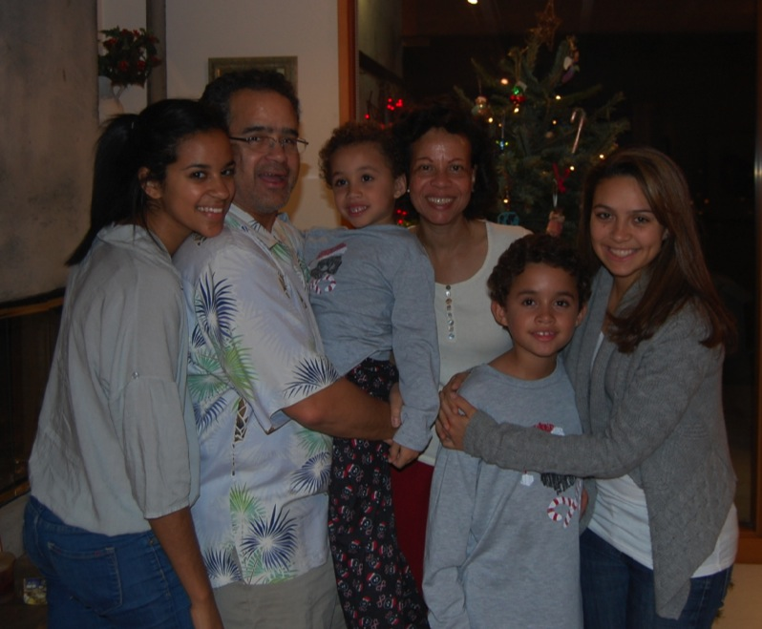
Notes:
Peter Taylor with wife, daughters, and nephews

Slide 14
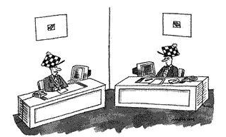

Remind me again… why are we doing this?
Because all organizations need direction
Why do we do what we do?
“I don't know how it started, either. All I know is that it's part of our organizational culture.”
For whom do we do it?
How do we get there?
Direction

Slide 15


  VALUES recap
UCOP
Values
  Integrity
  Respect
  Excellence
  Accountability
  Communication
  Collaboration
OGC / Legal Affairs
Compliance & Audit
Treasurer’s Office
Policy & Analysis
Laboratory
Operations
Business Operations
Academic Affairs
Health Sciences & Services
External Relations
CFO Division Values:
Effective Fiscal Stewardship
Customer Service
Continuous Improvement

Slide 16


  Should a division have separate VALUES from its “parent”?
  Although the sub-groups within a “family” share a set of broad values at the top, each functional group may have its own set of values that reflect its own set of specific duties.
Companywide Values:
Dedication to every client's success
Innovation that matters, for our company and for the world
Trust and personal responsibility in all relationships
BROAD
More Specific→
More Specific→
←More Specific
Global Procurement Values:
Understanding
Integrity and teamwork
Initiative and urgency
  It doesn’t mean the lower group conflicts with the higher group (in fact, they usually jibe quite well). It just means the work is getting more specific.

Slide 17
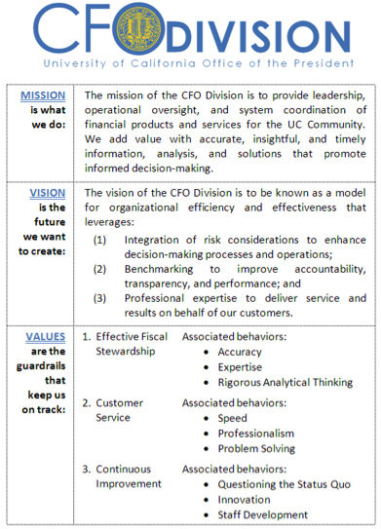
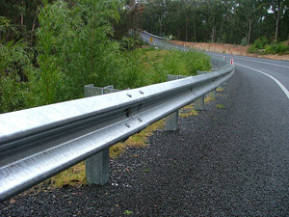
  Where we ended up…
VALUES
VALUES
VALUES
MISSION→
VISION→

Slide 18


  Keep in mind…
Territory
Map
The MAP
is not the TERRITORY

Slide 19
The Only Thing Constant is Change

Slide 20

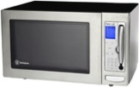
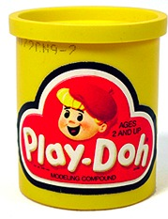



  Got change?
You can shape it.

Slide 21

  5 strategic goals
#2
Showcase our Value-Add
#1
#3
Reexamine the Day-to-Day
Engage with the Customer
#5
Be Action-Oriented
#4
Develop our Staff

Slide 22
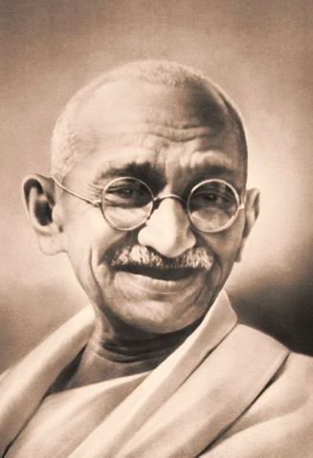
  A wise man once said…
Be the change you want to see in the world.

Slide 23

  A even wiser man once said…
90% of life
is just showing up.

Slide 24
Percent of department that responded

Slide 25
Which strategic goal will be most difficult to achieve?

Slide 26
Comments on “Develop Our Staff”
  “I do believe there are opportunities that are not immediately recognized to provide training for staff to develop competency. We just need to be creative in looking for those opportunities.”
  “Managers and supervisors have great intentions of developing their staff, but unfortunately we get so wrapped up with our ‘everyday’ that we sometimes let our employee development goals fall on our priority list.”
  “I think the current fiscal climate makes it difficult to send people to conferences.
  However, even if money is available, people are reluctant to attend and are concerned about how it might be perceived.”
  “I have asked for departmental tuition assistance to take some course towards a MBA program. My requests were not approved due to limited department budget.”
  “I was dismayed that an esteemed educational organization could not assist with educational expenses.”

Slide 27
Comments on “Develop Our Staff”
(cont’d.)
  “We may develop the staff but what’s the path? There is no clear path or structure that exists. How does someone know what they need to do to step up?”
  “I think the tendency will be an over-emphasis on conferences and training as that can be done relatively quickly and is concrete ways. I would rather focus on competence-building activities that come from within the Division.”
  “There are also some educational classes that take place afterhours and this takes away from their family life… it requires hours of personal time and is not an easy task to accomplish.”
  “With our current economic realities, we are constrained in recommending staff training and/or development tools that require an expenditure. That really limits our options.”
  “I am encouraged to see this staff development goals as I think they are important.”

Slide 28
Comments on “Reexamine the Day-to-Day”
  “How do we encourage other departments outside of the CFO Division to also re-examine their purchasing practices?”
  “My concern is not so much internally, but more related to convincing some of the campuses to make changes in their existing business processes.”
  “We can reexamine our processes but if there are no resources to address the changes proposed, it really defeats the purpose of reexamining our day to day.”
  “Even if you wanted to change something for the better, it will take time and effort to 1) figure out what the whole process is and 2) get everyone on board with the change.”
  “We can and do influence decision making, but this takes a great deal of time and just when you have all the bases covered, another group emerges that needs to be consulted.”

Slide 29
Comments on “Reexamine the Day-to-Day”
(cont’d.)
  “We’re in top gear at all times just to keep up with what’s coming at us. It makes it difficult to carve out the necessary space to reexamine what’s being done and how.”
  “In instances where we work with other campuses, or in some cases, other organizations… how do we effectively communicate a need for that change?”
  “It requires all employees to agree that all day-to-day procedures need to be established and evaluated… a number of employees may feel that a change is unnecessary while others may feel a change is important.”
  “My observation is that it’s cultural; turn that tide and the rest of the goals will fall into place. Everyone is so shorthanded that there is not time to stop for a moment to consider why something is done the way it is or give thought to doing it differently.”
  “When I first started working for UCOP three years ago, the phrase I heard the most was ‘that’s how it’s been done in the past.’ The implementation of the new process is challenging due to lack of information of the existing processes which we can compare to. This makes it difficult to validate a new process.”

Slide 30

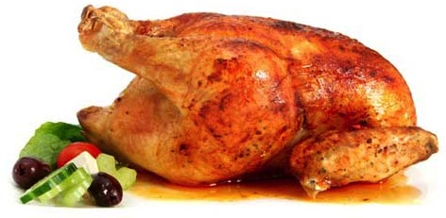

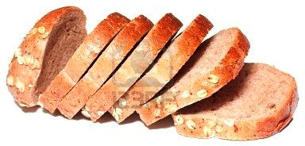
Food for thought
If You Build It, They Will Come
It’s Easier to Ask Forgiveness Than Permission
Look Both Inward and Outward
Perfection is the Enemy of Progress

Slide 31
SWOT Exercise

Slide 32
What is SWOT?
This is about achieving the objective
 | Helpful | Harmful
Internal | S | W
External | O | T
This is about the environment / organization
Strengths
Weaknesses
Opportunities
Threats

Slide 33

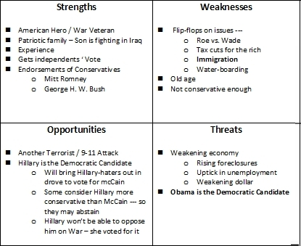
  A trip back in time…
The Year 2008
SWOT analysis of the McCain campaign…
…through the competitive lens of the Obama campaign

Slide 34





  Game time
  4 randomly
  selected groups…
  10-15 minutes
  to identify SWOTs…
  5 minutes
  to report out…
  5 stickers to vote on most important…
  1 high-level workplan to translate offline

Slide 35
  Mini-retreats
Financial Accounting | Mon., March 21 1:00-4:00 p.m. | Room 5320
Capital Markets Finance | Wed., March 30 9:00-11:00 a.m. | Room 10316
Risk Services | Wed., March 23 1:00-3:00 p.m. | Room 7409
Financial Services & Controls (OLP/B&TS/CTM) | Thurs., March 24 1:30-4:30 p.m. | Room 5320
Financial Services & Controls (BRC) | Tues., March 29 1:00-4:00 p.m. | Room 5320
Procurement Services | Mon., April 4 1:30-4:30 p.m. | Room 12322

Slide 36
Wrap-Up

Slide 37
  Using our values
UCOP
Values
  Integrity
  Respect
  Excellence
  Accountability
  Communication
  Collaboration
OGC / Legal Affairs
Compliance & Audit
Treasurer’s Office
Policy & Analysis
Laboratory
Operations
Business Operations
Academic Affairs
Health Sciences & Services
External Relations
CFO Division Values:
Effective Fiscal Stewardship
Customer Service
Continuous Improvement

Slide 38

  On the horizon…
      Talk about budget cuts
      at mini-retreats in March
      Next CFO Division Town Hall:
        May 13 @ 2:00 p.m.
        ENTIRE division
        “Who We Are” presentation
Friday
the 13th

Slide 39
  Divisional highlights
      Financial Accounting
        Financial Services & Controls
        Risk Services
        Procurement Services
        Capital Markets Finance
        Strategic Initiatives
        PPS Initiative

Slide 40
  Peet’s giftcard drawing
      Thanks to everyone who participated!

Slide 42
  Follow-up that was sent around to everyone the next week…
The following is a summary of the SWOT exercise conducted on January 28, 2011 at the CFO Division Town Hall where CFO Division managers looked closely at the strategic goal “Reexamine the Day-to-Day.” Some important notes:
  The point of the exercise was to identify the strengths, weaknesses, opportunities, and threats within the CFO Division that can either help us or hurt us in achieving the goal of reexamining our day-to-day business.
  Four groups were randomly formed by counting off one through four. One group was assigned to strengths, one to weaknesses, one to opportunities, and one to threats. The groups spent 15 minutes creating the lists below.
  After the lists were written and reported out, each person in the room received five stickers. They were instructed to go around the room and place their stickers on the items they feel are most important. There were no rules on placement; you could place them throughout, or you could concentrate them on one item.
  The “sticker votes” appear below in parentheses. Zero does not mean nobody thought it was important. It just means nobody allocated one of their stickers to it.
  At the end of the exercise, 7 key issues emerged with 9+ votes, as highlighted below in red.

Slide 43
  Reexamine the Day-to-Day: SWOT Analysis
Strengths Culture/tone from the top (11) Flat/less bureaucratic/you can make the call (2) More results-oriented/less process-oriented (2) Broad experience/diverse backgrounds (2) Drive/persistence/willingness (2) Creative/focused on the goal, not the process (0) We are smart people/technical proficiency (0) Open attitude of staff (0) | Weaknesses No authority to mandate (20) Lack of standard processes/not invented here (11) Morale/fear (5) Upfront investment/resources/time (3) Lack of clarity on guidelines/policies (2) Reluctance to speak/take the first step (0) Complexity/many layers of the onion (0) Lack of results from previous efforts (0) Complacency (0) No evaluation (0) Inflexible/not receptive (0)
Opportunities Standardization (13) Nothing off limits/Look at everything (10) Communicate best practices (5) Can seize the moment (3) Help facilitate change (3) “External” may be more receptive (0) Increase communication (0) Lead by example (0) Benchmarking (0) | Threats IT Infrastructure (11) Lack of data (9) Fear of cutbacks/job loss (5) Resistance to change/ time it takes to convince others (5) Complexity of existing structure/union contracts/etc. (5) Time suckers/PRAs/audits/regulations/reporting (4) Lack of funding/resources/not enough time (1) Volume of emails/communications (1) Low investment returns on portfolios (0) Duplication/lack of project management (0) Existing reputational issues/responsiveness/cust. service (0) Workplace inflexibility (0) Outdated regulations (0)

Slide 44
  When the SWOT follow-up was sent around, folks were also reminded that:
Departmental mini-retreats were coming up in March/April and would be lead by strategic planning consultant Lisanne Sison
All mini-retreat work would be department-specific, and attendance is 100% expected
The 3 goals of the mini-retreats would be the following:
  Use the town hall SWOT to develop a brief action plan for achieving “Reexamine the Day-to-Day”.
  Conduct a SWOT analysis for each of the four remaining strategic goals (“Develop Our Staff”, “Be Action-Oriented”, “Engage with the Customer”, “Showcase our Value-Add”).
  Use the new SWOTs to develop brief action plans for each of the four remaining strategic goals
Financial Accounting | Mon., March 21 1:00-4:00 p.m. | Room 5320
Capital Markets Finance | Wed., March 30 9:00-11:00 a.m. | Room 10316
Risk Services | Wed., March 23 1:00-3:00 p.m. | Room 7409
Financial Services & Controls (OLP/B&TS/CTM) | Thurs., March 24 1:30-4:30 p.m. | Room 5320
Financial Services & Controls (BRC) | Tues., March 29 1:00-4:00 p.m. | Room 5320
Procurement Services | Mon., April 4 1:30-4:30 p.m. | Room 12322

