Slide 1


Town Hall
October 8, 2010
CSU Conference Room #2
2:00-3:30 p.m.

Slide 2
Agenda
 | 2:00 – 2:15 | Welcome & Introduction
 | 2:15 – 3:15 | Values Exercise
 | 3:15 – 3:25 | CFO Division Announcements
 | 3:25 – 3:30 | Wrap-Up

Slide 3
Welcome & Introduction

Slide 4
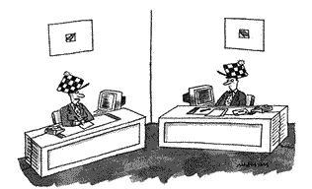
Our culture
“I don't know how it started, either. All I know is that it's part of our organizational culture."

Slide 5

  Why are we here? Why do we need a mission, vision, values?
  So people know what they can rely on us for
  Because all organizations need direction
  The time is right
    New division
    New leadership
    New staff
    Even some new departments!
      (Welcome, Benefit Plan Accounting)
Why do we do what we do?
For whom do we do it?
How do we get there?

Slide 6


  Role of UCOP VALUES
UCOP
  Integrity
  Respect
  Excellence
  Accountability
  Communication
  Collaboration
OGC / Legal Affairs
Compliance & Audit
Treasurer’s Office
Policy & Analysis
Laboratory
Operations
Business Operations
Academic Affairs
Health Sciences & Services
External Relations

Slide 7
  Welcome to our facilitator
  Lisanne Sison, Bickmore Risk Services:
    Facilitated senior staff retreat on 8/27/10
    Will facilitate today’s discussion with values exercise

Slide 8
  Desired outcome for today
    Identify what makes us (or will make us) uniquely successful
    Clarify interplay with UCOP
    Hone to small subset of 5 or 6 from which choose

Slide 9
Values Exercise

Slide 10



The University’s mission
  1. Teaching
        2. Research
              3. Public Service
                Right….?

Slide 11
The University’s official mission is actually more multi-dimensional than many realize
…serve society as a center of higher learning…
  “The distinctive mission of the University is to serve society as a center of higher learning, providing long-term societal benefits through transmitting advanced knowledge, discovering new knowledge, and functioning as an active working repository of organized knowledge. That obligation, more specifically, includes undergraduate education, graduate and professional education, research, and other kinds of public service, which are shaped and bounded by the central pervasive mission of discovering and advancing knowledge.”
  — from the University of California Academic Plan, 1974-1978
  http://www.universityofcalifornia.edu/aboutuc/missionstatement.html
…pervasive mission of discovering and advancing knowledge…

Slide 12
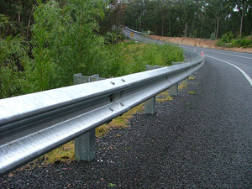
  What’s the difference between MISSION, VISION, and VALUES ?
    If our mission is what we do, and our vision is the future we want to create, then...
      Our values are the guardrails that keep us on track.
MISSIONary
Someone who carries out the work
VISIONary
Someone who sees what is possible
VALUES
VALUES
VALUES
MISSION→
VISION→

Slide 13



  MISSION is the reason a division, unit, or department exists
  University of Michigan, Business & Finance Division Mission Statement:
    “We partner with the University community to provide the technical, financial, physical, information, and human resource infrastructure essential to being a great public university of the world.”
  University of Georgia, Finance & Administration Mission Statement:
    “The mission of this division is to provide the best possible customer service and support to the students, faculty and staff of the University of Georgia by ensuring that the business and administrative support services of the University function ethically, efficiently, and effectively.”
  University of Texas System, Office of Finance Mission Statement:
    “Support the vision of The University of Texas System by providing world class debt management, investment oversight, and other financial services to the Board of Regents, the institutions, and System Administration, for the benefit of the citizens of the State of Texas.”

Slide 14



  Ask yourself some MISSION-critical questions
  Describe what you do and for whom…
  It doesn’t have to be earth-shattering…
  Be what your core competency is…
    But would your mother understand it?
    But does it inspire you?
    But does it align with what you do best?

Slide 15
  CFO Division MISSION
MISSION is what we do: | The mission of the CFO Division is to provide leadership, operational oversight, and system coordination of financial products and services for the UC Community. We add value with accurate, insightful, and timely information, analysis, and solutions that promote informed decision-making.

Slide 16
  VISION is what we will do to leave a leadership legacy
  University of Michigan, Business & Finance Division Vision:
    “We will become a high-performance organization by: (1) being known for our deep expertise, both technical and business; (2) demonstrating (via assessment and service) our understanding of the University's businesses; and (3) serving as fiduciaries of the University assets (physical, financial, human, information and technology assets).”
  University of Georgia, Finance & Administration Vision:
    “Finance and Administration will set the standard for integrity, teamwork, and excellence in the delivery of the business and administrative support services that are essential for the University of Georgia to become one of the foremost public research universities in the world, the institution of choice for the best students, and the employer of choice for the best faculty and staff.”
  University of Texas System, Office of Finance Vision:
    “To be the leading provider of financial services in higher education.”

Slide 17
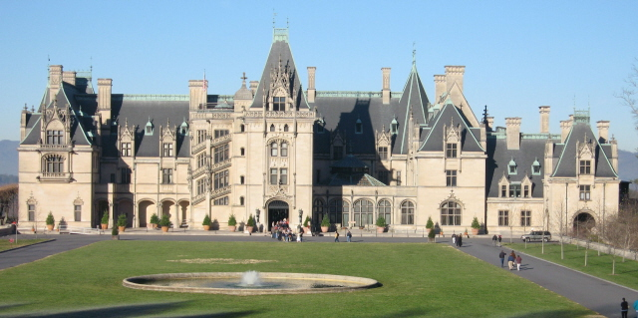
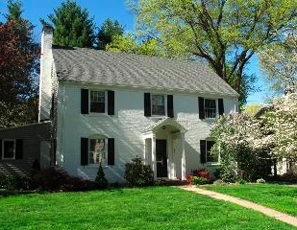
  Envisioning the VISION
  The vision should be very attractive…
    … but still realistic.
    Chateau with formal gardens?
    Center-hall colonial!

Slide 18
  CFO Division VISION
VISION is the future we want to create: | The vision of the CFO Division is to be known as a model for organizational efficiency and effective-ness that leverages: Integration of risk considerations to enhance decision-making processes and operations; Benchmarking to improve accountability, transparency, and performance; and Professional expertise to deliver service and results on behalf of our customers.

Slide 19
  VALUES are beliefs, principles, guidelines for decision-making
  University of Michigan, Business & Finance Division Values:
    Respect and Diversity
    Ethics and Integrity
    Innovation
    Collaboration
  University of Georgia, Finance & Administration Values:
    Integrity - Personal and Professional
    Mutual Respect and Fairness
    Excellence and Innovation
  University of Texas System, Office of Finance Values:
    Service First
    Excellence Always
    Integrity Throughout
    Professional Growth and Development
    Quality and Customer Service
    Health, Safety and Environment
    Community
Consistency between organizational values and individual behavior is
vital

Slide 20


  Should a division have separate VALUES from its “parent”?
  Although the sub-groups within a “family” share a set of broad values at the top, each functional group may have its own set of values that reflect its own set of specific duties.
Companywide Values:
Dedication to every client's success
Innovation that matters, for our company and for the world
Trust and personal responsibility in all relationships
BROAD
More Specific→
More Specific→
←More Specific
Global Procurement Values:
Understanding
Integrity and teamwork
Initiative and urgency
  It doesn’t mean the lower group conflicts with the higher group (in fact, they usually jibe quite well). It just means the work is getting more specific.

Slide 21
  Role of UCOP VALUES
UCOP
  Integrity
  Respect
  Excellence
  Accountability
  Communication
  Collaboration
OGC / Legal Affairs
Compliance & Audit
Treasurer’s Office
Policy & Analysis
Laboratory
Operations
Business Operations
Academic Affairs
Health Sciences & Services
External Relations

Slide 22

  Establish some core VALUES
  There’s the reality…
    … and there’s the aspiration.
“I don't know how it started, either. All I know is that it's part of our organizational culture.”
  Critical Questions:
    What are some of our actual behaviors? ____________________________________________
    What are some of our desired behaviors? ___________________________________________
    How are we different from other divisions within UCOP? ______________________________
    How should our desired behaviors be ranked? _______________________________________

Slide 23
  Suggested VALUES…
Customer Service
Strategic Thinking
Service Oriented
Respect
“Have Fun!”
Do the Right Things Right
Innovation
Respect & Diversity
Quality Theme
Problem Solving
Passion Theme
“Make It Happen”
Financial Expertise
Education / Professional Development
Results Orientation
Effective Fiscal Stewardship
Integrity
Clear, Timely, Honest Communication
Respectful
Solutions
Idea Sharing / Open Minded
Courageous
Continuous Improvement
Everyone’s a Decision-Maker
Respectful
Integrity
Diversity
Honesty
Honesty / Trust
Ethical
Integrity
Selfless / Teamwork
Accountability
Teamwork
Customer Service to Constituents
Professionalism
Social, Fun, Enjoyable Place to Work
Collaboration
Integrity
Strong Work Ethic
Staff Development & Career Path
Communication
Responsibility & Accountability
Synergy
Accountability
Respect
Transparency
Leading by Example
Excellence
Commitment
Customer Service
Accuracy & Speed
Rigorous Analytical Thinking
Balance
Individual Respect
Excellence
Competence
Stewardship
Innovation
Employee Empowerment
Ownership & Empowerment
Customer Service / Client-Centric
Teamwork
Collaboration
Openness Theme
Integrity
Ideas
Togetherness Theme
Resource of Actionable Information
Collaboration
Accountability
Transparency

Slide 24
  Categories/trends
Financial Expertise
Innovation
Solutions
Quality
Effective Fiscal Stewardship
Competence
Hard Working
Rigorous Analytical Thinking
Do the Right Things Right
Strategic Thinking
Problem Solving
Courageous
Ethical
Professionalism
Accuracy
Education & Professional Development
Passion
Strong Work Ethic
Ideas
Clear & Honest
Leading by Example
Speed
Continuous Improvement
Timely
Transparency
Commitment
Togetherness
Ownership
Idea Sharing
Partnership
Everyone’s a Decision-Maker
Trust
Synergy
Results Oriented
Employee Empowerment
Social, Fun, Enjoyable Place to Work
Open Minded
“Make It Happen”
Customer Service
“Have Fun!”
Teamwork
Action
Results
Openness

Slide 25
  Helpful reminders
VALUES
VALUES
VALUES
  Remember, values are the guardrails
  to guide our daily decision-making…
    What types of decisions do we have to make on a day-to-day basis that are unique to CFO Division?
    How is our daily business different from that of our colleagues throughout UCOP?
    Values don’t matter unless you’ve got the behavior to match
MISSION→
VISION→

Slide 26
CFO Division Announcements

Slide 27

  Rebranding … New names are official
      Financial Management → Financial Accounting
            General Accounting → Corporate Accounting
            HR Financial Services → Benefit Plan Accounting
        Controls & Accountability → Financial Services & Controls
            Travel Management → Central Travel Management
            Banking Services Group → Banking & Treasury Services
        Risk Services (no change)
        Strategic Sourcing → Procurement Services
        External Finance → Capital Markets Finance
        Quantitative Advisory Group → Strategic Initiatives
  When we better describe what we do,
  others know what they can expect of us.

Slide 28
  Divisional highlights
      Financial Accounting
        Financial Services & Controls
        Risk Services
        Procurement Services
        Capital Markets Finance
        Strategic Initiatives

Slide 29
  Peet’s giftcard drawing
      Thanks to everyone who participated!

Slide 30
Wrap-Up

Slide 31
  Wrapping up
  Which values resonated the most?
  Values guide performance
  Values play major role in strategic goals
  CFO Division Town Halls: approx. quarterly
  Next time: SWOT analysis, strategic goal-setting

Slide 33
  Summary of the values exercise…
The session began with a recap of the Mission and Vision established by the CFO Division department heads and the CFO at their “Senior Staff Retreat” on August 27.
There was a discussion on why values are an important component of any organizational strategic plan or goal-setting exercise.
The values suggested (i.e., submitted in advance) by staff were shown, and the five general categories were described (Financial Expertise, Ownership, Togetherness, Hard Working, and Quality). A brief discussion took place where we asked the audience what some of these words meant to each of them.
A voting exercise was conducted to identify those values that resonated the most with the group. Each person was given five votes that could be allocated in any way. People could even vote on the general category names themselves if desired. The votes appear below in parentheses. Zero does not mean nobody thought it was important. It just means nobody allocated one of their votes to it.
  At the end of the exercise, 10 key values emerged with 7+ votes, as highlighted below in red. In particular, “Customer Service” received the most votes by far: 21 votes.

Slide 34
  Results of the values voting exercise…
Values with 7+ votes are highlighted in red.
The 3 values chosen by the CFO are circled in dark blue.
The 9 terms chosen by the CFO to serve as “behaviors” are circled in green.
Un-circled items are covered by the overarching UCOP-wide values of accountability, excellence, integrity, respect, collaboration, and communication (see slide 5).
Category: Financial Expertise (3) Effective Fiscal Stewardship (7) Innovation (7) Competence (7) Strategic thinking (4) Rigorous analytical thinking (3) Problem solving (2) Solutions (1) Education and professional development (0) Ideas (0) | Category: Ownership (3) Customer Service (21) Results oriented (5) Employee empowerment (2) Make it happen (2) Results (1) Everyone is a decision maker (0) Action (0) | Category: Togetherness Teamwork (14) Social, Fun Place to Work (3) Open minded (2) Idea sharing (0) Partnership (1) Trust (0) Synergy (0) Have fun (0) Openness (0) | Category: Hardworking Commitment (11) Continuous improvement (9) Timely (4) Strong work ethic (3) Speed (1) Courageous (0) Passion (0) | Category: Quality (5) Transparency (9) Professionalism (8) Ethical (7) Do the right things right (5) Accuracy (3) Leading by example (2) Clear and honest (0)
One term was added as a “behavior”:
Questioning the Status Quo

Slide 35
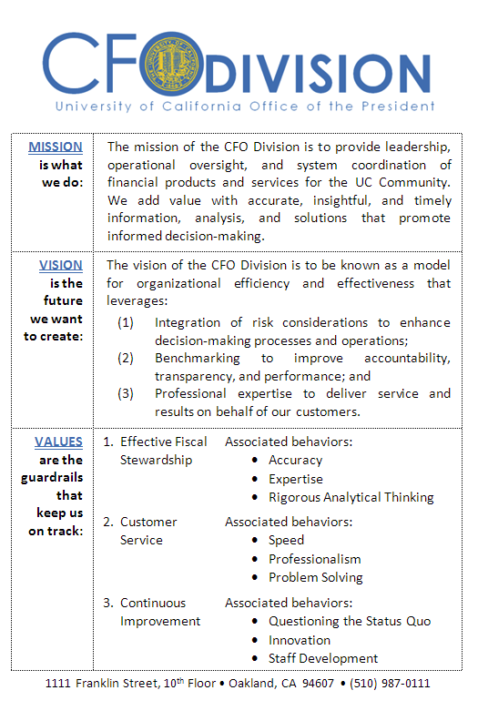
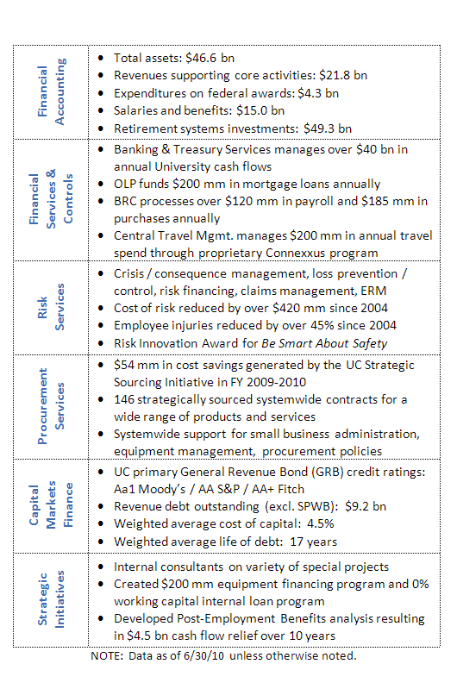
  Pocketcards were given to everyone on November 1st…

Slide 36
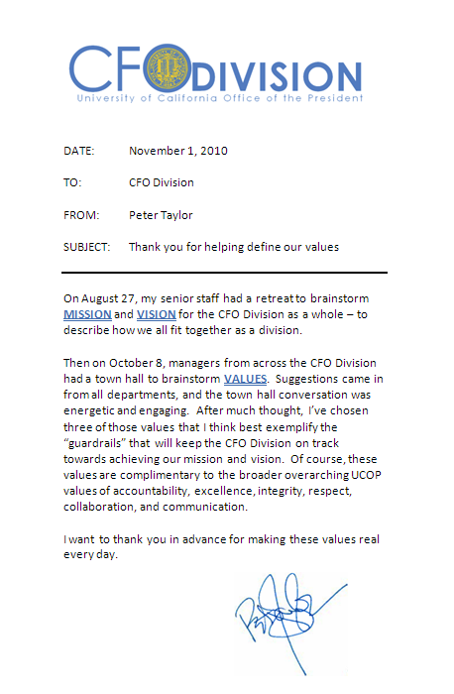
  …along with a note from Peter Taylor…

