Slide 1


Lunch-n-Learn: Capital Markets Finance
Presented By:
Pikka Sodhi & Allen Yin
September 27, 2012

Slide 2
Agenda
Who We Are
What We Do
  Debt Issuance Process
  Debt Portfolio
  Debt Management and Compliance
  Accomplishments

Slide 3
Who We Are

Slide 4
  Organizational Chart
Sandra Kim
Executive Director
Tim Loving
Administrative Assistant
Michael Mandelbaum
Senior Finance Officer
Pikka Sodhi
Finance Officer
Allen Yin
Finance Officer
Location
1111 Franklin St., Oakland
10th Floor, West Side, Between Accounting and Banking & Treasury Services

Slide 5
What We Do

Slide 6
Mission Statement
Capital Markets Finance at the University of California is responsible for managing the University's debt and loan portfolio. The mission of Capital Markets Finance is to support the capital-raising activities systemwide. The services we provide support capital programs for the campuses and medical centers who, in turn, provide services to our faculty and student body. In serving the University's needs, the staff of Capital Markets Finance is dedicated to providing efficient service with the highest standards of excellence.

Slide 7

University of California Capital Needs
  Capital needs continue to be a high priority for the University in order to fulfill its mission
  Accommodating student enrollment, systematic modernization and renewal of facilities, seismic corrections, deferred maintenance, and sustainability continue to remain the top capital priorities
  $9.1 billion Capital Financial Plan* FY12 through FY16:
    Approximately $2.4 billion of projects are projected for long term financing
* As of November 2011

Slide 8
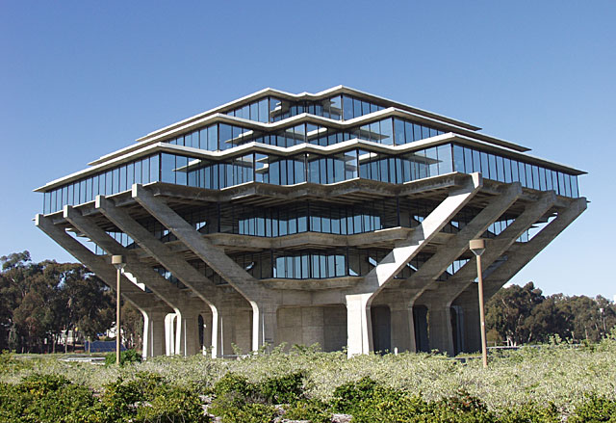




External Finance at the University of California
Campus Identifies Capital Project Need
Obtain Governance Approval for Project & External Finance
Campus Project Draws Funds from CMF
Long Term Financing
Post Issuance Compliance

Slide 9













Capital Markets Finance Internal Relationships
Office of the President
Regents & Secretary of the Regents
Budget & Capital Resources / Real Estate
Office of General Counsel
Financial Accounting
Banking & Treasury Services
Student Affairs
Treasurer’s Office
Audits & Compliance
Risk Services
Labor Relations
Health Sciences
External Relations – Communications

Slide 10
Capital Markets Finance External Relationships
Debt Issuance | Compliance/Others
Bond Investors | IRS
Rating Agencies | Municipal Securities Rulemaking Board
Bond Counsel, Underwriter’s Counsel | Securities Exchange Commission
Underwriters, Investment Bankers | Financial Press
California State Treasurer’s Office | Auditor (PwC)
Bond Trustee | Rebate Consultants
Financial Advisors
Commercial Banks
Swap Counterparties
Remarketing Agents / CP Dealers

Slide 11
Debt Issuance Process

Slide 12
Long Term Financing
Bond Issue Needed
Engage Financing Team
Documentation Process
Bond Pricing
Bond Closing

Slide 13


Bond Issue Needed
Bond Issue Needed
COMMERCIAL PAPER UTILIZATION
MARKET ENVIRONMENT
COMPLETED CAPITAL PROJECTS
Interim Financing sources need replenishment
Capital projects are in construction or almost complete and are ready for Long Term Financing
Market environment is conducive for financing and/or refunding of prior issued bonds

Slide 14



Engage Financing Team
Engage Financing Team
Finance Working Group
Bankers/ Underwriters | Rating Agencies | STO | Attorneys | Financial Advisors | Controller/ Auditor (PWC) | Bond Trustee

Slide 15

Financing Execution
Documentation Process
TO DO LIST | Completed?
Collect Project Information from Campuses
Obtain Ratings
Prepare University Disclosure
Decide on Bond Structure
Prepare Bond Documents
Prepare Bond Sizing
Private Use Surveys
Obtain PWC sign-off
Notify Banking Services and Treasurer’s Office
Double (Triple) Check Everything!

Slide 16



Bond Marketing and Pricing
Bond Pricing
Marketing the University’s Bonds
In the financing execution process the University prepares a disclosure for investors on the University
Bond Order Period
Bonds are sold through an order process after bond marketing process
Bond Pricing
Coupons and Rates are Set on the day of bond pricing
Enough bonds are sold for project capital needs
Including construction costs, capitalized interest and costs of issuance
If the University is refunding bonds, enough bonds need to be issued to fund an escrow to legally defease the refunded bond issue
This includes for example financial information, current credit ratings, student and state budget information
This disclosure is reviewed by investors to assist them in making a decision of whether or not they want to purchase the University’s bonds
Typically the marketing process before bonds are sold is a week
Typically the University offers bonds to retail investors (mom and pop) the day before they are offered to institutional investors (ie bond funds, insurance companies, hedge funds)
Bonds are sold by maturity – typically the University offers bonds from years 1 to 30 for new money capital projects

Slide 17


Closing a University Bond Issue
Bond Closing
After Bond Pricing the University works with Financing Team to Complete a Final Prospectus with all Coupons and Yields, Additional Legal Documents and Receive all Necessary Signatures and Certifications
Underwriter (Investment Bank) wires bond proceeds to Trustee
Bond Trustee Acknowledges Receipt of Bond Proceeds
Close Bond Issue – Bonds are registered at DTC
Bond Trustee Wires Funds to UC
Bond Proceeds Arrive at UC

Slide 18
Debt Portfolio

Slide 19
University of California Credit Types
Bond Type | Rating* |  |  | Outstanding Par
 | Moody's | S&P | Fitch
General Revenue Bonds | Aa1 | AA | AA+ | $ 7,825,235,000
Limited Project Revenue Bonds | Aa2 | AA- | AA | 1,810,360,000
Medical Center Revenue Bonds | Aa2 | AA- | - | 2,205,315,000
Hospital Revenue Bonds | - | - | - | 80,795,000
Commercial Paper** | P-1 | A-1+ | F-1+ | 2,000,000,000
Other Third Party Debt |  |  |  | 268,585,000
Financing Trust Structure |  |  |  | 419,910,000
State Public Works Board | Aa2 | AA- | AA | 2,457,810,000
* As of July 1, 2012
** Authorized amount

Slide 20
University of California Outstanding Debt by Credit
Outstanding Par by Credit Type
* As of July 1, 2012

Slide 21
University of California Debt Profile (FY 2013-2050)
The University has a front-loaded debt service structure
* As of July 1, 2012; Does not include final GRB AD principal of $860 million due in 2112

Slide 22
Debt Management & Compliance

Slide 23
Management of UC Debt Portfolio
Commercial Paper (CP) Program
    $2 Billion tax exempt and taxable CP authorization
    4 Dealers: Bank of America Merrill Lynch, Goldman Sachs, Morgan Stanley, JPM Chase
    Provides liquidity to finance the University’s needs:
      Financing of the University’s tri-partite mission of teaching, research, and public service
      Fund the State’s cashflow deferral needs, purchase of a State General Obligation bond, SB 79 State Investment
      CapEquip, the capital equipment program of the University
Lines of Credit
    $215 million line of credit for general corporate purposes.
    Other lines of credit primarily to fund campus capital projects that are funded with pledged gifts and projects with special needs
Bond Proceeds Expenditures
    For IRS tax compliance purposes, all tax-exempt bond proceeds should be expended within 5 years of issue date. If tax-exempt bond proceeds are remaining after 5 years they are “excess” proceeds and must be promptly dealt with in order to avoid IRS scrutiny

Slide 24
Compliance with IRS Regulations on Tax Exempt Financings
REQUIRED!
Continuing Disclosure
    Continuing disclosure for Lines of Credit and UC Bonds
    Includes updated Annual University Financial Statements, Medical Center Financial Statements, Performance of UC Investments, The University Annual Operating and Capital Budget, Debt Service Coverage etc.
Private Use Reporting
    All projects financed with tax-exempt (or Build America Bonds) debt are subject to the private use limitation. Lesser of 10% of or $15 million of bond proceeds (measured by campus and by bond issue)
8038 Filings for All Governmental Debt Issuance
    Tracks all governmental debt issuance. Required for any debt agreement (bond, installment purchase agreement or financial lease) on which the interest is excludable from income (i.e. tax-exempt).
    Late filing and/or failure to file accurately potentially has serious IRS compliance consequences. IRS Audit and potentially loss of tax-exempt status for all University financing.
Rebate Compliance and Spend-Down Requirements
    Section 148 of the IRS regulations deal with Rebate and Arbitrage Proceeds -- Investment of bonds proceeds and timely spend-down of all bond funds.

Slide 25
Accomplishments

Slide 26
University of California Century Bond - 2112
The University of California priced a benchmark 100-year taxable bond on Tuesday, February 21, 2012
The final issue amount was $860 million with a final, bullet maturity on May 15, 2112 and a coupon rate of 4.858%
The University’s transaction marked the largest 100 year offering for a borrower other than a sovereign
Investor demand was tremendous with over 70 investors participating in the transaction that included bond funds, insurance companies, hedge funds, banks, and pension funds
Final Terms
Issuer | Regents of the University of California
Ratings | Aa1 / AA / AA+
Security Description | Senior Lien Fixed Rate Bonds
Size | $860 million
Maturity | 100 Year (5/15/2112)
Coupon | 4.858%
Spread | 30 Year Treasury + 165 bps

Slide 27
LPRB 2012 Series G & H ($999,695,000)
Refunding
$150 million net savings($105 million PV savings)
Restructuring
$90 million in Berkeley housing par restructured
Berkeley was able to maintain flat housing rates for 2012-13
New Money
11 new campus projects financed
$220 million in project costs
~$6 million saved annually
40 projects systemwide realized savings

Slide 28
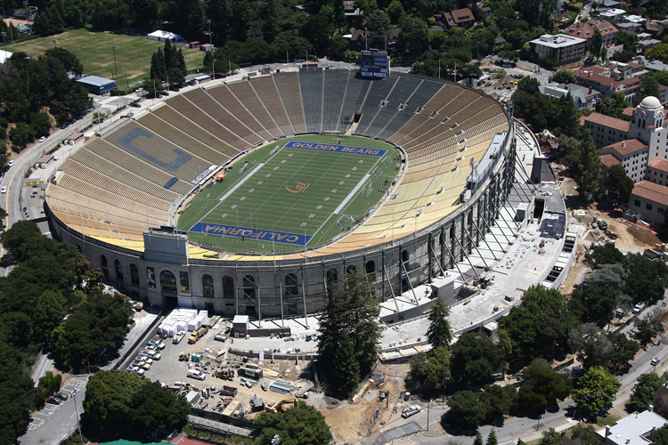
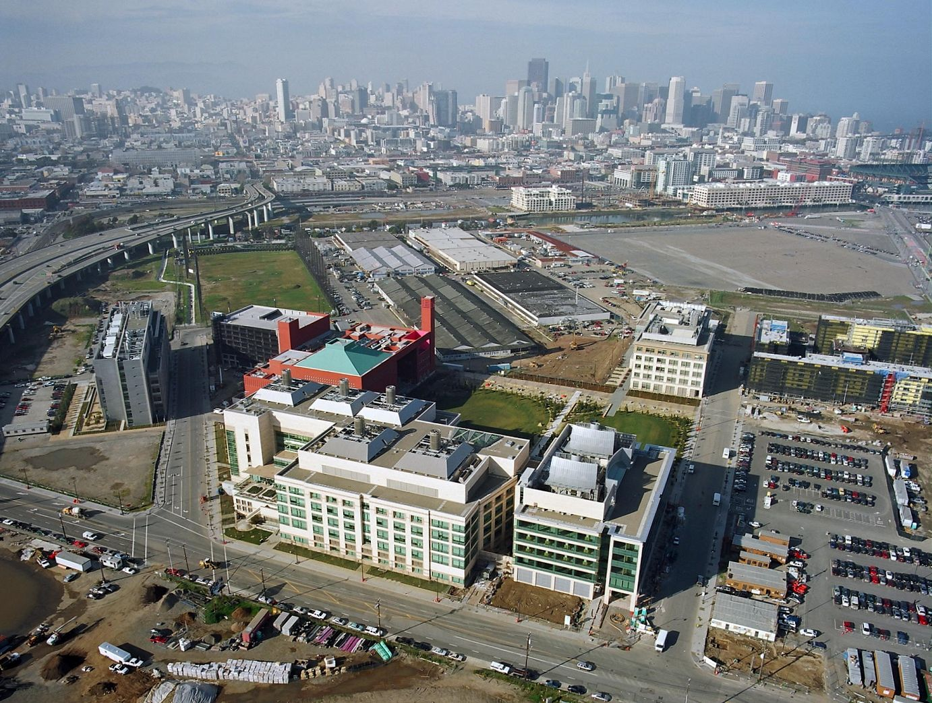
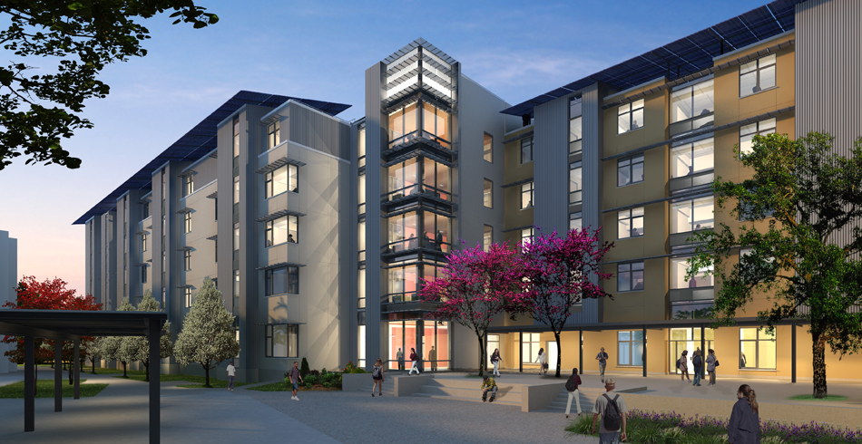
Recently Financed Projects
Cal Memorial Stadium | UCSF Mission Bay | UCM Housing Phase 4
$321 million total project cost | $1.5 billion total project cost | $48.7 million total project cost
$321 million financed | $700 million financed | $48.7 million financed

Slide 29
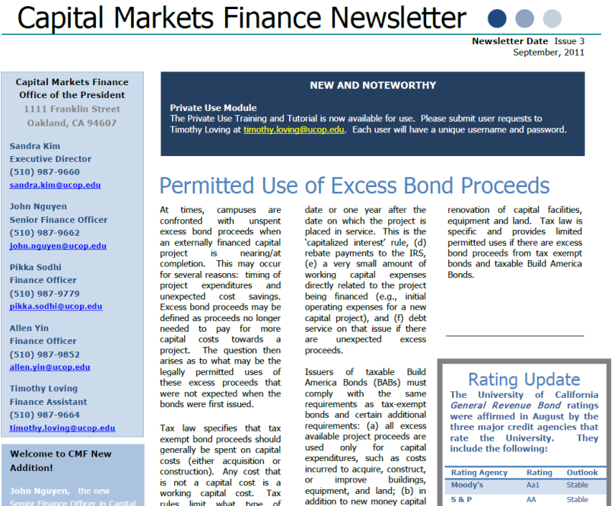
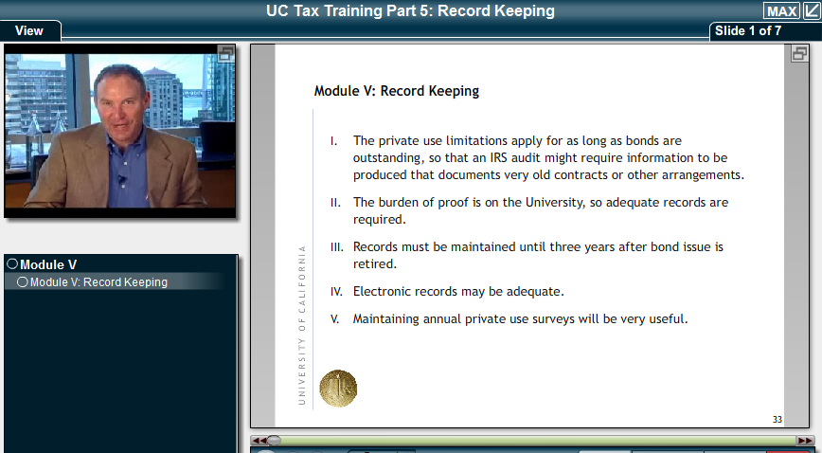
New Projects to Date
Debt Subgroup
CMF Newsletter
Bondholder Information Website
Private Use Survey & Tutorial
TM1
Debt Affordability Model

Slide 30
Not-So-Famous Quotes:
“Solid governance and management that has demonstrated willingness and ability to plan and implement financial and operational modifications to adjust to an evolving funding paradigm”
-Moody’s
“The ‘AA’ rating on the system’s general revenue debt reflect our opinion of the system’s very strong and growing demand at all of the 10 operating campuses, …, and history of successfully weathering multiple business- and state- funding cycles”
-Standard & Poor’s
“UC's substantial level of balance sheet resources; diverse revenue base, which enables it to weather temporary weakness in any one funding source; and manageable debt burden, despite the expansive, capital intensive nature of its operations, underpin its 'AA+' rating.”
-Fitch

