Slide 1
Lunch-n-Learn: Costing Policy & Analysis Overview
Presented By:
Joao Pires
Maria Cornejo
April 17, 2012
Notes:
Welcome to the Lunch and Learn series
I’m Joao and this is Maria

Slide 2
Popular Quotes:
“Sometimes the questions are complicated and the answers are simple.” Dr. Seuss
“Anyone who has never made a mistake has never tried anything new.” Albert Einstein
“Be yourself; everyone else is already taken.” Oscar Wilde
“I have not failed. I've just found 10,000 ways that won't work.” Thomas A. Edison
“Success is not final, failure is not fatal: it is the courage to continue that counts.” ― Winston S. Churchill
Notes:
We’ll start off with some quotes. Hope you find them helpful, inspiring and encouraging

Slide 3
Agenda
The Costing Policy and Analysis Function
Organizational Chart
Joao’s and Maria’s Office Location
What We Do
Examples of our Work
Current Projects
How Can We Help Each Other
Contact Information
Notes:
This is what we try to accomplish today

Slide 4
The Costing Policy & Analysis Function
The Costing Policy and Analysis function provides systemwide management of the financial and costing issues for federal and other extramurally funded projects (Contracts & Grants):
regulatory analysis and policy development,
federal indirect cost (Facility & Administrative) rate proposals,
coordination, negotiation and resolution with federal agencies and federal audit management.

Slide 5
Costing Policy & Analysis Organizational Chart
Peggy Arrivas, AVP and Systemwide Controller
Costing Policy and Analysis
Joao Pires
Director
Maria Cornejo
Costing Policy Analyst

Slide 6
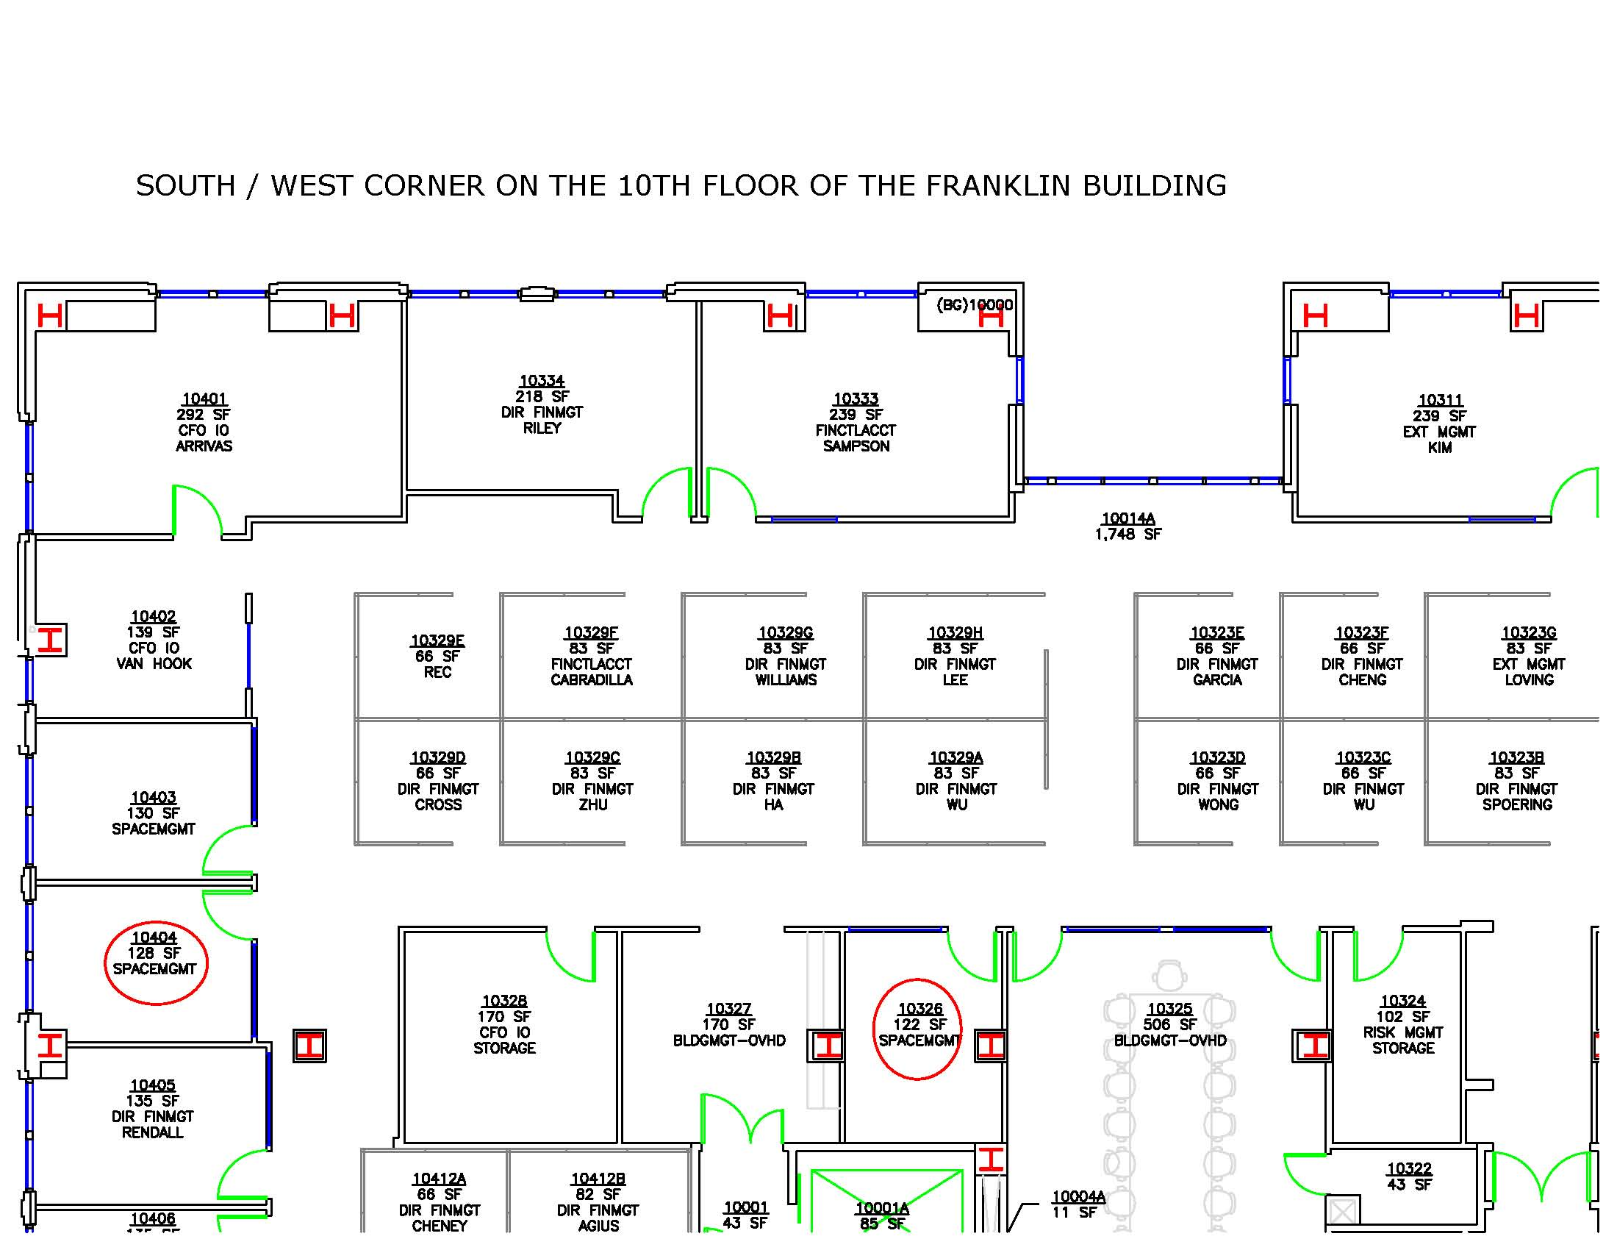
Joao’s and Maria’s Office Location on the 10th Floor

Slide 7
What We Do
The Costing Policy & Analysis primary functions cover the following areas:
Federal Indirect Cost (F&A) Rate Proposals and Negotiations
Federal Costing Regulation Analysis
Extramural Costing Policy Development
Primary Liaisons with Federal Audit Agencies
Federal Audit Resolution
A-133 Audit Report
Notes:
Coordinate with campus to develop and to submit F&A rate proposals
Interpretation of federal rules and regulations
Develop systemwide costing policies
Work with federal auditors

Slide 8
Definitions
Sponsored Projects – Awards made to UC by external sponsors to support research, training or public service programs
Direct Costs – are those costs that can be identified specifically with a particular sponsored project, an instructional activity, or any other institutional activity or that can be directly assigned to such activities relatively easily with a high degree of accuracy.
Salary of the Principal Investigator
Lab supplies
Lab instruments
Indirect Costs – are those costs that are incurred for common or joint objectives and cannot be identified readily and specifically with a particular sponsored project, an instructional activity, or any other institutional activity
Building depreciation and maintenance costs
Utility
Central Administration

Slide 9
Notes:
Depreciation of the lab building
Salary and benefit of the researcher
Equipment
Electricity
Infrastructure
Payroll processing

Slide 10
Life Cycle of a Sponsored Project
Proposal Preparation | Sponsor Review | Award Negotiation and Acceptance | Project Period |  |  |  | Closeout
Proposal Review |  |  | 1st Budget Period | 2nd Budget Period | 3rd Budget Period | No Cost time extension
Institutional Signature
Submission to Sponsor
Pre-award
Notes:
PI has an idea
Search for funding
Write proposal
Internal review and approval
submission

Slide 11
Operating revenue by source, Universitywide
2011 accountability report, IR

Slide 12
Direct research expenditures by source
In 2009-10, research expenditures totaling $4.7 billion accounted for nearly a quarter of the University’s entire operating budget
2011 accountability report, IR

Slide 13
Research indirect cost recovery by source, Universitywide
Budgets for externally funded research projects include both a direct cost component – the actual amounts needed to conduct the project – plus an overhead percentage to cover the indirect (F&A) costs required to house and support the research project. Indirect costs initially are financed by University funds, with reimbursement based on rates negotiated for each campus later.
Notes:
Indirect costs are initially paid for by the University

Slide 14
Notes:
How do we get to these rates? Let’s take a look at the next slide

Slide 15
F&A rate negotiation
How do we get to these rates?

Slide 16
Programs Subjected to Audit Procedures as Major Programs in FY 2011
Research & Development (R&D) Cluster
ARRA – State Fiscal Stabilization Fund
Digital Resource Licenses, Department of Energy
Poison Center Support and Enhancement Program, Health Resources and Service Administration

Slide 17
Current projects
The Costing Policy & Analysis unit is presently working on the following projects:
Automation of the Schedule of Expenditures of Federal Awards (SEFA) in the A-133 audit report.
Working with the campuses to correct award information incorrectly entered into their systems. Quality of the data affects financial and other statistical reports .
Systemwide Composite Fringe Benefits Rates to be used with the new payroll system.
CRIS (Comprehensive Rate Information System) License and RFP.

Slide 18
How Can We Help Each Other?
Sharing information with us on new initiatives that would be useful in the performance of our jobs and for informational purposes.
Help you understand federal regulatory changes that may affect you
Follow policy to minimize audit risks
Informing us should any duplication of effort situations are identified.
We are always available to help you.
We thank you for your support.

Slide 19
Our Contact Information
Joao.Pires@ucop.edu # 7-9844
Maria.Cornejo@ucop.edu # 7-0940

Slide 20
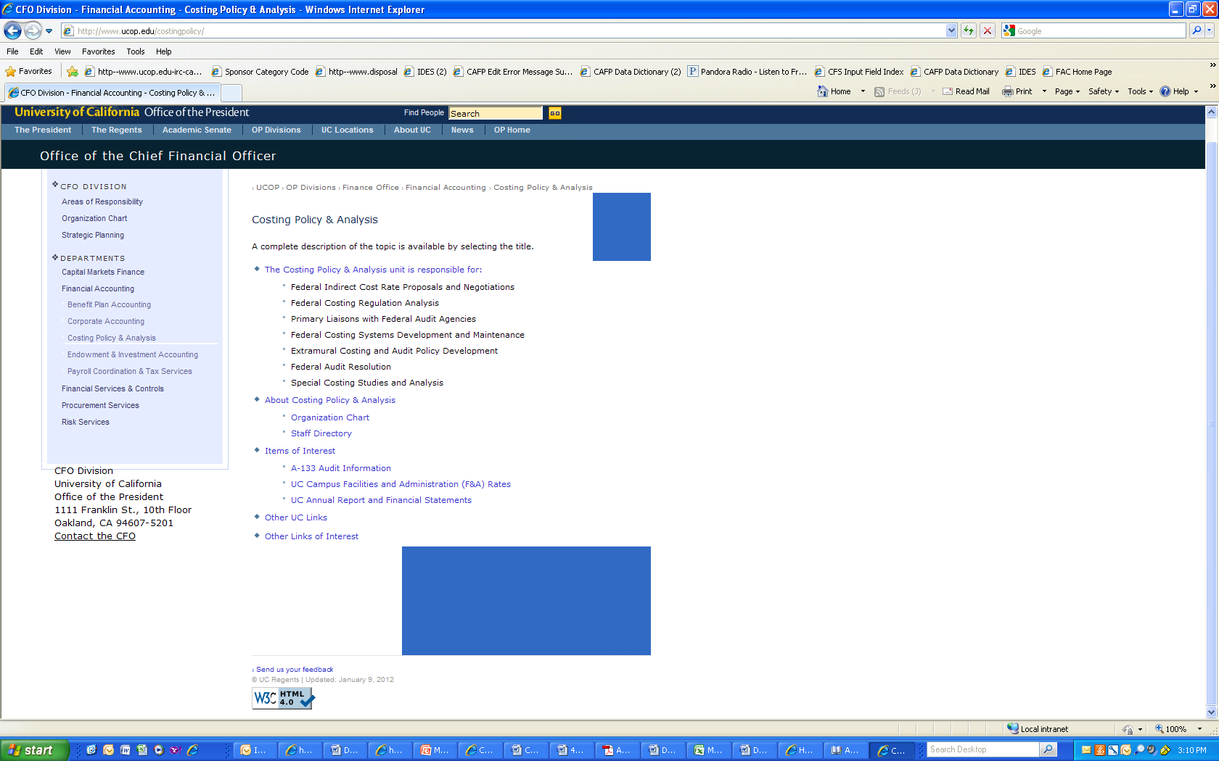
Costing Policy & Analysis web location: https:// http://www.ucop.edu/costingpolicy/

Slide 21
THANK YOU!

