Slide 1


Managers’ Town Hall
February 24, 2012
Franklin Lobby Conference Room
2:30-4:00 p.m.

Slide 2
Agenda
 | 2:30 – 2:45 | Welcome & General Announcements
 | 2:45 – 2:55 | Results of CFO Strategic Goal Survey
 | 2:55-3:55 | CFO Division Strategic Goals Exercise
 | 3:55 – 4:00 | Wrap-Up

Slide 3
Welcome

Slide 4
  CFO Division
  Announcements…
Erike Young
Janis
Vega
Cathy O’Sullivan
Ruth
Assily
Kevin
Kendall
Helen McCullough
Amy
Vrizuela
Luann
Ford
Gisella
Falossi
Phil
Pena
Maria
Anguiano
Grace Crickette
Valerie Vergara
Eric
Pollack
Notes:
Cathy O’Sullivan – New Working Smarter Director
Helen McCullough – Became a US Citizen and celebrated her 10 year anniversary at UCOP
Erike Young – ASSE National Safety Professional of the Year
Grace Crickette – Top 25 Women to Watch by Business Insurance
Phil Pena – Welcome, new member of Banking and Treasury Services
Valerie Vergara –Welcome, Life Sciences Commodity Manager
Eric Pollack – Welcome, Food & Hospitality Commodity Manager
Gisella Falossi – Welcome P$200mm SciQuest Systems Project Manager
Janis Vega and Ruth Assily – 25 years of service
Luann Ford – 30 years of service
Amy Vrizuela – 10 years of service
Kevin Kendall – XX Years of Service
Maria Anguiano – 2012 HOPE Leadership Class - statewide leadership program specifically designed for emerging Latina leaders in California.

Slide 5
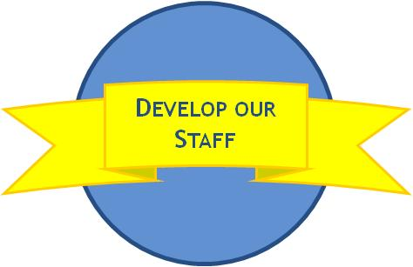


Lunch & Learn Series Schedule
Date | Presenting Group
27-Sep-11 | Strategic Initiatives (Lisa Baird/Maria Anguiano)
18-Oct-11 | Risk Services (Grace Crickette)
15-Nov-11 | Benefit Plan Accounting (David Olson)
18-Dec-11 | No meeting.
24-Jan-12 | Taxes (John Barrett)
21-Feb-12 | General Accounting (Doris Wildeman)
29-Mar-12 | Endowment & Investment Accounting (Kevin Kendall)
17-Apr-12 | Facilities and Administrative (F&A) Rates (Joao Pires)
29-May-12 | Capital/Debt Accounting (Irene Yamamoto)
19-Jun-12 | Office of Loan Programs (Ruth Assily)
24-Jul-12 | BRC (Helen Valness)
28-Aug-12 | Central Travel Management (Matt Golden)
27-Sep-12 | Capital Markets Finance (Sandra Kim)
30-Oct-12 | Procurement Services (Alan Moloney)
27-Nov-12 | Banking & Treasury Services (Jerry Frantz)
20-Dec-12 | No meeting.
DATE CHANGES!!
Changes: Moved to Larger Rooms 5320 or Lobby
Any Additional Suggestions?

Slide 6

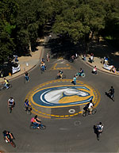
  Campus Site Visits
  Second Site Visit:
“…the tour was a
very positive
experience”
  Jan 31st
“This was a great opportunity
to see what happens out
at the campuses/medical
centers.”
“Amazed
by the
UCDHS footprint ”
“These trips are a
wonderful opportunity….just
inspiring to be reminded of the University’s
impact as an organization.
“The scale of the Center is amazing
– 100 buildings, 10,000 employees.
I had no idea it was that large.”
  Next Visit: LBNL – May 3rd
  Lead: Dan Sampson
  Senior Managers:
  please submit any additional candidates for site visits

Slide 7
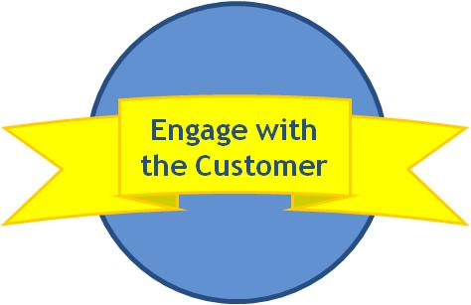
  Customer Survey - Results
Erike Young
Survey went out to all location in January
Over 700 responses
Every senior manager has individual unit responses
Customers feel
that they receive
expert advice
86%
Overall
Service and
Value
81%
Resolve problems/
issues to customer
satisfaction
85%
CFO Division
develops practical
solutions to concerns
78%
Timeliness in
responding to
requests
80%
Area of
Improvement
Over 20% of time, people are waiting 3-5 days for initial contact

Slide 8
  Customer Survey – Shout-outs
Recognized 3 or more times by customers
Debra
Almason
Grace
Crickette
Jerry
Frantz
Kevin Confetti
Michael
Strach
Janis
Vega
Jeff
Donahue
Lesley
Clark
Gary
Leonard
Terri
Kielhorn
Sandra
Kim
Alan
Moloney
Janine Crocker
Allen
Yin
Vicky
Lam
Erike
Young
Pikka
Sodhi
Sandra
Chan
Cheryl
Lloyd
Peggy
Arrivas
John Barrett
Doris
Wildeman
Irene
Yamamoto
Kim
Williams
Notes:
Peet’s Gift Card Drawing!!!

Slide 9
  HR Announcements, Comments and Questions?
      1. New UCOP Local HR Business Partner:
      Patsy Alejado
      2. Transition Assistance Payroll Advance Program
      Questions or Comments?
      2. Career Track Project
      Career Tracks will establish a consistent, market-based MSP and PSS job titling system within OP and ultimately across the UC system
      3. UPTE Campaign for Administrative Professionals
      Michael Lum (Michael.Lum@ucop.edu), Employee and Labor Relations Office can provide guidelines to help you discuss collective bargaining and unionization with your staff and/or to join you at your meetings

Slide 10

Annual Review of Strategic Goals

Slide 11
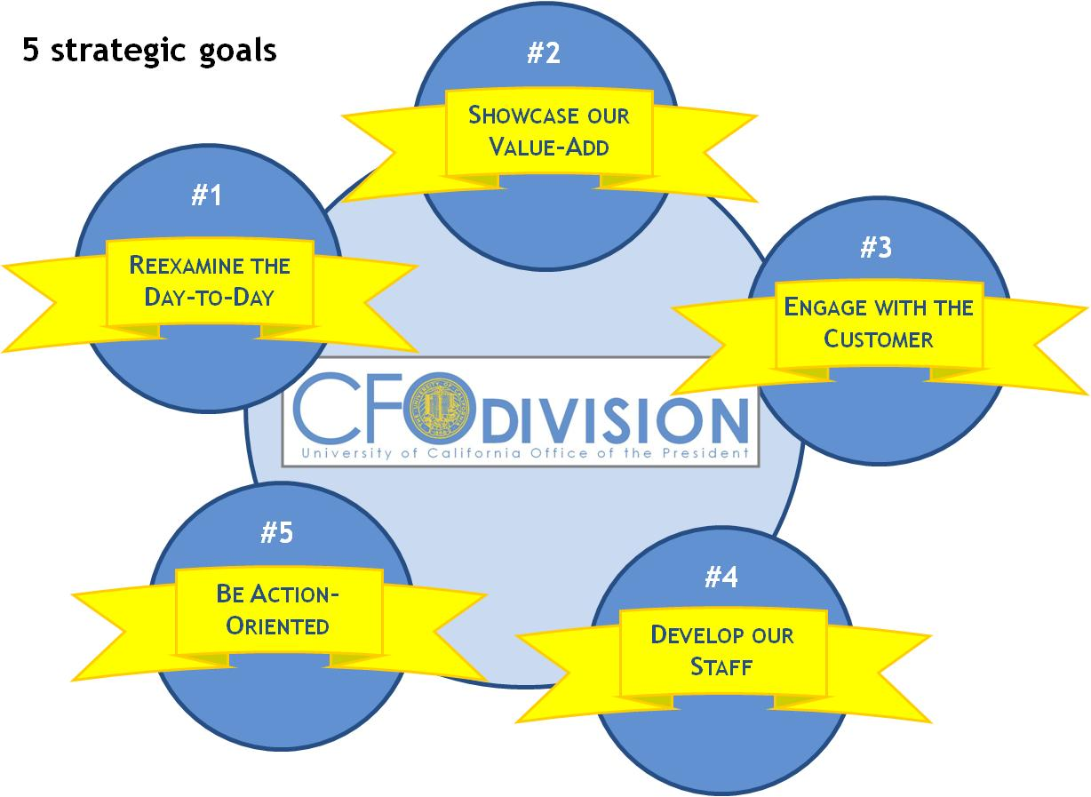
  Why are we talking about this?
Its been 1 year since we developed our 5 Strategic Goals and we need to ensure we are focused on making progress
"A dream is just a dream. A goal is a dream with a plan and a deadline.“
- Harvey Mackay

Slide 12
  Strategic goals survey sent out to all CFO Division employees:
  Participation up from prior year
% of participation

Slide 13
  We’ve come a long way since the last year….
  Perceived % progress rate
50% Progress Rate
On almost all
goals

Slide 14
Perception has changed somewhat on difficulty of goals to achieve by the Division…
Prior Year
Current Year

Slide 15





  Game Time – Breaking Down Barriers!!
  6 randomly
  selected groups…
  10 minutes to identify barriers to achieving 3 goals…
  20 minutes
  to report out…
  3 stickers to vote on most important…
  10 minutes, ideas on removing most significant barrier
  20 minutes
  to report out…

Slide 16
Wrap-Up

Slide 17
  Wrap-up
Values
      Next Meeting:
      CFO Division Town Hall
      June 1, 2012
        ENTIRE DIVISION !!!
      Navigating UCOP Reference Guide Available
      http://www.ucop.edu/busops/documents/navigating-ucop.pdf

