Slide 1


Town Hall
June 1, 2012

Slide 2
Agenda
Part I: | Welcome & Introduction
 | Staff Announcements
 | Why are we here?
Part II: | UCOP Local HR/IT Updates
HR | Structure & Services
IT | Email Management System
IT | CFO Division-wide Sharepoint
Part III: | Taking our Strategic Goals to the Next Level
 | Overview
 | Survey Highlights
 | Accomplishments to Date
 | Steps Left to Climb
Part IV: | Q&A + Wrap-Up
Part V: | Party Time!

Slide 3
Part ii: ucop local hr/IT
Updates

Slide 4
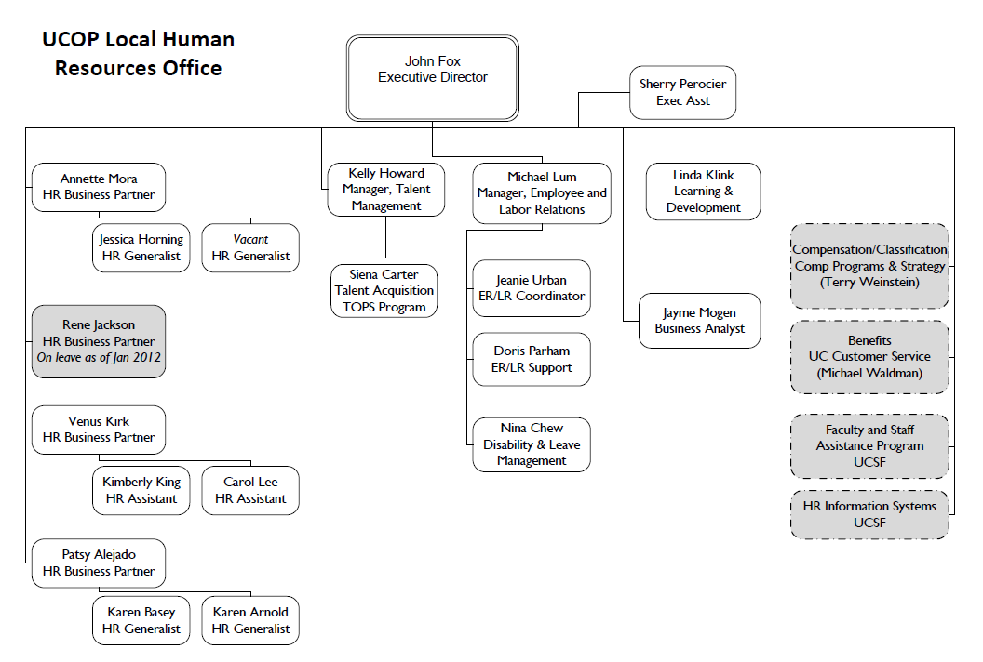
  New UCOP Local HR CFO Business Partner
Patsy Alejado – HR Business Partner
Franklin, 6th Floor
(510)987-0335 patsy.alejado@ucop.edu

Slide 5
IT: Email Management System
Speakers:
Milly Shiu & Gemma Rieser
CFO Trainings
Occurred
In May
Timeline
PREPARE: Review and make decisions about vaulted e-mail items
May 1- June 30: Review messages in Inbox, Sent, Drafts, and Junk & move those you want to keep
June 22: EVault is decommissioned, Vaulted messages that remain are deleted
June 30: The new storage option, the Outlook Archive, becomes available
July 1: All e-mail messages (in Inbox, Sent, Drafts, and Junk) over one year old are automatically deleted on a daily basis
For more help, go to:
http://www.ucop.edu/irc/
services/email-management.html

Slide 6
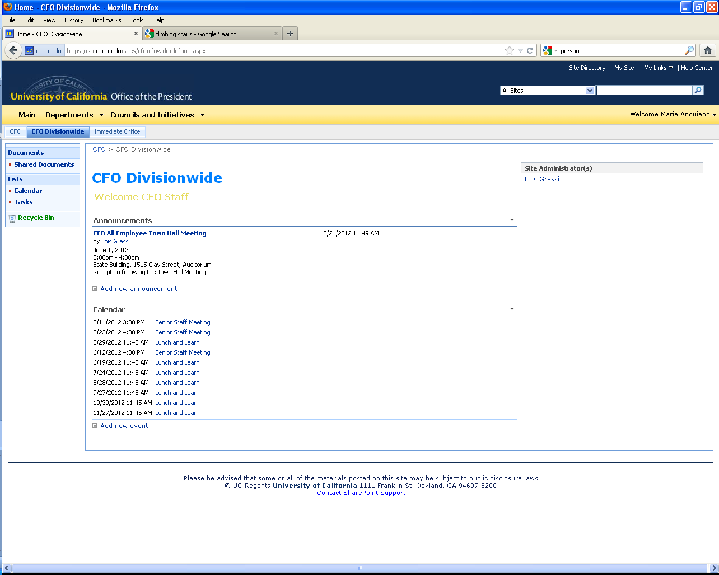
CFO Division Sharepoint Site, Official Launch!!
To access:
https://sp.ucop.edu
Go to Departments: CFO IO
Select Tab: CFO Divisionwide
Send your ideas
for content
to Lois Grassi
Weekly CFO Announcements

Slide 7

Part iIi:
Taking our Strategic Goals to the Next Level

Slide 8
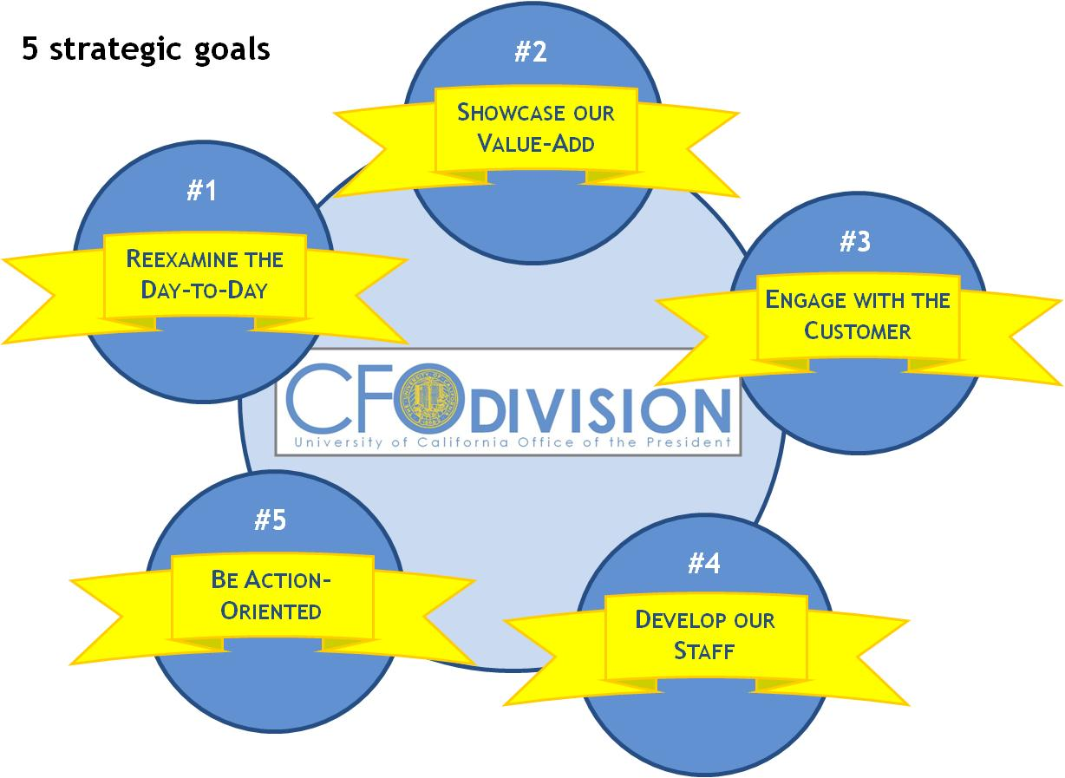
  Why are we talking about this?
This is our second annual town hall since we developed our 5 Strategic Goals and we need to ensure we are focused on making progress!
"A dream is just a dream. A goal is a dream with a plan and a deadline.“
- Harvey Mackay

Slide 9
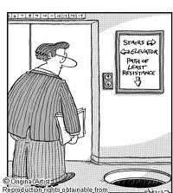
  Strategic Goals Demand Constant Attention
Measuring progress
and celebrating
successes is essential
to moving forward!!

Slide 10
  Strategic goals survey sent out to all CFO Division employees:
  Participation up from prior year!!
% participation

Slide 11
  We’ve come a long way since the last year….
  Perceived % progress rate
50% Progress Rate
On almost all
goals

Slide 12
Perception has changed somewhat on difficulty of goals to achieve by the Division…
Prior Year
Current Year

Slide 13
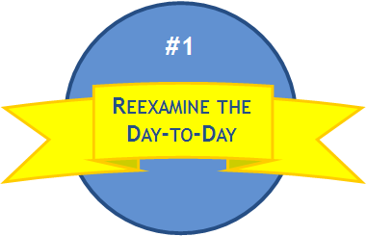
Manager TOWN HALL Session in February:
Focus on reviewing three most difficult strategic goals
Biggest
Barriers
#2
#4
Area 1
Area 2
Area 3
Develop our Staff
Showcase our Value-Add
Ideas for
Overcoming
Action Item 1
Action Item 2
Action Item 3

Slide 14

Lets Examine what we’ve accomplished…
So how much further is there left to climb?
… and how we can get to the next level

Slide 15


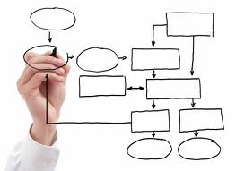
What’s been Done….
“Re-examine the Day-to-Day”
#1
  CFO Division Strategic Goal Survey
  Examples of Initiatives:
    Creation of SHIP: Student Health Insurance Program
    BRC Monthly Reconciliation Process Revisit
    Reengineering of Benefit Accounting Group processes

Slide 16



UC Student Health Insurance Plan
#1
Speaker:
Heather Pineda
Provides medical, dental, & vision coverage for graduate and undergraduate students at all UC locations
Anticipated students will save $8.4 mm in premium in FY2011-2012 and receive about $5.4mm in new benefits.
Over 135,000 students participate
Operational efficiency and savings across the system have been achieved by consolidating administration at UCOP.
The medical plan is self-funded, resulting in additional cost savings by removing carrier retention and broker fees from the premiums.
Heather Pineda, Plan Director,
Susan Mahoney, Program Manager,
Carol Lake, Financial Analyst,

Slide 17
BRC Revamps Reconciliation Process
#1
Speakers:
Helen Valness & Amal Smith
Eliminate
Eliminated the distribution of the monthly reconciliation packages
Streamline
Move to relying on budget to actual variance reporting by BDS
Focus on value added review and assurance as needed
Customer Focus
Respond to customer questions on ledger transactions and provide additional expenditure analysis and reports
Eliminated signing-off on the “green sheets”

Slide 18
Benefits Plan Accounting Business Process Improvement Project
#1
Speaker:
David Olson
Timeline
Plan
Sept. – Oct. 2011
Document
Oct. 2011- Feb. 2012
Assess/Design
April 2012
77 Improvement Targets
Policy/Procedure
Printing & Report Format
Process
Systems Changes/Other
Eliminate
Automate
Simplify
Move to
Electronic
Format
Improve
Consistency

Slide 19
Steps left to Climb:
“Re-examine the Day-to-Day”
#1
Biggest
Barriers
Ideas
For
Overcoming
Culture
2. Seeing change as threat
3. Need adequate resources, staff and skill levels
Strong support at top of organization
Better define and communicate goals to drive and support an environment of change
Training and Development - Use least “Change Adverse” to become change agents

Slide 20
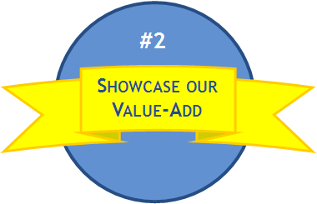
What’s Been Done
“Showcase Our Value-Add”
Risk
Summit
Working
Smarter
Sub-Division
Newsletters
Systemwide
Meetings

Slide 21
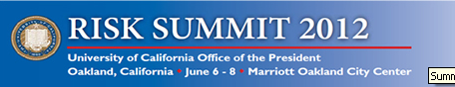


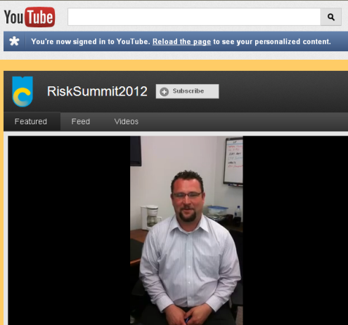

Risk Summit
Annual gathering of UC professionals is an opportunity to connect with colleagues to share perspectives, best practices, challenges and solutions that you can use to improve efficiency in your workplace and to better manage risk.
June 6-8, 2012
Oakland Marriott City Center 1001 Broadway • Oakland
Development Opportunity
for CFO Staff
(Must get Supervisor Approval)
Social Media Savvy!!
http://www.facebook.com/pages/UC-RiskSummit/431517106878371
https://twitter.com/#!/risksummit2012
http://www.youtube.com/user
/RiskSummit2012/featured

Slide 22
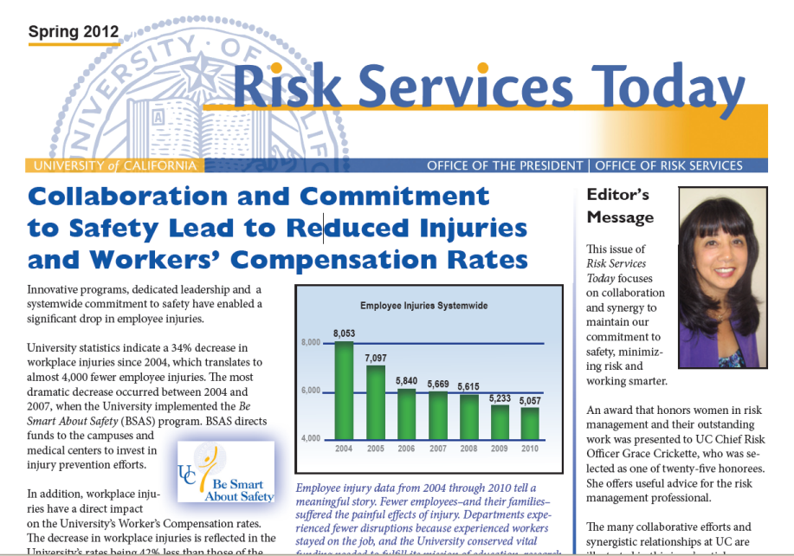
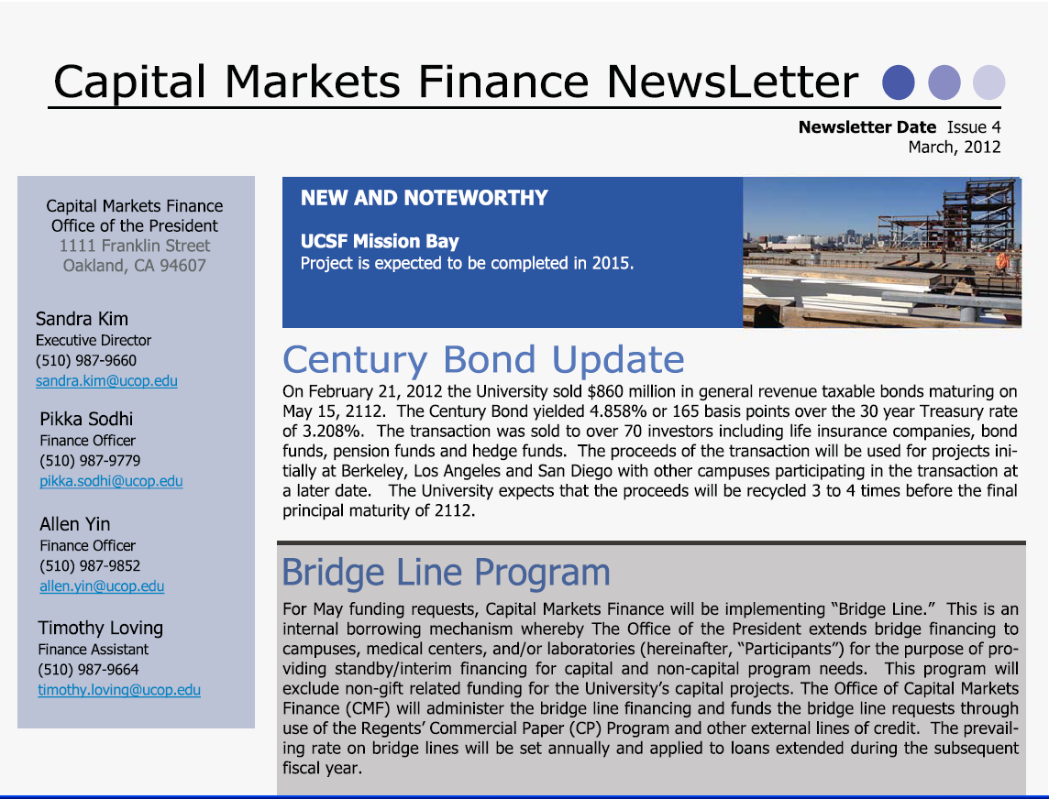
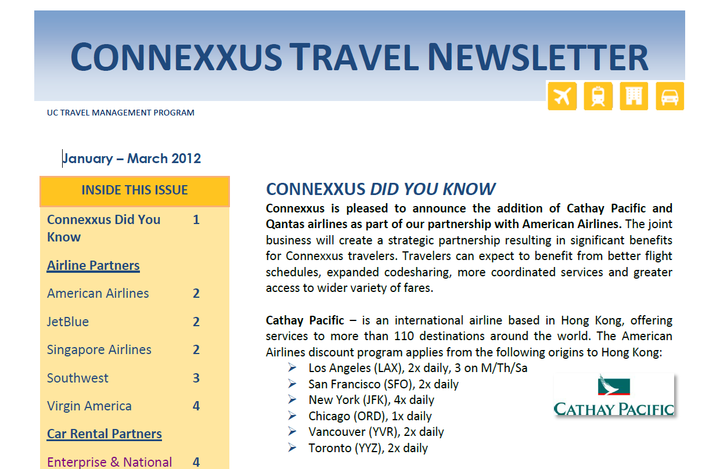
CFO Newsletters!
Thank You Cheryl Lloyd!!
Thank You Tim Loving!!
Thank You Giesel Velez!!

Slide 23
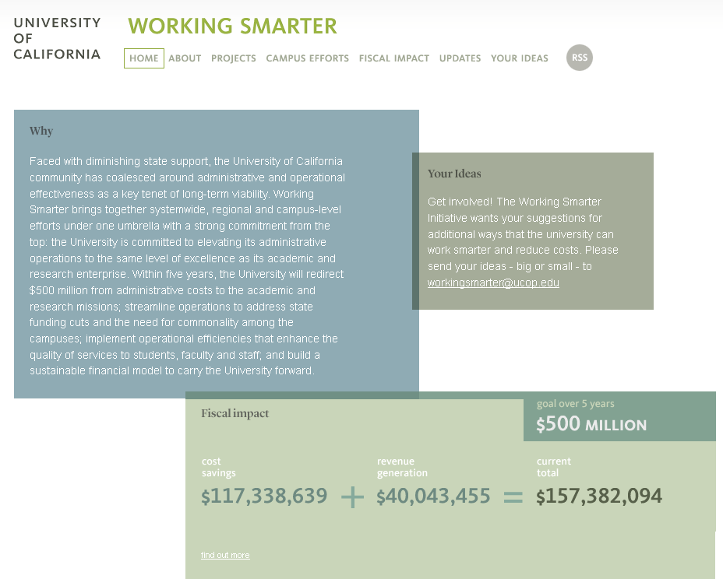
Working Smarter
New Working Smarter Director
Cathy O’Sullivan
http://workingsmarter.universityofcalifornia.edu/
CFO Division Initiatives
Responsible
for 84% of Savings/Revenue
$132 Million!!

Slide 24
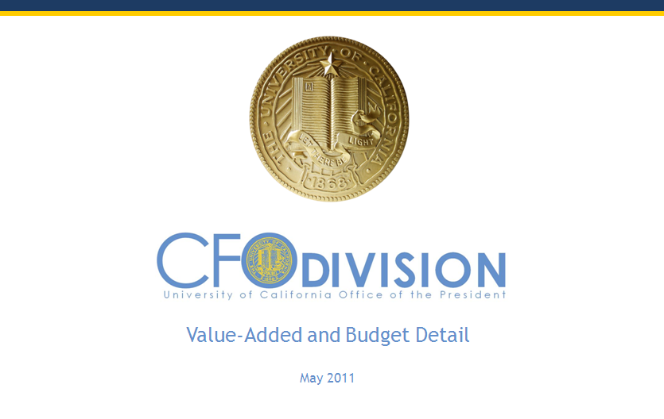
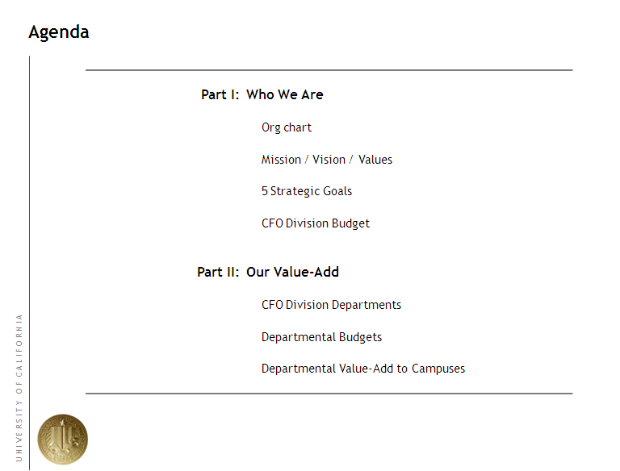
Systemwide Meetings
At last year’s Town Hall we previewed Peter’s
CFO Value-Add Presentation for COVC
CFO Division ranked by Executive Budget Committee as one of highest value-added units at Office of President!!!
Many presentations to systemwide groups
since May 2011

Slide 25
Steps left to Climb:
“Showcase Our Value-Add”
Biggest
Barriers
Ideas
For
Overcoming
Calculating and articulating value to right audience
Competing priorities
3. Marketing expertise resources not available
Benchmark, use standard metrics, set improvement goals
Add to unit goals for the year and invest resources to accomplish
Leverage existing resources – Sharepoint, ERMIS Dashboards, AIM KPI Report

Slide 26
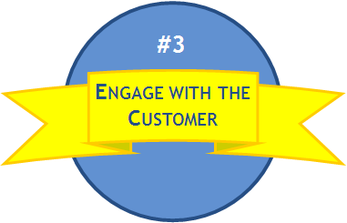

What’s Been Done
“Engage with the Customer”
  CFO Division Customer Survey
  Monthly Controller Meetings
    Whitepaper on common financial systems
  Quarterly Debt Advisory Meetings
  Weekly Material Manager Leadership Council Meetings
  Systemwide Treasury, Student Financial Services, Disbursements and Payroll Meetings
  Regular BRC/Travel Open Houses at Franklin and Kaiser buildings
  UC Path Committees

Slide 27
  Customer Survey - Results
Erike Young
Survey went out to all location in January
Over 700 responses
Every senior manager has individual unit responses
Customers feel
that they receive
expert advice
86%
Overall
Service and
Value
81%
Resolve problems/
issues to customer
satisfaction
85%
CFO Division
develops practical
solutions to concerns
78%
Timeliness in
responding to
requests
80%
Area for
Improvement
Over 20% of time, people are waiting 3-5 days for initial contact

Slide 28
  Top 7 Shout-outs from Customer Survey
Janis
Vega
Cheryl
Lloyd
John
Barrett
Michael
Strach
Grace
Crickett
Doris
Wildeman
Jeff
Donahue
Notes:
Risk Services
Grace - 18
Cheryl – 14
Doris 13
John Barrett – 15
Jeff Donahue - 13
Michael Strach – 11
Janis Vega -

Slide 29
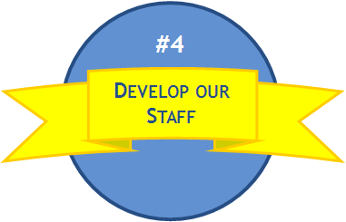
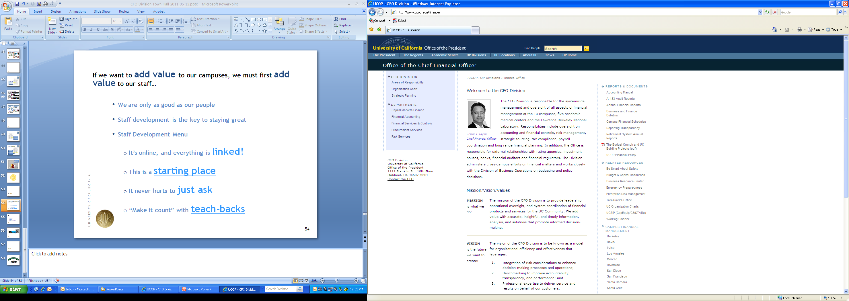


What’s been done:
“Develop Our Staff”
  Staff Development Menu
    It’s online; everything is linked!
  Lunch n’ Learns
  Site Visits – 3 so far UCSF, UC Davis, LBNL
    Employees nominated by managers
    10-15 Selected by Peter Taylor
  New Pilot CFO Staff Development Program

Slide 30

Lunch & Learn Series Schedule
Date | Presenting Group
27-Sep-11 | Strategic Initiatives (Lisa Baird/Maria Anguiano)
18-Oct-11 | Risk Services (Grace Crickette)
15-Nov-11 | Benefit Plan Accounting (David Olson)
18-Dec-11 | No meeting.
24-Jan-12 | Taxes (John Barrett)
21-Feb-12 | General Accounting (Doris Wildeman)
29-Mar-12 | Endowment & Investment Accounting (Kevin Kendall)
17-Apr-12 | Facilities and Administrative (F&A) Rates (Joao Pires)
29-May-12 | Capital/Debt Accounting (Irene Yamamoto)
19-Jun-12 | Office of Loan Programs (Ruth Assily)
24-Jul-12 | BRC (Helen Valness)
28-Aug-12 | Central Travel Management (Matt Golden)
27-Sep-12 | Capital Markets Finance (Sandra Kim)
30-Oct-12 | Procurement Services (Alan Moloney)
27-Nov-12 | Banking & Treasury Services (Jerry Frantz)
20-Dec-12 | No meeting.
Come learn
What your colleagues
work on !!!
Where:
Rooms 5320 or Lobby 1

Slide 31

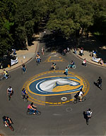
  Campus Site Visits
  Second Site Visit:
“…the tour was a
very positive
experience”
  Jan 31st
“This was a great opportunity
to see what happens out
at the campuses/medical
centers.”
“Amazed
by the
UCDHS footprint ”
“These trips are a
wonderful opportunity….just
inspiring to be reminded of the University’s
impact as an organization.
“The scale of the Center is amazing
– 100 buildings, 10,000 employees.
I had no idea it was that large.”
  Next Visit: LBNL – June 11th
  Lead: Dan Sampson
  Senior Managers:
  please submit any additional candidates for site visits

Slide 32
Pilot CFO Staff Development Program Overview
Speakers:
Maria A., Alan M., Brad N.
Pilot CFO Staff Development Program
What does program entail?
Who can apply?
Process
A 9-month, 6 person program involving training courses, a group project, and a project/work opportunity in an area of interest within the CFO Division
All non-managerial employees who have worked for the CFO Division for at least 1 year, received at least a “meets expectations” in their performance evaluation, and are approved and supported by their manager
Application Due Date: June 30th, 2012
Applicant Interviews: July 2012
Select Participants: August 2012
Program Length: September 6th 2012- June 1, 2013

Slide 33
Pilot CFO Staff Development Program cont.
9 Month Training Component
Internship Component
  ½-1 day courses every other week
  Courses will include Skills Assessment, Powerpoint, Excel, Modeling, Presentation Skills, Communications, Project Management
  From 10-30% of time, for 1-3 months
  Sample Projects include:
    UC Path – User Acceptance Testing
    Capital Markets Finance - Produce debt service schedules for the DIS after a major bond issuance
    Banking – Help campuses with cash flow data
    Corporate Accounting – Assist in compilation of financial data
    Risk - Propose funding model for self insurance
Group Project
  Program participants will work on a group project throughout the year
  Findings/Results/Conclusions from project will be presented at next annual Town Hall

Slide 34
Steps left to Climb:
“Develop our Staff”
Biggest
Barriers
Ideas
For
Overcoming
Lack of Time
No career tracks
3. Lack of structured programs
Managers must make this a priority
Create cross-training opportunities, HR Career Track Program
Create CFO Staff Development Program

Slide 35
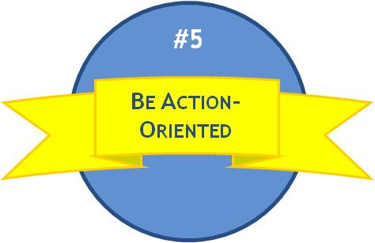
What’s Been Done
“Be Action-Oriented”
#5
Century
Bond
P$200
Program
EIA Online

Slide 36
University of California Century Bond – 2112!!
Speaker:
Allen Yin
The University of California priced a benchmark 100-year taxable bond on Tuesday, February 21, 2012
Largest 100 year offering for a borrower other than a sovereign
Investor demand was tremendous!
Over 70 investors participating in the transaction that included bond funds, insurance companies, hedge funds, banks, and pension funds
Final Terms
Issuer | Regents of the University of California
Ratings | Aa1 / AA / AA+
Security Description | Senior Lien Fixed Rate Bonds
Size | $860 million
Maturity | 100 Year (5/15/2112)
Coupon | 4.858%
Spread | 30 Year Treasury + 165 bps

Slide 37
The P200 Program:
Speaker:
Zoanne Nelson
P200 CHALLENGE:
Deliver $200 million in annual cost savings within five years by building an internal infrastructure to improve and sustain the procurement process.
P200 Program Initiatives
Org Alignment
Sourcing:
Supplier
& Contract Management
Analytics
Commodity Management
Large Category Sourcing Opportunities
Utilization
Program Management: assess, plan, design, implement, transition, measure
Change Management: train, communicate, prepare, support

Slide 38
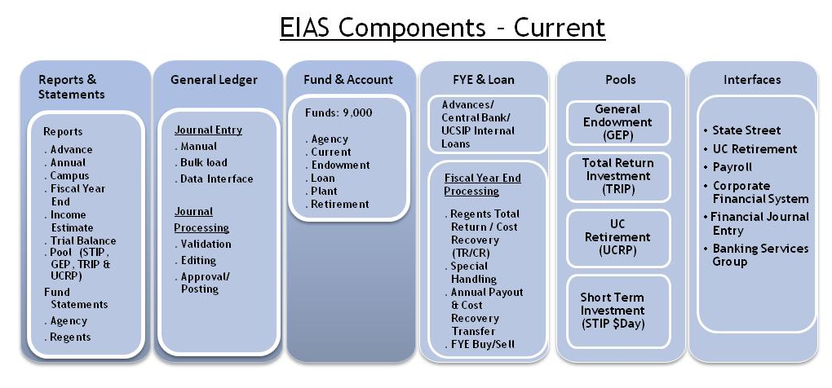
EIA Conversion
Speaker:
Kevin Kendall
Accounts: 8,900
. Asset
. Expense
. Fund Balance
. Liability
. Revenue
Accounts: 8,900
. Asset
. Expense
. Fund Balance
. Liability
. Revenue
EIAS – Preliminary Plan for Conversion
FundriverOnline
Data Warehouse
GL and CFS/CFR
EIAS Online
Fund
Scheduled Reports
EIA Journal Entry
Pool Processing
EIA General Ledger Accounts
File Interface
Data Warehouse Archive
Central Bank/UCSIP
Fiscal Year End Process
On Demand Reports

Slide 39

Concluding Remarks:
We’ve climbed many stairs this year but we still have more to go!!
CFO Division
will climb to a
new level!
FY2012-13
CFO Division
will be focused on removing barriers to strategic goals
FY 2011-12
CFO Division progressed on
all its strategic goals

Slide 40
Part v:
Q&A + Wrap-Up

Slide 41
  Q&A
      Questions?
      Comments?
      Feedback?

Slide 42
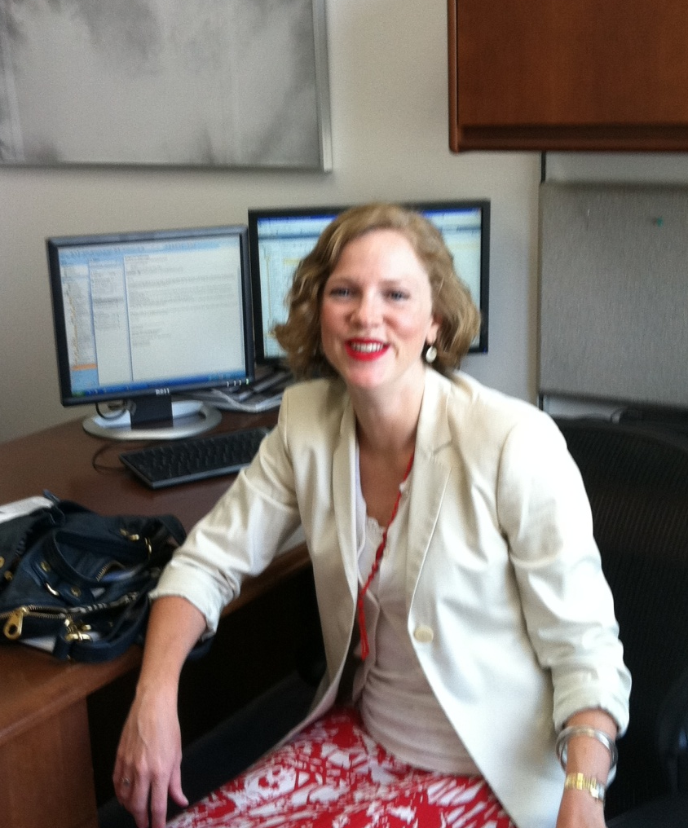
  Congratulations and Farewell to Lisa Baird!!!!
Thank you for our outstanding service to the University.
Your creativity, energy and innovative spirit will be greatly missed.
Good luck in your future endeavors!
“If you are lucky enough to have lived in Paris… then wherever you go for the rest of your life, it stays with you, for Paris is a moveable feast.”
- Ernest Hemingway

Slide 43
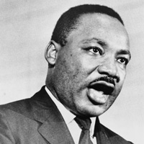
  Parting words…
      “Faith is taking the first step even when you don't see the whole staircase”
      — Martin Luther King Jr.

Slide 44
Part vI:
Party time

Slide 45

After Party !
906 Washington Street
Between 9th and 10th
3:30 – 5:00 p.m.

