Slide 1


Managers’ Town Hall
October 21, 2011
Franklin Lobby Conference Room
2:30-4:00 p.m.

Slide 2
Agenda
 | 2:30 – 2:45 | Welcome & General Announcements
 | 2:45 – 3:25 | Why Leadership Matters
 | 3:25 – 3:55 | The Role of IT within the CFO Division
 | 3:55 – 4:00 | Wrap-Up

Slide 3
Welcome

Slide 4
  CFO Division
  Announcements…
Cheryl Lloyd !
Grace Crickette!
$400 million
Bond Deal!
Financial Statements Complete!
Procurement
200 Launched!
Skip Worden!
PPS Contract Signed!
Notes:
Financial Statements Completed – Shout out to Peggy’s Entire Team
PPS Contract was signed and implementation has started! Contracts to Tony, Michele & Cathy O’Sullivan
Skip Worden– Joined CFO Division as Manager of Financial Accounting Systems
Grace Crickette – Received APQC Best Practice Partner Award for Effectively Managing Strategic Risk Across the Enterprise AND Information Security Executive (ISE) of the Year West Award for 2011
Cheryl Lloyd was co-conference chair for the 2011 University Risk Management & Insurance Association (URMIA) National Conference with Oregon State University in Portland, Oregon
Sandra Kim’s Team recently closed a $400 million bond deal
Procurement Services – Recently Launched their new initiative Procurement 200!

Slide 5
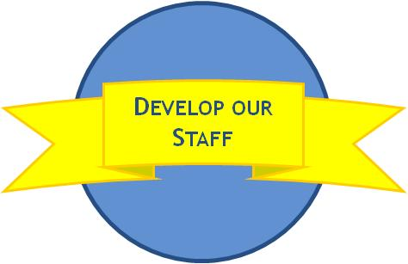
  Developmental Goals: Already Completed at least one!
Financial Services
& Controls
Financial Accounting
Procurement Services
Helen Valness
Amal Smith
Sharon Perry
Gigi Stollar
Karen Tomajan
Ana Trejo
Brad Niess
Charlotte Canilao
Mark Lozano
Josie Aguayo
Todd Colburn
Alex Zabelin
Barbara Heilmann
Rebecca Armstrong
Sonia Scott
Amy Vrizuela
Lorrelie Esteban
Gail Higgins
Grace Lin-Xie
Gemma Rieser
Matt Golden
Giesel Velez
Debra Stevens
Debra Almason
Jerry Franz
Michael Strach
Jeff Donahue Gordon Helmer
Luann Ford
Wendy Fong
Jay Valancy
Alyce Brown
Janis Vega
Chungwai Chum
Peggy Arrivas
Wilma Van Hook
John Barrett
Marcia Johnson
Helen McCullough
David Olsen
Cathy Chen
Sandra Chan
Teresa Chung
Kimberly Dominick
Fanny Ngo
Pusadee Berreman
Kevin Kendall
Johnny Wu
Helen Zhu
Alan Moloney
Lesley Clark
Pat Cheney
Brian Agius
Neil Kronenthal
Susan Bielen
Cathy O’Sullivan
Tracy Yuan
Stephen Benedict
Risk Services
Erike Young
Cynthia Low
Karen Vecchi
Gary Leonard
Terri Kielhorn
Kevin Confetti
Bob Charbonneau
Emily Breed
Capital Market Finance
Strategic Initiatives
Tim Loving
Pikka Sodhi
Allen Yin
Maria Anguiano
Lisa Baird

Slide 6


Lunch & Learn Series Schedule
Date | Presenting Group
27-Sep-11 | Strategic Initiatives (Lisa Baird/Maria Anguiano)
18-Oct-11 | Risk Services (Grace Crickette)
15-Nov-11 | Benefit Plan Accounting (David Olson)
18-Dec-11 | No meeting.
24-Jan-12 | Taxes (John Barrett)
28-Feb-12 | General Accounting (Doris Wildeman)
27-Mar-12 | Endowment & Investment Accounting (Kevin Kendall)
24-Apr-12 | Facilities and Administrative (F&A) Rates (Joao Pires)
29-May-12 | Capital/Debt Accounting (Irene Yamamoto)
19-Jun-12 | Office of Loan Programs (Ruth Assily)
24-Jul-12 | BRC (Helen Valness)
28-Aug-12 | Central Travel Management (Matt Golden)
25-Sep-12 | Capital Markets Finance (Sandra Kim)
30-Oct-12 | Procurement Services (Haggai Hisgilov)
27-Nov-12 | Banking & Treasury Services (Jerry Frantz)
20-Dec-12 | No meeting.
Come learn
what your
co-workers
do everyday!!
Upcoming Changes: Move to Larger Rooms (5320) starting in January
Any Additional Suggestions?

Slide 7

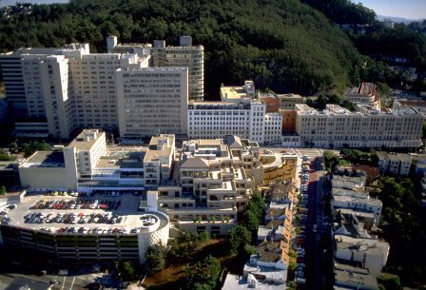
  Campus Site Visits
  First Site Visit:
  October 11th
“I appreciated the chance to see
UC on a broader scale, as opposed to
what we see every day”
“unique and
rewarding experience”
“definitely would
love another chance
to do this ”
“Thanks to Peter, his
direct reports and our
supervisors for this
opportunity and
allowing time for this
site visit”
“Site visit gave us an opportunity
to get to know the latest
and greatest on campus
which we would not usually have
and that was very exciting.”
  Next Visit: January 2012 - UC Davis

Slide 8
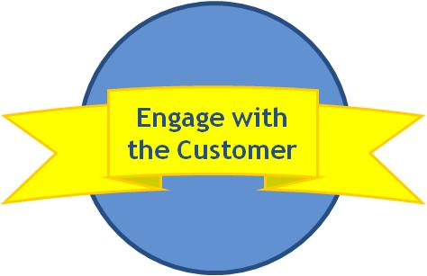
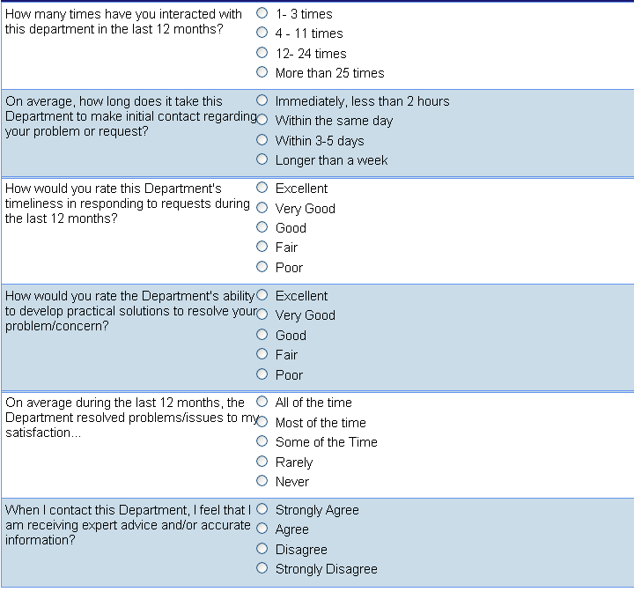
  Customer Survey - Demo
Erike Young, Pikka Sodhi

Slide 9
  Climate Council Update:
  Cheryl Lloyd, CFO Division Rep.
Campus Climate came into focus in May of 2009 after a series of highly charged racial, religious and cultural incidents on some UC Campuses.
Each campus and UCOP have representatives from each division.
Soon UC major survey of the faculty, staff and students will be conducted throughout the entire system to assess the climate
Over the next 6 months, survey questions will be developed, specific to each location. ETA: Fall 2012
UCOP will have its own survey with questions that are specific to issues at UCOP
Susan R. Rankin, PH.D of Penn State is a Research Associate and Associate Professor of Education will lead the project for U.C.
Questions? Contact Cheryl Lloyd
Notes:
She has presented and published widely on the impact of sexism, racism and heterosexism in the academia and in intercollegiate athletics. Dr. Rankin's current research focuses on the assessment of institutional climate and providing program planners and policy makers with recommended strategies to improve the campus climate for under-served communities.

Slide 10
  HR Announcements, Comments and Questions?
      New Interim UCOP Local HR Business Partner:
      Karen Basey
      2. Performance Evaluations Completed in September
      Questions or Comments?
      3. All Merits should have been communicated!
      Questions or Comments?

Slide 11

  Events
Values
      Thank you to those who attended
      CFO Division BASEBALL Day!!
      Thank you to Tim Loving for organizing!

Slide 12
STRATEGIC GOALS ADDRESSED
Develop our Staff
Leadership’s Role in Executing Strategy

Slide 13
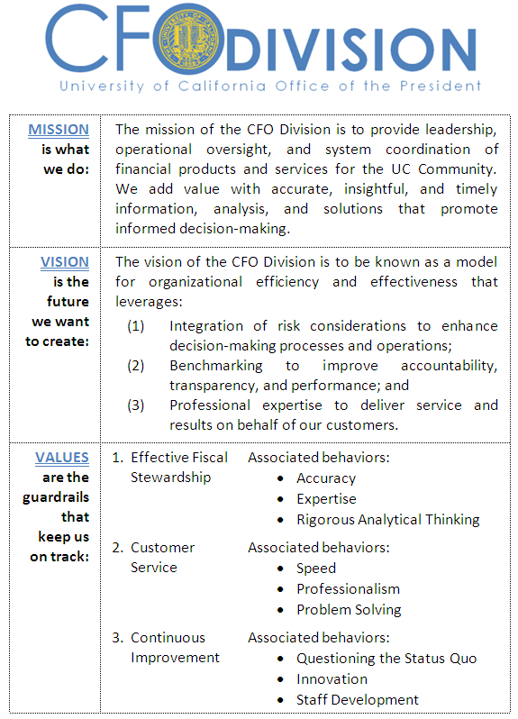
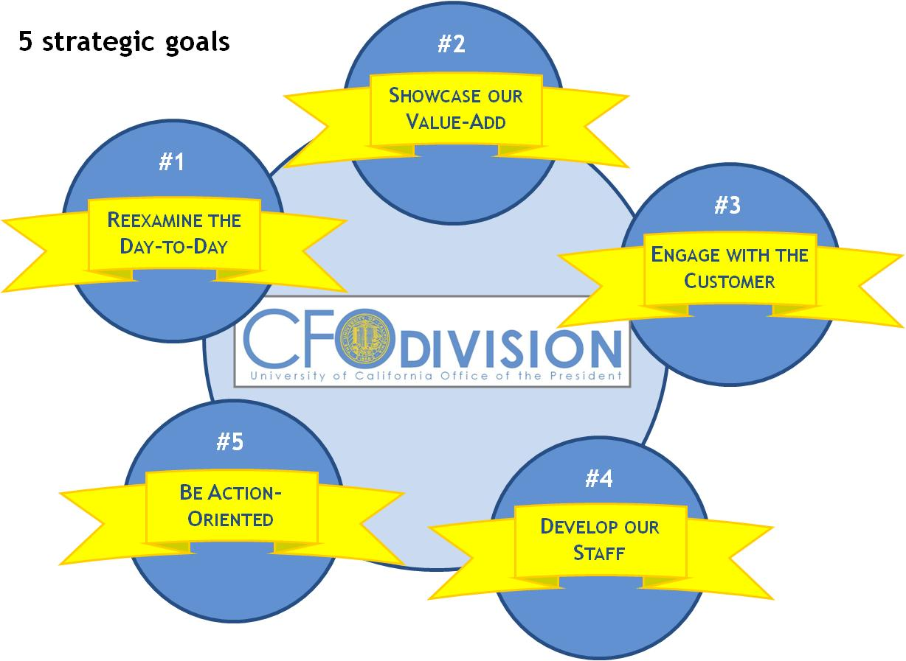

  Why are we talking about this?
It’s been a full year since our first Town Hall! A year since strategic ball set in motion…
We need to ensure we are focused on moving the Strategic Goals forward
Even elephants can dance!

Slide 14

  What is leadership?
Ability of a person in a formally assigned hierarchical role to influence a group to achieve organizational goals
From a practical perspective, leadership is the essence of what organizations are
Leadership is also a perceptual phenomenon
  First, followers observe superiors’ words and actions
  Then, they make inferences about superiors’ motives

Slide 15

  Does leadership matter in influencing strategic change?
According to Stanford/Haas researchers: !
It deeply affects strategic execution
15% of performance can be traced back to leadership
Even more (40%) when the leader has ample resources and scarce strategic opportunities
But we have FEW resources and a GAZILLION strategic opportunities!

Slide 16
  Key research findings are very telling
According to O’Reilly/Caldwell/Chatman:
  Not only does leadership matter…
  Consistency of leadership across hierarchical levels influences implementation of strategic initiatives
  Organizational performance was not affected by any one leader
  Only when leadership at different levels were aggregated did significant improvement occur

Slide 17
  What does it mean to be a leader?
Aside from the formal position and title, it’s the ability to:
  Articulate a vision for the unit that reinforces CFO vision
  Set a strategic direction (translate CFO vision into unit terms)
  Define measurable objectives reflective of the strategy
  Align the award system, utilizing the performance review
  Motivate subordinates
  Effectively deal with resistance to change

Slide 18

  Who are we talking about?
Intermediate levels, e.g., department or sub-division managers
It is critical for managers:
  Support the new strategy
  Gain support of subordinate managers to help implement the strategy

Slide 19

  What do you need to do?
To implement a new strategic initiative, managers at all levels need to:
    Reinforce it
    Allocate resources for it (e.g. SIF)
    Deal effectively with resistance to it

Slide 20

  The myth of the central monopoly
Once upon a time, there were campus foundations who were not quite satisfied with their asset management options
One of the largest foundations set up its own legal entity to start doing its own investing
Soon, more large foundations followed suit
The myth of the central monopoly
was debunked

Slide 21

  Common pitfalls… don’t be a victim!
“In times of rapid change, experience could be your worst enemy”
- T. Paul Getty
According to the research:
  “…[S]enior teams that had shorter tenure in these roles were more likely to change strategy while senior teams with longer tenure were more apt to persist with the existing strategy.”
  Don’t let tenure be a liability
  for you or your team!

Slide 22

  Common pitfalls… (con’t.)
According to the research:
  “When leaders at different hierarchical levels are misaligned with one another, employees may perceive mixed signals about the importance of the initiative and be less committed to implementing it.”
  If your people show misalignment,
  it is your problem! Fix it A.S.A.P.!

Slide 23


  Take-Away: Trickle Down Theory DOES Work
In LEADERSHIP
  “study confirms the intuition that to be successful in implementing a new strategic initiative… it is the alignment of leadership across hierarchical levels, not heroic individual leaders, that matters.”
  All levels of management
  must take ownership and
  march to the same tune
  Its everyone’s responsibility in the waterfall to move the Strategic goals forward!

Slide 24

  It helps to start with “why”
  Simon Sinek at TED
  http://www.youtube.com/watch?v=qp0HIF3SfI4

Slide 25
STRATEGIC GOALS ADDRESSED
Reexamine the Day-to-Day
IT Discussion
Paul Weiss & Jo Ellen Frances
ITS
Be Action-Oriented

Slide 26

  IT literacy impacts the bottom line
“Companies with IT-savvy managers are 20% more profitable than their competitors.”
  Peter Weill & Jeanne Ross
  Authors of IT Savvy: What Top Executives Must Know to Go from Pain to Gain

Slide 27
  A trip back in time: IR&C in 2004 (at a glance)
No
disaster
recovery
If you
didn’t come to
us, we didn’t come
to you:
Little funding for strategic forward-looking planning or full engagement with functional leadership
Have money,
will support:
Many websites and applications (including Pathways, EIAS, etc.)
Many applications that were funded by departments
6 campus payrolls; one z/OS-hosted customer (UCSF)
Disparate employee websites, i.e., UCFY (payroll) and YBO (benefits)
Limited
“universal” UCOP
support for the basics:
Multiple email & calendar systems, some not managed by IR&C
No central anti-virus, anti-spam, desktop support
No Windows infrastructure (AD, printing, file shares)
40 different wireless networks; no VPN
100 servers in office space, managed by multiple departments
Very out-of-date local network (some components ~10 yrs old)
Limited basic web infrastructure
Many
problems first detected by
end-users
Provided
some UC-wide policy and coordination role
No
Project office:
Each manager within IR&C managed their own set of projects in a mostly “silo’d” manner
Central
funding for:
Base Payroll
UCRS
Old “corporate systems” (some financial systems and limited data-warehouse capability)
No IT architecture:
Not for UCOP
Not for UC system
Neither capability NOR mandate/ authority
IT
governance
not
in place

Slide 28
  Some major changes
Best disaster recovery implementation for any UC location
(and better than almost all universities)
We are
starting to
come to you:
But the core problem remains: Little funding for strategic forward-looking planning or full engagement with functional leadership
Have money,
still will support
& work on:
Still websites and applications (including ApplyUC and EIAS)
Still applications that were funded by departments
9 campus payrolls, 5 z/OS-hosted customer (UCSF), 5 ERS customers
1 integrated employee benefit website (AYSO)
Emerging DSS for Institutional Research, better reporting and data warehouse capability
“Universal”
UCOP support for the
basics all accomplished,
even with budget cuts:
One email & calendar system
Central anti-virus, anti-spam, desktop support, full windows infrastructure (AD, printing, file shares)
2 integrated wireless networks (one for visitors, one for staff) and VPN
All servers now in data center, most virtualized; infrastructure mgd. by IR&C
Modern network
More solid web infrastructure & most departments are using SharePoint
Many
problems detected and resolved by
IR&C
Still
provide UC-wide policy and coordination role
Limited IR&C-facing project office in place:
Better capability to begin looking at projects across IR&C
Still central
funding for:
Base Payroll
UCRS
Old “corporate systems” (some financial systems and limited data-warehouse capability)
Still no IT architecture:
Not for UCOP
Not for UC system
Neither capability NOR mandate/ authority
IR&C
governance structure not functioning
fully

Slide 29
  Present tense: ITS (InformationTechnology Services) today
Bold orange font indicates
significant change since ‘04
UCOP
Data collection, analysis & reporting¹
Decision Support System
Information security program
Desktop/dept. computing support
Network and phones
Web site support and maintenance
Document/correspondence archives
SharePoint
Campuses
Payroll operations for UCD, UCR, UCI, UCSD, UCSC, UCSB, UCI, UCB, Hastings College of the Law, ASUCLA
Effort Reporting System operations for UCSF, UCSD, UCB
Mainframe computing services for UCSF, UCSC,UCSB,UCI , UCB
Disaster recovery services for UCOP + reciprocal for some of UCSD,UCI,UCSDMC
Systemwide
California Digital Library technology infrastructure
Development and maintenance of UC wide business systems:
UC Retirement System
Payroll Personnel System
At Your Service Online
Endowment Investment and Accounting System
Effort Reporting System
Pathways/applyUC –UC undergraduate online application
Web application development
Systemwide Coordination
IT & information privacy/security policy and legislative coordination
New technology initiatives, e.g. shared research computing, email, shared data centers
IT strategic planning for future computing needs
FCC licensing
IT Leadership Council (UC wide Chief Information Officers)
CENIC governance
Information Technology Infrastructure
24x7 data center operations, network, operating systems, database administration
Systemwide Coordination
& Response
Services Delivered by IR&C
¹ Data collection, analysis & reporting: 20 systems collect student, personnel, compensation, finance, budget, equipment, facilities, assets, contracts/grants data. Data is used for key reports such as Executive Compensation Report, Statistical Summary of Students/Staff, UC Financial Report, etc.

Slide 30
  ITS units today:
Paul Weiss
CIO UCOP
Jo Ellen Francis
Director
Immediate Office
Shirley Bittlingmeier
Director
Applications
IT strategic planning
ITLC executive committee
IT policy
Information privacy/security
CENIC governance
FCC license
Coordination
Infrastructure
PPS
AYSO & Benefits
Undergraduate Applications
Business Intelligence & Reporting
OP Department Applications and Web Development
    Tech Desk
    Data Center
    Operations
    Network and Telecom Services
    Server Maintenance and Support
    Mainframe Services
Director
Ramon Lim
Project Management Office
Oversight and management of IT-oriented projects for UCOP

Slide 31
  Going Forward ITS is Working On
Add staff to ITS in order to support PPS replacement project and build UC wide IT shared services capability
  Funding in place for first 3 yrs of PPS replacement project
Fix/enhance end user and executive support
  Internal restructuring of ITS is self funding needed changes
Develop architecture for UCOP and broad UC administrative system roadmap
  Some funding from PPS replacement project can be leveraged, may require some augmentation
Develop customer relationship management
  Will require some funding augmentation and functional leadership taking advantage of. ITS has some customer relationship mgt in place today, but falls short of what is needed
Build higher quality PMO, Support more fully developed IT governance
  Can leverage initial IR&C investments and PPS replacement project, will require augmentation
  Governance will require staffing by ITS, but key is executive engagement to make a reality

Slide 32
  What does ITS do for the CFO Division (today)?
Common financial systems
DSS – better business analysis
EIAS – supporting change to a vendor product
Strategic purchasing support
Liaison with Risk Services
IT policies (electronic communications Policy, information security policy)
Disaster Recovery Infrastructure support for Payroll Processing DR/BC initiative
Information security
Tech Desk Services
Technology Asset Management Program – cost effective, quicker installs for new hires
Accelerated Desktop Refresh Program (begins late Sept., BRC top of list for refresh)
Laptop Loaner program
But… we do not have an integrated roadmap
or strategy in place today

Slide 33
  Opportunities for CFO Division + ITS
Engage ITS early to brainstorm about CFO needs and potential technology solutions
Don’t engage vendor/solution without ITS
Work with the Customer Relationship Manager (once in place) to develop a broader view of needs and develop a roadmap
Communicate needs/provide feedback

Slide 34

  Key takeaways for CFO Division staff
  Understand the CFO Division role of the business decision-maker:
  As managers, we decide (not IR&C), HOWEVER…
  As non-IT managers, we need help from IR&C to know what questions to ask
  We need IR&C to not only be a technical consultant, but also an advisor, in the same way that a home lender should not only offer the different loan products, but should also be able to explain the pros/cons of each from the consumer’s perspective. We have to learn the difference, and ask!
Commonality and the role of Homegrown vs. COTS:
  Rely on Policy 5100 more to drive home the point about common systems, HOWEVER…
  We need to drive home the point internally (within CFO Division) that homegrown is the least attractive option (Policy 5100 is silent on the aspect of homegrown vs. COTS)
  We often dismiss COTS because it can only get us 80% of what we want
  We need to become comfortable with 80%
Many unknowns, but progress is being made
  Anticipate a strategic business relationship with IR&C going forward instead of a one-off project approach

Slide 35
QUESTIONS?

Slide 36
Wrap-Up

Slide 37
  Wrap-up
Values
      Next Meeting:
      Managers’ Town Hall Feb 2012 (TBD)
      2012 Strategic Goals
      Operational Focus Areas

