Slide 1


Lunch-n-Learn: Business Resource Center
Presented By:
Helen Valness
July 24, 2012

Slide 2
Agenda
Org Chart / Reporting Lines
UC Experience
Where We’re Located
What We Do
An Example
How We Can Help Each Other!

Slide 3
Agenda
1. Org Chart / Reporting Lines
2. UC Experience
3. Where We’re Located
4. What We Do
5. An Example
6. How We Can Help Each Other!

Slide 4
Peter Taylor
Chief Financial Officer
Business Resource Center:
  Org chart & reporting lines
Dan Sampson
AVP Financial Services & Controls
Helen Valness Director
Amal Smith
Accountability Manager
Ana Trejo
Team Lead
Brad Niess
Team Lead
Gigi Stollar Team Lead
Karen Tomajan Team Lead
Sharon Perry
Team Lead
Accountability Green Team
(2)
PAYROLL
Red Team
(10)
Yellow Team
(3)
Events Group
(4)
Purple Team
(9)
Blue Team
(9)
Gold Team
(9 )
Notes:
48

Slide 5
Agenda
1. Org Chart / Reporting Lines
2. UC Experience
3. Where We’re Located
4. What We Do
5. An Example
6. How We Can Help Each Other!

Slide 6
  Business Resource Center
  UC Experience
7
      Helen: 13 Years
      Amal: 12 Years
      Ana: 11 Years
      Brad: 14 Years
      Gigi: 32 Years
      Karen: 25 Years
      Sharon: 33 years
+ BRC Staff:
40
140 UC years experience
494 UC years experience.
Total UC years experience
in BRC: 634

Slide 7
Agenda
1. Org Chart / Reporting Lines
2. UC Experience
3. Where We’re Located
4. What We Do
5. An Example
6. How We Can Help Each Other!

Slide 8

  Business Resource Center:
  Where We’re Located
Franklin Building, 9th floor & 7th floor
Helen Director 9209
Amal Accountability Manager 9207
Ana Payroll Red Team 9317
Brad Yellow Team / Events Services Group 7208
Gigi Purple Team 9304
Karen Blue Team 9306
Sharon Gold Team 9302

Slide 9
Agenda
1. Org Chart / Reporting Lines
2. UC Experience
3. Where We’re Located
4. What We Do
5. An Example
6. How We Can Help Each Other!

Slide 10
Business Resource Center:
What We Do
Our Charge:
Centralize transaction processing for administrative functions, allowing departments to focus on their core duties in support of the President and the campuses.
Standardize, to the greatest extent possible, procedures and controls to ensure maximum service to departments as well as efficient, controlled processing.
Ensure compliance with University policies, procedures, and delegations of authority.

Slide 11
Business Resource Center:
What We Do
Functional areas and activities:
  Payroll
    All payroll services and transactions
    Time Reporting
  Purchasing
    Purchase orders
    Transactions over $5,000 requiring UCLA Purchasing approval
    Blanket agreements
    Service agreements, such as Professional Services Agreements (PSAs) & Independent Contractor Agreements (ICAs)
    Procurement card
  Express Travel Reimbursements
  Cashiering/check depositing
  Department Expenditure Reconciliations
  Event Planning and Contracting
  Contracts and Grants and Subawards
  Recharges
  Fiscal Close
  Training
  Advice and guidance on the application of policy

Slide 12
BRC Event Services Group (ESG)
Business Resource Center:
What We Do
BRC ESG Objectives
  Provide event planning services to UCOP departments (not all UCOP departments)
  Standardize procedures to ensure maximum service to departments in an efficient manner
  Maximize use of UC vendor contracts to achieve highest possible savings
  Improve compliance with University policies, procedures and delegations of authority
BRC ESG Service Offerings
  Pre-Event Consulting
  Event Production
  On-Site Management
  Post-Event Follow-up

Slide 13
BRC Event Services Group
Business Resource Center:
What We Do
BRC ESG Webpage: http://www.ucop.edu/brc/planning.html
  ESG Service Offerings
  ESG Forms
  ESG Process Maps
  UCOP Policies for Travel and Entertainment
  Meeting Planning Toolkit
  ESG Newsletters

Slide 14
Business Resource Center:
What We Do
Green Team: Accountability
  Performance reporting
    Key performance indicators
    Quarterly performance reports by team and by staff
  Control environment management (for better audit outcomes)
    Signature authority delegations
    Monthly General Ledger review and assurance
    UCLA systems security—Departmental Security Administrators
    Regular transaction monitoring: Holds & Incompletes, Unreconciled Items, Unread PANS
  Special data requests
    Quarterly UCOP expenditure analysis reports
    Other upon request
  Internal and external auditors liaison
  BRC staff support
    General administrative support
    BRC forms
    BRC website

Slide 15
Key Performance Indicator (KPI)
BruinBuy and Travel Order Creation Statistics
Net of UC Press and Education Abroad Program
35,000
31,346
Number of transactions
1,596
Regent’s Offices
28,000
4,671
21,636
20%
21,000
1,004
Regent’s Offices
6,837
2,353
16%
14,000
4,514
BRC
BRC
80%
84%
18,242
7,000
13,765
Travel
BruinBuy
2011-2012
Quarters 1-3
2010-2011

Slide 16
Key Performance Indicator (KPI)
Post Authorization Notification (PAN) Review Statistics
BRC targets no more than 10% unreviewed in over four days and no more than 3% in over ten days.
More Than 4 Days: 9%
More Than 10 Days: 1%
More Than 4 Days: 10%
More Than 10 Days: 2%
On Time Review: 90%
On Time Review: 88%
2011-2012
Quarters 1-3
2010-2011

Slide 17
Key Performance Indicator (KPI)
Days to Process Transactions
The BRC target of three business days or less represents a composite average for processing catalog purchase orders, non-catalog purchase orders and travel reimbursement requests.
Average days to process in 2011: 3.5 days
Average days to process in 2012: 3.7 days
Number of days
10
8
6
5.4
4
3.9
3.6
3.7
3.3
Target: 3 days
2.5
2
Days to Process:
Travel Transactions
BruinBuy Transactions
Quarter 1
Quarter 2, Restated
Quarter 3
Quarter 4
2011-2012

Slide 18
Key Performance Indicator (KPI)
Travel Transactions: Comparison of Rejected Transactions to Total Processed
The number of rejected travel transactions measures the quality of BRC processing and indicates whether travel support documentation is acceptable and in accordance with UC policy and standards. The BRC target for rejected travel transactions is 2% or less.
2011 Rejection Rate for BRC Processed Travel Transactions: 1.6%
2012 Rejection Rate for BRC Processed Travel Transactions: 0.8%
2,500
Number of transactions
2,000
1,631
1,675
1,500
1,208
1,000
500
17
10
8
Total Travel Transactions
1.4%
0.6%
0.5%
Rejected Transactions
Quarter 1
Quarter 2
Quarter 3
Quarter 4
2011-2012

Slide 19
Agenda
1. Org Chart / Reporting Lines
2. UC Experience
3. Where We’re Located
4. What We Do
5. An Example
6. How We Can Help Each Other!

Slide 20
Moving and Relocation
New hires may be offered payments to cover moving expenses and relocation allowances.
  Policies: G-13, G-28 and the Internal Revenue Code.
  Payments may be taxable or non-taxable depending on type and timing.
  Payments are offered at discretion of department but must be within UC guidelines.
Non –Payroll and Payroll BRC teams (BRC) become involved when the offer letter includes moving expenses and/or relocation allowances. It is important that the offer letter be specific.
BRC works with HR Business Partner and department on the organization and payment of these expenses.
Notes:
Ask question as to who knows the difference between moving expense and relocation allowance.

Slide 21
Moving Expenses
Moving expenses include (not all inclusive):
  House hunting trip(s):
    Travel (airfare using Connexxus, hotel, meals, car rental).
  Actual move costs:
    Actual costs of move (household goods, 2 cars, travel for employee and immediate family, if applicable);
    Must use UC strategically sourced moving companies (unless employee is doing the move);
    Time sensitive: must occur within 1 year of job start date to be considered non-taxable.
  Temporary housing in new location:
    30 day maximum
    If in a facility with kitchen, no meals are reimbursable
    If in facility without kitchen, meals reimbursable

Slide 22
Relocation Allowance
Relocation Allowance
  Is intended to offset higher living costs in a new location;
  Total value of allowance may not exceed 25% of an employee’s annualized salary;
  Typically paid over 4 years;
  Amount is a taxable expense to the employee.

Slide 23
Non-Taxable vs. Taxable
Non Taxable Expenses | Taxable Expenses *
Actual moving expenses (to cap) that occur within a year of job start date. Airfare Driving and lodging expenses if new employee drove rather than flew to new location Cost of moving van (U-Haul), including gas, if they do not use a moving company | Relocation allowance House hunting trip(s) Meals Car rental and gas Anything that is not within IRS non-taxable guidelines, including moving expenses that occur more than one year after the job start date
* All taxable items are paid through the payroll system, whether the employee is being reimbursed directly or if the items were paid by a third party. If paid by a third party, that amount will be added to an employee’s gross income.

Slide 24
Moving and Relocation
Got it? Ok, now let’s apply:
New employee has been offered a job at UCOP and needs to move from Nashville to Oakland to start work on September 1. He has 3 cars, a spouse, 3 children, a horse, a cat, and jet skis. He will be selling his home in Nashville and buying another in the Bay Area.
What can UC pay for to get him out here to start work on time? What will the BRC need to make sure everything is paid according to policy?

Slide 25
Agenda
1. Org Chart / Reporting Lines
2. UC Experience
3. Where We’re Located
4. What We Do
5. An Example
6. How We Can Help Each Other!

Slide 26
Business Resource Center:
How We Can Help Each Other!
Get transactions and information to us timely, not at the last minute
Help us find a solution for you
  Bring your questions to us
  Provide us with the full story so we can provide appropriate guidance
We want to make sure your transaction meets policy requirements and has appropriate approvals
OUR COMMON GOAL
Accurate and efficiently processed transactions
that comply with University policies and procedures

Slide 27
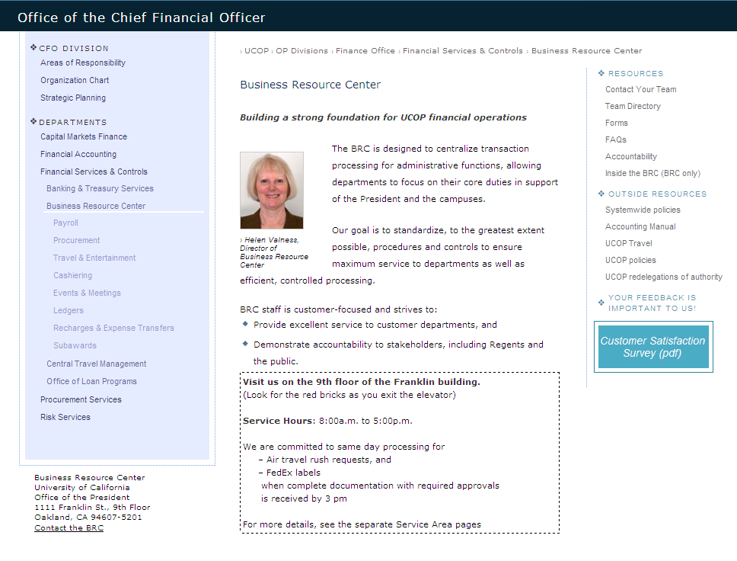
BRC Website: www.ucop.edu/brc/

Slide 28
Questions?

