Slide 1
AI and accessibility
Lucy Greco
UC Berkeley
Accessibility evangelist
http://bit.ly/420mMhn

Slide 2
Coding with AI
The code that much of the AI is modeled on needs to be accessible and most of the time it is not
Github Copilot was not able to create a simple footnote
Creating a bookmarklet for testing has more steps than just using pre-made bookmarklets
If you need a custom test, AI might do the job; but tweaking it might take more time than just writing the code to begin with

Slide 3
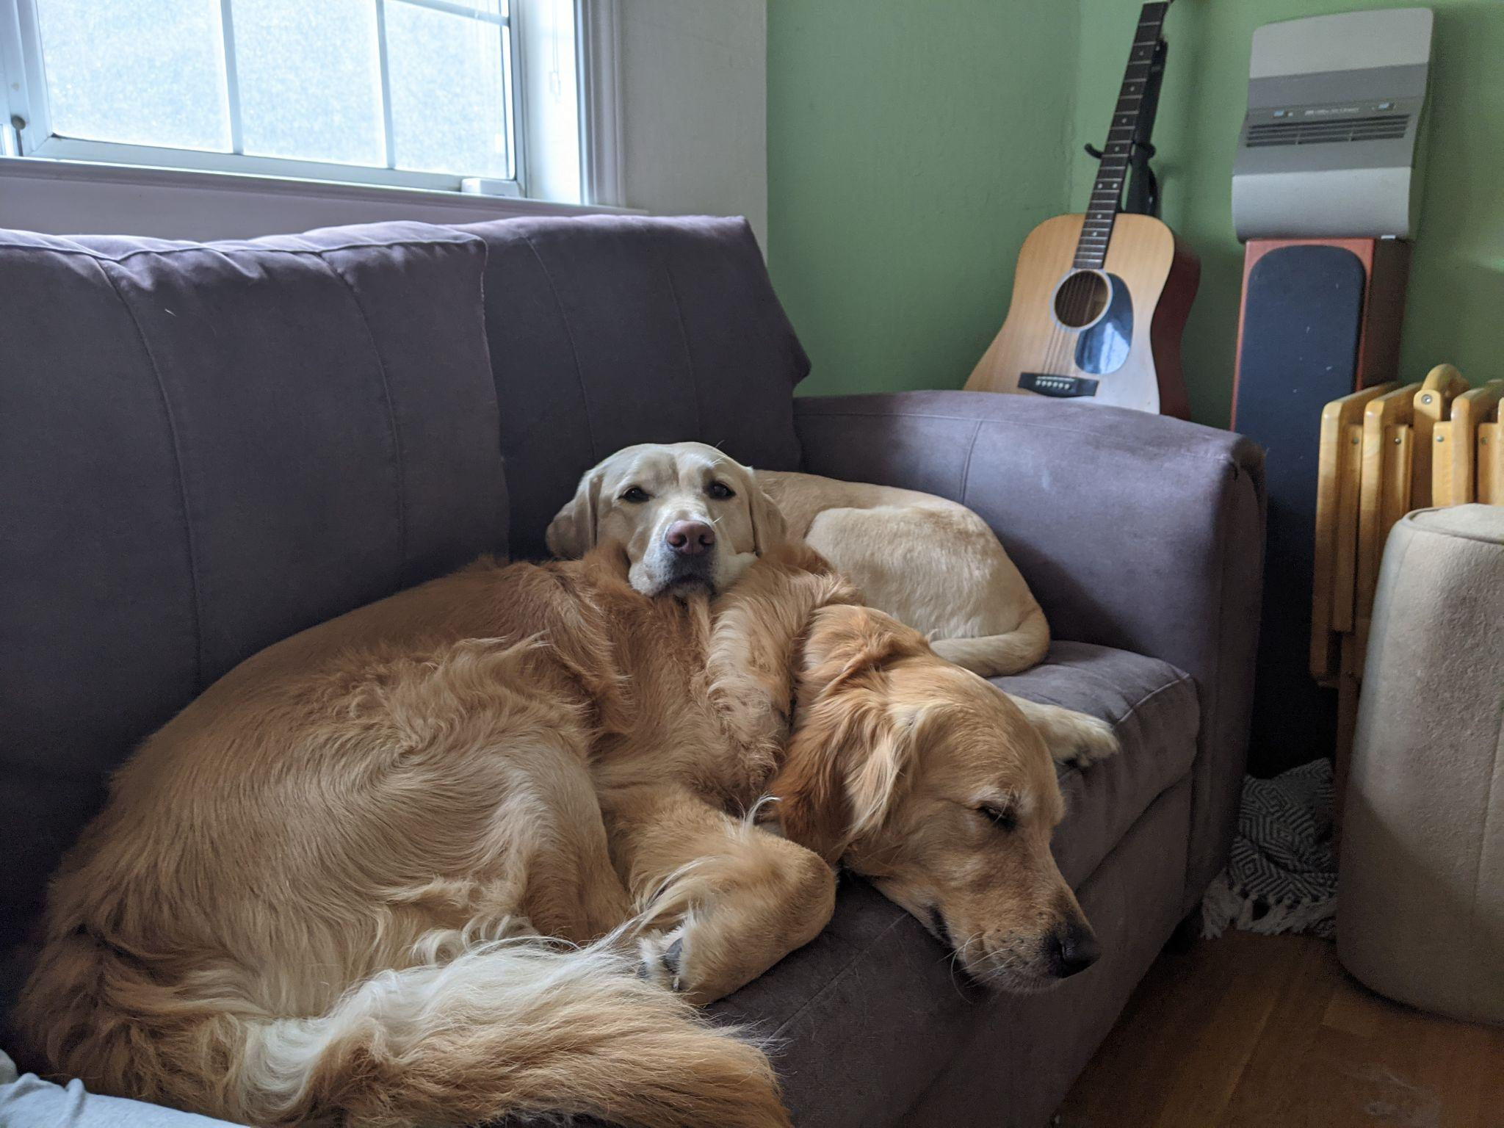
Dog Scene

Slide 4
Dog scene from Google Lookout
Image alt text:
In this picture we can see dogs on the couch, behind them we can see a speaker and a guitar, through the window we can see a wall and some plants.

Slide 5
Dog Scene from Seeing AI
From Microsoft
Image alt text:
Two dogs are lying on a couch. The dog in the foreground is lying on its side with its head resting on the couch cushion, while the dog in the background is lying on its stomach with its head resting on the other dog's body. The couch is positioned against a wall with a window above it. To the right of the couch, there is a guitar leaning against the wall, and next to it is a speaker. There is also a small table or stool with a few items on it near the speaker. The floor is wooden, and there is a small rug partially visible under the couch.

Slide 6
Dog Scene from Be My Eyes
Image alt text:
The image shows two golden retrievers lying on a dark gray couch. One dog is resting its head on the other, and both appear to be relaxed and possibly sleeping. The couch is positioned near a window with white blinds, allowing some light to filter into the room. In the background, there is an acoustic guitar leaning against the wall, next to a tall speaker. The wall is painted a light green color, and there is a small stack of wooden folding chairs next to the couch. The floor is wooden, and there is a small piece of a patterned rug visible near the couch.

Slide 7
Dog Scene from Gemini
From google
Image alt text:
Two dogs are lying on a couch. The dog in the front is a golden retriever, and the dog in the back is a white labrador retriever. The golden retriever has its head resting on the couch and its body curled up. The labrador retriever has its head resting on the golden retriever's back. The couch is a dark grey color, and the room is decorated with a guitar and a speaker. The photo was taken at an angle to show the dogs' full bodies.

Slide 8
Echo Labs - A truly amazing AI!
https://www.youtube.com/watch?v=2insL-CRJIo

Slide 9
Thank you
Lucy Greco
lgreco@berkeley.edu
https://accessaces.com/
http://bit.ly/420mMhn

