Slide 1
Beyond Compliance: What Not to Do (and What True Inclusion Requires)
05/15/2025
Content Editors & Developers | Accessibility Best Practices
Information Technology Services
Notes:
Thank you, Trevor, for that clear and insightful legal overview—those examples were incredibly helpful to understand the legal foundations as we continue to build accessible and inclusive digital experiences.
Good Morning and Happy Global Accessibility Awareness Day everyone! My name is Eric Mayes and I’m a UI / UX Developer in my 23rd year at UC Santa Barbara. I also spent four years as a student developer before transitioning into my current role. During that time, I was fortunate to have an incredible mentor—my manager, Joe Sabado—who introduced me to the importance of accessibility in design. One of my first major projects was helping to design and develop the interface for our university’s first online student registration system, replacing the older telephone-based process. That experience deeply shaped the way I think about inclusive design.
And when Tim Berners-Lee, inventor of the World Wide Web, helped open the 2012 Olympic Games by tweeting “This is for everyone,” it resonated deeply with me. It was a powerful reminder that accessibility isn’t just a feature—it’s foundational. As Berners-Lee himself said, “Access by everyone regardless of disability is an essential aspect.” That principle helped shape the accessibility mindset I carry with me today—one that sees inclusion not as an afterthought, but as a fundamental part of good design.
Today, our goal is to help you either take the first step toward an accessibility mindset—or strengthen the one you already have. It's about shifting our perspective: seeing compliance not as the end goal, but as the foundation for creating genuinely inclusive experiences. I see the compliance deadline as an opportunity to do better. Let’s go beyond checkboxes and deadlines. Accessibility should create meaningful access—not just meet minimum guidelines or reduce risk. Accessibility is about people, not just policies.
We ask people with disabilities to spend hours learning how to interact with a world that wasn’t built for them—navigating systems, interfaces, and environments that exclude.
But how often do WE take the time to learn how to design better, more inclusive interactions?
Recognizing our own biases is the first step toward building experiences that welcome everyone, no matter how they see, hear, move, or think
If you're designing or building something, pause and ask questions like: Can someone navigate this without a mouse?
What if they can't see, hear, or process information the way I do?
If you haven’t considered scenarios like these, bias is likely shaping your work.

Slide 2
Don’t Treat Accessibility as an Afterthought
Do: Design & Write with Accessibility in Mind from the Start
Practical Tips:
Accessibility should be baked into design, development, and content creation—not patched on later.
Content editors: Use clear, concise language, proper heading structures, and alternative text for images.
Developers: Implement semantic HTML, keyboard navigation, and ARIA roles only when necessary—not as a substitute for correct markup.
Notes:
Don’t Treat Accessibility as an Afterthought
Accessibility must be part of the process—not a fix applied later. Building with accessibility in mind leads to clearer content, better navigation, and more usable interfaces—for all users, not just those with disabilities. Content Editors
Clarity and structure matter: Use plain language and proper heading levels to make content easier to understand and navigate—especially for screen reader users.
Alt text is essential: Every image should have descriptive alternative text that conveys meaning or context for users who can’t see visuals.
Consistency improves accessibility: Consistent formatting and style support all users, especially those with cognitive disabilities.
Developers Screen readers and other assistive technologies rely on native semantic HTML to understand and communicate the structure and purpose of content. When we replace these elements with custom components, we risk obscuring that clarity and moving away from the web’s foundational principle: accessibility.
Semantic HTML is foundational: Use elements like <nav>, <button>, and <article> appropriately to give assistive technologies the right context.
Keyboard access is non-negotiable: Ensure users can fully navigate your application using only a keyboard—no mouse required.
Use ARIA wisely: ARIA roles and attributes can enhance accessibility, but only when semantic HTML doesn’t meet the need; misuse can actually break accessibility.

Slide 3
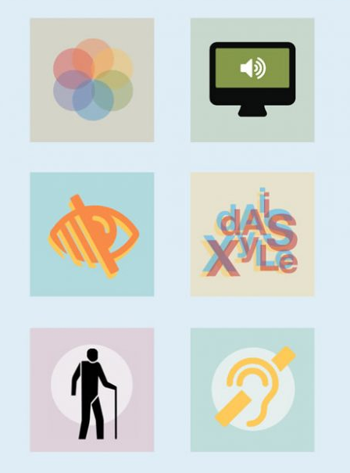
Don't assume all users interact with your design the same way
Do: Design for users...
on the autistic spectrum
of screen readers
with low vision
with dyslexia
with physical or motor disabilities
who are deaf or hard of hearing
with anxiety
Resource Guide : Dos and don'ts on designing for accessibility
Notes:
Don't assume all users interact with your design the same way As designers, it's crucial that we think inclusively from the start. This means intentionally designing for users with a wide range of needs and abilities.
On the "Do" side, we want to support users with cognitive differences like autism and dyslexia, as well as physical, visual, auditory, and emotional challenges. By doing so, we make our experiences more usable for everyone—not just those with disabilities.
On the "Don't" side, these are common pitfalls we want to avoid. For example, assuming all users can use a mouse, read text easily, or handle fast animations can exclude people. Accessibility isn't just a checklist—it’s a mindset. It means thinking of edge cases as core users, not afterthoughts.
As a developer, I often think I know more than I do when it comes to accessibility. Unlike learning a new programming language, I can't learn digital accessibility in one afternoon. There are too many nuances. AI will continue to help bridge this gap, however let’s make sure we're manually reviewing and testing automated things whether it’s the code that GitHub copilot provides, or the audio descriptions or captions that AI generates for us. These still require human intervention Testing without screen readers is like leaving out a browser in browser testing. Testing without a keyboard is like leaving out touch controls when designing for mobile. Using UI frameworks without understanding their accessibility implications is like building a house with prefabricated parts—without checking if the doors are wide enough for everyone to enter. Keep these user access needs in mind:
Autistic users – Use clear, consistent layouts and avoid sensory overload. Screen reader users – Ensure all content is accessible with meaningful structure and alt text. Low vision users – Use high contrast, scalable text, and avoid relying only on color. Dyslexic users – Choose readable fonts, align text left, and keep layouts simple. Deaf or hard of hearing users – Provide captions, transcripts, audio descriptions and visual alternatives to audio. Users with motor impairments – Ensure keyboard accessibility and allow time flexibility. Users with anxiety – Avoid unexpected actions, create predictable journeys, and allow user control.
On the slide I’ve linked to a fabulous resource guide - the UK home office posters for designing for accessibility. These posters remind us that accessibility isn't one-size-fits-all. Each group has different access needs, and good design means thinking about all of them from the start. It's not just about checking boxes for compliance—it's about creating digital spaces where everyone feels welcome, capable, and in control.

Slide 4
Don’t Rely Solely on Mouse & Touch Interactions
DO: Ensure Keyboard & Assistive Tech Compatibility
Practical Tips:
Many users rely on keyboard navigation, screen readers, and switch devices to interact with content.
Content editors: Ensure links and buttons are meaningful (e.g., avoid "Click here").
Developers: Test with tab navigation, focus indicators, and screen readers to guarantee usability.
Notes:
A critical accessibility mistake is designing only for mouse or touch interactions.
Not everyone uses a mouse—many users rely on keyboard navigation, screen readers, or switch devices to interact with digital content. If your site or app isn’t usable without a mouse, you’re automatically excluding those users.
For content editors, one quick fix is to avoid vague link text like 'Click here' or 'Read more.' These phrases don't tell screen reader users what the link is actually doing. Instead, use meaningful text like 'Download the annual report' or 'Learn more about our services.' Challenge yourself to use inclusive language and descriptions.
On the development side, always test your product using just the keyboard. Can you tab through everything in a logical order? Are focus indicators visible so users know where they are? Does a screen reader announce buttons and links correctly?
Accessible interaction starts by making sure users can get around—regardless of the tools they use.

Slide 5
DON’T: Convey Meaning Through Color Alone
DO: Use Sufficient Color Contrast & Multiple Cues
Practical Tips:
Colorblind users and those with low vision need strong contrast and additional indicators like text labels or icons.
Avoid using red text alone for errors; pair it with text instructions.
Implement WCAG contrast ratios and provide visible indicators for form validation.
Notes:
One of the most common accessibility issues is using color alone to convey information.
For example, if an error message shows up only in red text, a user with colorblindness might not notice it—or know what it means. Similarly, users with low vision may not see subtle color changes, like a faint red border around a form field.
That’s why color should always be paired with another indicator—like an icon, bold text, or a written instruction that says ‘Please enter your email address.’
Also, make sure your color contrast meets WCAG standards—especially for text over backgrounds. Low contrast may look sleek, but it’s unreadable for many users.
And when it comes to forms, go beyond color. Use clear, visible indicators to help screen reader users understand what went wrong and how to fix it.
In short: color can support meaning, but it can’t carry the message alone.

Slide 6
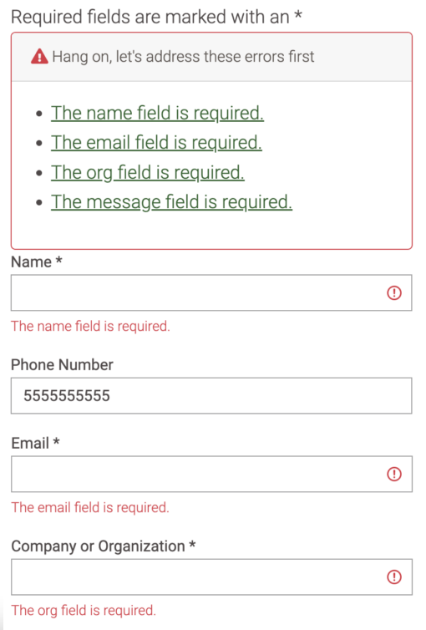
DON’T: Convey Meaning Through Color Alone
DO: Use Sufficient Color Contrast & Multiple Cues
Practical Tips:
Error Summary at the Top - Provide a clear, focusable summary listing all validation errors; each item should link to the related field.
Inline Error Messages - Place descriptive error messages directly next to or below the affected fields.
Linear Layouts for Low Vision Users - Stack fields vertically and avoid side-by-side inputs to support users navigating with magnification or narrow focus (“straw test”).
Notes:
In an accessible form, proper validation includes multiple layers of feedback that work for all users, including those using assistive technologies. Here's how a well-structured form might be designed:
Key Features include:
Error Summary at the Top:
When the user submits the form with errors, a clearly labeled error summary appears at the top. Each error is listed in a bulleted list, and each item is a link that jumps focus to the corresponding form field.
Using Field Groups with <fieldset> and <legend>:
Related fields (such as a group of radio buttons for contact method) are wrapped in a <fieldset> with a <legend> to provide context for screen readers.
Inline Error Messages:
Each field with an error displays an inline message immediately next to or below the field, describing the specific issue (e.g., "Email address is required" or "Please enter a valid email"). For our Drupal instance, UC Santa Barbara utilizes the Webform module by Jacob Rockowitz to provide these enhancements to forms created in Drupal
Visual Indicators Beyond Color:
Fields with errors are highlighted not just in red but also with icons, bold text, or aria-invalid="true" for screen readers. This ensures users who can’t perceive color still understand which fields are problematic. Even Better - Design your forms as if users are viewing them through a straw — only seeing one part at a time. For low vision users, stacking fields in a clear, linear top-to-bottom flow reduces cognitive load and makes it easier to follow. Avoid placing fields side-by-side or using complex layouts that break the visual and logical flow.

Slide 7
Don’t Leave Multimedia & Images Inaccessible
Do: Provide Text Alternatives for Non-Text Content
Practical Tips:
Every image, video, and infographic should have an alternative for those who can’t see it.
Write descriptive alt text and captions for multimedia.
Ensure video players support captions, transcripts, and audio description, and that assistive tech can access them.
Notes:
Non-text content—like images, videos, and infographics—can be powerful tools for communication. But if they’re not accessible, they immediately exclude users who can’t see or hear them.
Every image should have descriptive alt text, especially if it conveys meaning. For example, a chart showing rising sales should describe that trend—not just say 'sales chart.'
For videos, always include captions for users who are deaf or hard of hearing. Captions help in noisy environments too, so they improve usability for everyone. Whenever possible, also provide transcripts for users who prefer to read or use screen readers. In addition, offer audio descriptions to ensure that users who are blind or have low vision can access visual information, such as actions, scene changes, and on-screen text.
And from a development perspective, make sure your video players actually support these features—and that assistive technologies can access them.
If it’s visual or auditory, ask yourself: What would someone miss if they couldn’t see or hear this? Then build in a way to provide that same information another way.

Slide 8
DON’T assume a PDF is accessible just because it was saved from Word. (or because it looks good)
DO question whether a PDF is even the right format in the first place.
Practical Tips:
PDF ≠ Accessible by default – Even “well-structured” source files often break during conversion.
Remediation is complex – Requires specialized tools, knowledge, and still often fails real users.
Consider alternatives first – HTML or accessible Word docs often provide better, more inclusive access.
Article : The Problem With PDF
Notes:
DON’T assume a PDF is accessible just because it was saved from Word. (or because it looks good)
DO question whether a PDF is even the right format in the first place.
Touching briefly on Document Accessibility : There’s a powerful article called The Problem With PDF that really captures what so many of us in accessibility already know: PDF remediation is overly complex, assumes a lot of prior knowledge, and still often fails. The author, who is blind, describes how even supposedly accessible PDFs regularly block access to critical information—like medical referrals—and how frustrating and demoralizing that can be.
This isn’t just a tech issue. It’s an equity issue. And it raises a question we all need to ask: Why are we still defaulting to PDFs when we know they so often don’t work for everyone? Let’s not keep adding to the problem – As we move forward, we must be intentional about choosing formats that support accessibility from the start. Or at the very least, providing alternative formats - some paid for tools are able to generate multiple formats such as Text Files, Enhanced HTML, EPUB, OCR Tagged PDF, and Electronic Braille to name a few.

Slide 9
DON’T: Assume One-Time Compliance is Enough
DO: Continuously Test & Improve Accessibility
Practical Tips:
Accessibility is an ongoing process—technology, standards, and user needs evolve.
Regularly review content for readability and accessibility.
Conduct manual and automated testing (e.g., Siteimprove, Lighthouse, axe, NVDA, VoiceOver) and involve users with disabilities in testing—or consider partnering with accessibility testing services such as Fable or Knowbility.
Notes:
One of the biggest misconceptions is that accessibility is something you check off once and forget about. But accessibility isn’t a one-time task—it’s an ongoing process.
Technologies change, guidelines update, and most importantly—user needs evolve. What works today might not work tomorrow, especially if you're constantly adding new features or content.
That’s why it’s important to regularly review your content—not just for grammar or tone, but for clarity, readability, and accessibility. Are your headings still structured well? Are links still meaningful? Has anything new been added that might introduce barriers?
Don’t Assume Automated Tools Are Enough. Automated tools catch only a small percentage of issues. Manual testing and user feedback are essential for real-world accessibility.
We also need to remember compliance doesn’t equal usability. Things can pass a test, but they might not be a great user experience. And you can’t patch a bad user experience. We tend to design for what feels intuitive to us.
Instead, test with people who use screen readers, switch devices, or rely on captions. Their feedback reveals gaps you won’t catch alone. “When the light comes on is when product engineers see someone with disabilities using their products and see the challenges” Jennison Asuncion, Head of Accessibility (A11y) Engineering Evangelism, LinkedIn Learn from lived experience - Read or listen to people with disabilities talking about digital exclusion. First-person stories help surface blind spots better than checklists ever can. Take action starting today on Global Accessibility Awareness Day : Go to your Disabled Students Office. Hire Disabled Students for testing. Utilize services like Fable and Knobility. Plug into the community. Join the conversation on the UC Tech Slack channel. Go spend some time with the person with disabilities today even if it's just 30 minutes A holistic approach to accessibility involves all of us because creating inclusive digital experiences isn’t just the responsibility of designers or developers—it requires commitment across every role, from leadership to content creators, testers, marketers, and support staff. Nothing for us without us all
As we transition to our next session, it’s a real honor to introduce someone who has been a true catalyst for accessibility across the UC system. Lucy Greco has not only advanced the work but built a passionate community around it. As she prepares for retirement, we’re especially grateful to have her with us today. Please join me in welcoming Lucy Greco to share about ‘Using Artificial Intelligence (AI) for Accessibility Work.

