Slide 1
Accessibility in the Classroom
Rachel Leigh Bellofatto
Notes:
wait for spotlight notification to begin talking!

Slide 2
Notes:
Universal design for learning = designing instruction with multiple ways of learning to suit all students, recognizing their differences
Accessibility = designing environments, services, products, tools, anything, to ensure usability by those with disabilities either directly or with assistive technologies
my interest and the topics I’ll go over in this presentation sit at the intersection of UDL and Accessibility
for teaching and learning, I like to think of this intersection as “meeting every student where they are”
for example, let’s talk captions
captions are key to making audio content accessible to those with hearing loss
but captions are also known to increase retention and comprehension for many leaners
so when you ensure captions are available, you are making your learning content accessible AND inclusive

Slide 3
Things We Won’t Cover
syllabi language
accommodation requests
Universal Design for Learning
accessibility analysis & remediation tools
Notes:
all important, but if I discussed these in any depth, this presentation would be an hour long or so.

Slide 4
Accessibility in the classroom is:
more than just fulfilling accommodation requests
not one size fits all
a practice of inclusivity
Notes:
accommodation requests
are important
need to be taken seriously to remove barriers for student with disabilities
are not sought or granted to every student who may need one (medical documentation can be a significant barrier)
not one size fits all
there are many types of disabilities
the nature of a disability is varied
practice of inclusivity
making a class accessible benefits all students in some way
allows all students to partake without having to feel singled out, stigmatized

Slide 5
Quick Tips
design accessible slides
use digital presentations over whiteboards/chalkboards
use microphones when provided
seek out campus accessibility guidance
Notes:
only quick in that I’m going over them quickly, some of these can take quite some time to implement
I’m going to go into each of these in a little more detail in this presentation

Slide 6
Components of a Good Slide
appropriate contrast
concise text
relevant diagrams & pictures
large text
alt text & captions
uses structural elements
Notes:
might remove or go over quickly and have people refer to what Jill talked about
appropriate contrast
important for vision needs
concise text
cognitive
relevant diagrams & pictures
cognitive
helps those using screen readers
large text
I’m gping to go in the why shortly, it’s related to my comment on the inaccessibility of whiteboards
alt text & captions
uses structural elements
such as slide titles, headings, bulleted lists, reading order
important for screen readers and alternative formats

Slide 7
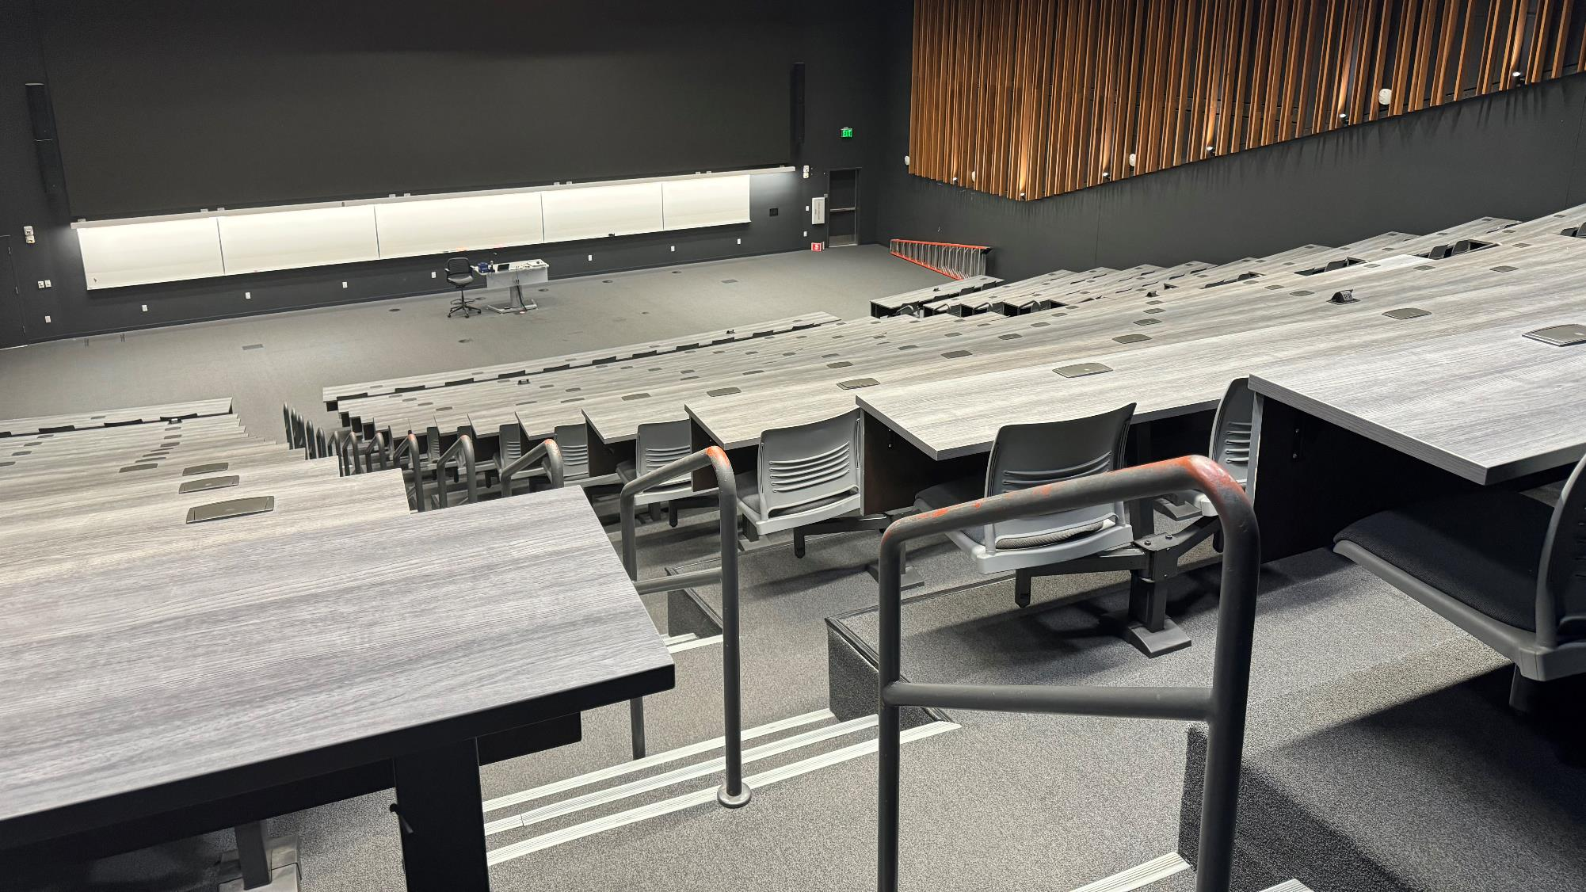
An Example Lecture Hall
Notes:
we’re going to use this to go over my tips about large text, using digital presentations, the pitfalls of whiteboards/chalkboards, and why microphones matter
ACS 120 is a nearly 300 seat lecture hall at UC Merced
it has one direct view LED wall that is capable of showing two large images simultaneously
faculty can plug in their own laptop
a document camera/visual presenter is provided to faculty
lighted white boards
microphones are provided

Slide 8
ADA Permanent Sign Requirements
Height | Viewing Distance | Minimum Character Height
40” – 70” | Under 6’ | 5/8”
 | 6’ or more | 5/8” + 1/8” per foot of viewing distance above 6’
Above 70” to 10’ | Under 15’ | 2”
 | 15’ or more | 2” + 1/8” per foot of viewing distance above 15’
Above 10’ | Under 21’ | 3”
 | 21’ or more | 3” + 1/8” per foot of viewing distance above 21’
Notes:
these requirements do not apply to digital signage, but we can use them as a baseline for what’s considered accessible
2017 ICC A117.1 Accessible and Usable Buildings and Facilities – an international building standard, does cover digital signage, but does not apply to the presentations we’re delivering in our classrooms
while these hard definitions of requirements do not exist, it is on us to facilitate accessibility

Slide 9
ACS 120 By the Numbers
80’9”
14’ 9”
26’8”
4'
min char height for front row: 3” + 1/8” x (27’ - 21’) = 3.75”
min char height for back row: 3” + 1/8” x (81’ - 21’) = 10.5”
8'
*diagram is dramatically not to scale
Notes:
measurements:
floor to screen: 8’
whiteboard height: 4’
screen height: 14’9”
screen to front row: 26’8”
screen to back row: 80’9”
using those sign calculations, that means
min text height for front row: 3.75”
min text height for back row: 10.5”

Slide 10
How Large Would Text Need to Be?
back row students matter
minimum character height = 10.5”
on whiteboard: ~22% of board height
on screen: ~6% of screen height
in PowerPoint, font size = 48
Notes:
what does that mean
display means math
percentage of display for character height = screen height / minimum character height
font size in PowerPoint = 48 = roughly 6% of the height of the powerpoint slide

Slide 11
View from the Front Row
Notes:
visual presenter text is me writing at normal lined paper height = more than tall enough (measurement here)
whiteboard text height is 10.5”
black
red
blue
green
703.5.7 Stroke Thickness. Stroke thickness of the uppercase letter “I” shall be 10 percent minimum and 30 percent maximum of the height of the character.

Slide 12
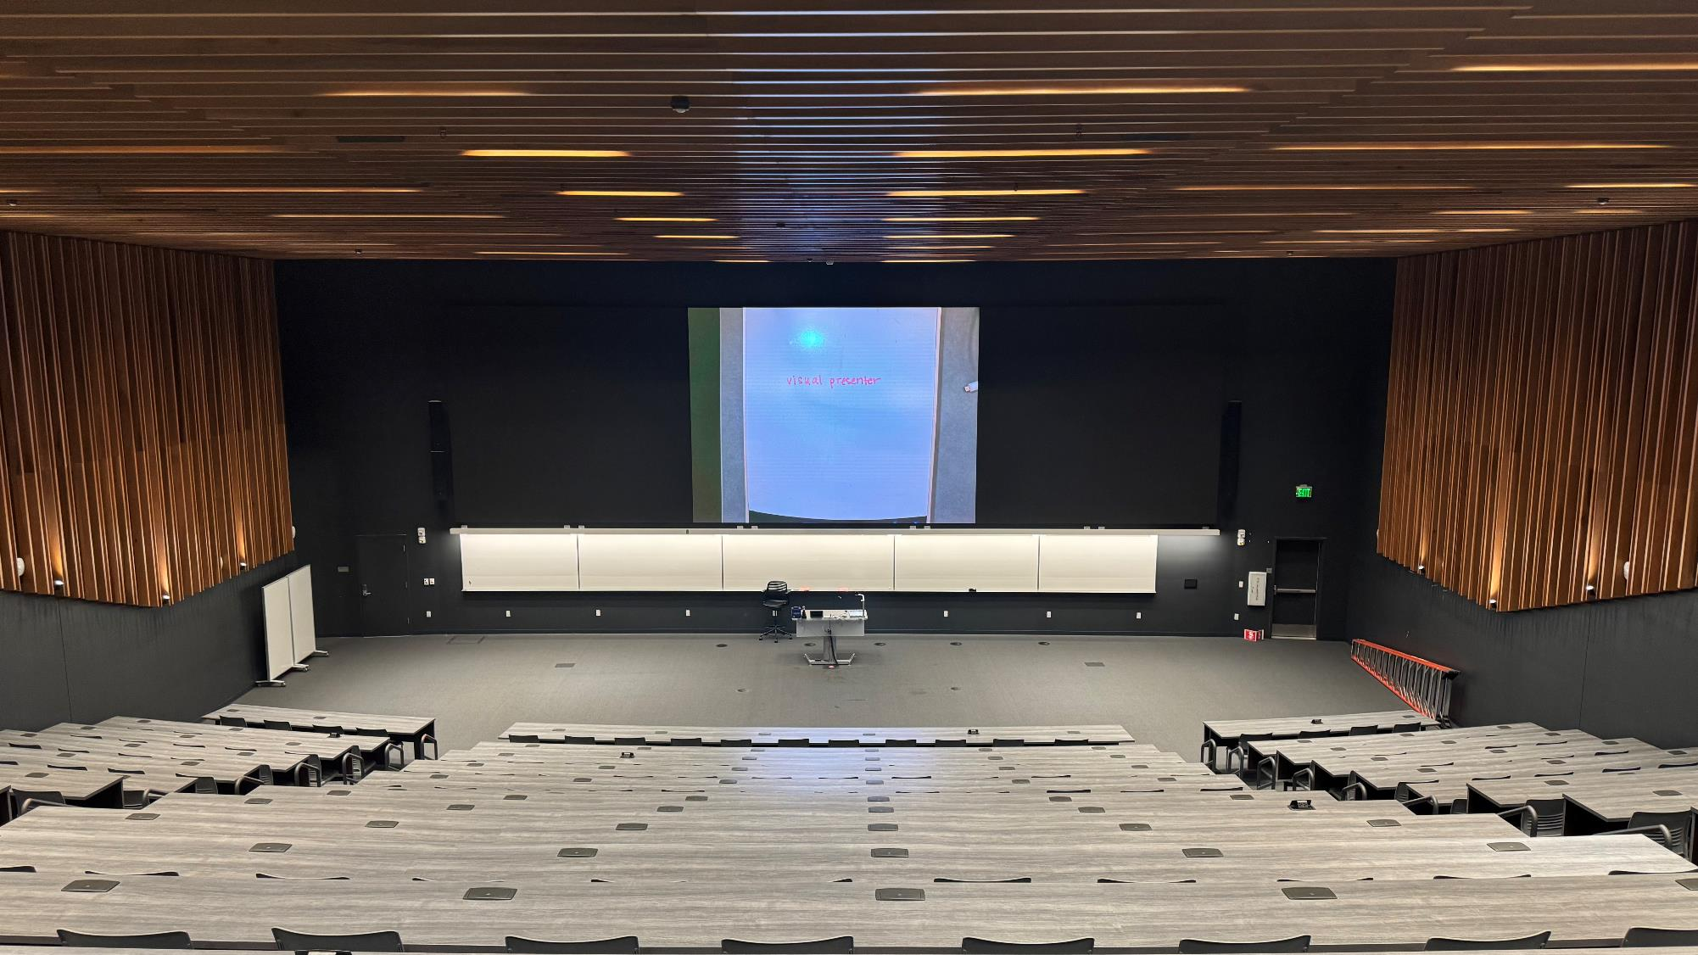
View from the Back Row

Slide 13
Being Heard
Minimum loudness for ALD as set by ADA: 60db
Notes:
minimum db for audibility according to ADA: 60db minimum for ALS
measurements:
no mic:
db at front row:
db at back:
mic:
db at front row:
db at back

Slide 14
Finding Campus Resources
Student Accessibility Offices
Digital Accessibility Programs
Teaching & Learning Centers
ADA Coordinators
Notes:
Thank you for joining!
Resources will be shared later via email!
Joining us next is Brian McNeilly, who will be talking with us about Leading Laterally

Slide 15
Resources & Citations
Suggested Read: Research Brief: Higher Education and the ADA
Guides to Accessibility in Common Presentation Software:
Google Slides: Make your document, presentation, and sheets more accessible
PowerPoint: Improve accessibility with the accessibility checker
Keynote: Create accessible documents, spreadsheets, or presentations with Pages, Numbers, or Keynote
ADA Minimum Character Heigh Requirement for Signs
Notes:
turn this into doc for sharing

