Slide 1
Accessible PowerPoint Tips Jill Wolters, Digital Accessibility Program Manager, UCSF Putting Together the Accessibility Puzzle Pieces May 16, 2024

Slide 2
Takeaway Tips for PowerPoint
Presenting with accessibility in mind
Creating accessible slide decks
Checking for accessibility
Identifying low-hanging fruit

Slide 3
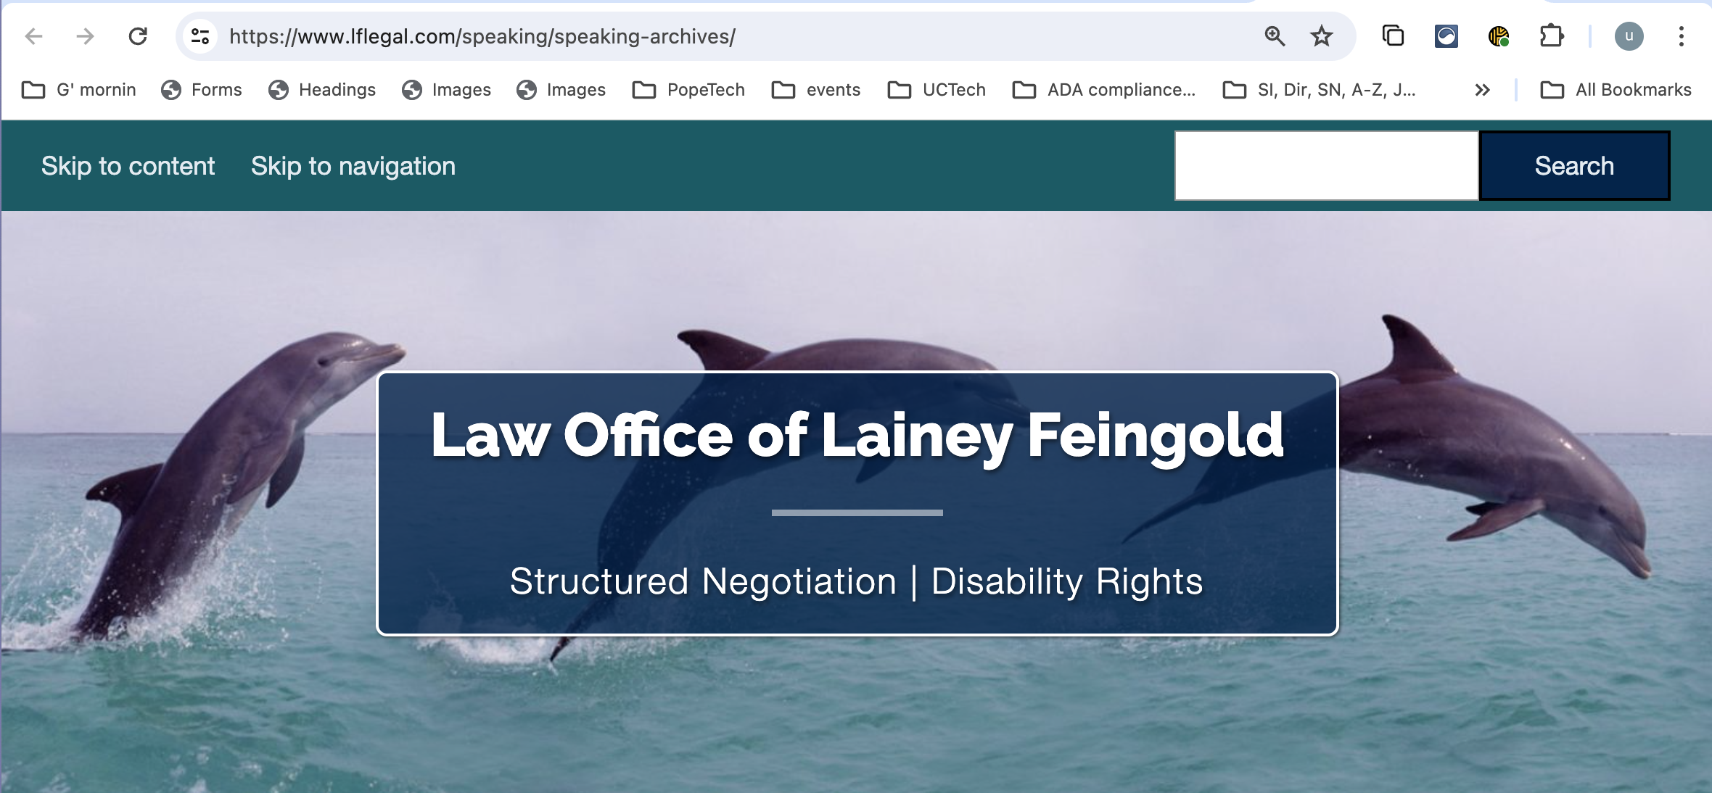
Tips for presenting
Role model
disability rights lawyer
author
public speaker
Lainey Feingold
lflegal.com

Slide 4
Tips for presenting continued
Describe the visuals that contain meaning; make good color choices for graphs and charts
Read the (minimal) text on the slide
Speak slowly, take pauses
Prep with the buddy system (proofing, timing)
Close window coverings and dim lights to provide contrast for in-person audience members with low vision

Slide 5
Tips for creating slide decks
Use pre-built accessible templates
Give every slide deck a title and each slide a title
Avoid tables for layout; for data tables add appropriate header rows. Simplify for clarity.
Work in the Desktop vs. Web version
Limit amount of text, use lists

Slide 6
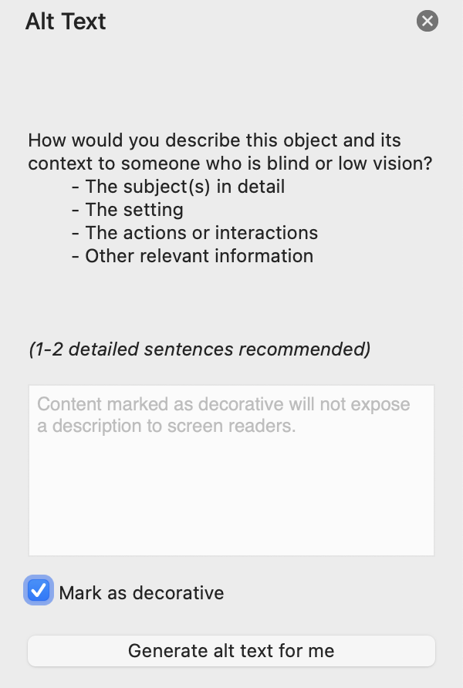
Tips for visuals
Use pictures to enhance your main idea
Add alt text to visuals that contain information
Mark "decorative" objects appropriately
Avoid motion or animations.

Slide 7
Tips for evaluating accessibility
Use the built-in Accessibility Checker.
To launch, select Review > Check accessibility
Issues are prioritized by Errors, Warnings and Intelligent Services
Steps to Fix are provided for each result

Slide 8
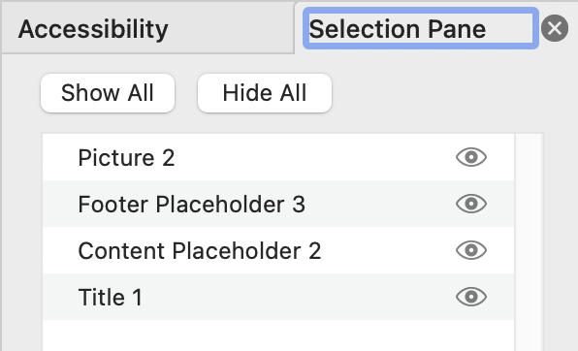
Tips for evaluating accessibility continues
Set and verify Reading Order at Arrange > Selection pane
Read the Microsoft support article Make your PowerPoint presentations accessible to people with disabilities
Follow the WebAIM Word and PowerPoint Accessibility Evaluation Guide

Slide 9
Tips to identify low-hanging fruit
Easy-to-fix issues
Add slide titles
Trim text to short phrases and bullet points
Remove animations and motion
Mark decorative images
Check Reading order

Slide 10
The end

