Slide 1
PowerPoint
Template 2015

Slide 2
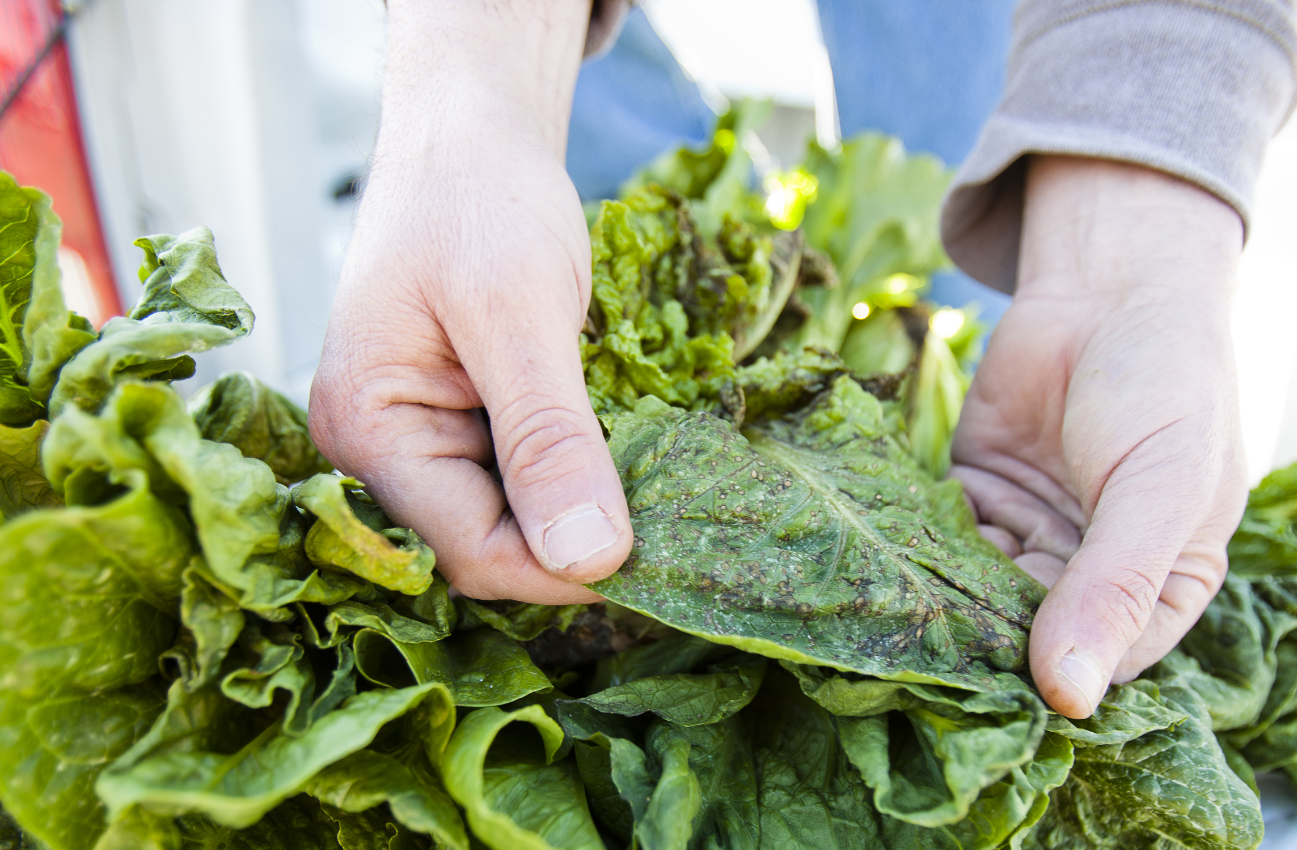
farm to table

Slide 3
phase one
Leadership will develop best practices, and the toolkits to implement them, that, once successfully deployed systemwide at UC, can be offered to schools and communities nationwide.
these projects include:
Expanding experiential learning
Leveraging food purchasing power
Develop insights and action plans in response to climate change
Developing policies to better enable small growers
Integrating food issues into undergraduate and graduate courses
Enhance the availability of healthy choices.
02.01.15 | p.1

