Slide 1
UCOP Budget Development System for FY1314 budget
Updated 5/13/2013 by UCOP Budget System Administrator Pei-Ru Chao

Slide 2
Agenda
System logon and bookmark URL and navigation
System tool bar overview
System tabs and data entry/flow overview
System tab by tab
  Payroll budget entry and summary tabs
  Supplies and Expenses budget entry
  Budget allocation by project and fiscal quarter
  Account Budget summary tab
  Budget Office tab(view adjustments made to proposed budget)
Budget review and approval workflow
Deadlines for FY1314 budget submission

Slide 3
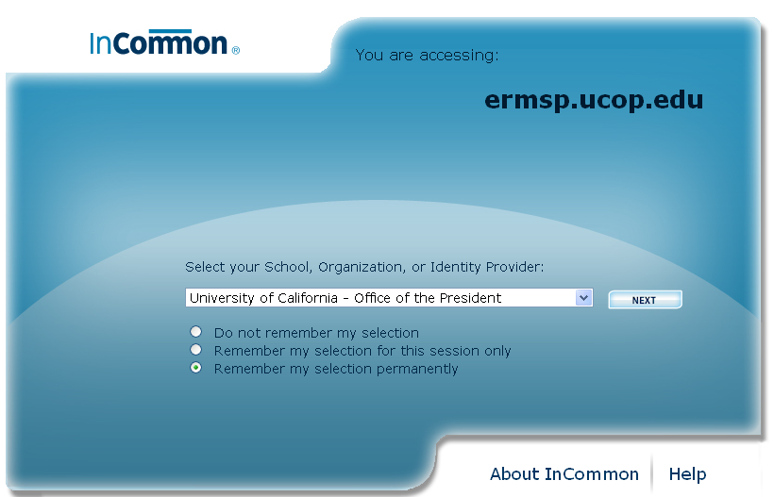
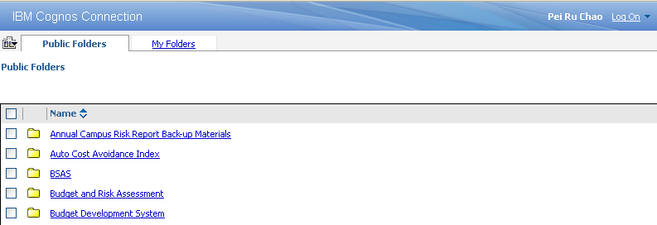
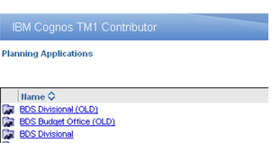
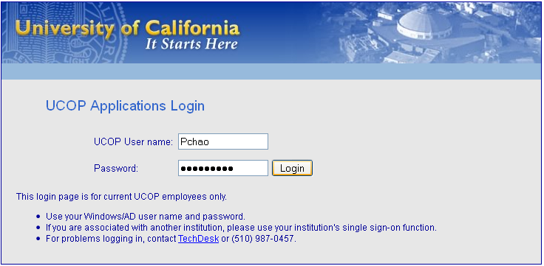
System access, logon and bookmark URL
Open Firefox (recommended), go to Bookmarks/All bookmarks. Right click on Bookmarks Menu/select New Bookmark: name the bookmark and enter the location: https://ermsp.ucop.edu/cognos
Select UCOP and “Remember my selection permanently”
Enter AD Logon (your UCOP log on)
Select “BDS Divisional” (Select BDS Divisional (OLD) for FY1213 budget)

Slide 4
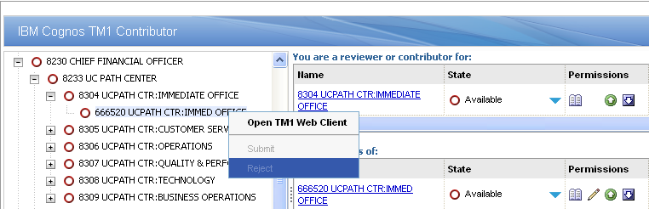
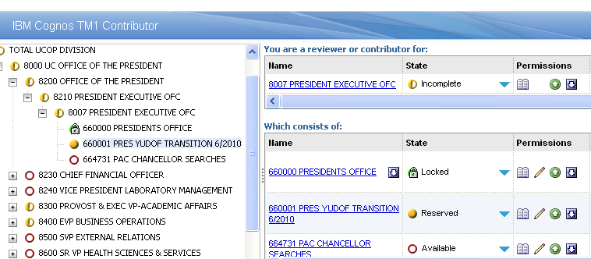
System navigation: workflow and permission
Right-click to open account, dept and sub/division
State (available, reserved, locked) indicates data status
Permissions: view, edit, submit and reject
  Take ownership to “edit, submit or reject” budget

Slide 5
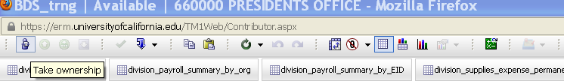
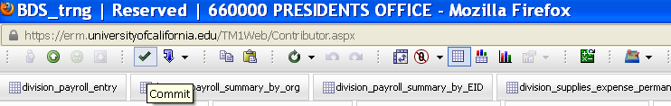
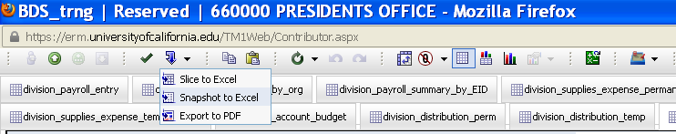
  System tool bar overview
Take ownership only to
  “edit”, “submit” or “reject” account budget
  “submit” or “reject” dept or above level budget
  To “view/review” budget at any level does not require ownership
Always “commit” to save data entry
“Snapshot to Excel” to export the tab to Excel (sort/print)

Slide 6
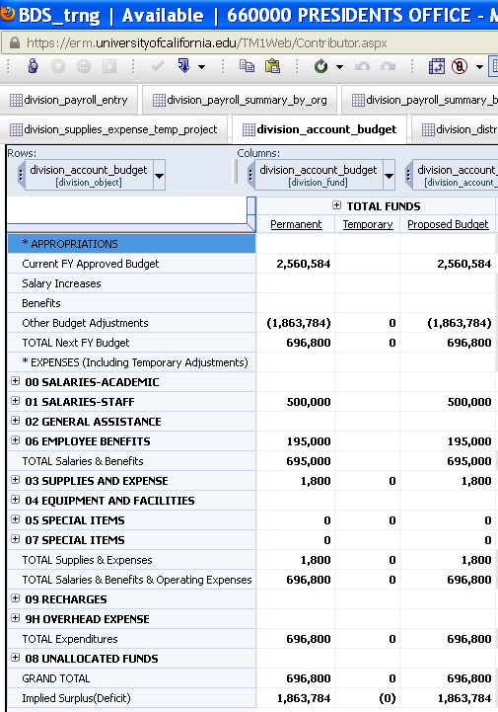
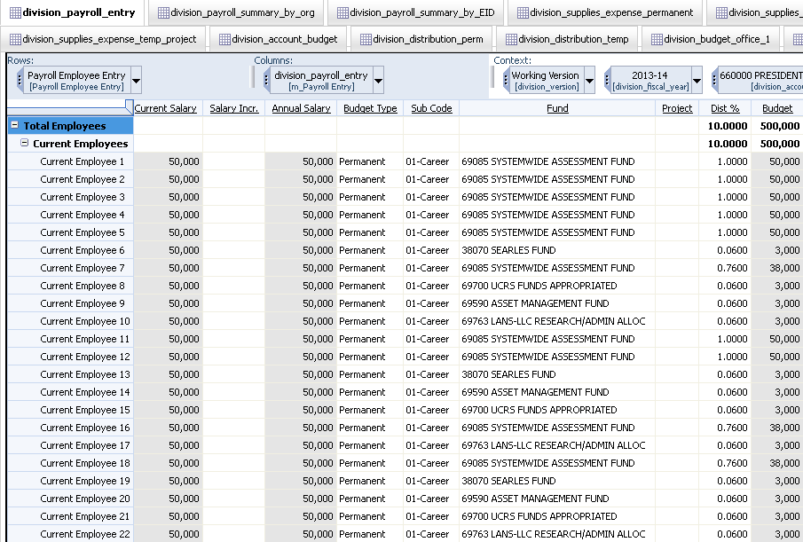
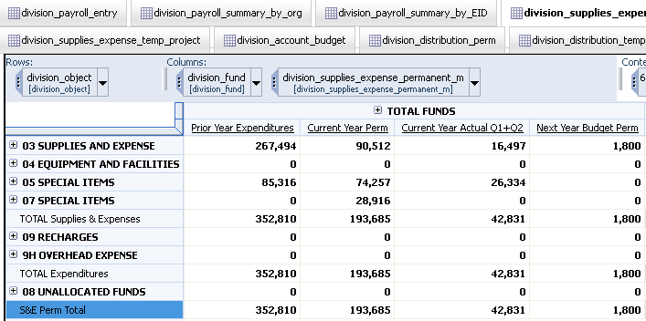
System tabs and data entry/flow overview
Payroll entry (Perm/Temp)=> Account Budget Tab
Supplies & Expenses (Perm/Temp) => Account Budget Tab

Slide 7
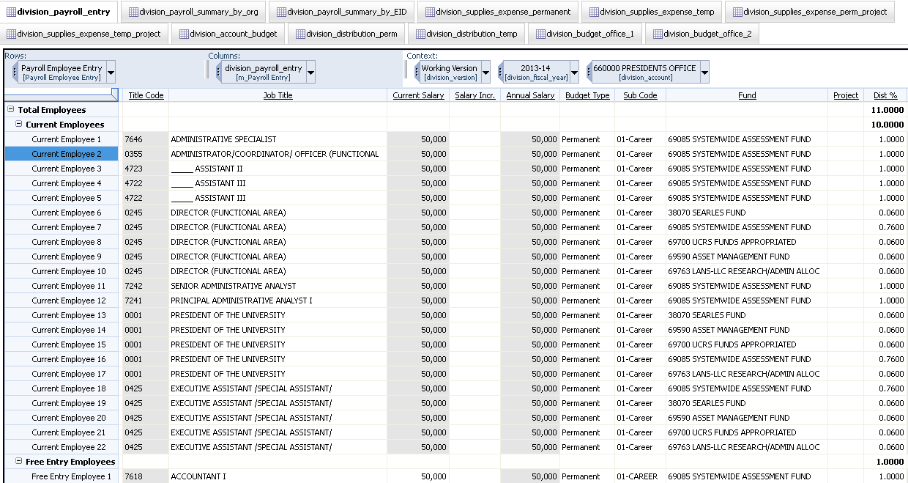
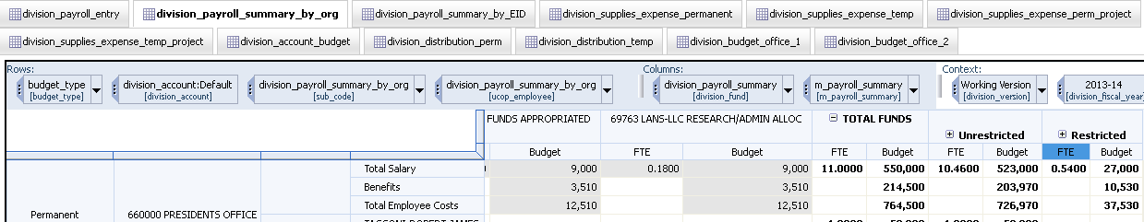
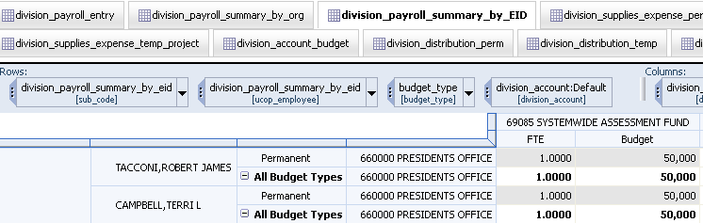
  System tab by tab
  Payroll budget entry and summary tabs
Payroll Entry Tab:
  Current Employees: Pre-populated from EDB+ Employee Pick list (All employees within the same sub-division)
  Free Entry Area: vacancies or lump sum budget (Name/ID required)
Pay Summary Tab: by org and by employee ID

Slide 8
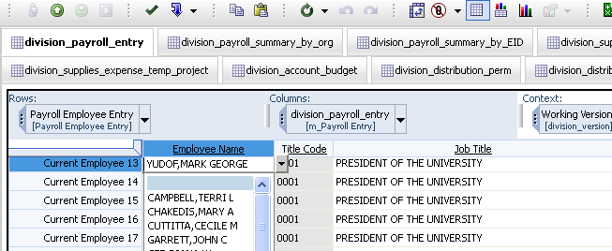
  System tab by tab
  Payroll budget entry (continued)
Current Employees
  Add/Delete (select blank) employees from the Employee Pick list
  Pick Lists for Job Title, Budget Type and Sub Code, Fund
    Budget Type is the funding source for employee salary
    Sub Code (00 for Academic, 01 for Career staff, 02 for Temp/Contract employees)
      Career employees can be paid by Perm/ Temp budget; temp employees can be paid by Perm/Temp budget
Free Entry Employees: Must enter Employee name and Employee ID
  Use ID V01 for perm vacancy 1 and XX1/XX2 for Lump Sum Sub2 payroll budget
  Data shows by IDin Summary tabs

Slide 9
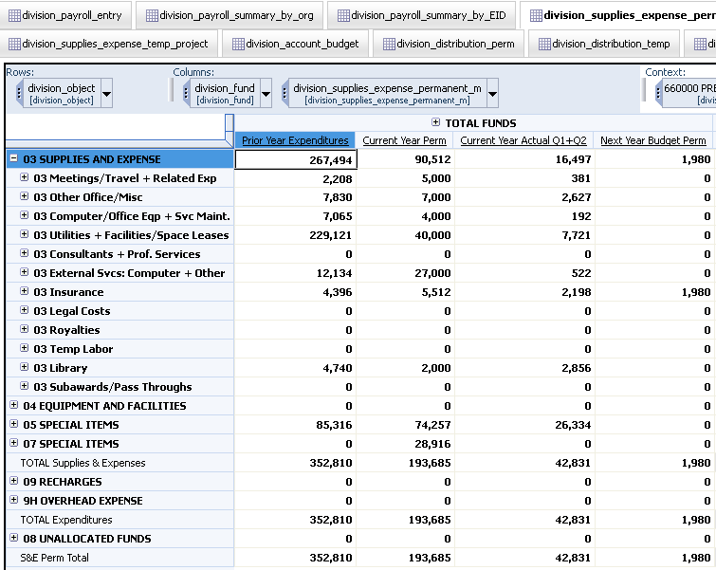
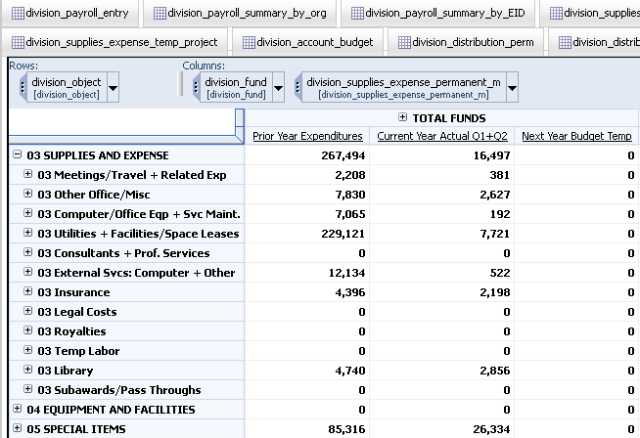
  System tab by tab
  Supplies and Expenses budget entry
S&E Perm and S&E Temp tabs
References: Prior year(FY1112) actual, current year (FY1213) Perm/Temp budget and current year Q1+Q2 actual
Enter budget at object code level if allocate budget by project

Slide 10
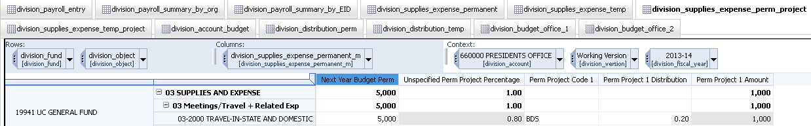
  System tab by tab
  Budget allocation by project
S&E Perm and S&E Temp budget flows to project allocation tabs
Enter Project code and Allocation (e.g., project: BDS, 20%)
  Allocate budget by projects at object code level
  Allocated amount auto-calculated
  Unspecified percentage showing remaining % to be allocated

Slide 11
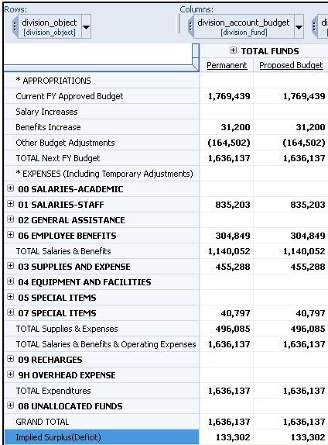
  System tab by tab
  Account Budget (Summary) Tab
This is a “read only” tab, no data entry is required
“Implied Surplus" auto-calculates the difference between the current year approved budget and proposed next year budget
“Benefits Increase” shows the incremental 3% benefits funding based on FY1213 approved salary budget
“Other budget adjustments” auto-calculates the budget addition or reduction to balance the account budget

Slide 12
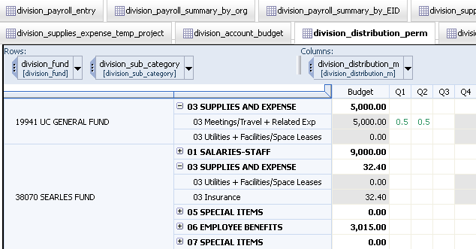
  System tab by tab
  Budget allocation by quarter
2 allocation tabs for Perm/Temp budget
Default setting 25% each quarter (no entry required)
Enter desired allocation at Expense Category level, for Q1, Q2, and Q3 only. Q4 balance is auto-calculated

Slide 13
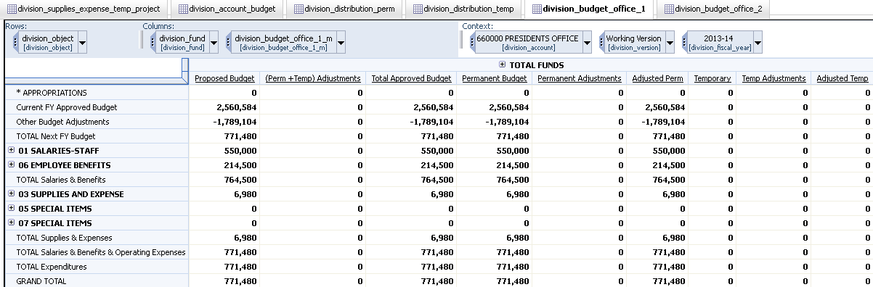
  System tab by tab
  Budget Office 1 Tab
This is a “read only” tab
Units see the “adjustments” made to the proposed budget

Slide 14
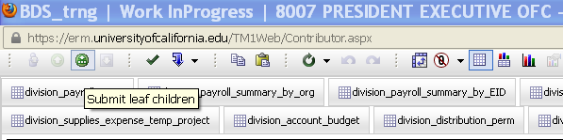
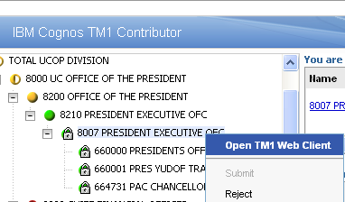
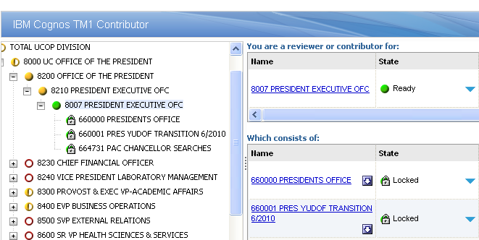
  Budget review and approval process
Units manager submit at dept, sub/division levels
  Units can “submit leaf children” at dept level to submit all accounts underneath
To revise any account budget, units reject the dept/sub-division above the account

Slide 15
Deadline for FY1314 budget submission via BDS
UCOP Budget Office is closing BDS for budget entry/submission on 5/20/2013
Questions? Please contact UCOP Budget Office: Roberto Guerato or Pei-Ru Chao

