Slide 1

Working With Stress
UCOP Safety Meeting April 2010
Develop by Karen Hsi, UCOP EH&S Student Intern

Slide 2
Imagine…
You are sitting in your office, you are swamped with papers and deadlines. Your supervisor just calls and gives you another assignment that he needs done by the end of the day. Your head starts to spin and ache. Instead of feeling more pumped and energized after your morning coffee you start to feel overwhelmed and you have difficulty concentrating on the tasks at hand.
Notes:
If this is a common description of your day… you may want to pay close attention to this safety meeting to find simple ways to help alleviate yourself from JOB STRESS!

Slide 3
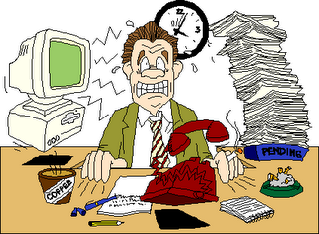
Job Stress
A set of harmful physical and psychological responses that occur when the requirements of the job do not match the capabilities, resources or needs of the worker.
- National Institute for Occupational Safety and Health (NIOSH)
Notes:
Job Stress is a set of harmful physical and psychological responses that occur when the requirements of the job do not match the capabilities, resources or needs of the worker.

Slide 4

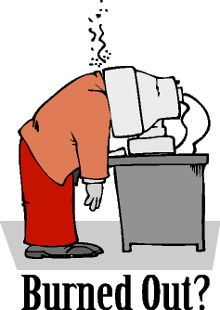
When stress takes over…
It can become a daily threat to health and well-being
Increases the risk of illness, injury, and job burn-out
Majority of the working population experiences work stress
Some stress is normal but excessive stress interferes with productivity, and reduces your physical and emotional health
Important to find ways to keep stress under control and reduce stress at work.
Notes:
When stress takes over…
It can become a daily threat to health and well-being
Increases the risk of illness, injury, and job burn-out
Nearly entire working population can be affected
While some stress is a normal part of life,
excessive stress interferes with your productivity and
reduces your physical and emotional health, so it’s
important to find ways to keep it under control.
Fortunately, there is a lot that you can do to manage
and reduce stress at work.

Slide 5
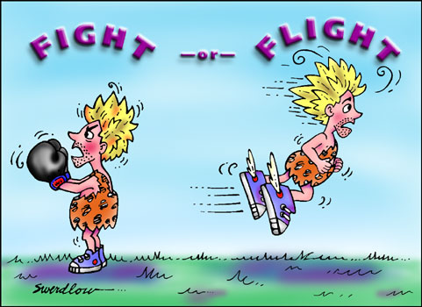
Fight or Flight gone BAD!
Persisting stressful situations keep the body in a constant state of activation, causing fatigue and damage to body.
Stressful working conditions may interfere with safe work practices, leaving worker more susceptible to hazards in the workplace!
Notes:
Occasional stress is normal, because body returns to equilibrium after stress passes. But when stressful situations persist body is kept in constant state of activation, causing fatigue and damage to body! Prolonged responses to stress results in fatigue or damage to the body. It can no longer repair and defend itself as before. As a result, the risk of disease and injury escalates. In fact, health care expenditures are nearly 50% greater for workers who report high levels of stress. It’s now widely believed that job stress increases the risk of cardiovascular disease, certain psychological disorders, and musculoskeletal disorders of the back and upper extremities. Stress may also exacerbate existing health problems and interfere with their treatment.

Slide 6

Job Stress and Health: What the Research Tells Us
Cardiovascular Disease
Musculoskeletal Disorders
Psychological Disorders
Workplace Injury
Suicide, Cancer, Ulcers, and Impaired Immune Function
Notes:
Cardiovascular Disease
Many studies suggest that psychologically demanding jobs that allow employees
little control over the work process increase the risk of cardiovascular disease.
Musculoskeletal Disorders
On the basis of research by National Institute for Occupational Safety and Health(NIOSH) and many other organizations, it is widely
believed that job stress increases the risk for development of back and upperextremity musculoskeletal disorders.
Psychological Disorders
Several studies suggest that differences in rates of mental health problems (such as
depression and burnout) for various occupations are due partly to differences in job
stress levels. (Economic and lifestyle differences between occupations may also
contribute to some of these problems.)
Workplace Injury
Although more study is needed, there is a growing concern that stressful working
conditions interfere with safe work practices and set the stage for injuries at work.
Suicide, Cancer, Ulcers, and Impaired Immune Function
Some studies suggest a relationship between stressful working conditions and these
health problems. However, more research is needed before firm conclusions can be
drawn.
—Encyclopaedia of Occupational Safety and Health

Slide 7
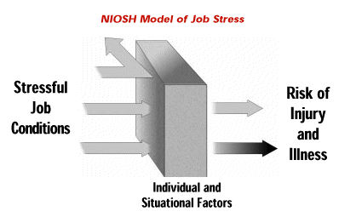
NIOSH model of Job Stress
Stressful working conditions lead to risk of injury and illness.
Balance between work and personal life
Supportive co-workers
A relaxed and positive outlook
Notes:
Some personal and situational factors can reduce the impact of stressful conditions on safety and health. These factors may include a balance between work and personal life, supportive co-workers, and a relaxed and positive outlook.

Slide 8

Common Causes of Excessive Workplace Stress
Fear of layoffs
Increased demands for overtime due to staff cutbacks
Pressure to perform to meet rising expectations but with no increase in job satisfaction
Pressure to work at optimum levels- all the time!
Notes:
Common Causes of Excessive Workplace Stress
Fear of layoffs
Increased demands for overtime due to staff cutbacks
Pressure to perform to meet rising expectations but with no increase in job satisfaction
Pressure to work at optimum levels- all the time!

Slide 9


Early Warnings of Job Stress
Headache
Sleep disturbances
Difficulty in concentrating
Short temper
Upset stomach
Job dissatisfaction
Low morale
Feeling anxious, irritable, or depressed
Apathy, loss of interest in work.
Problems sleeping
Fatigue
Trouble concentrating
Muscle tension or headaches
Stomach problems
Social withdrawal
Loss of sex drive
Using alcohol or drugs to cope
Notes:
Warning signs of excessive stress at work
When people feel overwhelmed, they lose confidence and become irritable or
withdrawn, making them less productive and effective and their work less
rewarding. If the warning signs of work stress go unattended, they can lead to
bigger problems. Beyond interfering with job performance and satisfaction,
chronic or intense stress can also lead to physical and emotional health problems.

Slide 10

How to Manage Job Stress
Taking responsibility for improving
your physical and emotional well-being.
Avoiding Pitfalls by identifying knee jerk habits and negative attitudes that add to the stress you experience at work.
Learning better communication skills to ease and improve your relationships with management and coworkers.
Notes:
You can learn how to manage job stress
There are a variety of steps you can take to reduce both your overall stress levels
and the stress you find on the job and in the workplace. These include:
Taking responsibility for improving your physical and emotional wellbeing.
Avoiding pitfalls by identifying knee jerk habits and negative attitudes that
add to the stress you experience at work.
Learning better communication skills to ease and improve your
relationships with management and coworkers.

Slide 11
The Do’s and Don’ts of how to manage job stress
http://www.youtube.com/watch?v=srSZD-Ybocg

Slide 12
Reducing Job Stress by Taking Care of Yourself
Get moving
-Aerobic exercise- generates endorphins (hormones that contribute to natural feels of well being)
Make food choices that keep you going and make you feel good.
- Eating small but frequent meals helps to maintain blood sugar
Minimize alcohol consumption and avoid nicotine
Get enough sleep
Notes:
When stress on the job is interfering with your ability to work, care for yourself, or
manage your personal life, it’s time to take action. Start by paying attention to
your physical and emotional health. When your own needs are taken care of,
you’re stronger and more resilient to stress. The better you feel, the better
equipped you’ll be to manage work stress without becoming overwhelmed.
Taking care of yourself doesn’t require a total lifestyle overhaul. Even small things
can lift your mood, increase your energy, and make you feel like you’re back in
the driver’s seat. Take things one step at a time, and as you make more positive
lifestyle choices, you’ll soon notice a noticeable difference in your stress level,
both at home at work.

Slide 13
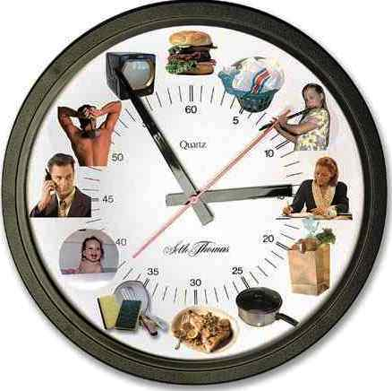
Reducing Job Stress by Prioritizing and Organizing
Time management tips
Create a balanced schedule
Don’t over-commit yourself
Try to leave earlier in the morning
Plan regular breaks
Task management tips
Prioritize tasks
Break projects into small steps
Delegate responsibility
Notes:
Time management tips for reducing job stress
-Create a balanced schedule. Analyze your schedule, responsibilities, and
daily tasks. All work and no play is a recipe for burnout. Try to find a balance
between work and family life, social activities and solitary pursuits, daily
responsibilities and downtime.
-Don’t over-commit yourself. Avoid scheduling things back-to-back or
trying to fit too much into one day. All too often, we underestimate how long
things will take. If you've got too much on your plate, distinguish between
the "shoulds" and the "musts." Drop tasks that aren't truly necessary to the
bottom of the list or eliminate them entirely.
-Try to leave earlier in the morning. Even 10-15 minutes can make the
difference between frantically rushing to your desk and having time to ease
into your day. Don’t add to your stress levels by running late.
-Plan regular breaks. Make sure to take short breaks throughout the day to
sit back and clear your mind. Also try to get away from your desk for lunch.
Stepping away from work to briefly relax and recharge will help you be more,
not less, productive.
Task management tips for reducing job stress
-Prioritize tasks. Make a list of tasks you have to do, and tackle them in
order of importance. Do the high-priority items first. If you have something
particularly unpleasant to do, get it over with early. The rest of your day will
be more pleasant as a result.
-Break projects into small steps. If a large project seems overwhelming,
make a step-by-step plan. Focus on one manageable step at a time, rather
than taking on everything at once.
-Delegate responsibility. You don’t have to do it all yourself, whether at
home, school, or on the job. If other people can take care of the task, why
not let them? Let go of the desire to control or oversee every little step.
You’ll be letting go of unnecessary stress in the process.

Slide 14
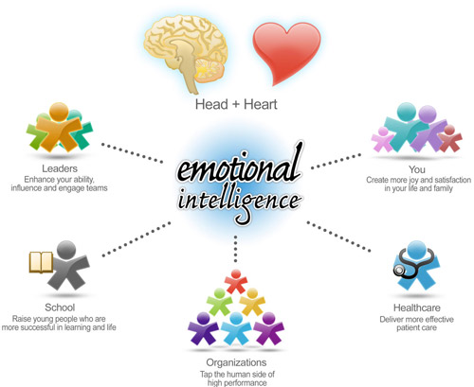
Reducing Workplace Stress by Improving Emotional Intelligence
Emotional Intelligence- ability to manage and use emotions in positive and constructive ways
Self-awareness
Self-management
Social awareness
Relationship management
Notes:
The more emotional intelligence you have, the more stress
you can avoid in the workplace. Fortunately, emotional
intelligence is not something we’re born with; it’s something
we can learn and develop.
Emotional intelligence in the workplace has four major components:
- Self-awareness – The ability to recognize your emotions and their impact
while using gut feelings to guide your decisions.
-Self-management – The ability to control your emotions and behavior and
adapt to changing circumstances.
-Social awareness – The ability to sense, understand, and react to other's
emotions and feel comfortable socially.
-Relationship management – The ability to inspire, influence, and connect
to others and manage conflict.

Slide 15
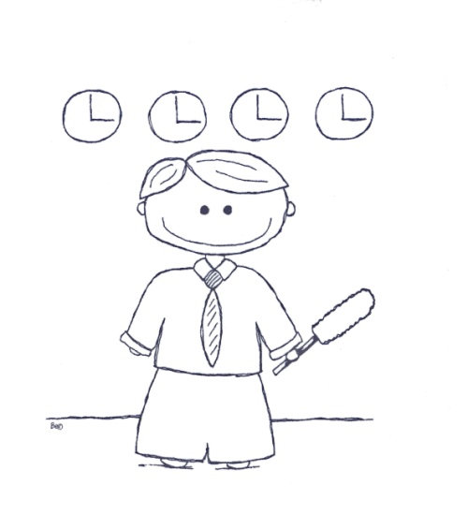

Reducing Job Stress by Breaking Bad Habits
Eliminate self-defeating behaviors by…
Resisting Perfection
Cleaning Up Your Act
Flipping Your Negative Thinking
Notes:
Many of us make job stress worse with patterns of thought or behavior that keep
us from relieving pressure on ourselves. If you can turn around these self-defeating
habits, you’ll find employer-imposed stress easier to handle.
Resist perfectionism. No project, situation, or decision is ever perfect, and
you put undue stress on yourself by trying to do everything perfectly. When
you set unrealistic goals for yourself or try to do too much, you’re setting
yourself up to fall short. Do your best, and you’ll do fine.
Clean up your act. If you’re always running late, set your clocks and
watches fast and give yourself extra time. If your desk is a mess, file and
throw away the clutter; just knowing where everything is saves time and cuts
stress. Make to-do lists and cross off items as you accomplish them. Plan
your day and stick to the schedule — you’ll feel less overwhelmed.
Flip your negative thinking. If you see the downside of every situation and
interaction, you’ll find yourself drained of energy and motivation. Try to think
positively about your work, avoid negative-thinking co-workers, and pat
yourself on the back about small accomplishments, even if no one else does.

Slide 16
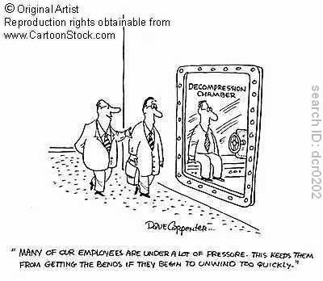
Find Ways to Dispel Stress
Get time away
Talk it out
Cultivate allies at work
Find humor in the situation
Notes:
Get time away. If you feel stress building, take a break. Walk away from
the situation. Take a stroll around the block, sit on a park bench, or spend a
few minutes meditating. Exercise does wonders for the psyche. But even just
finding a quiet place and listening to your iPod can reduce stress
Talk it out. Sometimes the best stress-reducer is simply sharing your stress
with someone close to you. The act of talking it out – and getting support
and empathy from someone else – is often an excellent way of blowing off
steam and reducing stress.
Cultivate allies at work. Just knowing you have one or more co-workers
who are willing to assist you in times of stress will reduce your stress level.
Just remember to reciprocate and help them when they are in need.
Find humor in the situation. When you – or the people around you – start
taking things too seriously, find a way to break through with laughter. Share

Slide 17
Jerry takes over stress at UCOP!
Jerry shows us that he can manage his the stressful workload on his desk by simply using a little humor and spreading laughter and fun!
Way to go Jerry!

Slide 18


Job Stress is very managable…so take control and turn this…

Slide 19

Into this!!!

