Slide 1
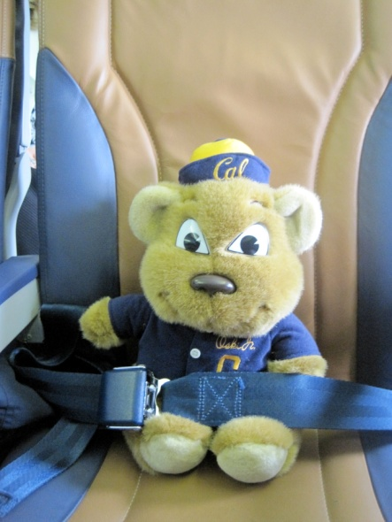
Travel Safety
UCOP Safety Meeting June 2010
Developed by Karen Hsi, UCOP EH&S Student Intern
Notes:
The June 2010 Safety Meeting topic is Travel Safety.
Many UCOP employees are required to travel. This training will provide UCOP employees with information to plan and prepare their trip to minimize the risk of injury . The training will also address recommended actions to take while on travel to minimize the probably of becoming a victim of a crime.
Also, June is the beginning of summer, and many UCOP employees may be taking trips with families, friends, and relatives. Information in this training module will also help make your personal travels safer for all members of your family.

Slide 2
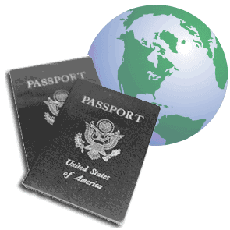
Travel Safety Hazards
Transportation Accidents
Assault/Robbery/Thief
Fire
Lifting/Ergonomics
Notes:
What are the primary hazards while traveling?
The first type are accidents related to transportation…..primarily airline or motor vehicle accidents.
The second type of hazard is being a victim of a crime, such as assaults, robbery, pick pockets, or thief.
The next type of hazard is hotel or motel fires
The last type of hazard is ergonomics. Lifting heavy luggage which would result in potential back or arm injuries

Slide 3
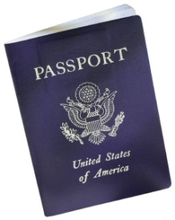
Pre- Travel Preparations
Photocopy (Front & Back) – Credit Cards, Tickets, Health Insurance, Passport, & Other Important Documents
  Phone Numbers to Call for Replacement
Leave Itinerary with Family/Office
Map Out Directions From Airport to Hotel and/or Destinations
  Keep in Carry-On Luggage
Notes:
A stress-free trip could be avoided with organized pre-planning. In the event you lose your wallet or purse you could lose valuable documents you will need to get replacements . So you should photocopy your credit cards, ticket, health insurance, passport, and other important documents along with the phone numbers to call to get replacements. These phone numbers are typically found on the back of your credit cards
A travel itinerary is important, especially if traveling alone – Leave your itinerary with family members or your office.
Map Out Directions. The worst thing to do is arrive in a strange city at night and not know where to go. Plan your travel route from the airport to your hotel or the meeting location ahead of time. Keep the map in your carry-on luggage in case your check-in luggage gets lost.

Slide 4
Pre- Travel Preparations
Hotel Have Automatic Fire Sprinklers?
  www.usfa.fema.gov/hotel
Oversees Travel – Go to:
  http://travel.state.gov/travel/tips/safety/safety_1180.html
Emergency Phone Numbers
  Physician, Family
  Local Police Dept. 911 Equivalent Number
Put Essentials in Carry-On Luggage
  Lithium Batteries are Not Permitted in Checked Luggage - Fire Hazard
Notes:
When you reserve your hotel room, how do you know if your hotel is equipped with automatic fire sprinklers? The federal government requires their employees to stay in hotels or motels which have fire sprinklers. You can go to the FEMA webpage and check to see if the hotel of your choice is equipped with sprinklers.
If your trip is overseas, there are several safety/security precautions which you should be aware of. The U.S. State Department has a website for people traveling overseas. This is the webpage link to their safety tips.
Another part of pre-planning is having emergency phone numbers. Your physician, family members and even the local police. If you are traveling to a city with a cell phone you can call the local police department and ask them for an equivalent 911 number. You can then program that phone number into you cell phone in the event of an emergency
Lastly, we all have heard of horror stories from people who fly on airlines and they lose their checked luggage or have their luggage end up in another city and not get their luggage until the next day. So part of the pre-planning would be to pack some of your essential items in your carry-on luggage.
Please note that lithium batteries are not permitted to be placed in checked luggage due to the potential fire hazard from lithium batteries. So you should carry your lithium batteries with your carry-on luggage.

Slide 5

Out-of-State/Out-of-Country Travel
Must register all UC out-of-state or out-of-country travel
  Book trips through Connexxus – You are automatically registered
    Exception – Trips booked on Southwest Airlines
      Register through: www.uctravel.org
Benefits of Registration:
  Travel Insurance & Out-of-Country Medical Coverage
  Emergency Travel Assistance
    Track employees during disasters/civil unrest & arrange to bring employee home
Notes:
All UC-related travel which are out-of-state or out-of-country must be registered through the uctravel.org webpage. If you book your trip through the UC Connexxus webpage, your trip will automatically be registered. The only exception are trips booked through the Connexxus Southwest Airlines SWABiz webpage. For SWABiz reservations you must register the trip through the www.uctravel.org webpage.
Following registration you will receive an e-mail from WorldcueTraveler@ijet.com confirming your registration. The e-mail will also provide you with your policy number, emergency contact information, and webpage links to provide you with updated information and alerts related to your travel destination.
The trip registration benefits includes travel insurance coverage, out-of-country medical coverage, and emergency travel assistance. This is particularly important in the event of natural disasters or during times of civil unrest in the country which you may be visiting. If you register your trip, and one of these incidents occur, through the travel assistance program, UC can arrange to have you extracted from the area.

Slide 6

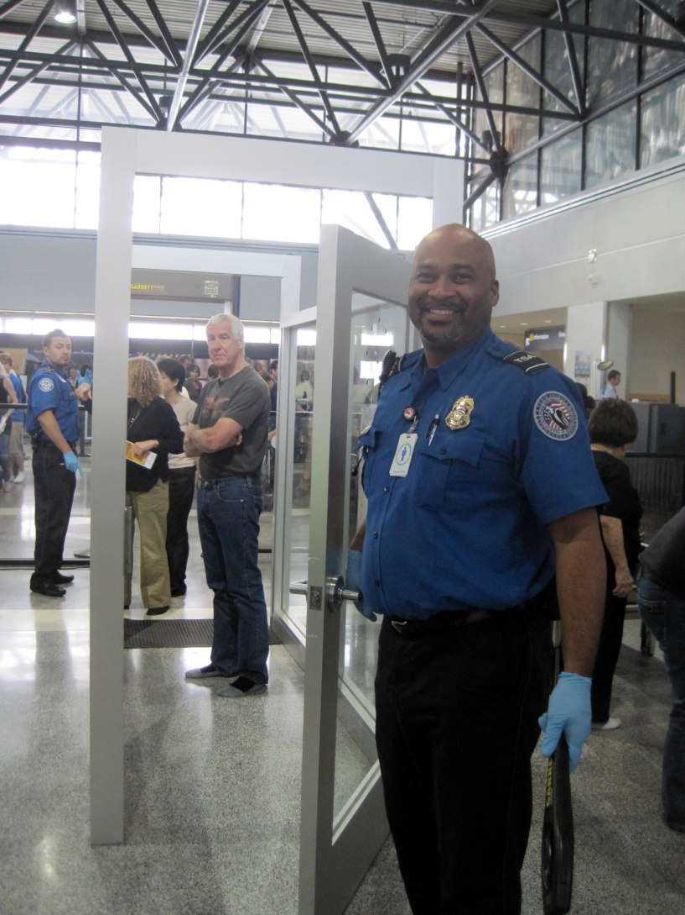
Going Through Airport Security
All liquid bottles should be 3 ounces or less and put into a 1quart Ziploc® bag
Remember to take all water & other beverages out of carry-on baggage
Remove laptop from case & place in a separate screening bin
Take shoes off
Follow instructions from the TSA personnel
Notes:
Airport Security – All liquid containers must be 3 ounces or less in size and must all fit into a single one quart size Ziploc® bag. Be sure to remove all water/beverages out of your carry-on baggage.
Remove you laptop computer from its bag and place the laptop in its own separate screening bin.
Remove shoes and place them on the screening belt and follow the instructions from the TSA personnel.

Slide 7
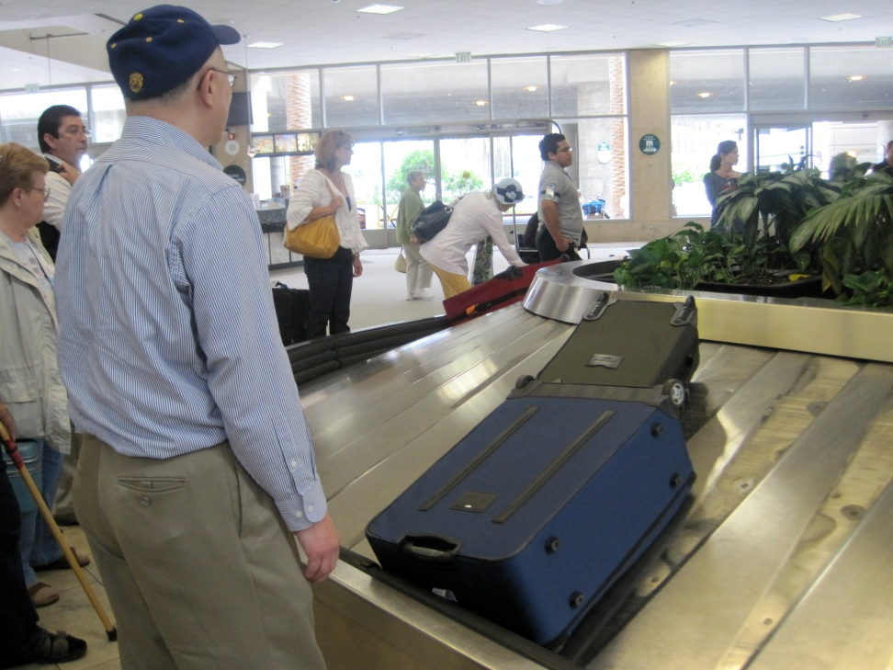
Ergonomics
Luggage with Wheels
Luggage Weight Less Than:
  50 Pounds – Male; or
  45 Pounds - Female
Caution Lifting Luggage from Car Trunk
Laptops
  Case with Wide Padded Shoulder Straps
  Alternate Between Shoulders Regularly
  Put Accessories in Suitcase
Notes:
As we previously mentioned, carrying luggage has the potential to create back, arm, and even shoulder injuries. If you have a lot of items to pack, use luggage which have wheels. As discussed in previous safety meetings, there is a recommended “safe” weight for lifting. For males, the weight of the luggage should be kept below 50 pounds and for females, the weight of the luggage should be kept below 45 pounds. When you load and unload luggage into and out of the trunk of your automobile, use care and caution. Your back will probably be in an “extended” position which can potentially increase the possibility of injuring your lower back.
If you are traveling with you laptop computer, it should be carried in a laptop case which has wide padded shoulder straps. You should periodically alternate carrying the case to both shoulders. Also to lighten the load, put the accessories in the suitcase rather than carrying them in the laptop case.

Slide 8
Transportation
Airline
From Seat - Count Number of Rows to Nearest Emergency Exit
  Number of Rows to the Exit in Front
  Number of Rows to the Exit Behind
Listen to Safety Briefing By Flight Attendant
Event of Accident/Crash – Listen and Follow to Flight Attendant Instructions
Notes:
The next area we’ll discuss is safety on the airplane. When you find your seat on the airplane you should plan what you would do in the event of an accident. How would you escape from the airplane? Airline crash statistics show that of the persons who survive an airplane crash, the highest rate of fatalities is due to smoke inhalation. You should know the location of the two nearest emergency exits from your seat on the airplane. Following a crash, visibility on the airplane may be poor, so you should count the number of rows from your seat to the nearest emergency exit in front of you and also the number of rows to the nearest emergency exit behind you. You want the two nearest exits in case your path to the nearest emergency exit is blocked.
It is important to listen to the safety briefing which the flight attendants cover at the beginning of the flight. In the event of an crash, accident, or incident, listen and follow the flight attendant’s instructions.

Slide 9
Thrombosis
Defined as a clot of coagulated blood in the blood vessel
During long trips deep vein thrombosis can develop from lack of movement.
Can be fatal – Pulmonary Embolism
World Health Organization (WHO) estimates that 1 out of 4,500 travelers will develop a clot
During flights of more than 4 hours try and move around, get blood circulation flowing
Notes:
Thrombosis is a clot of coagulated blood which develops in the blood vessels. During long trips deep vein thrombosis can develop due to lack of movement.
Thrombosis can be fatal. Large clots can dislodge and circulate to the lungs and result in a fatal pulmonary embolism – which is a blockage of the blood vessels in the lungs
The World Health Organization estimates 1 out of 4500 travelers will develop a clot.
Due to the health risk of thrombosis, on airline flights of more than 4 hours, travelers should attempt to move around to get blood circulation flowing.

Slide 10
Some advice on how to prevent Thrombosis!
1. Wear compressions stockings
2. Flex and Point your toes
3. Bounce your legs
4. Ask your physician about taking blood thinners
Notes:
These tips help prevent blood pooling in the lower leg--blood pooling is a big factor in blood clots. Compression stockings and socks are sold for both men and women in many sizes and styles. Look for these online, at medical supply stores, in pharmacies and at some department stores
Northwest Airlines (now Delta Airlines) suggests the flex & point your toe exercise for passengers on long flights. It is a very simple exercise that can be done anywhere. Simply flex your toes back as far as they will go and then point them forward. Repeat this until your toes tire, and do it at least once during every two hours of sitting.
Bounce your legs is another exercise easily be done from your chair at home or on an airplane (although it may annoy the passenger next to you).
If you know you'll have to sit for long periods discuss the situation with you physician. If he/she believes you are at risk for blood clots your physician may recommend taking blood thinners.

Slide 11
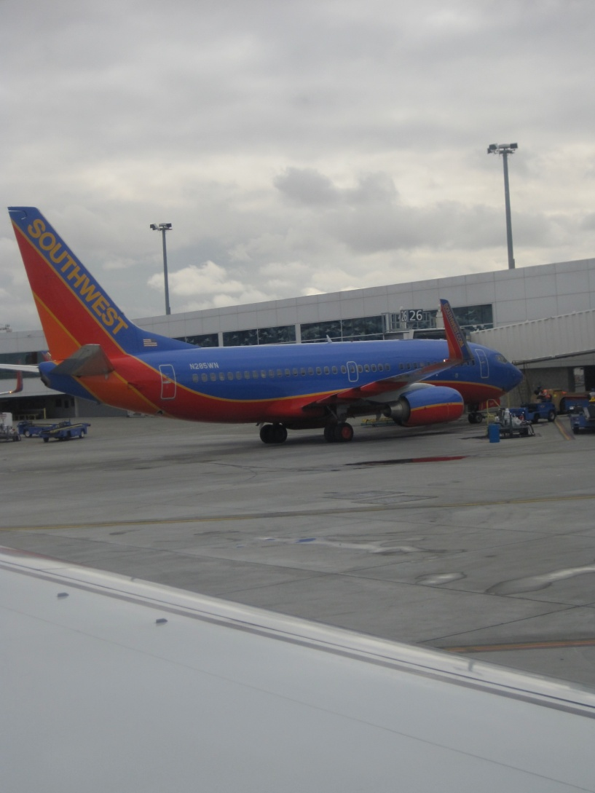
Travel Reminders Video
http://animoto.com/play/6HdxrB9kU7ZiyVpUWquunA

Slide 12
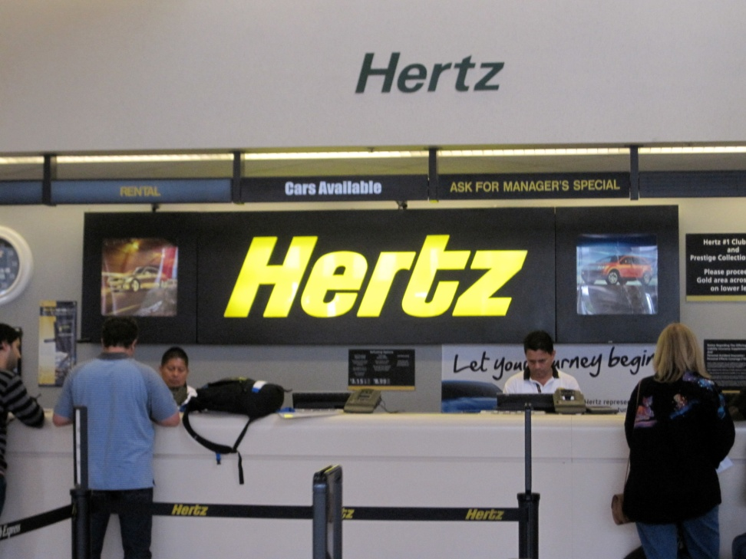
Transportation
Rental Car Safety
Rental Car with No “Company Logo”
Keep Luggage in Trunk
  Do Not Want to Draw Attention -You are a Visitor
Be Wary of Pulling Over, Especially in the Dark or in Unfamiliar Territory
Do Not Exit Car Until It is Safe
Stay on Main Roads
Keep Rental Car Doors Locked
Notes:
If you rent a car. Here are some safety recommendations to minimize your chances of being a victim of robbery, assault, or car jacking.
1) Rent a vehicle from a rental car company which does not have the rental car company’s logo on the vehicle. A logo is advertising to robbers or car thieves that you are from out of town and more vulnerable.
2) Keep your luggage in the trunk while driving around. Visible luggage in the back seat draw attention to your vehicle.
3) Become familiar with all the features of your rental car, headlights, hazard lights, door locks, and windshield wipers before you drive away from the rental car lot. If you are not familiar on how to operate some of these safety features and you attempt to use them while driving, you will become distracted and that will increase the probability of getting into an accident.
4) Be wary of pulling over in a dark unfamiliar area. If you need to exit your car, drive to a well populated area such as a shopping center, supermarket, or gas station before you exit you vehicle. Never stray off to side streets. Stay on the main roads.

Slide 13
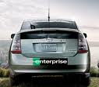
Transportation
Rental Car Safety
http://www.youtube.com/watch?v=MavNSc2_Zy4
Inspect Your Car and Become Familiar with Vehicle Safety Features Before Driving the Car Out of the Lot
  Headlights, Hazard Lights, Door Locks & Spare Tire

Slide 14
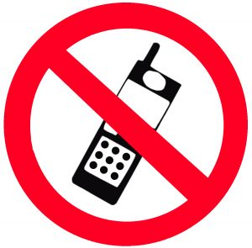
NO Texting while Driving
“The employee is expected to avoid using a cellular phone or any other type of electronic communications equipment under any circumstances where such use might create or appear to create a hazard, including use while operating a motor vehicle.”
– UCOP Business and Finance Bulletin(March 2007)
Notes:
However, the requirement to avoid using the equipment while operating a motor vehicle does not apply to emergency response personnel, e.g., police, fire, traffic enforcement, environmental health and safety, health care, and disaster response personnel, including facilities management personnel who may use a cellular telephone for emergency purposes.

Slide 15
Hotel Safety
Rooms with Electronic Locks, Deadbolts, Peepholes
Garage Elevators Go to Lobby, Not Guest Floors
Entering Elevators with Suspicious Looking Strangers
High Rise Hotels Rooms on the 6th Floor or Lower - Fire Ladders Can Reach
Notes:
Our next topic is hotel safety. When selecting a hotel, safety features you should look for are rooms with electronic locks, deadbolt locks, and peepholes. The hotel should have their garage elevators go to the lobby, and a separate elevator going to the guest floors. This will prevent criminals from sneaking onto the guest floor rooms.
If you are entering an elevator and the other person looks suspicious….be cautious and wait for the next elevator.
When requesting a room in a high rise hotel, be aware that in the event of a fire, the ladders on the fire trucks can only reach floor 6 and below.

Slide 16
Hotel Safety
Valuables in Hotel/Room Safe
Use Peep Hole Before Opening Door
  When in Doubt, Call the Front Desk
Deadbolt Door Each Time You Enter Room
“Make-Up Room” Sign – Advertises No One is in the Room
Inquire with Hotel Staff on “Safe” and “Unsafe” Local Areas
Notes:
Other general hotel safety recommendations:
Keep valuables in the hotel or room safe.
Use the peep hole before you open the door. If the person claims to be affiliated with the hotel for a non-solicited service, call the front desk before you open the door.
Make it a habit to deadbolt the door each time you enter the room.
When you leave the room in the morning…putting the “Make-Up Room” sign on the door advertises to potential burglars that no one is in the room.
If you are in a city which you are not familiar with…inquire with the hotel staff as to the “safe” and “unsafe” areas.

Slide 17
Hotel Safety
First Entry to Room
  Hold Door Open & Turn On Light
  Visually Scan the Room
Emergency Exits
  Look at Floor Layout on Back of Room Door
  Count the Number of Doors to Nearest Emergency Exit & Secondary Emergency Exit
  Make Sure Emergency Exits are Not Locked
Prepare to Leave Room in Emergencies
  Items on Night Stand/Flashlight
Notes:
First Entry – Can Have the Bell Hop first enter room. If you are by yourself…hold the door open, turn on the light, and visually scan the room to make sure no one else is in the room.
You should be aware of where the emergency exits are located. Look at the floor layout on the back of the front door of the room to find out where are the locations of the two nearest emergency exits. Go out to the hallway and count the number of doors between your room and the nearest emergency exit. In the event your primary exit is blocked you should do the same for and count the number of doors between your room and the secondary emergency exit. You need to count the number of doors because in event of a fire you may not be able to see the exit sign due to smoke so you will be crawling on the floor to get to the emergency exits. That’s why you need to count the number of doors.
You should check the emergency exit doors and make sure they are not locked. If the emergency exit doors are locked, notify the hotel manager ASAP.
In the event of an emergency, be prepare to leave room immediately, so you should keep all essential Items you need nearby on the nightstand to grab and leave. A small travel flashlight may come in handily in the event of a power failure.

Slide 18

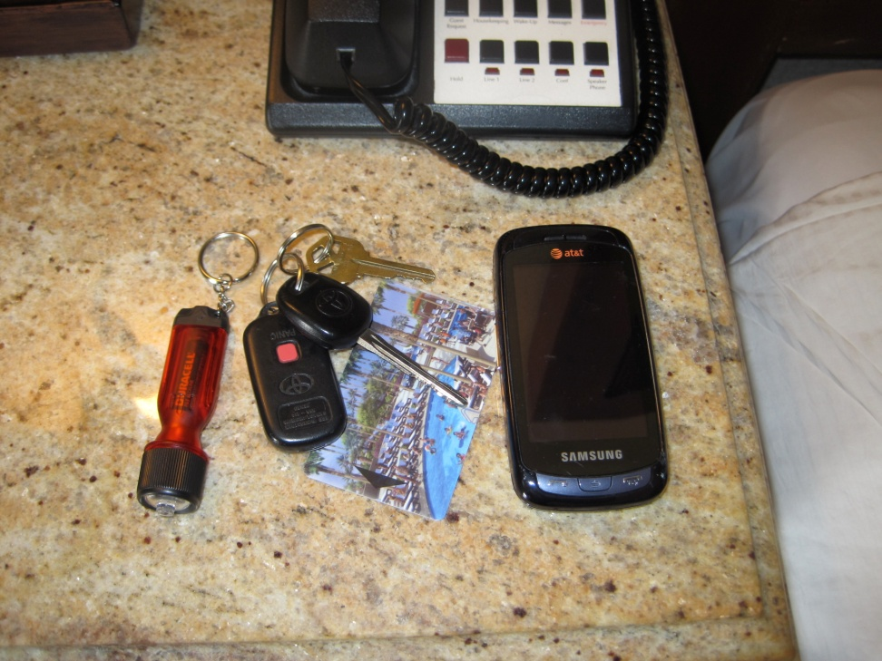
Hotel Fires
More than 4000 Motel/Hotel Fires Per Year
  Averages More Than 10 Motel/Hotel Fires per Day
  Pre-Planning Important
In the Event of a Fire
  Take Essentials, Cell Phone, Room Keys, & Flashlight (Leave Near Bed)
  With Family – Designate Meeting Location
  Feel Door (Use Backside of Hand)
Notes:
In the United States, there are more than 4000 hotels/motel fires per year. That equals to more than 10 per day. Pre-planning is important. It may save your life.
In the event of a fire, you should take essential items which are immediately nearby (cell phone, wallet, room key and a flashlight). If you are traveling with family. Designate a meeting location in case you get separated during your evacuation.
If the fire is outside your room, you must feel the door to determine if it is hot. Use the backside of you hand because if door is hot….you do not want to burn your palm. It would make it difficult to open the door with a burned palm.

Slide 19

Hotel Fire- Hot Door
Do Not Open Door! Stay Put
Call Fire Dept.–Tell Them Your Exact Location
Place Signal on Window–Sheets or Towels
Fill Tub with Water
Place Damp Towels/Sheets
  Around Cracks
  Wet Towel Over Your Nose & Mouth
Shut Off Fans/Air Conditioners
If Smoke in Room – Open Windows
Higher than Second Floor – Do Not Jump
Notes:
Next, we will discuss what to do if the door is hot. If hot….Do not open the door! Stay put in you room. Call the Fire Department and tell them your exact location. You may want to put a signal in the window like a towel or a bed sheet so they can pinpoint your exact location.
Fill your tub with water. Wet towels or sheets and put them around the cracks in the door or any air vents to keep the smoke from entering your room. To filter out smoke you should wet a towel and tie it to cover your nose and mouth.
To avoid smoke from entering you room turn off the fan and air conditioner system.
If smoke gets into you room, cautiously open the windows. Be aware that heavier smoke from the outside may be drawn into your room, so be prepared to close your windows.
If your room is higher than the second floor – Do not jump. People who jump from the third floor and above typically sustain injuries which are fatal. Wait in you room to be rescued by the fire department.

Slide 20
Hotel Fire- Door Not Hot
Slowly Open Door, Check if Hallway Clear
Crawl to Stairway Emergency Exit
Lock Room Door In Case You Need to Return to Room
Do Not Use Elevators
Cautiously Use Exit Stairwell
If Encounter Heavy Smoke, Turn Around - Try Second Emergency Exit
Meet At Designated Spot
Notes:
We will now discuss what to do if the door is not hot and you will be attempting to leave the hotel via the emergency exits.
If the door is not hot, slowly open to door. If flames shoot back at you, close the door. If you are able to open to door, check to see if the hallway is clear of flames. If clear, get on your knees and crawl towards the emergency exit. You want to crawl because smoke and products of combustion will rise and the fresh air will be near the floor. Before you start to crawl make sure you have your room key with you and lock the door. You want your room key and the door locked in case you cannot escape and so you will have a place to return to.
Remember as part of the preparation, you should be aware of the number of doors to pass by till you reach the emergency exit. Never use the elevator! When you reach the emergency exit, cautiously use the exit stairwell. If you encounter heavy smoke, turn around and try the secondary emergency exit.
If you go down the stairwell and encounter heavy smoke, you may need to exit on another floor and try to use the secondary stairway exit on that floor.
When you make it down, if traveling with family or other co-workers, meet at your designated spot.

Slide 21
Hotel Fire Safety Video!
Steps to take if a fire did occur in your hotel…
http://animoto.com/play/nDf9HGKHQWT3kNC502L7Cg

Slide 22
General Travel Safety Precautions
Watch for “Staged Mishaps” – Ploy to Divert Your Attention
Beware of Your Surroundings
Keep Valuables Secured
Safety in Numbers – Stay with Groups
Ask for Help or An Escort if Uneasy with a Situation
Do Not Draw Attention to Yourself
  Clothing/Jewelry
  Looking at Maps
    Avoid Looking Like a Tourist - Wrap Local Newspaper or Magazine Outside Map/Guidebook
Use ATMs During the Day & When People Are Around
Notes:
Next we will discuss some general safety precautions while traveling:
1) Avoid or be aware of being drawn into staged mishaps. These are meant to divert your attention while the criminal could pick your pocket, steal an item, or just draw you into a situation where they can rob or assault you.
2) Be aware of your surroundings. If you are knowledgeable about where you are, and what is going on, your chances of being a crime victim is greatly reduced.
3) Keep your valuables secured. Do not leave valuable items out in the open in your hotel room. While walking in areas where there are crowds, men should not keep their wallets in their back pockets. Keep your wallet in the front pockets to avoid pick pockets. Women should keep their purses closed and hold the purse under their arms rather than the straps. Backpack and fanny packs are easy for targets for pick pockets.
4) There are safety in numbers. If possible, travel in groups.
5) If you are in a situation where you feel uncomfortable, ask the business or the hotel staff for an escort to your car or to an area where you would feel safe to proceed.
6) Do not draw attention to yourself with flashy clothing or expensive jewelry. Avoid looking at maps or tour guides out in the open like a tourist. If necessary, wrap the map or tour book in a newspaper so you would blend in more with the local crowd.
7) Use the ATMs during the day in areas and locations where several people are present to avoid being a robbery victim.

Slide 23
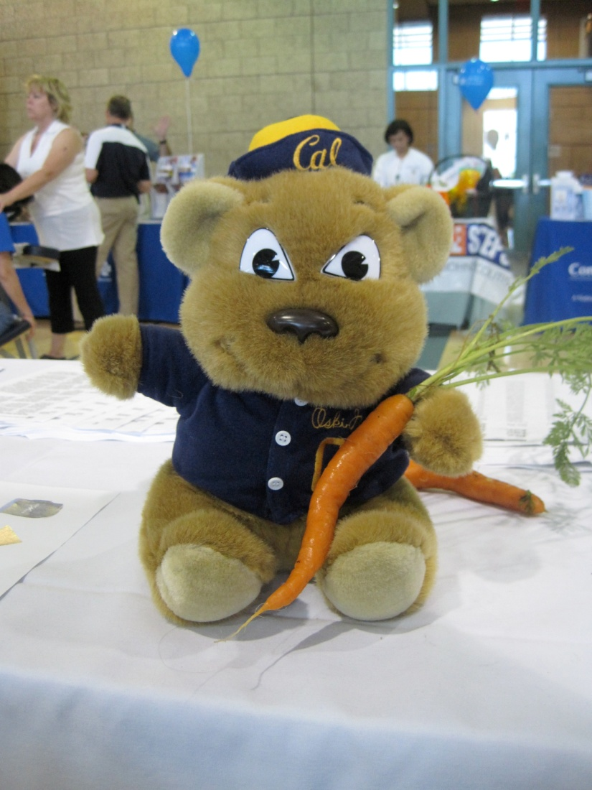
Food Safety On Trips
Food allergies while travelling
  Inquire About Ingredients in the Menu Items
Take caution to food borne illnesses
Notes:
Food safety is another area to keep in mind while traveling. You should be aware of food allergies and the possibility of food borne illnesses while eating at establishments which you may not be familiar with. Do not hesitate to inquire about the ingredients in menu items prior to ordering. Consider the safety of the food items which you purchase or order. Items which may not have been properly prepared or improperly stored may result in food borne illnesses.

Slide 24
Travel Safety Reference Webpages
UC Travel Webpage: www.uctravel.org
FEMA List of Sprinklered Hotels:
  www.usfa.fema.gov/hotel
U.S. State Dept. Travel Safety Webpage:
  http://travel.state.gov/travel/tips/safety/safety_1180.html
Safe Trip Abroad Publication
  http://travel.state.gov/travel/tips/safety/safety_1747.html
Notes:
These are travel safety webpage references:
The University of California Travel webpage;
The FEMA listing of sprinklered hotels in the United States;
The U.S. State Department travel link for U.S. citizens and residents who are traveling overseas; and
The U.S. State Department Safe Travel Abroad Publication.

