Slide 1

Have a Safe Summer!
A Simpsons Safety Tutorial

Slide 2
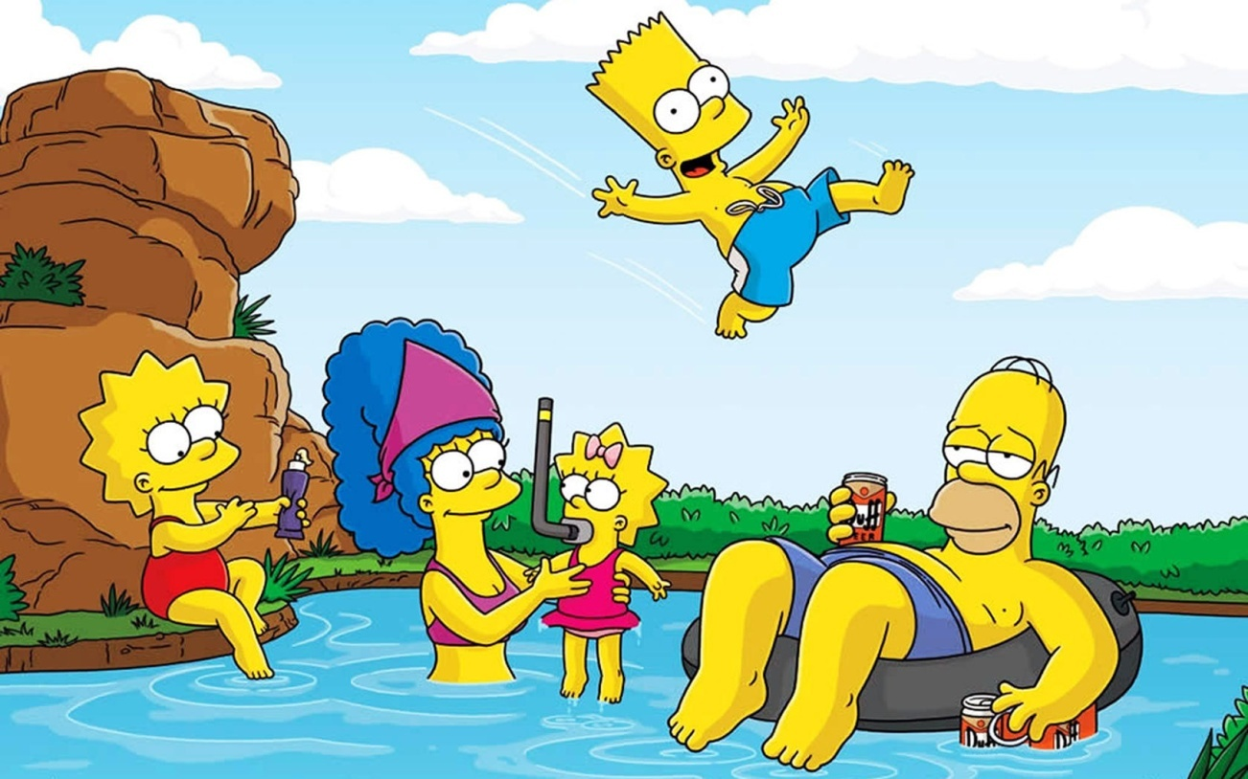
What are some things in this picture that the
Simpson family may be doing safely?

Slide 3
Protect Yourself from the Sun and Heat!
Put on your sun screen like Lisa!

Slide 4
Your sunscreen should protect you from both UVB and UVA rays!
Interesting article from 20/20 exploring this topic:
http://abcnews.go.com/2020/Health/story?id=858453&page=1

Slide 5
Also take frequent breaks to rest in the shade and drink plenty of water!
Homer is keeping himself hydrated… although not with water as is directed. Avoid high-sugar sodas or alcoholic drinks when trying to avoid heat-related illness

Slide 6
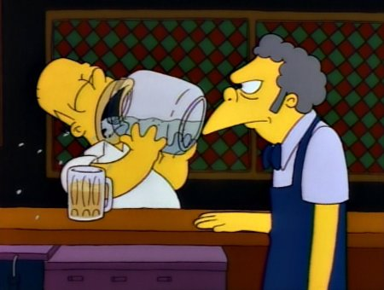
Stay hydrated with water!

Slide 7
Water Safety- Children should never be unsupervised near water.
Monitor young children around pools and ponds like Marge!

Slide 8
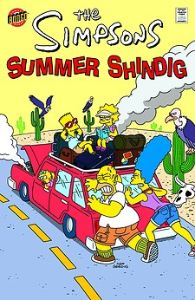
Have Safe Summer Trips!
Be sure tires have enough tread and are inflated properly. Check coolant and other fluid levels, especially before a long trip. Have a mechanic check engine belts, hoses, and clamps.
Never leave a child unattended in a car!

Slide 9
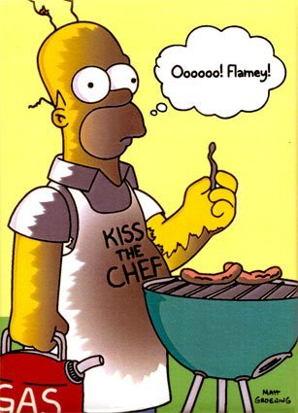
Enjoy Great Food- Safely!
Keeping hot foods above 140 degrees and cold foods below 40 degrees will help prevent E. Coli, salmonella, and other bacterial infections.

Slide 10
USDA guidelines revises guideline on how to cook pork!
http://www.washingtonpost.com/blogs/the-checkup/post/usda-revises-guidelines-on-cooking-pork/2011/05/25/AGziHIBH_blog.html

Slide 11
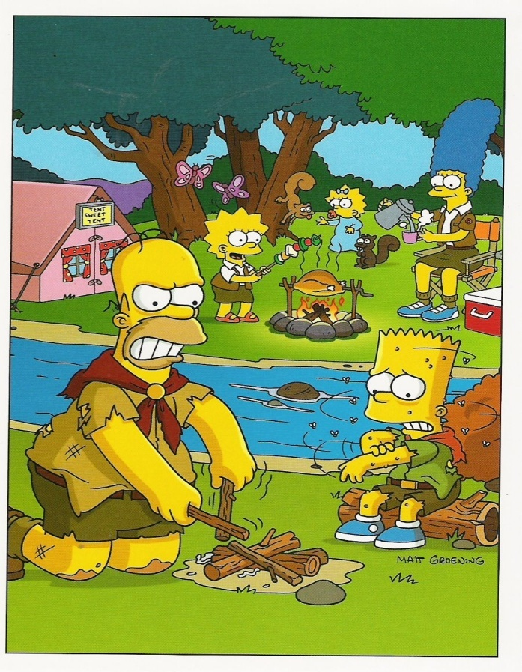
Mosquito Busters!
Avoid mosquitoes by staying indoors during the dawn and dusk hours when these insects are most active.
Drain any standing water where mosquitoes can breed
Repel mosquitoes by using repellents containing DEET or effective agents.

