Slide 1


Be Smart About Driving
Developed by Karen Hsi, UCOP Intern
Notes:
This month’s safety meeting topic is Driving Safety.

Slide 2
A “Reality” Check
Every 12 minutes someone dies in a motor vehicle crash
Every ten seconds a vehicle-related injury occurs
Every five seconds a vehicle collision occurs
Vehicle collisions are the Number 1 cause of work-related
deaths in the U.S.
ALMOST ALL OF THEM ARE PREVENTABLE….

Slide 3

Basics of Safe Driving
Always wear a seatbelt
Adjust the seat and check mirrors
Pay attention
Do not talk/text on the phone
Never drive impaired
Do not speed
Never run stop signs or red lights
Give pedestrians the right of way
Get rid of all other distractions
Look out for the other driver–Drive defensively
Notes:
You may have years of experience but just because you are a good driver does not mean everyone else on the road is as well. Follow the basic rules of driving to help ensure your safety and the safety of others:
- Always wear a seatbelt
- Adjust the seat and check mirrors
- Pay attention
- Do not talk on the phone
- Never drive impaired
- Do not speed
- Never run stop signs or red lights
- Give pedestrians the right of way
- Get rid of all other distractions
- Look out for the other driver – Drive defensively

Slide 4
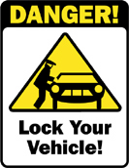
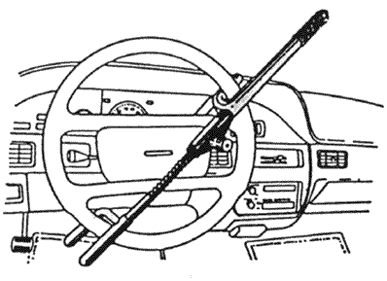
Avoid Becoming a Victim of a Break-In
LOCK the doors and close the windows
Do not leave valuables in plain view,
put them out of sight in the trunk
or under the seat
Deter auto theft by using a steering
wheel club
Never leave your car running or leave the keys in the car unattended even for a minute. Take the keys with you and lock the doors every time.
Notes:
Avoid becoming a victim of a car break-in
Always lock the door and close the windows when you leave your car.
Do not leave valuables in plain view – Put them out of sight, either in the trunk or under the seat
You can deter auto theft by using a steering wheel club
Never leave your car running or leave the keys in the car unattended even for a minute. Take the keys with you and lock the doors every time

Slide 5
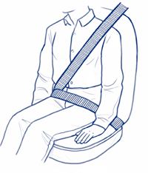
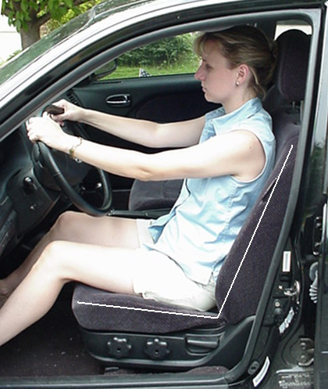
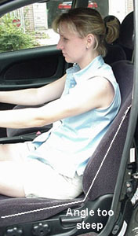

Don’t Compromise Safety for Comfort
Set your head rest at the top of your ear level
Make sure your seat belt is properly secured
Adjust your seat to be in the
upright position
correct way to wear a seat belt
Sitting upright
Slouching
Make sure your seat belt is secured across your shoulders and waist. Make sure your seat is not reclined too far and that you can reach the gas and brake pedals with ease.
Notes:
While Driving, Do Not Compromise Safety for Comfort
- For maximum visibility, the top of your headrest should be set to line up with the top of your ear
- Make sure your seat belt is properly secured – Across your shoulders and waist.
- Adjust your seat to be in the upright position – Do not recline you seat too far back. Make sure you can reach the gas and brake pedals with ease.

Slide 6



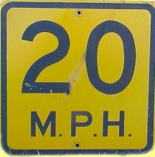

Most Common Causes of Fatal Automobile Crashes
Distracted drivers
- UC Policy G-46
Driver fatigue
Drunk driving
Speeding
Aggressive driving
Weather
Notes:
What are some of the most common causes of automobile crashes?
According to the National Highway Traffic Safety Administration (NHTSA), the following are the six most common causes of automobile crashes which result in a fatality. It is of interest to note when we discuss each of these 6 causes, the greatest threat to drivers is the drivers themselves.
The most common cause is a distracted driver: AAA has found that 25% to 50% of all motor vehicle crashes are have driver distraction as the root cause. Activities such as drivers who are talking on the cell phone, looking at scenery, rubbernecking at an accident, adjusting the radio or listening to loud music are some examples of activities which distract the driver. UC Policy G-46 prohibits the use of cell phones while operating a motor vehicle. This will prevent the driver from being distracted.
2. The second most common cause is driver fatigue, which account for 100,000 accidents each year. The NHTSA has found the greatest risk is between 11 PM and 8 AM, the time when most people are used to sleeping. To avoid fatigue, you should:
- Pull over and stop if you feel drowsy;
- Take a break from driving every 2 hours;
- Share driving with another person; and
Prior to taking a long trip, get a good nights rest.
Drunk driving is the third most common cause of driver-related fatalities. In 2003, during the weekdays, drunk drivers accounted for 30 percent of all fatal crashes in the U.S. On the weekends, 53% of the fatalities are related to drunk drivers. Never mix drinking with driving. If you will be consuming alcohol, in advance, always designate a driver who will not drink.
Speeding is the 4th leading cause of auto-related fatalities. Speeding is a multi-tiered threat. It not only reduces your response time to avoid a crash, but it also increases the risk of crashing and makes the crash more severe if it does occur. The Insurance Institute for Highway Safety (IIHS) has found when speed increases from 40 mph to 60 mph, the energy released in a crash more than doubles.
Always:
Obey the speed limit
Do not drive in a hurry
Give yourself extra time to recognize hazards around you
Aggressive driving is the 5th leading cause of auto-related fatalities.
Examples of aggressive driving behavior are: aggressive tailgating; flashing lights at other drivers because they’re irritated; rude gestures; deliberately preventing another driver from moving their vehicle; changing lanes frequently or in an unsafe manner; and failure to yield the right of way.
If you encounter an aggressive driver you should remain calm and keep your distance from that driver. Do not pass that aggressive driver unless you have to. You should try to change lanes to get away from that aggressive driver once it is safe to do so.
Weather is the 6th leading cause of auto-related fatal crashes.
Increment weather, hail, heavy rain, ice & snow, fog, and high winds can make driving more difficult. You will have trouble seeing the road clearly and will need more time to stop. Slow down and leave extra room between your vehicle and the car in front of you. During the first rainstorms of the year the roads are even more slick due to the oils which accumulate on the road. Also water may accumulate on the side of the road because the storm drains may back-up from all the debris which accumulated over the summer and fall.

Slide 7
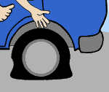


Rental Cars
Make sure everything is working properly
  Scratches, dents, under/over inflated tires
Familiarize yourself with your new car
  Locations of speedometer, gas gauge, light switches, windshield wipers, and defroster
    Make sure you know how they work
  Before you head out onto traffic
    Feel out brakes, gas, & steering - These vary from car to car
Notes:
Rental Cars
If you are driving a rental car, you should be aware that every car has a different feel. It is important to familiarize yourself with your rental car as you will not only be in a new car but in a new environment than you are not used to driving in.
Prior to driving away with you rental car, check to make sure everything is working. On the outside of the vehicle, check for scratches, dents, and make sure the tires are not under or over inflated.
Familiarize yourself with the location of all the controls of your vehicle:
Note the locations of the speedometer, gas gauge, light switches, windshield wipers, & defroster. Make sure you know how all these controls work.
Feel out the brakes, gas, and steering before you head out into traffic. These can vary from car to car.

Slide 8

What to Do if There is an Accident
Stop and pull out of traffic if possible
Check for & aid injuries & call 911 if needed
Exchange names, insurance information, drivers license information, and phone numbers with involved driver(s)
Get the names, addresses, and phone numbers of any witnesses
Try to avoid dangerous situations by being a defensive driver. However, if an accident should occur, you need to take certain steps to avoid potential complications.
Notes:
What should you do if you are involved in an accident?
You should stop and pull out of traffic if possible.
Check for and aid injuries if necessary. If needed, immediately call 911
Exchange names, insurance information, drivers license information, and phone numbers with the involved drivers.
Get the names, addresses, and phone numbers of any witnesses

Slide 9
Motor Vehicle Accident While on UC Business
UCOP General, Employment Practices & Automobile Liability FAQ
http://www.ucop.edu/riskmgt/faq/faq_genemplauto.html
Contact Supervisor
  Supervisor should contact UCOP Risk Manager, Karen Vecchi 510-987-9826
Injury – Contact Supervisor & HR Benefits
  Emergency – Go to nearest Emergency Room
Notes:
Motor vehicle accident while on UC Business.
The UCOP has a website providing guidance if you are in a motor vehicle accident while on UC business.
Primary insurance coverage for the accident - Depends on vehicle. If you are driving a rental car using the UC Corporate ID number, the rental car’s insurance company provides the primary coverage. If you are driving your personal vehicle, your personal automobile insurance carrier provides the primary coverage. Your UC Department can pay the first $500 or the amount of your deductible, whichever is less.
Contact your supervisor - Inform him/her about the accident. The supervisor should notify the UCOP Risk Manager, Karen Vecchi regarding an automobile accident while on UC business.
If you are injured - If a non-emergency type injury, contact your supervisor and Human Resources- Benefits. If the accident is within the East Bay area, you will be referred to one of the three UCOP Occupational Health Centers. If you are out of the area, you will be referred to a nearby medical center. If it is an emergency, go to the nearest emergency room as soon as possible.

Slide 10
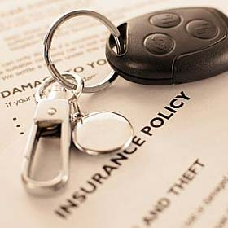
Primary Insurance Coverage
If you get into an accident on UC Business, insurance coverage depends on the vehicle you are driving.
UC Rental Vehicle- Rental Car Co.’s Insurance
- Using Corporate ID number
- UC Price Rate
Personal Vehicle- Personal Insurance Carrier
- UC Department can only pay the first $500 or the amount of deductible
Notes:
Remember that if you get into an accident on UC Business, the primary insurance coverage for the accident depends on the vehicle you drive.
If you are driving a rental car using the UC Corporate ID number, the rental car’s insurance company provides the primary coverage. If you are driving your personal vehicle, your personal automobile insurance carrier provides the primary coverage. Your UC Department can pay the first $500 or the amount of your deductible, whichever is less.

Slide 11
Be Safe, Be Courteous
The 30 seconds you save by speeding is not worth getting into a crash. Slow down and give yourself plenty of time to get to your destination
Notes:
In closing, be safe and be courteous while you are driving.
The 30 seconds you save by speeding is not worth getting into a crash. Slow down and give yourself plenty of time to get to your destination.

