Slide 1

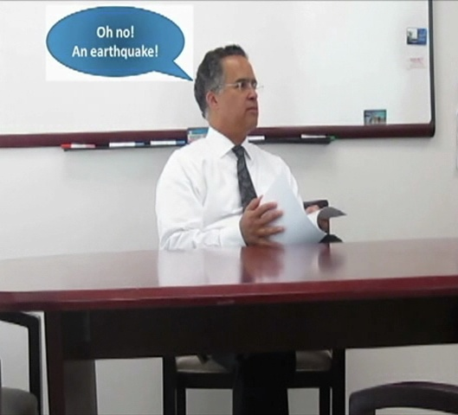

Are you ready to SHAKE OUT?
UCOP October 2011
Safety Meeting
Developed by Karen Hsi

Slide 2
OCTOBER 20, 2011 at 10:20 AM
On the third Thursday of October each year, the University of California Office of the President will be participating in the largest public earthquake drill.
At 1111 Franklin Street and the Kaiser Building
  PA System will Announce “Earthquake Drill”
  UCOP Staff will “Drop! Cover! Hold On!”
Other UCOP Sites at Leased Facilities
  Floor Wardens and/or Department Safety Officers will Announce “Earthquake Drill”
  UCOP Staff will “Drop! Cover! Hold On!” for 60 seconds

Slide 3

UCOP Great California Shakeout Preparation
1111 Franklin Street Lobby - Earthquake Preparedness Booth
  October 17 to 20
  Information/Literature/Posters
Other UCOP Locations
  Earthquake Preparedness Informational Materials Available Either At an Informational Table or Sent Directly to Employees via e-mail

Slide 4
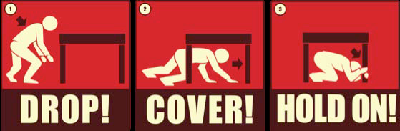
DROP to the Ground (Before the Earthquake Drops You!),
Take COVER by Getting Under a Sturdy Desk or Table, and
HOLD ON to it Until the Shaking Stops

Slide 5
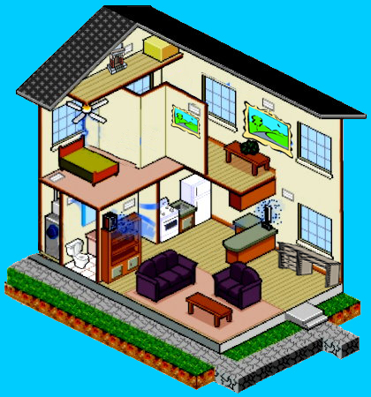
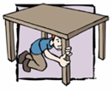

Home Earthquake Preparedness
Dangerous Spot
Areas near a brick fireplace may be dangerous because the brick masonry may crumble and bricks may fall on you.
Maintenance Spot
Maintenance Spot
Secure your pictures or art work on the walls so they will not fall off the “hook”.
Safe Spot
Dangerous Spot
Dangerous Spot
Pictures and hanging objects can fall and cause injuries
Dangerous Spot
Ceiling fans or objects overhead could fall on you and pin you down or cause injuries.
Dangerous Spot
Areas near windows are dangerous, because glass can shatter and break on you.
Dangerous Spot
Secure heavy items to the wall so they will not fall onto you or block your egress. Items can be secured by bolting bookshelves and cabinets to the studs in the walls, or by using earthquake putty to secure items such as vases to a bookshelf.
Maintenance Spot
Keep a wrench near the gas shut off for your home and be familiar with how to turn the gas off
Safe Spot
It is safe under a sturdy desk or table where you could drop, cover, and hold on.
Maintenance Spot
Turn off your hot water heater and secure the heater itself with two straps.
Safe Spot
Ducking and covering near a couch, with the sofa cushions over your head is safer than trying to run to another room

Slide 6
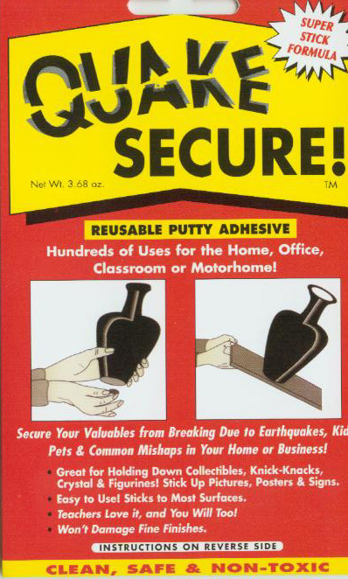
“Secure Your Space”
Inspection Checklist
Secure Pictures/Art
Secure Hot Water Heater
Wrench Near Emergency Gas Shut Off
Secure Heavy Items
Know Safe Spots in Every Room
  Sturdy Tables, Desks
Know Dangerous Spots in Every Room
  Windows, Hanging Objects, Fireplace, Appliances
  Employees who complete the “Secure Your Space” inspection checklist by Oct. 20 will be entered in a raffle for a gift card.

