Slide 1


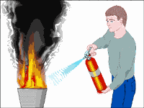
Use of Portable
Fire Extinguishers
University of California
Office of the President
Developed by Karen Hsi, EH&S Student Intern
Notes:
This month’s safety meeting topic is our annual refresher training in the use of portable fire extinguishers.

Slide 2
Fire Extinguisher Demonstration Video
http://www.youtube.com/watch?v=y_7QpzmjGEM
Make sure to aim at the base of the fire!

Slide 3

Fire Extinguisher Use
Annual Refresher Training for Use of Portable Fire Extinguishers
  Cal/OSHA Safety Training Requirement
Review:
  General Principles of Fire Extinguisher Use
  Guidelines on When to Use a Portable Fire Extinguisher:
    During the Initial Stages of a Fire
Notes:
Annual fire extinguisher refresher training is required by the Cal/OSHA safety regulations for all employees who are expected to use a portable fire extinguisher. We will review the general principles on fire extinguisher use and guidelines on when you should use a fire extinguisher – only during the initial stages of a fire.

Slide 4


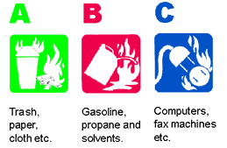

Major Types of Fires
Type A: Combustible Materials
  Paper, Wood, Cloth
Type B: Flammable/Combustible Liquids
  Chemicals, Oil, Paint, Grease
Type C: Energized Electrical Equipment
  Appliances, Electrical Wiring, Plugs
Notes:
How are fires classified? For UCOP purposes, there are 3 major classification of fires: Type A, B, and C.
Type A - Fires are combustible materials, such as wood, paper, and cloth. The symbol for a Type A fire is a green triangle.
Type B - Fires are flammable/combustible liquids, such as chemicals, oil, paint, and grease. The Type B fire symbol is a red square.
Type C - Fires are energized electrical equipment such as appliances, electrical wiring, & electrical wall plugs. The Type C fire symbol is a blue circle.

Slide 5
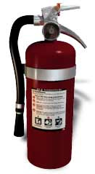
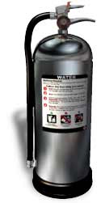
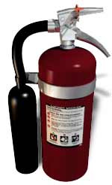
Types of Fire Extinguishers
Multi-Purpose (Red Color) - Dry Chemical
  ABC (Ammonium Phosphate) or
  BC (Potassium Bicarbonate)
Pressurized Water (Silver Color)
  Type A Fire Only
Carbon Dioxide (Red Color with No Gauge)
  Type BC Fire Only
Notes:
What are the various types of portable fire extinguishers we may find at UCOP facilities?
Multi-Purpose Dry Chemical Extinguisher – The most likely type you will find at UCOP locations is the red-colored multi-purpose dry chemical extinguisher. This type extinguisher overlays the fuel with a layer of powder, separating the fuel from the oxygen around it, thus putting out the flame. The multi-purpose extinguisher can be rated for use either for an ABC type fire or a BC type fire. The ABC type extinguisher contains ammonium phosphate. The BC type extinguisher contains potassium bicarbonate.
Pressurized Water Extinguisher – A pressurized water extinguisher is silver colored. It is used only to extinguisher Type A fires, such as wood, paper, and other types of combustible materials. Never use water on a grease fire or an electrical fire!!
Carbon Dioxide Extinguisher - The last type is a carbon dioxide extinguisher, which is also red colored. A carbon dioxide extinguisher does not have a gauge on the top of the extinguisher. The carbon dioxide extinguisher is to be used on Type B and Type C fires only. Because there have been incidents where the trash fire would flare up again after the carbon dioxide has been applied to the fire, carbon dioxide fire extinguishers cannot be used on Type A fires.

Slide 6
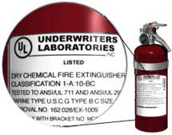
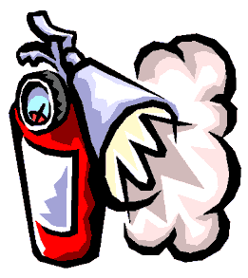
Fire Extinguisher Capacity Rating for a 2A:10 BC Extinguisher
2A:10 BC – Recommended Capacity for Homes
Number in Front of the “A”
  Equals to the Equivalent Number of Units for 1.25 Gallons of Water
    2A Equals 2.5 Gallons of Water (2 X 1.25 = 2.5 Gallons)
Number in Front of the “BC”
  Area in Square Feet That a Non-Expert is Able to Extinguish a Class B or Class B Fire
    10BC Equals 10 Square Feet
Notes:
How can you determine the capacity rating for a portable fire extinguisher? The majority of the portable fire extinguishers in UCOP office/kitchen areas are rated 2A:10 BC. This is also the recommended capacity rating which fire departments recommend for homes.
Number in Front of the Letter A:
The number in front of the letter A equals the equivalent number of units for 1.25 gallons of water. So the 2A means the extinguisher has the capacity of extinguish a fire equal to 2.5 gallons of water. 2 times 1.25 equals 2.5.
Number in Front of the Letters BC:
The number in front of the letter BC is equal to the square feet area that a non-expert is able to extinguish a Class B or Class C Fire. So a 10BC equals 10 square feet

Slide 7
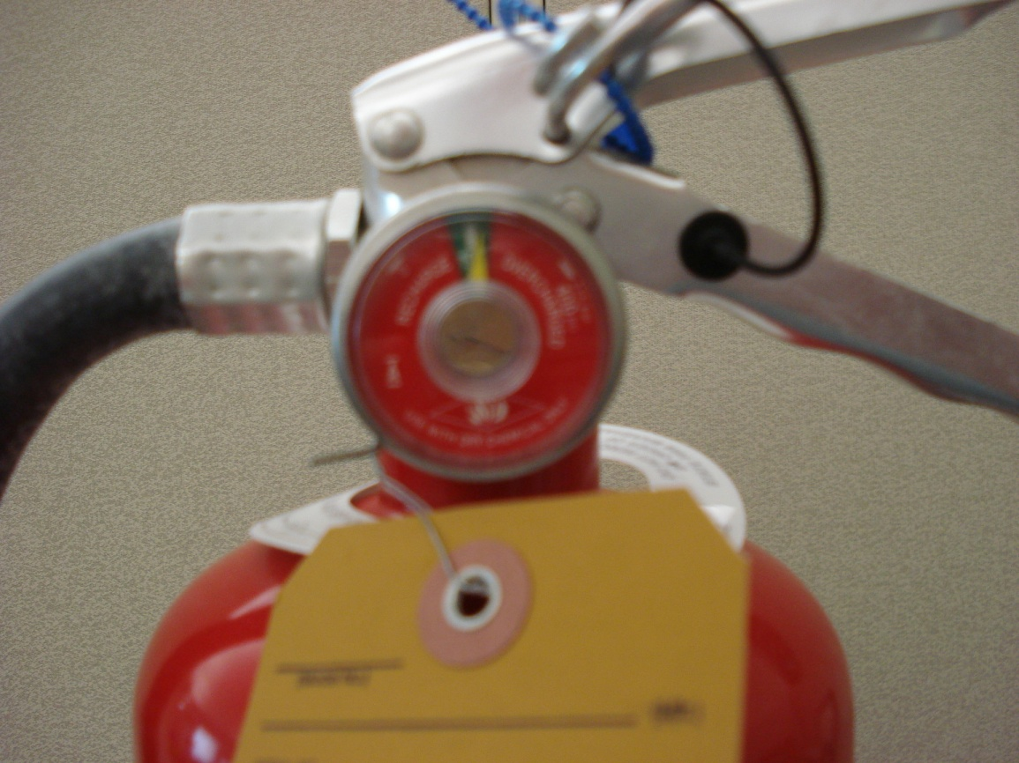
Fire Extinguisher Gauge
Prior to Use:
  Make Sure the Extinguisher is Fully Charged
    Needle in the Green Area
Notes:
Fire Extinguisher Gauge: Prior to using the extinguisher, make sure the fire extinguisher is fully charged. The needle in the gauge must be in the green area if it is a fully charged extinguisher.

Slide 8
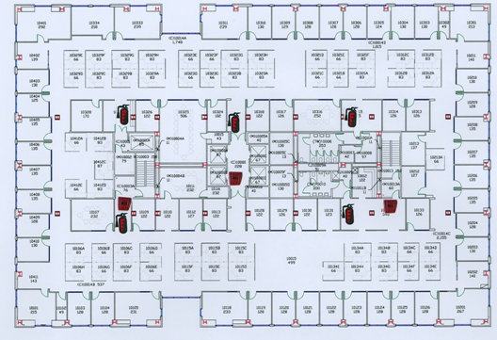
Typical Fire Extinguisher Locations for 1111 Franklin Street
Kitchen Areas
Outside Restrooms
Near Elevator Lobby
Near Emergency Exits
Notes:
The next three slides list the portable fire extinguisher locations at the major UCOP sites. [NOTE: Department Safety Officers should point out the specific fire extinguisher locations for your Unit/Department’s work area ]
1111 Franklin Street:
On a typical floor at 1111 Franklin Street, the portable fire extinguishers are located in or near the kitchen areas, near the restrooms, near the emergency exit doorways, and near the elevator lobby.

Slide 9
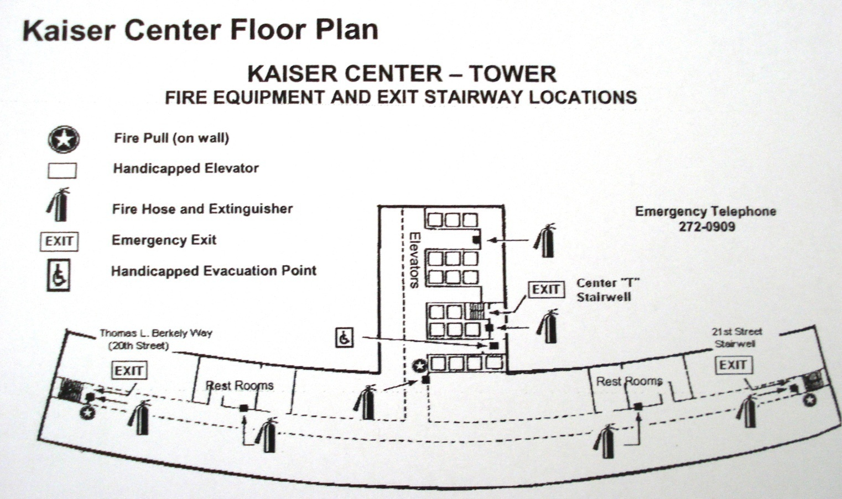
Typical Fire Extinguisher Locations
For the Kaiser Building
Main Hallway, Near the Restrooms, and Near the Exits
Notes:
Kaiser Building:
For the Kaiser Building, the portable fire extinguishers are located in the main hallway, near the restrooms, and near the exits for each floor.

Slide 10
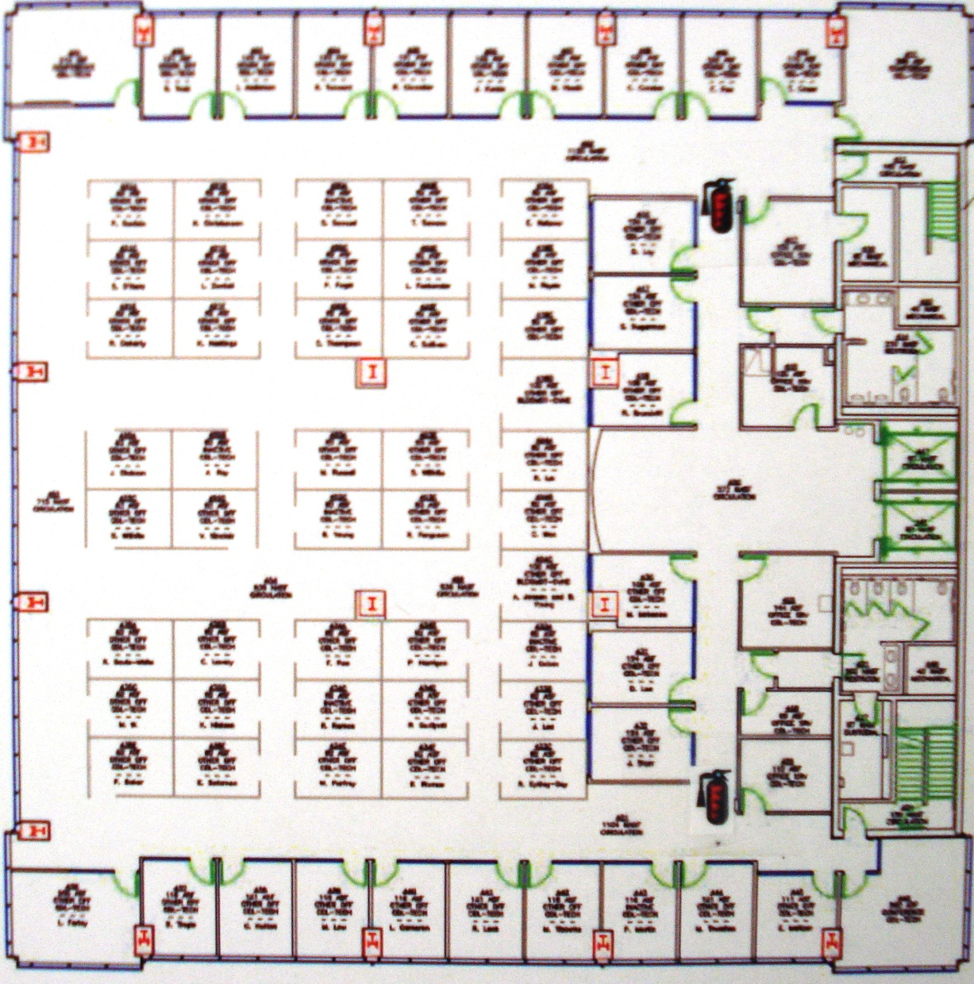
Typical Fire Extinguisher Locations
For 415 – 20th Street
Outside the Copy Room at Each End of the Floors
Notes:
415-20th Street:
At 415- 20th Street, the portable fire extinguishers are located outside the copy room on each of the floors.

Slide 11
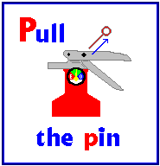
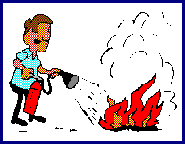
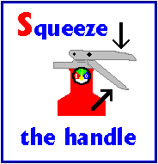
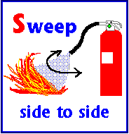
How to Use a Fire Extinguisher
Remember “PASS”
Aim
Stand 6 to 8 Feet Away
P - Pull the Pin
A – Aim at the Base of the Flame
S – Squeeze the Handle
S – Sweep from Side to Side
Step Backwards When Done – Never Turn Your Back Towards an Extinguished Fire!
Notes:
Remember the term “PASS” when you use a portable fire extinguisher. You should stand 6 to 8 feet away from the fire and:
Pull the pin
Aim at the base of the flame
Squeeze the handle
Sweep from side to side
When the fire has been extinguished, step backwards towards the exit. You should never turn your back towards an extinguished fire! The fire may suddenly flare up behind you!

Slide 12

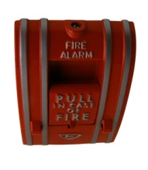
You are NOT Required to Use a Fire Extinguisher on a Fire.
Your Responsibilities in a Fire Situation:
  Recognize a Fire Condition;
  Activate the Fire Alarm System;
  Evacuate the Building;
  Call 9-911 to Report the Fire Condition
Remember - You are not a Trained Firefighter. You Should Never Put Your Life in Danger!
Notes:
What are your responsibilities in a fire situation? In the event of a fire, you should:
Recognize the fire condition;
Activate the fire alarm system;
Evacuate the building;
Call 9-911 to report the fire (or have a co-worker call 9-911)
You are not a trained firefighter. You should never put your life in danger by attempting to fight a fire with a portable fire extinguisher!

Slide 13

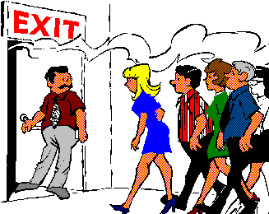
When to Use a Fire Extinguisher
Small & Contained
  Wastebasket, Small Appliance, etc.
Safe Escape Route Behind You
Extinguisher Rated for Type of Fire You are Fighting
Trained in Use & Confident You Can Operate it Effectively
Slightest Doubt - DON'T! Get Out. Close the Door to Slow the Spread of the Fire
Notes:
When should you use a fire extinguisher?
Small and Contained: You can use a fire extinguisher if it is a small contained fire, such as a wastebasket or a small appliance. If the fire has spread do not attempt to use an extinguisher!
Safe Escape Route: If there is a safe escape route behind you, then it is OK to attempt to use an extinguisher to put out a small contained fire. If the fire comes between you and the exit, do not attempt to put the fire out.
Properly Rated Extinguisher: You should use the extinguisher only if it is the proper type of extinguisher for the type of fire you will be attempting to extinguish. If it is the wrong type or size of extinguisher, do not attempt to use the extinguisher to put out the fire.
Trained and Confident in Use: Use the extinguisher only if you have been trained in the proper use and you feel confident you can use the extinguisher effectively to put out the fire. If you have any doubt in your ability, Do NOT attempt to use the extinguisher! Leave the area and close the door to help slow the spread of the fire.

