Slide 1



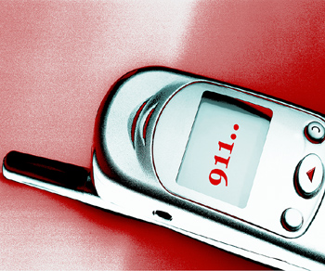
Personal Safety Reminder
February 2011 Safety Meeting Topic
Developed by Karen Hsi, UCOP EH&S Student Intern
Notes:
Due to the recent incident of sexual assault in Oakland near the corner of Jackson and 8th St. near the Lake Merritt BART station, we will re-emphasize personal safety awareness and give you tips on how to avoid becoming victims of crimes such as these. The most decisive factor in staying safe is taking personal responsibility for your own security and well-being. Statistics show that people who stay aware of danger and take proactive steps to avoid it are far less likely to become the victims of crime. Make a commitment to actively manage your personal safety by regularly practicing these common-sense measures. For colleagues who work, live and/or exercise around Lake Merritt, here are some reminders about ways to help keep yourself safe.

Slide 2
Be Aware of Your Surroundings
Don’t allow distractions such as music or texting make you a target for theft or assault.
Keep your cell phone with you for emergency phone calls only. Try to stay away from walking and talking on your cell phone.
Notes:
Be Aware of Your Surroundings
Don’t allow distractions such as music or texting make you a target for theft or assault.
Keep your cell phone with you for emergency phone calls only. Try to stay away from walking and talking on your cell phone.

Slide 3
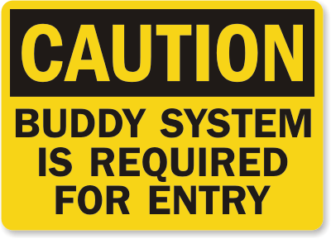

Stay in well lit and populated areas
Don’t walk or jog alone at night.
Park in well-lit areas close to the building, and avoid waiting alone.
If you are out alone, all UCOP employees should have gotten safety flashlights with an alarm button.
Notes:
Stay in well lit and populated areas
Don’t walk or jog alone at night.
Park in well-lit areas close to the building, and avoid waiting alone.
If you are out alone, all UCOP employees should have gotten safety flashlights with an alarm button.

Slide 4
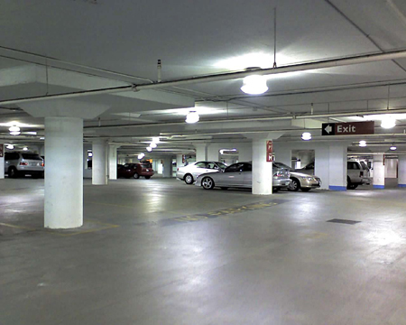
Be especially alert when entering and exiting your vehicle
When you leave a store or other building at night, scan the area before heading for your vehicle and arrange for an escort or call police if you see a threat
When you park, lock your car, roll windows up completely and be sure possessions in your vehicle are out of sight. Be especially careful in parking lots, where many vehicle burglaries occur.
Notes:
Be especially alert when entering and exiting your vehicle
arrange for an escort or call police if you see a threat
When you parWhen you leave a store or other building at night, scan the area before heading for your vehicle and k, lock your car, roll windows up completely and be sure possessions in your vehicle are out of sight. Be especially careful in parking lots, where many vehicle burglaries occur.

Slide 5
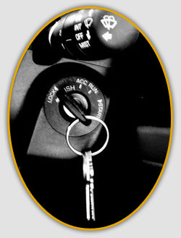
Remember to lock your car door immediately upon entering your vehicle
While driving, keep your doors and windows locked. Keep valuables under the seat.
Notes:
Remember to lock your car door immediately upon entering your vehicle
While driving, keep your doors and windows locked. Keep valuables under the seat.

Slide 6
If someone or something looks suspicious call the police
Program the emergency number into your cell phone.
When reporting an incident, stay on the line after you give the dispatcher the basic information. You won’t be required to give your name or number. However, the dispatcher may need additional information that will help officers safely and efficiently respond.
Notes:
If someone or something looks suspicious call the police
Program the emergency number into your cell phone.
When reporting an incident, stay on the line after you give the dispatcher the basic information. You won’t be required to give your name or number. However, the dispatcher may need additional information that will help officers safely and efficiently respond.

Slide 7
If you are at work and feel threatened or observe suspicious activity, do not hesitate to call Building Security.
For all Oakland-based employees, City of Oakland Safety Ambassadors available for escort to garages or BART from 7am-8:45pm.
Before 12pm: (510) 898-8488
After 12pm: (510) 898-8952
Please call 30 minutes ahead of time to schedule.
For Franklin, after 8:45pm security will escort you personally.
Notes:
If you are at work and feel threatened or observe suspicious activity, do not hesitate to call Building Security
For all Oakland-based employees, City of Oakland Safety Ambassadors available for escort to garages or BART from 7am-8:45pm. Before 12pm: (510) 898-8488
After 12pm: (510) 898-8952. Please call 30 minutes ahead of time to schedule.
For employee in the Franklin Street Building, after 8:45pm, Building Security will escort you personally.

