Slide 1

UCOP Injuries and Corrective Measures Recap 2010
UCOP March 2011 Safety Meeting
Developed by Karen Hsi, UCOP EH&S Student Intern Intern

Slide 2
2010 UCOP Injuries
27 Recordable Injuries in 2010
Injury Locations
  Kaiser – 9
  UC Press – 2
  Franklin St. – 9
  Goleta – 1
  Broadway- 2
  20th St. - 1
  Off-Site - 1
  “Privacy Case” (Location Unknown)- 2
Notes:
There were a total of 27 recordable workplace injuries at UCOP in 2010. Overall, the Be Smart About Safety Program is still continuing to reduce the on-the-job injuries at UCOP.
This slide shoes the locations of where the injuries took place.

Slide 3
UCOP Job-Related Injuries
2003-2010
Notes:
This graph shows the total number of job-related injuries at UCOP each year from 2003 to 2010. The number of job-related injuries at UCOP for 2010 increased when compared to 2009, but the general trend still a significant decrease since the start of the Be Smart About Safety Program at UCOP in 2006.

Slide 4
Number of Injuries Per 100 Employees
Notes:
The number of UCOP injuries per 100 employees:
2006- 3.3
2007- 1.7
2008- 1.6
2009- 0.9
2010- 1.84

Slide 5
Days Away from Work
Days of Job Transfer or Restriction
Notes:
Looking at these charts, we can see the severity of these injuries. One of the charts shows the days that the injured employee was away from work and the other shows the number of days of either job transfer or restriction.
For “Days Away From Work”:
2006-455
2007-106
2008-233
2009-47
2010-33
For “Days of Job Transfer or Restriction”:
2006-599
2007-397
2008-1211
2009-22
2010- 96

Slide 6
Types of Injuries in 2010
11 -Repetitive Stress Injuries
10 -Slips, Trips, and Falls
1 -Lifting
1- Vehicle
4- Illnesses
Notes:
Of the 27 injuries in 2010:
11 were repetitive stress injuries (RSI)
10 were slips, trips, and falls
2 were lifting and vehicle-related injuries
4 were illnesses
Focus: We will focus on repetitive motion injuries and slips, trips, and falls and the corrective measures to help prevent these injuries.

Slide 7
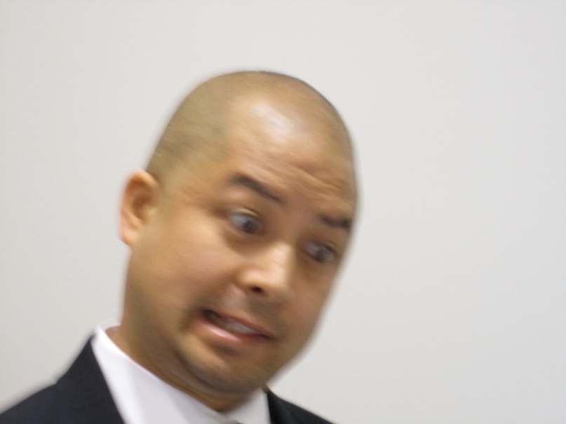
Steve has been sitting at his computer for many hours staring at the computer screen. As you can see he is not in the best shape right now. What should he do?
Notes:
Alternative question: Seeing that RSI’s is one of our leading causes for injuries, how should people try to correct RSI’s?

Slide 8
This is what Rhoderick thinks…
http://www.youtube.com/watch?v=t3UGTlZfzh8
Corrective Measures for Repetitive Stress Injuries and Lifting
~ rotate job tasks
~ stretching exercises before work and before lifting
Notes:
This is what Rhoderick thinks…
Corrective Measures for Repetitive Stress Injuries and Lifting
~ rotate job tasks
~ stretching exercises before work and before lifting

Slide 9
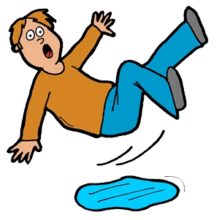
Help to Prevent Slips, Trips, and Falls
http://www.youtube.com/watch?v=_DUegjMxBCo
Corrective Measures
for Slips, Trips, and Falls:
~ Better footwear- rubber soles
~ Watch your steps- especially on stairs, elevated surfaces, polished marble floors, stepping onto rugs/carpets,& elevator gap
Notes:
Help to Prevent Slips, Trips, and Falls
Corrective Measures for Slips, Trips, and Falls:
~ Better footwear- rubber soles
~ Watch your steps- especially on stairs, elevated surfaces, polished marble floors, stepping onto rugs/carpets, and the elevator gap

