Slide 1
UCOP Family
FEUD
USE OF PORTABLE
FIRE EXTINGUISHERS
JULY 2011 SAFETY MEETING
UNIVERSITY OF CALIFORNIA, OFFICE OF THE PRESIDENT

Slide 2
Annual portable fire extinguisher training is required because…?
X
Cal/OSHA regulations
1
You are expected to use a fire extinguisher at work
2
X
X

Slide 3
Fire Extinguisher Use
Annual Refresher Training for Use of Portable Fire Extinguisher
Cal/OSHA Safety Training Requirement
Review:
1) General Principles for Fire Extinguisher Use
2) Guidelines on When to Use a Portable Fire Extinguisher

Slide 4
Name examples of Type A: Combustible Material fires.
X
Paper
1
Wood
2
X
Cloth
3
X

Slide 5
Name examples of Type B: Combustible Material fires.
X
Chemicals
1
Oil
2
X
Paint
3
X
Grease
4

Slide 6
Name most common examples of Type C: Energized Electrical Equipment fires.
X
Appliances
1
Electrical Wiring
2
X
Plugs
3
X

Slide 7
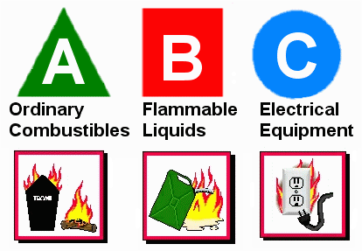
Major Types of Fires
Type A:
Combustible Materials
Type B: Flammable/Combustible Liquids
Type C:
Energized Electrical Equipment

Slide 8
Name the conditions when use of a fire
extinguisher is appropriate.
X
Fire is small and contained
1
Extinguisher rated for type of fire
2
X
You are properly trained and can
confidently operate it effectively
3
X
Safe Egress
4

Slide 9
When to Use a Fire Extinguisher
- Small & Contained
- Safe Escape Route Behind You
Extinguisher Rated for Type of Fire You Are
Fighting
Trained in Use & Confident You Can Operate it
Effectively
SLIGHTEST DOUBT – DON’T! Get Out. Close the Door to Slow the Spread of the Fire

Slide 10
What are the different types
of Fire Extinguishers?
X
Multi-Purpose (Red Color)
1
Pressurized Water (Silver Color)
2
X
Carbon Dioxide
(Red Color with no gauge)
3
X

Slide 11
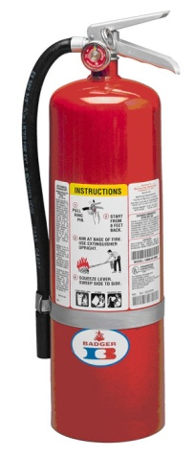
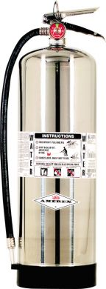
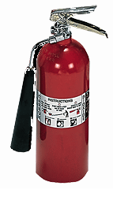
Types of Fire Extinguishers
Multi-Purpose (Red Color) – Dry Chemical
ABC (Ammonium Phosphate) or
BC (Potassium Bicarbonate)
Pressurized Water (Silver Color)
Type A Fire Only
Carbon Dioxide (Red Color with No Gauge)
Type BC Fire Only

Slide 12
When putting out a fire, make sure to aim at…
X
The base of the fire
1
X
X

Slide 13
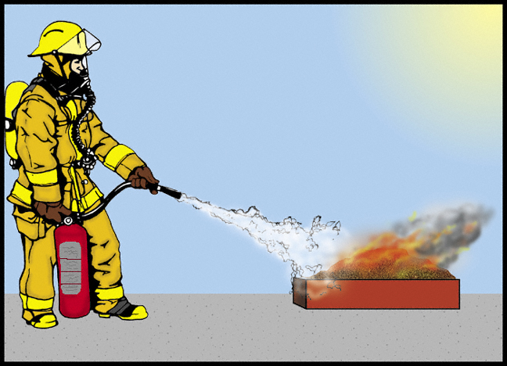
Make sure to aim at the base of the flame!

Slide 14
A fire extinguisher that is rated 2A:10 BC means it has a fire fighting capacity equivalent to:
X
2.5 Gallons of Water and 10 Square Feet for a BC Type Fire
1
X
X

Slide 15
Fire Extinguisher Capacity Rating
For a 2A:10 BC Extinguisher
2A:10 BC – Recommended Capacity for Homes
Number in Front of the “A”
Equals to Equivalent Number of Units for 1.25 Gallons of Water
2A Equals 2.5 Gallons of Water
(2 x 1.25 Gallons = 2.5 Gallons)
Number in Front of the “BC”
Area in Sq. Ft. that a non-expert is able to extinguish a Class B or Class C Fire
10BC = 10 Square Feet

Slide 16
What does the acronym PASS stand for?
X
Pull
1
Aim
2
X
Squeeze
3
X
Sweep
4

Slide 17
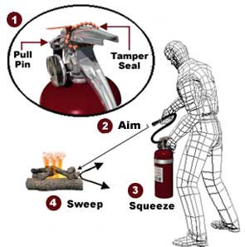
How to Use a Fire Extinguisher
Remember “PASS”
Stand 6 to 8 ft away
P: Pull the Pin
A: Aim at the Base of the Flame
S: Squeeze the Handle
S: Sweep from Side to Side
Step Backwards When Done – Never Turn Your Back Towards an Extinguished Fire!

Slide 18
Name actions you should take when
you see a fire.
X
Activate a fire alarm system
1
Evacuate the building
2
X
Call 911 and report the fire incident
3
X
Use a fire extinguisher to put out fire (if small and contained)
4

Slide 19
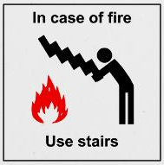
You are NOT Required to Use a
Fire Extinguisher on a Fire.
Your Responsibilities in a Fire Situation:
Recognize a Fire Condition
Activate the Fire Alarm System
Evacuate the Building
Call 9-911 to Report the Fire Condition
Prior to use: Make sure the fire extinguisher is fully charged and the needle is the green area.
Remember you are not a Trained Firefighter.
YOU SHOULD NEVER PUT YOUR LIFE IN DANGER!

Slide 20
Where are the fire extinguisher locations
in the 1111 Franklin Street building?
X
Kitchen Areas
1
Outside Restrooms
2
X
Near Elevator Lobby
3
X
Near Emergency Exits
4

Slide 21
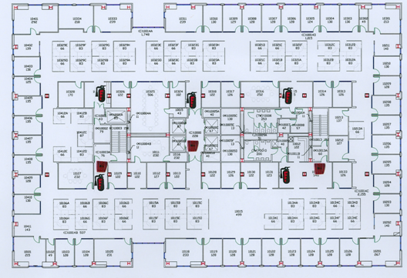
1111 Franklin Street Building
Fire Extinguisher Locations

