Slide 1
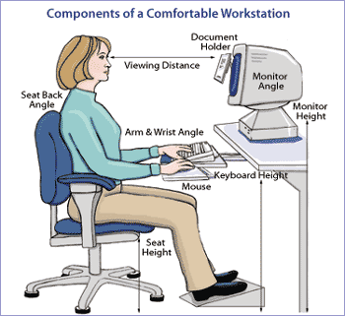
Ergonomics Training 101
UCOP January 2011
Safety Meeting
Developed by: Karen Hsi
EH&S Student Intern
Notes:
As part of Cal/OSHA regulations, this training will cover the required information that employees will need to know about the UCOP ergonomics program.

Slide 2
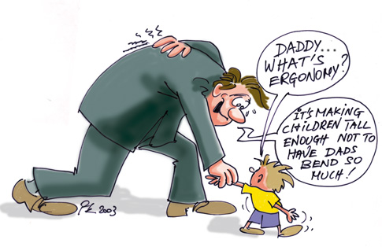
What is ergonomics?
Ergonomics is the study of the way we interface with the machines and mechanical devices we use in our everyday activities.
Notes:
According to our BSAS Injury Illness Prevention Plan, ergonomics is the study of the way we interface with the machines and mechanical devices we use in our everyday activities.

Slide 3
2 ways to request Ergonomic Evaluations
Take Remedy Interactive self-assessment. The assessment will let you know if your set up is good or at risk. At risk employees are recommended to request an evaluation as soon as possible.
Add RSI Guard (Stretch Break Reminder): http://www.rsiguard.com/download/?id=ucop
You can also send in a request directly by sending an email to: EHS@ucop.edu
Notes:
There are two ways to request ergonomic evaluations at UCOP. All employees are sent an email to take the Remedy Interactive self-assessment. This assessment will let you know if your set up is good or at risk. At risk employees are recommended to request an evaluation as soon as possible. You can also send in a request directly by sending an email to: EHS@ucop.edu. RSI Guard is a stretch break reminder which can be downloaded onto your computer. The link to the RSI guard is: http://www.rsiguard.com/download/?id=ucop. However, UCOP staff cannot download the RSI guard directly to their computer. UCOP staff need to put in a TechDesk request and request TechDesk to download the RSI guard their computer. When staff put in the TechDesk request, they should include the RSI guard link.

Slide 4
Increase of Ergonomic Evaluations Requested
Notes:
Here is a graph showing the increase of ergonomic evaluations requested in the past year. (2009-2010)

Slide 5
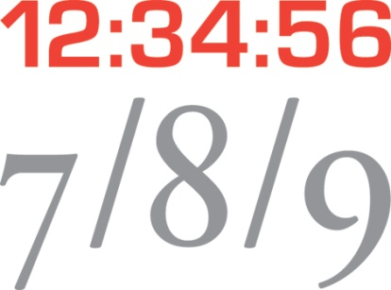
After the request…
You will get an email back with a specific date and time for the next available appointment.
Then you will receive an Outlook invite, which will remind you of when your ergonomic evaluation appointment will be.
Ergonomist will come to your office at that set time/date if confirmed.
Notes:
After the request is made, you will get an email back with a specific date and time for the next available appointment.
Then you will receive an Outlook invite, which will remind you of when your ergonomic evaluation appointment will be.
The ergonomist will come to your office at that set time/date if confirmed.

Slide 6
An actual ergonomic evaluation…
Takes about 45 minutes
A complete evaluation is a comprehensive assessment of your surroundings and tools that you use at work.
Notes:
An actual ergonomic evaluation takes about 45 minutes to complete. A complete evaluation is a comprehensive assessment of your surroundings and tools that you use at work.

Slide 7
Report and Equipment order form
Report with recommended equipment will be sent to the employee and supervisor in about 5-7 working days
Supervisor is held responsible for equipment that needs to the be ordered.
Ergonomic order form only used for ordering recommended ergo equipment also attached to the email
Make sure to email signed and completed form and report back to EHS@ucop.edu.
Notes:
A report will be sent to the employee and supervisor in approximately 5-7 working days.
The Supervisor is held responsible for equipment that needs to be ordered.
Along with the report, there should be an ergonomic order form only used for ordering recommended ergo equipment. Make sure the formed is completed, signed, and sent back to EHS@ucop.edu

Slide 8
Be Smart About Safety Matching Fund Program
BSAS will pay for ½ of the price of the recommended ergonomic equipment that you choose to order.
Do NOT need to order everything that’s recommended, may come back and order later.
Notes:
The Be Smart About Safety Matching Fund Program is part of UCOP’s ergonomic program. BSAS will pay for ½ of the price of the recommended ergonomic equipment that you choose to order. You do NOT need to order everything that’s recommended, you may come back later and order additional ergo equipment .

Slide 9
Follow-up Questions on the Order…
Matching signature and order form are signed as soon as possible and sent immediately to BRC for processing.
Any follow-up about your order, contact your BRC representative team.
If Department is Not Part of BRC, Contact BRC Blue Team
BRC places your equipment order, not BSAS.
Once the order is processed, BRC sends an e-mail to the UCOP employee
Notes:
For follow-up questions on the order…
Matching signature and order form are signed as soon as possible and sent immediately to BRC for processing.
Any follow-up about your order, contact your BRC representative team. If your department is not part of the
BRC, contact the BRC Blue team. BRC places your equipment order, not BSAS. Once BRC processes the order, BRC sends an e-mail to the UCOP employee.

Slide 10
After equipment is delivered…
Submit i-Request for anything that would need to be installed and/or assembled
Chair, keyboard tray, etc.
If work-surface needs to be raised or lowered submit an i-Request
BSAS does NOT pay for installation
costs
For optional follow-up ergonomic appointment to check new setup email EHS@ucop.edu
I-REQUEST
Notes:
After equipment is delivered…
Submit i-Request for anything that would need to be installed (Chair, keyboard tray, etc.)
If the work-surface needs to be raised or lowered submit an i-Request.
BSAS does NOT pay for any of the installation costs.
For an optional follow-up ergonomic appointment to check the new setup, email EHS@ucop.edu

Slide 11
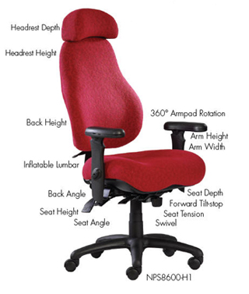
Chair Fitting
Pull-out adjustment cards to help you adjust the chair properly should be located on the arm.
Send an email to schedule an appointment (same procedure as ergo evaluation)
Have to go to the ergo lab for chair fitting
Choose from 4 different types of chairs
After getting the chair, must submit i-Request to get it assembled.
Notes:
Send an email to schedule an appointment (same procedure as an ergo evaluation)
Have to go to the ergo lab for chair fitting, ergonomist will not go to your office location.
There in the ergo lab, the employee will sit on 4 different chairs that will be adjusted for their comfort.
The employee selects one, and it goes through the same process as ordering the ergo evaluation equipment.
After getting the chair, you must submit an i-Request to get it assembled.

Slide 12
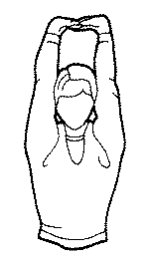
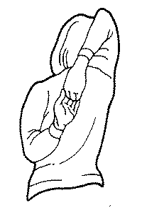
Important Ergo Tips…
Do NOT need a Manager’s permission to request an evaluation
Requests are usually responded to within 1 business day
Remember to do some stretches before sitting down to work!
RSI Guard is an
excellent tool.
Send request to
EHS@ucop.edu
Notes:
Here are some important ergo tips to remember. You do NOT need a Manager’s permission to request an evaluation.
Requests are usually responded to within 1 business day. Don’t delete those ergo emails. Remember to do some stretches before sitting down to work!
RSI Guard is an excellent tool to use for reminders of these stretches throughout the day. Send a request to EHS@ucop.edu for the link to the RSI Guard download, but the TeckDesk must be the one to install the RSI Guard onto you computer.

Slide 13
If you are experiencing any discomfort in your working environment, request the ergonomist to take a look… DON’T WAIT!
Notes:
If you are experiencing any discomfort in your working environment, request the ergonomist to take a look… DON’T WAIT! Better safe than sorry! If you have any additional ergonomics questions, please email EHS@ucop.edu.

