Slide 1
UCOP
Environmental Allergens
at the Workplace
August 2011 Safety Meeting
Developed by: Karen Hsi

Slide 2
Trends in the Workplace
Over the last several months, employers have seen an increasing number of persons have reporting allergic reactions, migraine headaches, and aggravation of medical conditions that have been caused by the use of perfumes/colognes, as well as other scented products in the workplace. This increased sensitivity to chemicals and environmental allergens may cause people to react with varying degrees of severity.
Notes:
Over the last several months, an increasing number of persons have reported allergic reactions, migraine headaches, and aggravation of medical conditions that have been caused by the use of perfumes/colognes, as well as other scented products in the workplace, including UCOP. This increased sensitivity to chemicals and environmental allergens may cause people to react with varying degrees of severity.

Slide 3
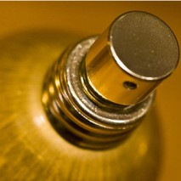
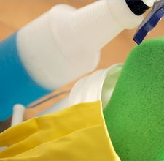
What is an Environmental Allergen?
Scented products
- Perfume/Cologne
- Candles
- Air Fresheners
- Body Lotions
Chemical cleaners
Aerosol products
Notes:
Examples of Environmental Allergens:
Scented products
- Perfume/Cologne
- Candles
- Air Fresheners
- Body Lotions
Chemical cleaners
Aerosol products

Slide 4
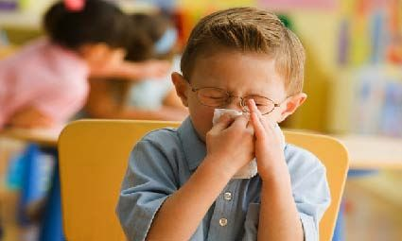

Chemical Sensitivity can cause…
Headaches
Nausea
Difficulty breathing
Hoarse voice or loss of voice
Difficulty concentrating
Tingling of the lips and skin
Muscle and joint pain
Notes:
For employees with fragrance sensitivity, this means riding in an elevator or working in a cubicle next to a person with perfume/cologne can result in:
Headaches
Nausea
Difficulty breathing
Hoarse voice or loss of voice
Difficulty concentrating
Tingling of the lips and skin
Muscle and joint pain

Slide 5

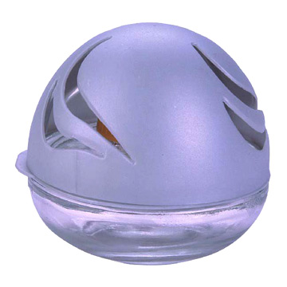
How to Help Alleviate the Problem…
Avoid using disinfecting sprays at work, wipes are recommended
Avoid using air fresheners in your cubicle
Avoid decorating with scented candles at the workplace
Be aware of any strong fragrances that may aggravate other persons around you
Notes:
Disinfecting sprays, such as Lysol, should not be used to clean at work, wipes are recommended
Sprays may cause irritation of eyes and mucous membranes, and depression of central nervous system
Also remember that these products may aggravate existing respiratory conditions of you and those around you.
Avoid using air fresheners in your cubicle
Avoid decorating with scented candles at the workplace
Be aware of any strong fragrances that may aggravate other persons around you

Slide 6

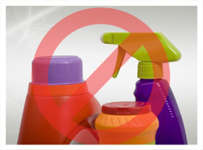
We Share the Air…
For employees with chemical/fragrance sensitivity, just riding in an elevator or working in a cubicle next to someone with perfume/cologne can cause the symptoms of Multiple Chemical Sensitivity (MCS).
Be conscientious and courteous to others who may be scent-sensitive.
Notes:
The UCOP Security and Safety Committee is currently evaluating the development of a fragrance-free workplace policy, but requests your help in the meantime to help create a comfortable and accommodating work environment for all employees and visitors by keeping all offices and other public spaces free of chemical based scented products.

