Slide 1
ELEVATOR SAFETY

Slide 2
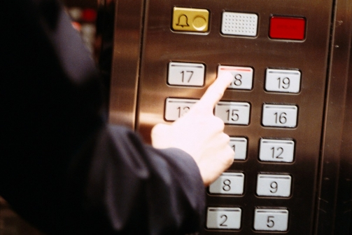
Recent Fatalities
CSU Long Beach – 12/7/11
New York Midtown Building -12/14/11
October is National Elevator Safety Month.
Notes:
Due to an alarming rash of elevator-related accidents, the United States Congress recently declared the month of October to be National Elevator Safety Month. Click the hyperlinks to read about CSU Long Beach elevator fatality and New York Midtown elevator fatality.

Slide 3
Notes:
Just for reference, here are the stats for University of California Elevator Related Injuries for fiscal year 2011.

Slide 4
UNDER NO CIRCUMSTANCES SHOULD YOU TRY TO EXIT ELEVATOR THAT IS STALLED.
If Doors Do Not Open When Elevator Stops:
First Push “DOOR OPEN” Button
If Door Still Does Not Open, Ring Alarm or Use the Intercom or Phone
Wait Until Qualified Person Can Assist You
27 people killed each year
10,200 people injured
Notes:
According to the U.S. Bureau of Labor Statistics and Consumer Product Safety Commission 27 people are killed in elevator accidents each year. Injuries from elevators affect about 10,200 people per year, with the majority of these accidents being related to elevator door malfunction, carriage misalignment with floors, and passenger safety vulnerabilities.

Slide 5
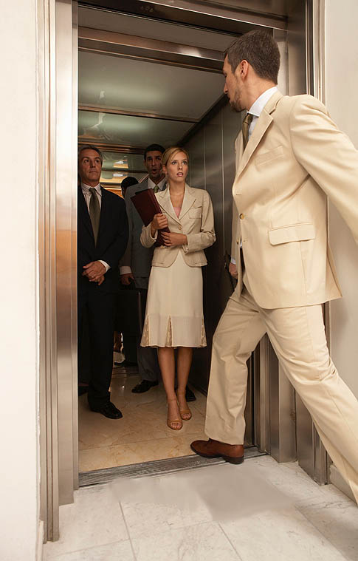
Elevator Safety Rules
1. Watch Your Step Entering & Exiting.
Is the elevator level to the floor?

Slide 6
Elevator Safety Rules
2. Leave Closing Doors Alone.
~Door Sensors Are Not Always Reliable.
Push “Door Open” to hold doors open

Slide 7
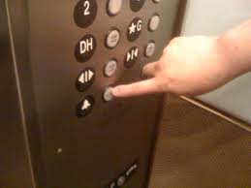
Elevator Safety Rules
3. If Doors Don’t Open, Ring Alarm Button and Wait.
Alarm buttons will connect to a 24-7 dispatch.

Slide 8
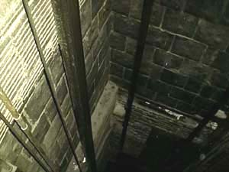
Elevator Safety Rules
4. Never Try to Leave a Stalled Car.
Stay put and wait for help.

Slide 9
Elevator Safety Rules
5. Never Enter an Elevator with A Suspicious Looking Person Inside.
Best Practice- Buddy System.

Slide 10
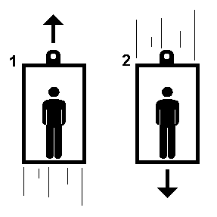
How Do Elevators Work?
Low Rise Buildings – Hydraulic
Fluid-Driven Piston
Mid-to High Rise Buildings - Cable
Traction Steel Ropes: 4 to 8 Cables
Elevator Safety Systems
Cable Elevators – Braking System if Car Moves Too Fast & Governor to Catch Cable
Electromagnetic Brakes
Elevator doors operated by computers.
Notes:
How do elevators work? There are 2 types of elevators. For low rise buildings, they use hydraulic elevators which operate with a fluid-driven piston to raise and lower the elevator. NOTE: Click on the link to show how the elevator operates. For mid-to High rise buildings, they use the cable type elevators which operate with traction steel ropes to raise and lower the elevator. NOTE: Click on the link to show how the elevator works.
All these elevators have built in back-up safety systems as well.

Slide 11
Chief Building Engineer for 1111 Franklin
If you have any further questions about the specific elevators located in the your building, please contact Matthew Leet and he can follow up with the appropriate building engineers for your locations.
Matthew Leet
Matthew.Leet@ucop.edu
Notes:
All 8 elevators in the Franklin building are serviced on a monthly basis and inspected by the state annually. We were within compliance for this current year.

Slide 12
THANK YOU!

