Slide 1

Office and Home Electrical Safety
April 2011 Safety Topic
Notes:
For this month’s safety spotlight, we will be discussing Office and Home Electrical Safety and the ways to help prevent electrical fires.

Slide 2

U.S. Consumer Product Safety Commission Has Found:
  Electrical Fires – Majority Caused by Aging Wiring and Misuse of Surge Protectors
  In the U.S. Over 750 People Are Killed Every Year by Electrical Fires
  Extension Cords - Leading Cause of Home Electrical Fires in the U.S.
    An Extension Cord Related Fire Occurs Every 6 Minutes
Notes:
The United States Consumer Production Safety Commission has found:
- The majority of the electrical fires in the United States are caused by aging wiring and the misuse of electrical surge protectors.
- Over 750 people are killed by electrical fires every year in the United States.
- The leading cause of home electrical fires is related to the improper use of extension cords. In the United States there is an extension cord-related fire every 6 minutes.

Slide 3
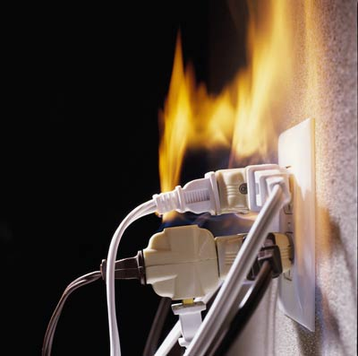
To help prevent electrical fires, here are some tips you should remember…
  Replace damaged or frayed electrical cords.
  Do not run electrical cords through doorways or under carpets.
  Avoid overloading electrical outlets
  If electrical switches or outlets feel warm, contact facilities ASAP
Notes:
To help prevent electrical fires, here are some tips you should remember…
- Replace damaged or frayed electrical cords.
- Do not run electrical cords through doorways and under rugs. Cords run through doorways can be damaged. Electrical current generates heat as it travels through electrical cords. If electrical cords are run placed under carpets, the heat would not be able to dissipate and may result in the damage to the electrical cord.
- Avoid overloading electrical outlets. If you have several high wattage appliances, only plug in one appliance into each receptacle at a time
- If electrical switches or outlets feel warm to the touch, contact Facilities Management ASAP. The heat may be an indication of a possible electrical problem. If it is your home electrical switch/outlet, you should contact a licensed electrician to properly assess the situation.

Slide 4
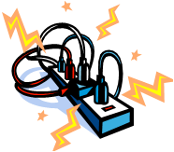
Avoid Exceeding the Capacity of the Electrical Outlet
  Never Overload the Capacity of the Power Strip or the Surge Protector
  Only Plug One Surge Protector or Power Strip into a Single Duplex Electrical Outlet
  Never Plug a Surge Protector or Power Strip into Another Surge Protector or Power Strip
Notes:
Avoid exceeding the capacity of the electrical outlet…
Never overload the capacity of the power strip or surge protector
Only plug in one surge protector/power strip into a single duplex electrical outlet.
Never plug a surge protector/power strip into another surge protector/power strip

Slide 5

How to Determine the Capacity of a Power Cord, Power Strip, or a Surge Protector
  Assume 125 Watts per Amp to Calculate the Conversion
  Total Watts Should Not Exceed 80% (0.80) of the Rated Capacity
  Example – Surge Protector Rated at 15 Amps
    15 Amps X 125 Watts/Amp = 1875 Watts
  1875 Watts X 0.80 = 1500 Watts Capacity of the Surge Protector
Notes:
How to Determine the Capacity of a Power Cord, Power Strip, or a Surge Protector:
To calculate the conversion, assume there are 125 watts per amp.
The total watts should not exceed 80% of the rated capacity.
Example – For a surge protector rated at 15 amps, the capacity is 15 amps times 125 watts per amp, which equals 1875 watts. Using the 80% capacity, we multiply the 1875 watts times 0.80 which equals 1500 watts. This is the capacity of the 15 amp surge protector.

Slide 6

Main Points:
  Periodically Inspect Outlets, Appliances, Plugs and Cords
  Extension Cords are Only For Temporary Use
    Do Not Nail or Staple to Objects
    Do Not Run Under Rugs or Through Doorways
  Do Not Exceed the Capacity of the Electrical Outlet, Power Strip, or Surge Protector
Notes:
Summary – Main Points:
Periodically inspect electrical outlets, appliances, plugs, and cords to ensure they are in good condition. Remove the item(s) from service if they fail the inspection
Extension cords are only for temporary use. They should not be used in lieu of fixed permanent wiring. Do not nail or staple the extension cord to objects. Do not run the extension cords under rugs or through doorways
Do not exceed the capacity of the electrical outlet, power strip, or surge protector.

