Slide 1

Corridors
and
Egress
May 2011 Safety Topic
Notes:
For this month’s safety spotlight, we will be discussing Corridor and Egress Safety.

Slide 2
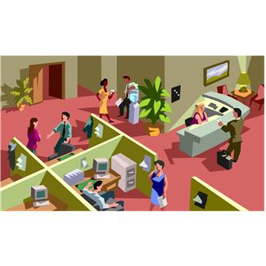
UCOP Corridor and Egress Incidents
  UCOP Employees Have Accidently :
    Run into Other Employees in Corridors/Walkways
    Been Hit By Items Being Pushed by Other Employees
      Dolly or Cart
  Result
    Injury Requiring Medical Attention
    Non-Injury – But Could Be Classified As a “Near Miss”
      Near Misses – Implement Corrective Measures
  UCOP Safety Spotlight Issue #3
    Suggestions to Prevent Injuries or Slips & Trips
Notes:
UCOP Corridor and Egress Incidents
Several incidents have occurred at UCOP locations where employees have accidently run into other employees in corridors/walkways or the employees have been hit by items being pushed by other employees, such as a dolly or a cart.
These “accidents” have resulted in injuries which have required medical attention, or luckily have not resulted in an injury, but would be classified as a “near miss”. Although no injuries may occur in a “near miss”, corrective measures should be implemented to prevent similar type of incidents from occurring in the future.
Safety Spotlight Issue #3 offers suggestions to prevent injuries or slips and trips while traveling in corridors and walkways.

Slide 3

Look Out for These Walking Hazards
  Hidden, or un-obvious steps
  Smooth surfaces such as waxed floors or marble flooring
  Carpeting and rugs without anti slip edges or edges not taped down
  Wet floors
  Loose carpet treading
Notes:
Look Out for These Walking Hazards
Hidden, or un-obvious steps
Smooth surfaces such as waxed floors, marble flooring
Loose flooring such as bricks, tile, or floorboards
- Carpeting and rugs without anti-slip edges or edges not taped down
- Wet floors
- Loose carpet treading

Slide 4
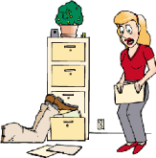
Housekeeping
  Avoid Placement of Furniture or Other Large Items in High Traffic Areas
  Avoid Storage of Materials in Walking Areas
  Don’t Use Electrical Cords in Walking Areas
  Clean-up Untidy Floors and Stairs, Including “Office Toys”, Tools, and Even Pencils
  Close All Open Drawers
  Keep Your Walking Area Clean
Notes:
Housekeeping
- Avoid placement of furniture or other large items in high traffic areas
- Avoid storage of materials in walking areas
Don’t use electrical cords in walking areas
Clean-up untidy floors and stairs, including “office toys’, tools, and even pencils
Close all open drawers
Keep your walking area clean

Slide 5

Walking Hazards
  Walk, Do Not Run!
  Keep to the Right, Especially When Walking Around Corners or Blind Intersections
  If Pushing a Cart or Dolly, Keep to the Right. If Turning Left, Make a Wide Turn
    Look and Listen for Other Persons When Approaching an Intersection or Corner
Notes:
Walking Hazards
- Walk, do not run!
- Keep to the right, especially when walking around corners or blind intersections
If pushing a cart or dolly, keep to the right. If turning left, make a wide turn.
Look and listen for other persons when approaching an intersection or a corner.

