Slide 1
Bicycle Safety
UCOP Safety Training
May 2010

Slide 2
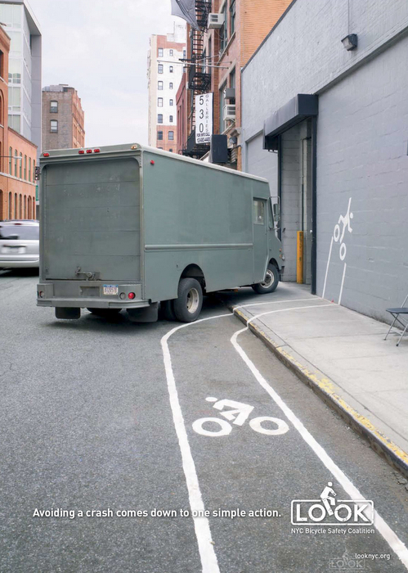
Can’t we all just get along?
On city streets, cyclists have the same rights and responsibilities as drivers.
In the United States, about 750 cyclists are killed in accidents every year, almost all involving automobiles
As motorists, we need to be aware of cyclists!
http://www.youtube.com/watch?v=Ahg6qcgoay4&feature=player_embedded
Notes:
As motorists in the Bay Area or when visiting UC campuses, we need to be conscious of cyclists on the road.
In the United States, about 750 cyclists are killed in accidents every year, almost all involving automobiles.
Before we get started, here is an image and a video that dramatize why bicycle safety is subject that is important for motorists as well as cyclists. [click on the link on the screen to play YouTube video]

Slide 3
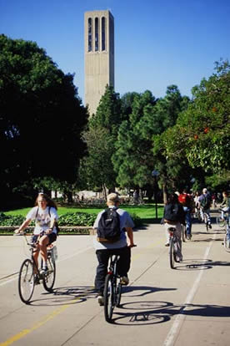
Benefits of biking
Biking is…
Less expensive than driving or riding public transportation
A great work out
Great for the environment
The ubiquitous cyclists of UC Santa Barbara
Notes:
Bicycling is a low-cost mode of transportation, provides great exercise, and is environmentally friendly. Biking is an important mode of transportation on most of our UC campuses.
Commuting to and from work by bicycle is less expensive than riding public transportation or driving.
Biking is a low-impact cardiovascular workout. Biking can help you lose weight, reduce stress, and lessen your risk of heart disease.
Riding a bike helps reduce air pollution and traffic congestion.
Dedicated bike lanes are becoming more and more common, making bike commuting easier than ever. That said,
it’s important to observe some rules to ensure a safe ride.

Slide 4
Your head is not as hard as asphalt
Always wear a helmet
Bicyclists and bicycle passengers under 18 years old are required to wear helmets meeting specified standards
Violations are punishable by a fine of up to $25.00
Notes:
Bicyclists and bicycle passengers under 18 years old are required to wear helmets meeting specified standards
(ANSI Z 90.4 Bicycle Helmet Standard, SNELL or The American Society for Testing Materials ASTM F-1447 Standard)
that are conspicuously labeled with those standards.
This also applies to a passenger in a restraining seat attached to the bicycle or in a trailer towed by the bicycle. Violations are punishable by a fine of up to $25.00.

Slide 5
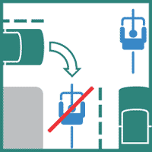
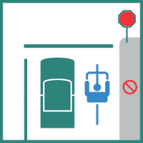
Don’t follow your heart, follow the lane
…Stop signs apply to cyclists too.
Always ride with traffic. Never ride the wrong way down one-way streets
Stop signs apply to bicyclists and motorists alike.
Notes:
Bicycle riders on public streets have the same rights and responsibilities as automobile drivers.
Cyclists are part of the normal traffic flow and are entitled to share the road with other drivers. Like drivers, bicyclists must:
Yield to pedestrians,
Abide by traffic signals & stop signs, and
Ride in the direction of traffic

Slide 6
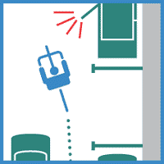
Don’t door me, bro!
Try to ride a door’s width away from parked cars.
If you have to ride in the door zone, ride very slowly.
Cyclists have the right to ride in a traffic lane if it is too narrow to share with a car.
Notes:
Getting “doored” – hit with a car door as it opens – is many cyclists' worst nightmare.
Please look around before opening the door of a parked car.

Slide 7
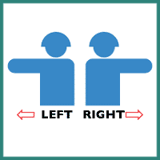
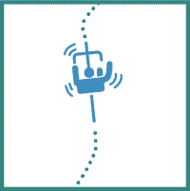
When and when not to be a one-armed bandit
Use hand signals to tell motorists what you intend to do.
Unless signaling, keep both hands ready to break
Notes:
Use hand signals. Hand signals tell motorists what you intend to do. Signalling is a matter of law, of courtesy, and of self-protection.
All required signals are given as follows: a) Left turn: left hand and arm extended horizontally beyond the side of the bicycle; b) Right turn: two signalling methods exist, including left hand and arm extended upward beyond the side of the bicycle, or right hand and arm extended horizontally. While signaling with the right hand is more widely understood, braking may be more difficult with this method. c) Stop or sudden decrease of speed: left hand and arm extended downward beyond the side of the bicycle.
Keep both hands ready to brake. You may not stop in time if you brake one-handed. Allow extra distance for stopping in the rain and heavy fog, since brakes are less efficient when wet.

Slide 8
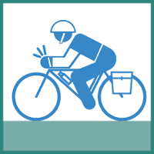
Ride a well-equipped bike
Recommended for your ride:
bell,
rear-view mirror,
rack or basket (or backpack)
lights & reflector,
water bottle,
bike pump & patch kit
bike lock
Notes:
Be sure your bike is adjusted to fit you properly.
For safety and efficiency, outfit it with:
a bell,
rear-view mirror,
rack or basket (or wear a back-pack)
lights and reflector (Mandatory if riding at night)
a water bottle (because it’s easy to get dehydrated),
bike pump and patch kit
A bike lock (because bike theft is rampant)

Slide 9
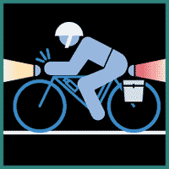
The dark side of cycling
Required for night riding:
A forward facing white light
A backward facing red reflector or light
White or yellow reflectors on pedals and bike frame
Notes:
Bicycling at night Bicycles operated during darkness must have the following:
a white light that is visible from a distance of 300 feet to the front and sides of the bicycle; the light may be mounted on the bicycle or attached to the rider.
a red reflector or light mounted on the rear of the bicycle and visible from 500 feet to the rear of the bicycle
a white or yellow reflector mounted on each pedal visible 200 feet to the front and rear of the bicycle, a white or yellow reflector on each side forward of the center of the bicycle and a white or red reflector on each side to the rear of the center of the bicycle. Bicycles equipped with reflectorized tires on the front and rear need not be equipped with side reflectors. All reflectors and reflectorized tires must meet DMV requirements.

Slide 10
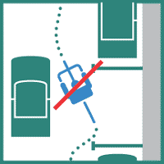
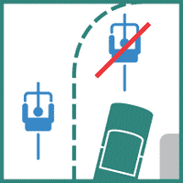
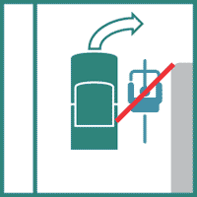
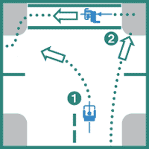
A couple dos and don’ts
DON’T
DO
Don’t: weave between parked cars
Do: Follow lane markings at all times
Don’t: pass on the right at intersections
Do: Choose the best way to make a left-hand turn
Notes:
Don’t weave between parked cars. Don’t ride out to the curb between parked cars, unless they are far apart. Motorists may not see you when you try to move back into traffic.
Passing on the right Be careful. Motorists may not look for or see a bicycle passing on the right. Don’t be bereft, pass on the left Cyclists can legally move left to turn left, to pass a parked or moving vehicle or another bicycle, or to make a turn, avoid debris, an animal, or other hazards. Cyclists may ride near the left curb or edge of a one-way street.
Follow lane markings. Cyclists make left and right turns in the same way that drivers do, using the same turn lanes.
A cyclist turning left should use a left-turn lane.
A cyclist traveling straight ahead should use a through traffic lane rather than ride next to the curb and block traffic making right turns.
Don’t turn left from the right lane.
Choose the best way to turn left. There are two ways to make a left turn:
Like an auto. Signal, move into the left lane, and turn left.
Like a pedestrian. If you are within a designated crosswalk, dismount and walk your bike across.

Slide 11
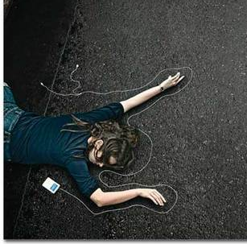
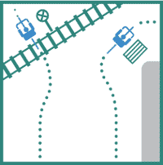
Stay alert, stay alive
Don’t wear headphones.
Pull over to use your cell phone.
Avoid road hazards.
Cross tracks perpendicularly
Notes:
Avoid road hazards. Watch out for streetcar and railroad tracks. Cross them perpendicularly. Avoid parallel-slat sewer grates, utility covers, painted and/or oily pavement, gravel, and pot-holes. These are all more hazardous when wet.
DON'T wear headphones. DO pull over if you need to use your cellphone.

Slide 12
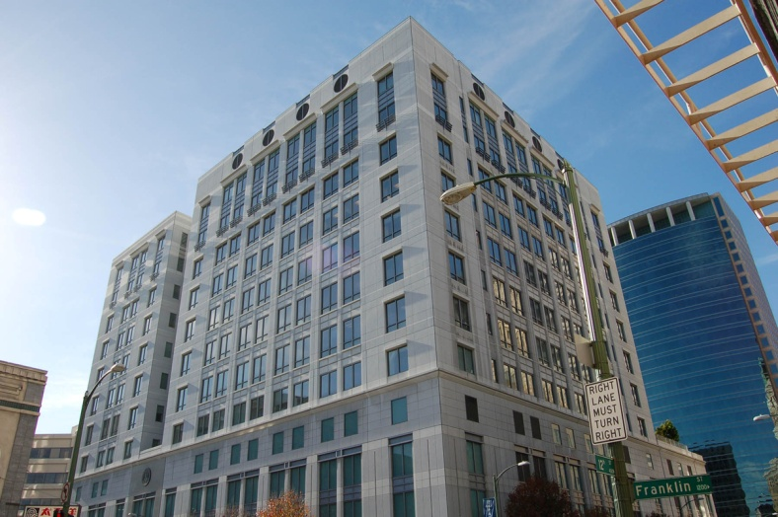
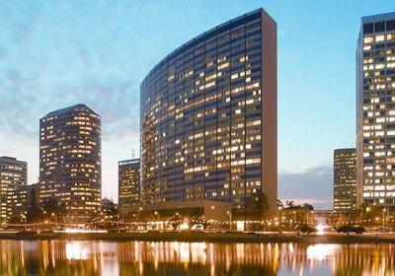
Bike commuting at UCOP
Secure bike parking available at the Franklin and Kaiser Buildings
Contact Building Services Work Management Center (510-287-3344) to gain access
Showers and changing facilities
are available on the ninth
floor of the Franklin Building

Slide 13
Resources
For more information on bike routes in the Bay Area and bike safety:
http://bicycling.511.org/
http://www.sfbike.org/
http://www.ebbc.org/
Section 21200-21212 of the California Vehicle Code (VC),
All safety tips and diagrams are from http://bicycling.511.org/traffic.htm
Notes:
The Bay Area's 16th Annual Bike to Work Day will take place on Thursday, May 13th, 2010.
During Bike to Work Day, “Energizer Stations” are located along Bay Area county commute routes where bicyclists can stop for refreshments, giveaways, and bicycling information.
Energizer Stations will be open during morning commute hours and some will even re-open during the evening commute.
About 40 UCOP employees participated in last year’s Bike to Work Day.

