Slide 1
Sleep Tight… Don’t Let the Bed Bugs Bite!
UCOP October 2010 Safety Meeting
Developed by Karen Hsi, UCOP EH&S Student Intern
Notes:
For this month’s safety meeting topic we will be discussing bed bugs. Recently, there has been many reported infestations of these pests in well-known hotels, university dormitory rooms and student cooperative housing . As a reminder of safety during your travels, we will be discussing some tips and pointers to keep in mind about bed bugs.

Slide 2
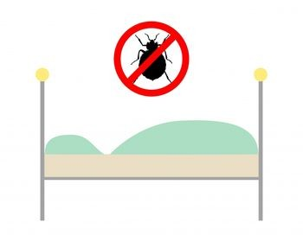
Their Latest Victims…
New York City’s Niketown Store was temporarily shut down due to an invasion of bed bugs!
One of our own UC Risk Managers suffered several bites!
Possibly caused by increase in international travels!
Notes:
New York City’s Niketown store and one of our UCOP Risk Managers were the latest victims of bed bugs! There has been a widespread epidemic of bed bug infestation causing businesses to have to temporarily close down and increased paranoia in travelers. The tips given in this presentation will help to decrease your chances of being the next victim and carrying these pests home with you.

Slide 3
Reported Bed Bug Infestations across Hotels in the U.S.
Notes:
This epidemic is very prevalent, so take extra precaution before even going on a trip. Check your hotel at bedbugregistry.com. This is a free, public database of user-submitted bed bug reports from across the U.S. and Canada. It was founded in 2006, and has since then collected about 20,000 reports covering 12,000 locations.

Slide 4
Tricky Little Buggers…
Where you like to rest… they like to rest too!
What makes them hard to detect?
Have excellent abilities to squeeze into cracks and crevices and will often go unnoticed by the “casual observer.”
Shun light, and if disturbed will move to quieter, more remote areas
Check bed crevices when you get to the hotel!
Notes:
Since bed bugs like to rest where you like to rest, make sure one of the first steps you take when you get to hotel room is to check the bed you will be sleeping on. If there are any bed bugs, you would be able to spot them by checking the seams of the mattress and near the headboards. Bed bugs are hard to detect because they have excellent abilities to squeeze into cracks and crevices, so they often go unnoticed. They tend to move away from light and go deeper into crevices if disturbed, so if they make their way into your mattress it may be too late! Make sure that your mattress doesn’t have too many rips and tears, because bed bugs will go into the mattress if they can find a way in.

Slide 5
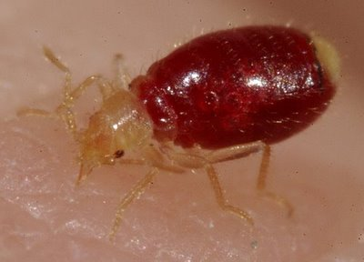
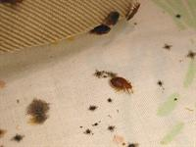
What do they look like?
Oval, flattened, brown, and wingless
Approx.1/4 to 3/8 inch long (5-9mm)
Looks similar to a wood tick
Young bed bugs are even smaller (1/16 inch or 1.6 mm) when they first hatch and they are colorless
They leave cast skins as they grow and fecal spots after a blood meal.
Notes:
You might ask, what am I looking for when I look for bed bugs, what do these bed bugs look like? They are oval, flattening, brown, and wingless pests. They are approximately 1/4 to 3/8 inches long (5-9mm). They look very similar to a wood tick. Young bed bugs are even smaller (1/16 inch or 1.6mm) and are usually colorless. First signs that these bugs are around are the cast skins and fecal spots they leave on the beds. If you see these spots around, you can probably suspect to find a couple bed bugs in the proximity.

Slide 6
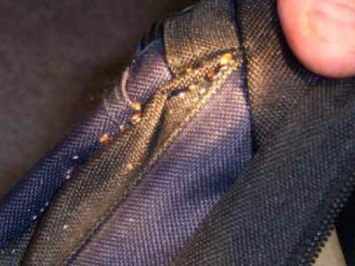
Inspect all personal items…
Upon entering the hotel room…
Coming home from travels…
Use luggage racks provided instead of putting luggage on beds
Inspect beds sheets for visible pepper-looking spots
Carefully inspect your items paying attention to cracks, crevices, seams, and folds.
May travel on clothing/luggage but not directly on people.
Notes:
It is very important to inspect all your personal items coming into the hotel and coming out. Upon entering your hotel room, instead of throwing your luggage and backpacks directly onto the bed, use luggage racks that are provided by most hotels, or even put your luggage on a table or chair for easy unpacking. You want to avoid throwing your luggage directly on your bed, because this may be unsanitary and bed bugs are often carried into hotel rooms on your luggage or clothing or if there is already an infestation, bed bugs could easily get into your luggage and clothes. Always inspect the bed sheets, seams, mattress corners for the pepper- looking fecal spots. Upon leaving the hotel, just carefully inspect cracks and crevices of your luggage and clothes again if you suspect bed bugs. These bugs do not travel directly on people, but on clothing and luggage, so check carefully to avoid bringing them home!

Slide 7
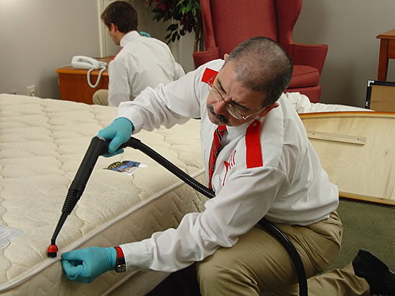
Steps to take after possible infestation…
Contain all items suspected of carrying bed bugs in plastic bags until items can be laundered, washed by hand, heated, or frozen
When washing set on highest heat that clothing can withstand
Suitcase and items that cannot be placed into washing machine can be hand-washed with soap and the hottest water possible (100ºF to120ºF)
Items that cannot be washed can be heated or frozen.
120ºF minimum target temperature for heat treatment
23ºF minimum temperature maintained for 5 days for frozen treatment
Notes:
No one wants to have to throw out all the mattress and sheets they have at home, or call pest control for an extermination. These are the steps you should take after a possible infestation to make sure that these bugs do not make your home their next home.
Contain all items suspected of carrying bed bugs in plastic bags until items can be laundered, washed by hand, heated, or frozen
When washing set on highest heat that clothing can withstand
Suitcase and items that cannot be placed into a washing machine can be hand-washed with soap and the hottest water possible (100ºF to 120ºF)
Items that cannot be washed can be heated or frozen.
120ºF minimum target temperature for heat treatment
23ºF minimum temperature maintained for 5 days for frozen treatment

Slide 8
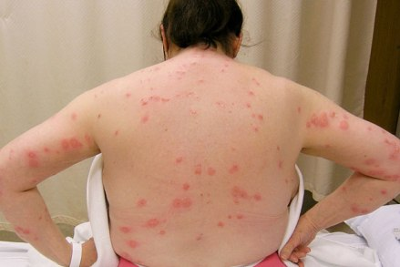
Symptoms and Signs of Bed Bug Bites…
Redness, swelling, or itching
Small, flat, or raised bumps on the skin
Tendency to find several bites together in a row
Bed bugs secrete odors from their glands and often leave dark fecal spots on bedsheets where they hide out
Notes:
Here are some of the symptoms and signs of bed bug bites to help you detect a possible infestation.
Redness, swelling, or itching
Small, flat, or raised bumps on the skin
Tendency to find several bites together in a row - The difference between flea bites and bed bug bites is that you tend to find bed bug bites together in a row of little red bites. As they say, these bugs like to have their “breakfast, lunch, and dinner.”
Bed bugs secrete odors from their glands and often leave dark fecal spots on bedsheets where they hide out

Slide 9
How to take care of Bed Bug Bites…
Scratching may result in INFECTION!
DON’T SCRATCH!!!
No treatment
Steroid creams or oral antihistamines can be used for severe itching
If bites become infected, use of antibiotics may be required
Notes:
There really is no treatment for bed bug bites. There are creams and antihistamines available to stop the itching, because it is important not to scratch the bites in order to avoid infection. If they become infected, you may need to take antibiotics, and consult a doctor for further instructions.

Slide 10
5 Star hotel with 6 legs…
Guest at Waldorf Astoria hotel in Midtown reported bed bugs.
Reported incidents at Four Seasons hotel
Check www.bedbugregistry.com before you book your hotel!
http://www.youtube.com/watch?v=WfKCcSPCOQo
Peak biting times are usually during dawn!
Notes:
Don’t think that just because you stay at a 5 star hotel, bed bugs aren’t going to be a problem. Recently, there have been many reports of bed bugs at even the most prestigious, and high rated hotels.
http://www.nbcnewyork.com/news/local-beat/Guest-Says-She--104483874.html
So remember to check your hotel out before you even book it!
www.bedbugregistry.com

