Slide 1
Sourcing Analytics Training

Slide 2
Contents
This training pack is designed to give an Analyst a comprehensive overview of the key tools and methods which they may be required to use in the course the sourcing and procurement process.
The pack contains an introduction to some of the key areas of focus, and details of how to find further information through external resources.

Slide 3
Agenda
Conducting Sourcing Analysis | 90 minutes
Data Management Methods | 30 minutes
Creating & Analyzing RFIs & RFPs | 60 minutes
Preparing for Fact Based Negotiations | 60 minutes
Appendix

Slide 4
Agenda
Conducting Sourcing Analysis
Data Management Methods
Creating & Analyzing RFIs & RFPs
Preparing for Fact Based Negotiations
Appendix

Slide 5
Conducting Sourcing Analysis
1
Industry analysis
  Developing Industry Analysis
  What can Industry Analysis tell us?
  Determining Industry Structure
  Measuring Industry Financials
  Identifying Industry Trends & Dynamics
  Identifying Leading Practices
Supplier Analysis
  Developing Supplier Analysis
  What can Supplier Analysis tell us?
  Assessing Supplier Capabilities
  Identifying Supplier Positioning
  Measuring Supplier Financials
Category Opportunity Assessment Example
  Where does Industry and Supplier Analysis fit in?
  Bearings Category Profile Example
TCO Analysis
  Determining Total Cost of Ownership
2
3
4

Slide 6
Developing Industry Analysis
When conducting Industry Analysis, there are four key activity areas that will reveal the implications of various industry forces on the Sourcing Strategy.
Determine
Industry
Structure
Measure
Industry
Financials
Identify Industry Trends/
Dynamics
Identify
Industry Leading Practices
Describe competition
Develop under-
standing of supplier
/ buyer power
Define overall size and growth
Measure key ratios
Discern common profit and cost
Identify key trends
Assess impact of technology, government
Identify unique solutions
Find innovative suppliers
Seek success stories
Assess supply
market complexity
Benchmark supplier
costs and success
Define potential
levers as a customer
Use best ideas
Implications of the Industry on Sourcing this Category

Slide 7
What Can Industry Analysis Tell Us?
Industry Analysis can answer several key questions concerning the competitive intensity, profitability trends, and best practices in a certain market.
Activity Area
Key Questions to be Answered
Tools & Techniques
Determine
Industry
Structure
What is the balance of power between industry participants and customers?
What is the nature of competition in this industry?
How big is the industry and who are the major players?
How does this industry structure translate into supply market complexity?
Porter‘s Five Forces
Industry Research
Measure
Industry
Financials
What is the overall financial position of this industry?
What is the profit/cost structure of this industry?
How does the industry compare to other industries?
Measure Industry Financials Template
  Industry Cost Bar
  Ratio Analysis Worksheet
Identify Industry
Trends/ Dynamics
What are the key trends in the industry?
What are the potential strategic levers for a customer facing this industry?
How do macroeconomic, regulatory and technology trends affect this industry?
Internet Search Engines
Analyst reports
Industry Publications
Identify Industry
Leading Practices
What are the industry leading practices?
Category Sourcing Strategy Report
Synthesis of Interim Deliverables

Slide 8
Determining Industry Structure
The Porter’s 5-Forces Model provides a framework for analyzing industry structure and supply market complexity from the supplier’s perspective.
Step 1: Answer key questions relating to each of the five forces
Step 2: Summarise the top three findings per force
Step 3: Provide an overall score of market complexity for the industry
Barriers to New Entrants
Economics of Scale Brand Identity Switching Costs Capital Requirements | Product Differentiation Access to Distribution Cost Advantages Expected retaliation
External Factors
Politics / Government Environment Socio – economic Technological Advances Regulatory
Power of Suppliers
Input Differentiation Costs of Switching Suppliers Threat of Forward Integration | Presence of Substitute Inputs Magnitude of Purchase Cost relative to total industry purchases
Industry Rivalry
Industry Rivalry Over / Under Capacity Competitive Diversity Industry Maturity | Industry Growth Value Adds Corporate Stakes
Power of Buyers
Substitute Products Buyer Information Number of Buyers Price of Items | Bargaining Levers Purchase Volume Buyer Switching Costs Price Sensitivity
Substitutes
Relative Price Performance Switching Costs Buyer Propensity to Substitute
Yes/High Complexity
Partial/Moderate
Complexity
No/Low Complexity

Slide 9
Measuring Industry Financials
The industry cost bar can be used to illustrate the major cost drivers of the industry and aids in identifying potential opportunities.
Step 1: Select 3-5 representative suppliers from the industry group
Step 2: Review the Financial Statements of those suppliers
Step 3: Document findings and opportunities
100%
4%
Profit
90%
8%
80%
7%
Other Expenses
70%
14%
Depreciation
60%
% of sales
25%
Payroll costs
50%
40%
Other Goods & Services
30%
Raw Materials
20%
41%
10%
0%
Cost & profit components
Relevance of Different Cost Levers in the Industry

Slide 10
Industry Trends & Dynamics
Looking at trends such as Merger & Acquisition activity and market concentration and plotting this information on a matrix provides a basis for understanding where the pressures lie and helps to identify areas of change.
Market Consolidation
FRAGMENTED
SPECIALITY
# of
Many competitors; none can gain a significant advantage over another
Typically a low profit margin for all players in the market
Example: Dry Cleaning
Many competitors; the most successful dominate the niche areas of the market
These niche players can be highly profitable
Example: Pharmaceuticals
# of
Industry
Industry
Competitors
Competitors
Time
Time
Market Concentration
Trend?
STALEMATE
Trend?
SCALE
200X
201X
Few competitors; none can gain a sustainable advantage
Industry typically has boom-and-bust cycles as one competitor invests to gain an advantage and the rest follow, erasing the advantage
Example: Airlines
Few competitors; the top one or two hold a commanding advantage over the group
Top competitors can be extremely profitable, with remainder usually close to break-even
Example: Memory Chips
Merger &Acquisition Activity
# M&A
Transactions
Time

Slide 11
Industry Trends & Dynamics
Looking at trends such as Merger & Acquisition activity and market concentration and plotting this information on a matrix provides a basis for understanding where the pressures lie and helps to identify areas of change.
Implications on Strategy
If the market is focused on (or transitioning towards) SCALE
Align with the ‘Winners’
Increased competition and/or scale economies may lead to lower pricing
If the market is focused on (or transitioning towards) SPECIALITY
Understand the complexity in the industry
Select relevant niches and players
If the market is in (or transitioning towards) STALEMATE / FRAGMENTATION
Align with suppliers with appropriate capabilities, possibly helping them to improve their market position; or
Change suppliers frequently as needs / industry circumstances change

Slide 12
Identifying Leading Practices
Understanding industry leading practices will provide context for assessing individual suppliers.
Example Leading Practices
Leveraging benefits of partnering (I.e., Vendor Managed Inventory solutions, Integrated supply)
Technology enabled interaction with supplier (i.e. Systems integration with Spend Radar and other systems)
New entrants providing specialized service or changing dynamics of buying in this business

Slide 13
Conducting Sourcing Analysis
1
Industry analysis
  Developing Industry Analysis
  What can Industry Analysis tell us?
  Determining Industry Structure
  Measuring Industry Financials
  Identifying Industry Trends & Dynamics
  Identifying Leading Practices
Supplier Analysis
  Developing Supplier Analysis
  What can Supplier Analysis tell us?
  Assessing Supplier Capabilities
  Identifying Supplier Positioning
  Measuring Supplier Financials
Category Opportunity Assessment Example
  Where does Industry and Supplier Analysis fit in?
  Bearings Category Profile Example
TCO Analysis
  Determining Total Cost of Ownership
2
3
4

Slide 14
Developing Supplier Analysis
Supplier Analysis uses primarily public resources to learn about supplier capabilities and positioning.
Assess Supplier Capabilities
Identify Supplier Positioning
Measure Supplier Financials
Describe supplier product/service offerings
Evaluate operating capabilities
Analyze investment in technology
Map supplier market positions
Assess supplier corporate strategies and prices
Assess comparative financial ratios of suppliers
Determine profit level and cost
Research: Secondary sources - literature search, annual reports, internet and/or supplier
survey or interviews
Develop Key Supplier Profiles
Define market
position of
current suppliers
Understand financial
position of suppliers
Supplier Analysis leads to a list of potential candidates and may reveal new,
innovative players or ideas

Slide 15
What can Supplier Analysis Tell Us?
Industry Analysis can answer several key questions concerning the competitive intensity, profitability trends and best practices in a certain market.
Activity Area
Key Questions to be Answered
Tools & Techniques
Assess Supplier Capabilities
What are the product/service offerings of each supplier?
What are the internal operating capabilities of
each supplier?
What technological advances have supplier made?
Supplier Research
Industry Leading Practices
Identify
Supplier
Positions
What are the suppliers’ market positions?
What are the suppliers' corporate strategies?
What prices do suppliers charge? Different prices for
equivalent items?
Supplier Research
Product/Service Price Matrix
Measure
Supplier
Financials
What is the financial position of each supplier?
Profitability? Risk?
What makes up supplier costs?
Supplier Research
Comparative Financial Ratio Matrix
Supplier Cost Bars
Synthesis of Interim Deliverables

Slide 16
Assessing Supplier Capabilities
Begin the analysis by collecting all possible supplier names and quickly evaluating their size and relevance for sourcing this category.
Taking airlines as an example, it is relatively easy to determine which airlines cater for different geographies and therefore which ones are of interest depending on the buyers perspective
Asia / Pacific
North America
Europe
Middle East
Star Alliance
South America
Africa
America
Air France
Delta
Nth America
British Airways
Sth America
Continental
America, Europe
KLM / Northwest
Asia
SN Brussels Airlines
Primary carrier
Iberia
Secondary carrier
Morocco
Africa
Royal Air Maroc, Air Lib, Air Littoral
Domestic

Slide 17
Identifying Supplier Positioning
There are a number of key questions which can give insight into the positioning of a supplier relative to the competitors in the market.
Key Questions
What are the suppliers’ market positions?
Sub Question 1: What are the suppliers' corporate strategies?
Key Sources: Supplier Websites, Industry Publications, Press Conferences, News Articles
Sub Question 2: What prices do suppliers charge?
Key Sources: Supplier Catalogs, Distributor Catalogs, Historic Prices Paid

Slide 18
Measuring Supplier Financials
Construct a cost-breakdown for each supplier that allows us to hypothesize how we can drive them down and reduce the overall cost of procurement.
Supplier Cost Drivers Example
Cost Drivers
Description
Profit Margin
1
2
100%
Freight
Location/distance
Volume/number of truck loads
Supplier costs are hard to find. Use analyst and annual reports to breakdown the supplier’s cost bar
Costs are either variable and change by volume, fixed and allocated for accounting purpose or mixed and change in steps
The focus of the work is to both understand the relative costs between suppliers of different size or volume and understand the potential impact of this sourcing contract and costs
}
80%
Admin
}
Volume
Multiple products
Marketing Strategy
60%
Volume
Plant capacity
Technology
Depreciation
}
Percent
of Total
Costs
Utilities
}
Material type
Manufacturing process
40%
Labor
}
Volume
Technology
20%
Raw Materials
Volume
Order size
Technology
Level of vertical integration
}
0%
$
Cost of goods sold

Slide 19
Conducting Sourcing Analysis
1
Industry analysis
  Developing Industry Analysis
  What can Industry Analysis tell us?
  Determining Industry Structure
  Measuring Industry Financials
  Identifying Industry Trends & Dynamics
  Identifying Leading Practices
Supplier Analysis
  Developing Supplier Analysis
  What can Supplier Analysis tell us?
  Assessing Supplier Capabilities
  Identifying Supplier Positioning
  Measuring Supplier Financials
Category Opportunity Assessment Example
  Where does Industry and Supplier Analysis fit in?
  Bearings Category Profile Example
TCO Analysis
  Determining Total Cost of Ownership
2
3
4

Slide 20
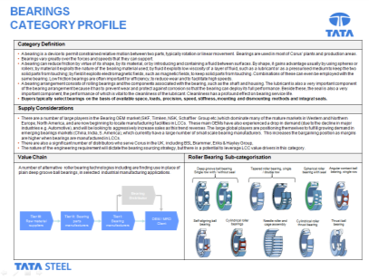
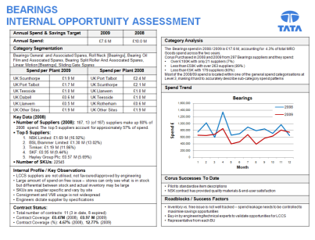
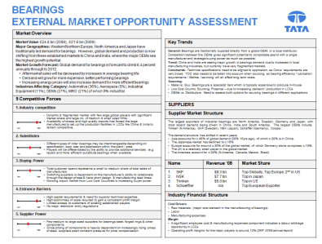
Where does it fit in?
The Industry analysis will usually form part of a larger opportunity analysis of a category or sub-category.
Lets take Bearings as an example...
Three documents were prepared to identify opportunities within the category
These provide background on the category (category profile), identify typical purchasing trends within the business (internal opportunity assessment) and investigate trends within the supplier markets (external market opportunity assessment)
Questions Answered
What are the different types of Bearings?
Which areas of the plant require Bearings?
What is the typical value chain for a Bearing?
Questions Answered
Which sites consume the highest number of Bearings?
Who are the key incumbent suppliers?
How much spend is under a contract?
How does demand vary over time?
Questions Answered
What is the industry structure and competitive landscape?
What are the current trends in the market?
How is the industry performing financially?
Who are the key players in the market ?

Slide 21










Bearings: Category Profile
Industry Analysis can answer several key questions concerning the competitive intensity, profitability trends and best practices in a certain market.
Category Definition
A bearing is a device to permit constrained relative motion between two parts, typically rotation or linear movement. Bearings are used in most of Corus’ plants and production areas. Bearings vary greatly over the forces and speeds that they can support. A bearing can reduce friction by virtue of its shape, by its material, or by introducing and containing a fluid between surfaces. By shape, it gains advantage usually by using spheres or rollers; by material it exploits the nature of the bearing material used; by fluid it exploits low viscosity of a layer of fluid, such as a lubricant or as a pressurised medium to keep the two solid parts from touching; by field it exploits electromagnetic fields, such as magnetic fields, to keep solid parts from touching. Combinations of these can even be employed with the same bearing. Low friction bearings are often important for efficiency, to reduce wear and to facilitate high speeds. A bearing arrangement consists of rolling bearings and the components associated with the bearing, such as the shaft and housing. The lubricant is also a very important component of the bearing arrangement because it has to prevent wear and protect against corrosion so that the bearing can deploy its full performance. Beside these, the seal is also a very important component, the performance of which is vital to the cleanliness of the lubricant. Cleanliness has a profound effect on bearing service life. Buyers typically select bearings on the basis of available space, loads, precision, speed, stiffness, mounting and dismounting methods and integral seals.
Supply Considerations
There are a number of large players in the Bearing OEM market (SKF, Timken, NSK, Schaffler Group etc.)which dominate many of the mature markets in Western and Northern Europe, North America, and are now beginning to locate manufacturing facilities in LCCs. These main OEMs have also experienced a drop in demand (due to the decline in major industries e.g. Automotive), and will be looking to aggressively increase sales as this trend reverses. The large global players are positioning themselves to fulfill growing demand in emerging bearings markets (China, India, S. America), which currently have a large number of small scale bearing manufacturers. This increases the bargaining position as margins are higher when bearings are manufactured in LCCs. There are also a significant number of distributors who serve Corus in the US, including BSL Brammer, Eriks & Hayley Group, The nature of the engineering requirement will dictate the bearing sourcing strategy, but there is a potential to leverage LCC value drivers in this category.
Value Chain | Roller Bearing Sub-categorization
A number of alternative roller bearing technologies including are finding use in place of plain deep groove ball bearings, in selected industrial manufacturing applications.
Deep groove ball bearing Single row with / without seal
Tapered roller bearing, single / double row
Spherical roller bearing with seal
Angular contact ball bearing, single row
Bearing Distributor
Tier III:
Raw material suppliers
Tier II: Bearing parts manufacturers
Tier I:
Bearing manufacturers
OEM / MRO Client
Self-aligning ball bearing
Cylindrical roller bearings
Needle roller and cage assembly
Cylindrical roller thrust bearing
Thrust ball bearing

Slide 22
Bearings: Internal Opportunity Assessment
Annual Spend & Savings Target |  | 2009 | 2008
Annual Spend: |  | $7.6 M | $10.0 M
Category Segmentation
Bearings General and Associated Spares, Roll Neck [Bearings], Bearing Oil Film and Associated Spares, Bearing Split Roller And Associated Spares, Linear Motion [Bearings], Sliding Gate Spares
Spend per Plant 2009 |  | Spend per Plant 2008
US Scunthorpe | $1.9 M | US Port Talbot | $2.4 M
US Port Talbot | $1.7 M | US Scunthorpe | $2.1 M
US Teesside | $1.0 M | US Llanwern | $1.0 M
US Dalzell | $0.6 M | US Teesside | $1.0 M
US Llanwern | $0.5 M | US Rotherham | $0.6 M
US Other Sites | $1.9 M | US Other Sites | $1.9 M
Key Data (2008) Number of Suppliers (2008): 187, 13 (of 187) suppliers make up 80% of 2008 spend. The top 5 suppliers account for approximately 57% of spend. Top 5 Suppliers: NSK Limited: $1.69 M (16.92%) BSL Brammer Limited: $1.30 M (13.02%) Timken: $1.19 M (11.86%) SKF: $0.95 M (9.44%) Hayley Group Plc: $0.57 M (5.69%) Number of SKUs: 22545
Internal Profile / Key Observations LCCS suppliers are not utilised, not favoured/approved by engineering Large amount of spend on free issue – stores can only see what is in stock but differential between stock and actual inventory may be large SKUs are supplier specific and vary by site Consignment and VMI usage is not widespread Engineers dictate supplier by specifications
Contract Status: Total number of contracts: 11 (3 in date, 8 expired) Contract Coverage: $0.47M (2008), $0.97 M (2009) Contract Coverage (%): 4.67% (2008), 12.77% (2009)
Category Analysis
The Bearings spend in 2008 / 2009 is $17.6 M, accounting for 4.3% of total MRO Goods spend across the two years. Corus Purchased in 2008 and 2009 from 297 Bearings suppliers and they spend: Over $100K with only 21 suppliers (7%) Less than $50K with over 263 suppliers (89% ) Less than $5K with 179 suppliers (60%) Most of the 2008/09 spend is located within one of the general spend categorizations at Level 3, making it hard to accurately describe sub-category spend patterns
Spend Trend
Corus Successes To Date
Pilot to standardize item descriptions NSK contract has provided quality materials & end-user satisfaction
Roadblocks / Success Factors
Inventory vs. free issue is not well tracked – spend leakage needs to be controlled to maximise savings opportunities Buy-in by engineering/technical experts to validate opportunities for LCCS Representative from each BU

Slide 23
Bearings: External Market Assessment
Industry Structure
Market Value: $24.8 bn (2008), $21.6 bn (2009) Major Geographies: Western/Northern Europe, North America and Japan have traditionally led demand for bearings. However, global demand and production is now shifting from these established markets to China and India, where the major OEMs see the highest growth potential. Market Growth Forecast: Global demand for bearings is forecast to climb 6.4 percent annually through to 2012. Aftermarket sales will be decreased by increases in average bearing life Demand will grow for more expensive, better performing bearings Increasing energy prices will also increase demand for more efficient bearings Industries Affecting Category: Automotive (36%), Aerospace (5%), Industrial Equipment (11%), OEMs (27%), MRO (21%) of which 9% Industrial
5 Competitive Forces
1. Industry competition
 | Dynamic & fragmented market with few large global players with significant market share and large no. of medium & small sized firms. Availability of cheap and high quality imports has forced the large manufactures to set up the production facilities in LCCs like China & India to remain competitive.
2. Substitutes
 | Different types of roller bearings may be interchangeable depending on specification, load, size and application within the plant / area. Players will be differentiated by the ability to provide additional services (e.g. repair) and more efficient substitute bearings when available
3. Buying Power
 | Total customer spend represents a small to medium share of total sales of manufacturers Switching suppliers is dependant on the manufacturer’s ability to collaborate through the design phase & have short design & manufacturing lead times. Growing import market from Low Cost Countries is increasing buyer power
4. Entrance Barriers
 | High capital requirements & need for superior technical expertise. High economies of scale required to gain a consistent profit margin Limited access to customers of existing established players No major restrictive entry regulations
5. Supplier Power
 | Few medium to large sized suppliers for bearings steel, forged rings & other components Since pricing of components is heavily dependent on increasingly rising prices of steel, suppliers exert constant pressure for price compensation
Key Trends
General: Bearings are traditionally supplied directly from a global OEM, or a local distributor. Competition between the OEMs gives significant potential to consolidate spend with a single manufacturer and leverage buying power as much as possible. Trend: China and India are seeing major growth in bearings demand due to increases in local manufacturing industries, but currently have very fragmented markets. Constraints: Technical specifications need to be aligned to application, as Corus’ requirements are very broad. TCO also needs to be taken into account when sourcing, as bearing efficiency / lubrication requirements / lifetime / servicing will all affect long term costs. Sourcing: Make vs. Buy: Bearings are a specialist item which is typically expensive to produce in-house Low Cost Country Sourcing: Potential – due to increasing demand / production in LCCs OEMs vs. Distributors: Need to assess both options for sourcing bearings in different applications
SUPPLIERS
Supplier Market Structure
The largest exporters of industrial bearings are North America, Sweden, Germany and Japan, with most recent demand being driven in China, India and South America. The largest OEMs include: Timken (N.America), SKF (Sweden), NSK (Japan), Schaffler (Germany), Cooper. The demand structure has shifted in recent years: Asia accounts for c.40% of global demand (30% 10yrs ago), of which c.20% is in China. The Japanese market has declined to c.15% Europe accounts for around c.30% of the global market, of which Germany alone comprises c.10%. The US is a relatively small player in the global market. The Americas account for c.30% (N.America, Canada, Mexico, Brazil)
Name | Revenue ‘08 | Market Share
SKF NSK Timken Schaeffler | $8.3 bn $7.7 bn $5.0 bn n/a | Top Globally, Top Europe, 2nd in US Top in Japan Top in US Top European Exporter
Industry Financial Structure
Cost Drivers Raw materials (major cost element in the manufacturing of bearings) Labor Manufacturing expenses Margin A significant employee cost & manufacturing expenses component indicates a labour arbitrage opportunity in LCCs Operating profit margins for the major players is around 12% (SKF 2008 annual report)
Low
High
Low
High
Low
High
Low
High
Low
High

Slide 24

Determining Industry Structure
The high level industry structure can be defined using freely available resources from the internet and key supplier websites.
Industry Structure
Industry Structure
Market Value: $24.8 bn (2008), $21.6 bn (2009) Major Geographies: Western/Northern Europe, North America and Japan have traditionally led demand for bearings. However, global demand and production is now shifting from these established markets to China and India, where the major OEMs see the highest growth potential. Market Growth Forecast: Global demand for bearings is forecast to climb 6.4 percent annually through to 2012. Aftermarket sales will be decreased by increases in average bearing life Demand will grow for more expensive, better performing bearings Increasing energy prices will also increase demand for more efficient bearings Industries Affecting Category: Automotive (36%), Aerospace (5%), Industrial Equipment (11%), OEMs (27%), MRO (21%) of which 9% Industrial
Key Sources:
Freedonia Group – World Bearings to 2014 - http://tinyurl.com/33h88z4
Hint: Although many companies offer market research reports, they often charge a hefty price for the privilege. However, these reports will often have detailed introductions to show the extent of the report, and these can be harvested for information. Other key market research companies include
SKF Group Investor Website – Bearings Industry Overview - http://investors.skf.com/en/industry-overview-and-competitors
Hint: Key suppliers will often publish information on their performance relative to the market competition. This can be used to extract information on growth forecasts and relative industry distributions.

Slide 25
Determining Competitive Forces
The high level competitive forces can also be defined using freely available resources from the internet and key supplier websites.
Industry Structure
5 Competitive Forces
1. Industry competition
 | Dynamic & fragmented market with few large global players with significant market share and large no. of medium & small sized firms. Availability of cheap and high quality imports has forced the large manufactures to set up the production facilities in LCCs like China & India to remain competitive.
2. Substitutes
 | Different types of roller bearings may be interchangeable depending on specification, load, size and application within the plant / area. Players will be differentiated by the ability to provide additional services (e.g. repair) and more efficient substitute bearings when available
3. Buying Power
 | Total customer spend represents a small to medium share of total sales of manufacturers Switching suppliers is dependant on the manufacturer’s ability to collaborate through the design phase & have short design & manufacturing lead times. Growing import market from Low Cost Countries is increasing buyer power
4. Entrance Barriers
 | High capital requirements & need for superior technical expertise. High economies of scale required to gain a consistent profit margin Limited access to customers of existing established players No major restrictive entry regulations
5. Supplier Power
 | Few medium to large sized suppliers for bearings steel, forged rings & other components Since pricing of components is heavily dependent on increasingly rising prices of steel, suppliers exert constant pressure for price compensation
Low
High
Low
High
Competition:
There are a few large global players who dominate the market and can use Low Cost Countries to keep prices down
Substitutes:
They key players offer some similar products, which would allow some substitution
Buying Power:
Average customer spend is only a small percentage of total sales, reducing buyer power
Entrance Barriers:
Bearings are manufacturing & technology intensive, therefore require significant up front investment
Supplier Power:
Bearings are primarily steel, therefore tied to commodity prices which are not controlled by suppliers. Some suppliers can tie buyers into branded products through specific process technologies
Low
High
Low
High
Low
High

Slide 26
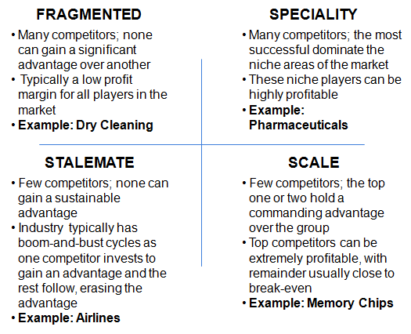


Determining Key Trends
To determine the industry trends we can apply the principles of the Trend Matrix.
Key Trends
General: Bearings are traditionally supplied directly from a global OEM, or a local distributor. Competition between the OEMs gives significant potential to consolidate spend with a single manufacturer and leverage buying power as much as possible. Trend: China and India are seeing major growth in bearings demand due to increases in local manufacturing industries, but currently have very fragmented markets. Constraints: Technical specifications need to be aligned to application, as Corus’ requirements are very broad. TCO also needs to be taken into account when sourcing, as bearing efficiency / lubrication requirements / lifetime / servicing will all affect long term costs. Sourcing: Make vs. Buy: Bearings are a specialist item which is expensive to produce in house Low Cost Country :Potential – due to increasing demand / production in LCCs OEMs vs. Distributors: Need to assess both options for sourcing bearings in different applications
Industry Structure
Determining Trends
Fragmented Market? No. Only markets in China and India are fragmented, the wider market is relatively consolidated
Specialty Market? No. Key players can cater to all areas of the Bearings Market
Stalemate Market? No. There are a small number of large players with a significant advantage over smaller companies and consistent sales
Scale Market? Yes. The few successful companies in the industry hold a significant advantage over the group and are very profitable
“If the market is focused on scale, align with the winners”

Slide 27

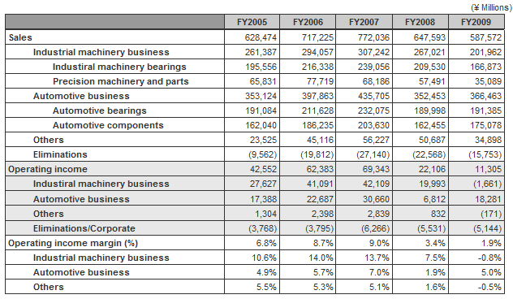
Determining Supplier Financials
To determine the industry Structure we can look at company financial statements.
Name | Revenue ‘08 | Market Share
SKF NSK Timken Schaeffler | $8.3 bn $7.7 bn $5.0 bn n/a | Top Globally, Top Europe, 2nd in US Top supplier in Japan Top in US Top European Exporter
Industry Structure
It is often hard to find the complete cost breakdown for a product through public resources (companies like to keep this a secret…), but it is usually possible to find the revenue and total profit made by a company
From the NSK global website it is possible to download the company financial highlights over a number of years.
Revenue (Sales) in 2008 was 647,593 Million Japanese Yen. Standardising this to US Dollars as a common currency gives $7.7bn
Profit (Operating Income) was 22,106 Million Japanese Yen. This gives $265M.
The percentage profit (Operating Income Margin (%)) is 3.4% in 2008
This also provides the information required to identify trends over different years

Slide 28
Conducting Sourcing Analysis
1
Industry analysis
  Developing Industry Analysis
  What can Industry Analysis tell us?
  Determining Industry Structure
  Measuring Industry Financials
  Identifying Industry Trends & Dynamics
  Identifying Leading Practices
Supplier Analysis
  Developing Supplier Analysis
  What can Supplier Analysis tell us?
  Assessing Supplier Capabilities
  Identifying Supplier Positioning
  Measuring Supplier Financials
Category Opportunity Assessment Example
  Where does Industry and Supplier Analysis fit in?
  Bearings Category Profile Example
TCO Analysis
  Develop Total Cost of Ownership Model
2
3
4

Slide 29
Total Cost of Ownership (TCO) Model
As part of the category profile, a model must be developed that breaks down the components that make up the total cost of the goods and / or services within the category. The TCO model can be used identify opportunities to lower these costs.
Spend
Operational Purchasing Costs
Most procurement professionals target price. There are numerous leverage points to enhance the negotiation of the final transaction price.
Administrative people and systems are involved to order, receive and pay the purchased goods and services. Simplified or automated processes reduce the total cost of ownership.
Volume leverage
Rebate management
Performance, incentive structure
Gain sharing
Guaranteed reductions
Freight (consolidated orders)
Lease vs. Buy
Consolidated invoicing
eProcurement
Purchase order processing
Receiving
Stockless inventory
Performance reporting
Payables
Quality
Total
Cost of
Ownership
Storage and Handling Costs
All TCO components typically offer opportunities for benefits
The way in which materials are used and disposed of represents one of the largest potential sources to reduce the total cost of ownership.
Elimination
Demand management
Standardization
Product specifications
Extended life products
Supplier provided services
Product design
Transportation
Recycle / Reuse
Scrap
Functional equivalents / substitutes (e.g., generics)
6
TCO = Total Cost of Ownership - all costs, both direct and indirect, associated with a category that are incurred over the life of the material/service. These costs may include price, acquisition costs, taxes, operating costs, maintenance, holding, disposal costs, etc.

Slide 30
Develop Total Cost of Ownership (TCO) Model
The total cost of ownership is a method of determining all costs associated with obtaining and using a product or service.
— Cost Elements vs. Cost Drivers —
EXAMPLE
 |  | What are they? |  | Examples
COST ELEMENTS |  | Components of total cost of ownership (TCO) – “buckets” of cost that can be quantified |  | Price Transportation costs Purchasing administration costs Inventory costs Supplier certification costs
COST DRIVERS |  | Cost Drivers are factors or activities that can be changed and have an impact on the magnitude of the cost element. They can at times be significant sources of savings for some categories |  | Specification Distance shipped Number of suppliers Number of purchase orders
Drivers of cost within suppliers’ operations can be very important for categories where unit price is still likely to be the largest component of our total cost.

Slide 31
Develop Total Cost of Ownership (TCO) Model
Use the TCO cost elements and drivers to identify the actions that will result in sourcing savings.
EXAMPLE
– Cost Elements vs. Cost Drivers –
INTERNAL AQUISITION COST
COST ELEMENTS
TRANSPORT-
MATERIALS
QUALITY
INVENTORY
MAINTENANCE
ATION
MANAGEMENT
COSTS
CARRYING
COST
COST
COST
Transport Distance
Number Of Suppliers
Supplier Certification
Inventory Levels
Reliability
COST DRIVERS
Transport Mode
Number Of Stock
Incoming Quality
Planning Stability
Maintenance
Locations
Practices
Order And Payment
Process
POTENTIAL ACTIONS
Local Suppliers
Supplier Reduction
SPC Training At
Just-In-Time
Sourcing
"Milk-run" To
Ship Direct To Line
Suppliers
Deliveries
Specs/Sources
Suppliers
Redesign Processes
Eliminate Incoming
New Planning
Implementing
Managed Freight
Inspection
Tools
Predictive
Maintenance

Slide 32
Agenda
Conducting Sourcing Analysis
Data Management Methods
Creating & Analyzing RFIs & RFPs
Preparing for Fact Based Negotiations
Appendix

Slide 33
Data Management Methods
1
Prioritizing Line Item Data for Solicitations
2
Example of the Prioritization Method

Slide 34
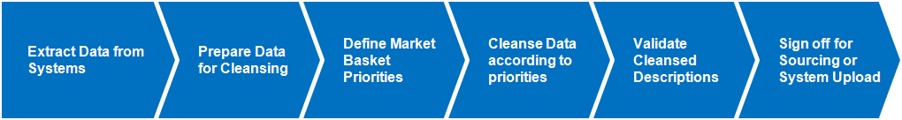
Data Cleansing Process
Data cleansing is intended to improve the level of visibility into spending details and patterns.
Step 1: Extract data from system(s)
Step 2: Prepare and prioritize data for cleansing
Step 3: Define a “Market Basket” and priority materials for cleansing
Step 4: Cleanse Priority Data
Step 5: Validate Cleansed Descriptions
Once data is cleansed and the new descriptions are validated the data can be put forward into a formal RFx process

Slide 35
How Do You Fit Into the Process?
Master Data Cleansing involves a number of different people from Procurement, including data analytics resources.
Process Element | Extract Data | Prepare Data | Define Market Basket | Cleanse Descriptions | Validate Cleansed Descriptions | Sign off
Category Manager | Consulted | Consulted | Accountable | Consulted | Accountable | Accountable
Stakeholders | Informed | Informed | Consulted | Consulted | Responsible | Responsible
Sourcing Analyst | Responsible | Responsible | Responsible | Responsible | Informed | Informed
Responsible: Those who undertake the work to achieve the task
Accountable: Those who are ultimately accountable for the correct and thorough completion of the deliverable or task, and the one to whom Responsible is accountable
Consulted: Those whose opinions are sought; and with whom there is two-way communication
Informed: Those who are kept up-to-date on progress, often only on completion of the task or deliverable; and with whom there is just one-way communication

Slide 36
Data Extraction
Data extraction is the first step in the process to creating a market basket and provides a base for all further calculations.
The basic data used for the cleansing exercise are the business intelligence reports which draw on the data in the purchasing systems. Vendor reports can also be used for this exercise. The following list highlights the key fields required for cleansing, depending on the category:
Material #
Material Short Description
Material Long Description
Site
Material Group
Last Price Paid
Contract #
Purchase Order Volume
Stores Consumption

Slide 37
What is a Market Basket?
The market basket approach is used to evaluate the pricing differences between a group of suppliers, based on a representative sample of items that are purchased.
This approach allows you to determine which supplier(s) have the best pricing in the market, and shortlist (where applicable) a group of suppliers to assess based on additional services
The creation of market baskets takes place as part of the seven step sourcing process, which will involve going out to bid on a number of items with multiple suppliers
A market basket is the list of items that have been chosen to include in a pricing evaluation, and therefore it forms part of an RFP
Suppliers with the most competitive pricing are identified using an RFP. At which point, negotiations can take place to define the additional services and agreements that may be part of a contract

Slide 38
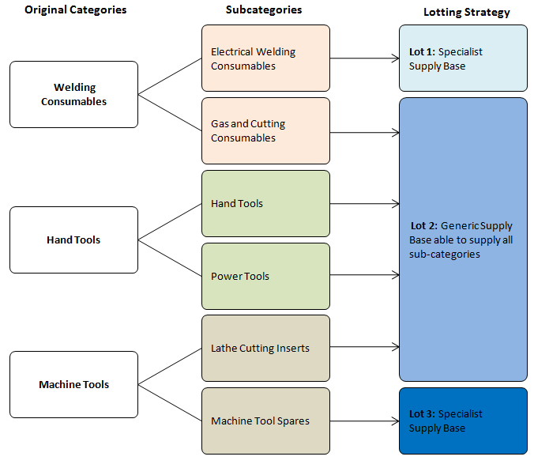
RFP Lotting Strategies
Depending on the type of goods or services in the solicitation, it is often sensible to group (lot) and award the items depending on who can supply them in the market.
Example Lotting Strategy:
In this example there are three MRO categories which have been split for cleansing
Industry research and supplier analysis are used to identify key capabilities within the supply market and group the subcategories according to this distribution
The market research indicated that Electrical Welding Consumables and Machine Tool Spares are a specialist subcategories, and therefore merit their own category lot
The remainder of the subcategories are offered by a number of MRO distributors in the marketplace, and therefore can be grouped together to leverage their combined value.

Slide 39
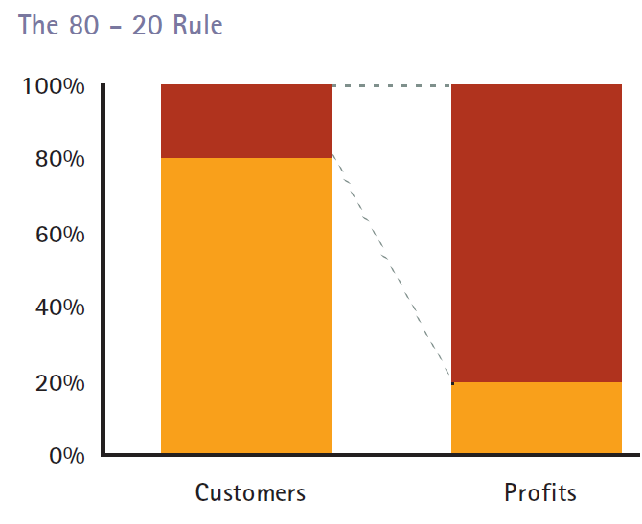
Data Prioritization Methods – The Pareto Principle
Once the market capabilities and lotting strategy have been defined, the data must be prioritized for cleansing.
To prioritize the data, we can use the Pareto Principle…
The Principle states that, for many events, roughly 80% of the effects come from 20% of the causes.
The principle is often applied to business situations, as it allows the prioritization of the ‘vital’ data which accounts for the majority of the results
It can also be applied to other areas. For Example:
  The values of oil reserves in oil fields – 80% of Oil Reserve Value is in 20% of Fields
  In procurement it can generally be said that 80% of spend will be accounted for by 20% of the items purchased
The Pareto Principle
Items
Spend

Slide 40
Data Management Methods
1
Prioritizing Line Item Data for Solicitations
2
Example of the Prioritization Method

Slide 41
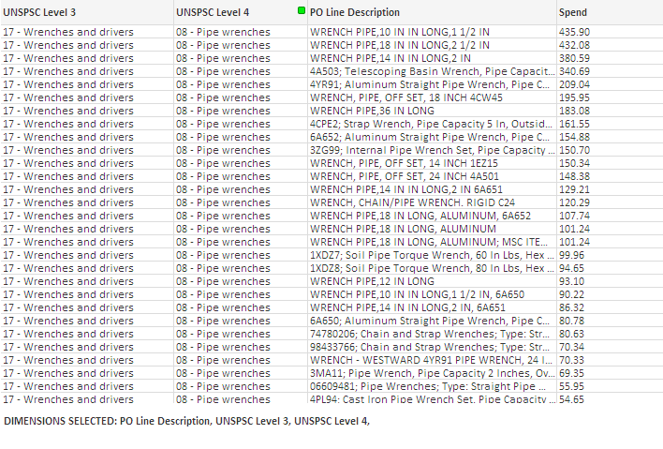
Ensure Data Has Item Level Detail
Step 1: Ensure that your data contains spend at the item level.
Step 2: Sort the items on spend high to low.
829.09

Slide 42
Assess Wrongly Classified or One-Off Spend
Step 3: Cleanse list of wrongly categorized items of high value that will skew the distribution.
If there are any high value items that are wrongly classified in the category, they will skew the 80:20 distribution and could mean that fewer items are prioritized.
To overcome this problem, it is a good rule of thumb to investigate the highest value items to ensure that they are not wrongly categorized.
Lower value items will not have such an immediate impact on the prioritization, and can be dealt with at a later stage.

Slide 43
Remove Erroneous Line Items
Step 4: Remove any items which may skew the Pareto Analysis.
829.09

Slide 44

Data Prioritization Walk Through
Step 5: Identify the 80:20 (Pareto) split within the data.
Step 6: The items which are outlined in green fall into the top 80% of spend, and therefore would be prioritized for cleansing or the next steps of the solicitation.
829.09

Slide 45
Agenda
Conducting Sourcing Analysis
Data Management Methods
Creating & Analyzing RFIs & RFPs
Preparing for Fact Based Negotiations
Appendix

Slide 46
Creating & Analyzing RFIs / RFPs
1
What are the key solicitation documents?
How do they fit into the Sourcing Process?
Why use an RFI or RFP?
How do you fit into the process?
2
Typical Document Structure
Hypothesis Driven Analysis
Identifying Selection Criteria
Weighting Selection Criteria
Removing price from negotiations
Supplier Relationship Management
3
Focus on document questionnaires
  Financials Analysis
  Commercial Capabilities
  Technical Capabilities
4
Focus on Contract Award Scenarios

Slide 47
Key Solicitation Documents
There are multiple way to conduct a competitive process and engage with the market; collectively these are referred to as “RFx.”
Competitive Approach
Description
RFI – Request for Information
Purpose – To obtain general information from suppliers; to develop list of qualified suppliers or to down-select prior to pricing solicitation
Used For – Any product, service, or category
Specifics – Not binding on the UC or a supplier, used prior to strategy development or prior to solicitation
Used when seeking insight from supplier community that is not otherwise available, or when looking to identify qualified suppliers
RFC – Request for Comment
Purpose – To obtain comments from suppliers on a specific subject or approach to be used in a future competitive event
Used For – Any product, service, or category
Specifics – Not binding on the UC or a supplier, used subsequent to strategy development and prior to solicitation
Used when attempting an innovative or non-traditional sourcing strategy, or diverging from historic sourcing strategies
Key Success Factors
RFQ – Request for Quote
Purpose – Invite suppliers to provide a quote for products or services
Used For – Highly Standardized or Commoditized Products or Services (Example: Tires)
Specifics – Product Specifications, Payment Terms, Contract Length
Requests – Price per item
Used when Price is the only factor

Slide 48
Key Solicitation Documents
Continued from previous slide.
Competitive Approach
Description
RFP – Request for Proposal
Purpose – Invite suppliers to bid on products or services
Downfall – Lengthier than other methods
Benefits – Request and receive details on important qualitative selection factors; Evaluation considers input from a broad spectrum of functional experts ensuring that the solution chosen will suit requirements
Used when quality is an important factor in supplier selection
Reverse Auction
Purpose – Drive incremental benefit through real-time competition
Specifics – Conducted on an eProcurement platform; conducted after a list of qualified suppliers has been developed using an RFx
Used when market conditions create a competitive environment, there are at least three suppliers included in the event; buyer requirements are clearly defined
FBN – Fact Based Negotiation
Purpose – Fact based method to achieve favorable pricing and terms for products and services
Used – As part of a broader sourcing strategy; After a qualification event, competitive event such as an RFP or reverse auction
Specifics – Address multiple issues:
– Takes multiple interests and viewpoints into account
– Uses benchmarks
– Outcomes dependent on data and facts presented

Slide 49
How Does This Fit Into the Sourcing Process?
RFIs and RFPs are the first direct market engagement in the Seven Step Sourcing process, and allow the category manager to understand current industry capabilities.
> RFIs & RFPs are conducted at the step 5 in the Sourcing process; following the development of a category sourcing strategy based on internal and external analysis
Data Collection & Analysis
Opportunity Development & Negotiation
Implementation
Step 1
Step 2
Step 3
Step 4
Step 5
Step 6
Step 7
Identify Opportunities
Develop Category Profile
Develop Sourcing Strategy
Identify Selection Factors & Screen Suppliers
Conduct RFI / Auction
Develop & Negotiate Agreements
Implement Agreements
Gather High Level Spend
Identify & Prioritize Opportunities
Develop High Level Category Segmentation Approach
Estimate Opportunity & Finalize Project Plan
Identify Team & Mobilize Project
Category Sourcing Initiative
Define Data Collection Approach
Map Procurement Flow
Evaluate Category Importance
Measure Customer Values
Understand Total Cost of Ownership
Determine Industry Structure
Measure Industry Financials
Identify Industry Trends / Dynamics
Identify Industry Leading Practices
Assess Supplier Capabilities
Identify Supplier Positioning
Measure Supplier Financials
Determine External Supply Market Strategy
Define Internal Change tactics
Define Category Baseline
Category Sourcing Strategy report
Determine Approach
Pre-qualify Suppliers (RFI)
Financial Analysis
Develop RFP Selection Model
Manage Communication
Answer Questions
Review RFP Responses
Verify and Analyze Capabilities
Prepare Implementation Plan
Prepare Financial Analysis / Fact Based Negotiation Case
Prepare for Negotiations
Negotiate Business Agreement
Document Results Achieved
Finalise Implementation Plan
Develop Communication Strategy
Define Performance Measurement
Document Implementation Plan
Implement Program
Value Tracking

Slide 50
Narrowing Down a Large Group of Suppliers
In addition to providing information on industry capabilities, RFIs and RFPs can be used to filter out unsuitable candidates based on a set of business requirements.
Large Supplier pool identified
Screen 0
Minimal Requirements
Obvious criteria - easy kills (too small, no capacity,
unwilling to meet supply conditions…)
Screen I
Request for
Information (RFI)
Brief questionnaires that screen a large number
of suppliers on the physical ability to meet needs
Request for
Proposal (RFP)
Detailed proposal from suppliers as to how they intend
to provide the quality required at a reasonable cost
Screen II
Screen III
Site Visits/
Verification
Ability to meet/exceed service levels and add value
Negotiation Preparation

Slide 51
How Do You Fit Into the Process?
The role of the Analyst can vary depending on the engagement, but will include a number of standard elements.
Activities
Category Manager
Sourcing Analyst
Identify and give weight to decision criteria
Identify and give weight to decision criteria
Develop calculation model
Develop calculation model
Develop RFP Selection Model
Manage Communications
Develop a communication plan for suppliers
Develop a communication plan for suppliers
Complete RFP
Complete RFP template
Issue RFP to suppliers
Complete RFP template
Issue RFP to suppliers
Answer
Questions
Answer suppliers questions regarding RFP
Answer suppliers questions regarding RFP
Review & Compile Responses
Receive and compile responses
Receive and compile responses
Verify & Analyse Capabilities
Measure suppliers against standards and expectations
Measure suppliers against standards and expectations

Slide 52
Creating & Analyzing RFIs / RFPs
1
What are the key solicitation documents?
How do they fit into the Sourcing Process?
Why use an RFI or RFP?
How do you fit into the process?
2
Typical Document Structure
Hypothesis Driven Analysis
Identifying Selection Criteria
Weighting Selection Criteria
Removing price from negotiations
Supplier Relationship Management
3
Focus on document questionnaires
  Financials Analysis
  Commercial Capabilities
  Technical Capabilities
4
Focus on Contract Award Scenarios

Slide 53
Typical RFP Structure
There are three key sections to an RFP, which provide context to the solicitation and lay out the commercial and technical specification which will be assessed.
The Document Overview
  This will include a set of general instructions
  A non-disclosure agreement
  An intent to bid form
  A set of purchasing terms and conditions
  Site locations
  The Commercial Offering
    A bidder pricing sheet to capture item level prices
    Total cost of ownership reduction proposals
  The Technical Assessment
    A bidder questionnaire to capture technical capabilities
    A technical expertise proposal section
    Service level agreements and supplier performance

Slide 54
Typical Document Structure
The following outline structure is common to many Direct Materials RFPs and contains sections which are also used in the RFI process.
Section | Purpose | Document
1. General Instructions | Summary of the scope & objectives of the sourcing project, and response guidelines | RFP & RFI
2. Non Disclosure Agreement | Legal agreement that bidders will not share any confidential data with third parties | RFP & RFI
3. Intent to Bid | Up front confirmation that bidder intends to respond to the RFP, allowing sourcing team to plan for evaluation | RFP
4. Purchase terms & Conditions | Definition of standard purchasing terms and conditions which the bidder must agree to | RFP
5. Delivery Site Locations | Define all potential delivery sites across the US to assess bidder ability to supply multiple locations | RFP & RFI
6. Bidder Pricing Sheets | Determine best price per item, lead time per item, any alternative products available | RFP
7. Total Cost of Ownership Proposals | Forum for bidders to present a number of proposals for delivering savings and improving the current state of operations | RFP
8. Bidder Questionnaire | Determine whether the bidder can fulfil the business requirements for the sourcing project (RFI), or answer detailed questions on how they propose to implement a solution (RFP) | RFP & RFI
9. Technical Expertise Proposals | Section to assess bidder ability to provide on-site technical expertise. This could include the execution of product trials, direct end user support, product recommendations or root cause failure analysis. | RFP
10. Service Levels & Measures of Performance | Summary of expected service levels and performance measures which will be included in any resulting contract | RFP
11. Glossary of Terms | Description of any non-standard terminology used in the document | RFP & RFI
Overview
Commercial
Technical

Slide 55
Starting With the End in Mind...
The analytic process should start with a basic hypothesis or set of questions which then shapes the design of the RFI & RFP questionnaires.
“There is an opportunity to reduce complexity and increase value delivery by bundling spend across categories with industrial products distributors and make use of value added services to reduce total cost and improve service”
Hypothesis
Questions & Analysis
Are there companies who are able to provide multiple MRO categories?
Do these companies offer value adding services?
Metrics & Weighting
Categories supplied, Geographic capability, Lead times, Financial Health; SAP Integration, Consignment Stock, VMI, Bar-coding, Technical Expertise
Design
Design the solicitation document capture these metrics in a manner which will be easily comparable; focusing on the key requirements
Evaluation
Evaluate supplier capability to bundle multiple categories to university sites and assess their additional value adding capabilities to prove or disprove the initial hypothesis

Slide 56
Identifying Selection Criteria
A set of selection criteria must be defined according to the analytical process which meet the business requirements for the sourcing project.
Identify Potential Selection Criteria
Select and Rank Criteria
Weight Criteria according to importance
Develop the selection model
Hypothesis
Questions
Weighting
Design
The following sources of information can be used to identify and weight selection factors for a particular sourcing process
Additional Requirements
$4.5K
$4.5K
Training
Training
-
-
$5.5K
$5.5K
Distribution
Distribution
-
-
$62.1K
$62.1K
$52.1K
$10K
$48.1K
$4.0K
Other
$10K
Inv/ Quality
$4.4K
Minimal Requirements
Minimal Requirements
Request for Quotation
$44.4K
$47.7K
$0.2K
QA/Inspection
$4.4K
-
Materials Mgt.
$3.3K
$39.4K
$0.2K
FDA Prep
$3.3K
$0.5K
Supplier Payment
-
-
Retainer
$5.0K
$0.1K
PO Prep
$5.0K
$5.0K
Retainer
-
-
$0.5K
Receiving
$1.1K
-
-
Misc.
$2.2K
Dev./Planning
$1.5K
-
-
Transportation
Supplier/
Purc Price
$5.8K
-
$39.4K
Design/Dev.
$39.4K
$31.0K
-
Remove Requirements
that are not
applicable
Production
Supplier/
Agency
Materials
Quality
Inventory
Other
Total
Purchase
Retainer
Management
Costs
System
Price per
Fee
Cost
Average
Quality
Order
Minimum Requirements
Internal Customers : Values
Inventory
Total Cost of Ownership

Slide 57
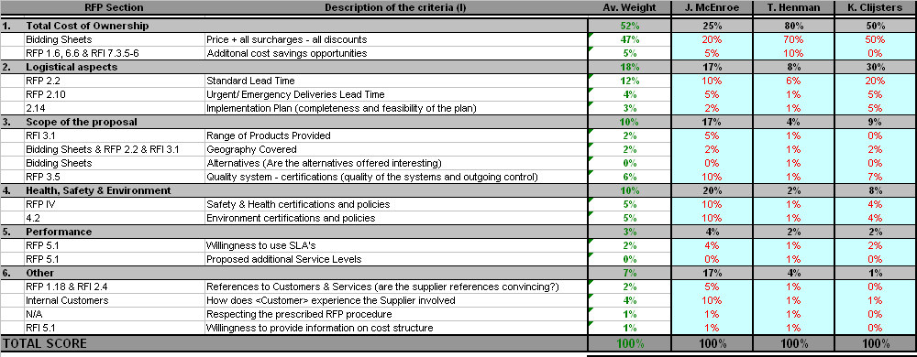
Weighting Selection Criteria
The criteria that have been identified are weighted according to relative importance as determined by key stakeholders in the business.
> The weighted criteria are determined and used to calculate an overall score for potential suppliers during the selection process

Slide 58
“10-4” Process
After relevant high-level and detailed sub-criteria are identified, the Evaluation Committee can use a “10-4” process to select, rank and weight the high-level and sub-criteria.
Post all high-level criteria
Each Evaluation Committee member is allotted 1,000 points to “spend” on any of the criteria; nobody can spend more than 400 points on any one criteria (except Price)
After all the points are “spent,” they are added up for each criteria and then graphed in descending order of total votes (Pareto Chart)
Evaluation Committee determines where to draw the line to eliminate criteria (e.g., remove ones with few to no votes)
Evaluation Committee then determines the weight of each remaining criteria, using the ranking and total votes received as a guide (sum of all weights must equal 100%)
After high-level criteria are weighted, Evaluation Committee repeats process for detailed sub-criteria in each weighted high-level criteria
Points
Criteria
Ranking
Decide where this line will be drawn (e.g., what is “in” and “out”)
Weighting

Slide 59
Example Weighting Selection Exercise
A group exercise involving all necessary stakeholders can be used to determine the weighting criteria for a category.
Divide the group into teams and use a matrix to determine how important people feel each group of questions is in relation all others.
Each team will complete a matrix by giving a high score if the metric is more important, and a low score if it is less important.
The scores will then be consolidated to determine the weighting.
An illustrative matrix is shown below, and the following scoring system has been applied:
0 – much less important;
1 – less important;
2 – equally important;
3 – more important;
4 – much more important

Slide 60
Example Weighting Selection Exercise
The results of the weighting exercise will ensure that the sections which are most important to the stakeholders will be given more weight in a decision process.
The following weightings will then be applied to each section score in the RFP
#
Evaluation Criteria
Weighting
1
Price
9.5%
2
Ability to meet stated Business requirements
8.1%
3
Financial stability
8.0%
4
Operational excellence
8.0%
5
Track-record
6.8%
6
Regulatory Compliance
6.6%
7
Best Practice
6.6%
8
Systems Integration
6.5%
9
Supplier footprint close to our locations
6.1%
10
Local access to spare parts
5.6%
11
Contracting
5.4%
12
Capability across different vendor equipment
5.1%
13
Responsiveness
4.2%
14
Sub-contracting relationships
4.1%
15
Change Orientation
3.3%
16
Cultural and organizational fit
3.2%
17
Value added services
3.0%

Slide 61
Evaluation Approaches
The two key elements of the RFP which we can use to evaluate a supplier’s suitability are the Technical Capabilities and the Commercial Offering – which require two different approaches.
Commercial
Offering
Bidder Pricing Sheets used to assess the suppliers relative pricing on a set of items
If it is felt that the suppliers are bidding above a fair market price for the items, a reverse auction (eAuction) can be used to drive prices down to a reasonable level
TCO proposals are assessed independently.
Result: Price is removed from the negotiations – focus is on service and technical capability
Technical
Capabilities
Section weighting criteria are applied to the supplier responses where a numerical answer is provided
Non-numerical sections are scored based on relative offering
The most suitable supplier is selected based on technical capability and additional services
Result: Award decision is focused on added value which a supplier can provide beyond purchase price

Slide 62
Typical Award Scenarios
Once the responses have been evaluated the contract will be awarded based on a predetermined award scenario which is focused on the category objectives.
Sample Award Scenarios
Description
Considerations
The combination of lots and bundles which provides the lowest overall price – regardless of supplier
This approach would optimize unit prices, but this may compromise operational efficiency by working with many suppliers
Lowest Price
1
The most advantageous balance of price/cost, quality, service performance and other elements. Evaluators will determine the Proposals’ value by scoring the Proposals based on a uniform set of weighted evaluation criteria. Each Proposal’s Best Value score will be the average of all evaluators’ total scores awarded for the Proposal
This approach would optimize contract award based on price and long term value and additional services
Best Value
2
Low Cost Per Quality Point
Evaluators will determine each Proposal’s quality point score by scoring the Proposal based on a uniform set of weighted evaluation criteria. The Proposal’s Quality Point Score will be the average of the evaluators’ total scores awarded for that Proposal. Each Proposal’s Total Cost will be divided by its Quality Point Score
This approach would optimize the qualitative portion of the proposal response, while evaluating the total cost.
3
Detailed descriptions of the Best Value and Low CPQP award scenarios have been downloaded from SRS and embedded here

Slide 63
Best Value Example
The example below illustrates how the evaluator would determine Best Value using a total points value of 20,000 across all criteria.
Criteria | Weight | Points |  | Bidder 1 | Bidder 2 | Bidder 3
Management | 75% | 3,750 |  | 1,000 | 2,500 | 1,500
Customer Service |  | 3,750 |  | 1,000 | 2,500 | 1,500
Delivery |  | 3,750 |  | 1,000 | 2,500 | 1,500
Breadth of Product |  | 3,750 |  | 1,000 | 2,500 | 1,500
Price | 25% | 5,000 |  | $10,000 | $20,000 | $30,000
Totals | 100% | 20,000
Criteria
Example Scoring
Criteria | Bidder 1 | Bidder 2 | Bidder 3
Cost Ratio | 1.00 | 0.500 | 0.33
Cost Points | 5,000 | 2,500 | 1,667
Total QP Points | 4,000 | 10,000 | 6,000
Total Points | 9,000 | 10,000 | 6,000
Rank | 2 | 1 | 3
Cost Ratio = Total Cost/Lowest Cost
Cost Points = Cost Ratio * Price Points
Total Qualitative Points (Mgmt., Cust. Svc, etc.)
Total Points = Qualitative Points + Pricing Points

Slide 64
Cost Per Quality Point Example
The example below illustrates how the evaluator would determine Cost Per Quality Point using a total points value of 20,000 across all criteria.
Criteria | Weight | Points |  | Bidder 1 | Bidder 2 | Bidder 3
Management | 25% | 5,000 |  | 1,000 | 2,500 | 1,500
Customer Service | 25% | 5,000 |  | 1,000 | 2,500 | 1,500
Delivery | 25% | 5,000 |  | 1,000 | 2,500 | 1,500
Breadth of Product | 25% | 5,000 |  | 1,000 | 2,500 | 1,500
Totals | 100% | 20,000
Example Quality Points (QP)
Criteria
Criteria | Bidder 1 | Bidder 2 | Bidder 3
Cost | $10,000 | $20,000 | $30,000
Total QP Points | 4,000 | 10,000 | 6,000
Cost Per Quality Point | $2.50 | $2.00 | $5.00
Rank | 2 | 1 | 3
Cost per Quality Points = Total Cost / Total # Quality Points

Slide 65


Removing Pricing from the CPQP Equation
By requesting prices for items up front in a bidder pricing sheet it is possibly to focus the rest of the solicitation process on the Commercial and Technical Capabilities.
> Item prices are requested at the RFP stage
> Bidders are asked to complete a bidder pricing sheet detailing item prices and lead times
> This data is then evaluated by the Sourcing Analyst to determine the relative prices of each supplier
Data Provided to the Bidder
Data Requested from the Bidder

Slide 66
Supplier Relationship Management
How do you fit into the process?
A Sourcing Analyst contributes to each of the four primary steps in the Supplier Relationship Management process
1.0 Segment Suppliers
2.0 Onboard Suppliers
3.0 Manage Supplier Performance
4.0 Manage Supplier Continuous Improvement
& Collaboration
1.2 Develop Supplier Segmentation Strategy
2.1 Develop Supplier Integration Plan
3.1 Evaluate Supplier Performance
4.1 Establish / Sustain Supplier Collaboration
1.3 Evaluate Supplier Performance Metrics
2.2 Integrate Supplier
3.2 Manage Supplier Performance
4.2 Recognize Supplier Performance
1.4 Develop Non- Performance Tracking Tools
3.3 Manage Supplier Issues
1.5 Socialize Category Strategy w/ Suppliers
Analyst Responsibilities:
Gather supplier data in order to conduct the segmentation process
Identify data sources for Supplier Performance metrics
Support Supplier Scorecard development
Gather supplier data
Populate the Supplier Scorecard
Help identify areas of opportunity for supplier improvement
Monitor supplier performance data (i.e., ongoing areas of opportunity)
Gather supplier data to support continuous improvement opportunities

Slide 67
Supplier Segmentation Approach
Leading procurement organizations segment their suppliers based on financial impact and qualitative and complexity factors, and then manage each segment differently.
Financial Criteria to Consider
Category Spend: What is the relative size of spend in category?
Is the category subject to price volatility?
Qualitative Criteria to Consider
Cost Engineering: What is the importance and / or value of cost engineering (cost drivers)?
Joint Business Planning: What is the importance and/or value of joint business planning?
Innovation: What is the level of customization for products?
Industry: Is production capacity constrained within this industry? Are there few competitors within industry?
Smallest Number of Suppliers
Key Characteristics of Each Tier
Tier A
(Strategic)
Provides the greatest potential value to UC
Poses the highest potential risk to UC
Focuses on building and maintaining mutually beneficial relationships
Tier B
(Collaborative)
Provides moderate potential value to UC
Poses moderate risk to UC
Seeks to collaborate with suppliers as needed to deliver value
Tier C
(Transactional)
Provides products or services that are lower in spend and are not critical to the operations of UC or delivery of critical services
Focuses on transaction efficiency versus relationships
Larger Number of Suppliers

Slide 68
Supplier Segmentation Approach
There is a defined supplier relationship management approach for each supplier tier.
Supplier Tier | Supplier Relationship Lead | Interaction Depth and Frequency | Supplier Evaluation | Supplier Product / Service Roadmap Discussion | Contract Monitoring
Tier A | Category Management & Sourcing Director or Category Manager | Quarterly face-to-face meeting, or more frequent if needed Attended by CPO and senior supplier leadership | Supplier Quarterly Scorecard Authorized User annual supplier performance surveys | Annual | Monthly monitoring and management of Service Level Agreements Quarterly monitoring and management of Authorized User compliance
Tier B | Category Lead Contract Specialist | Annual conference calls Attended by Category Manager | Supplier Annual Scorecard | As needed | As needed
Tier C | Contract Specialist | Email Only as needed | Exception only | Exception only | Exception only
COE Team Members are expected to understand what type of suppliers are in their portfolio, segment them appropriately, and drive strategies to lower cost while improving quality

Slide 69
Supplier Segmentation Approach
UC Procurement can use the segment approach to evaluate its suppliers and develop supplier relationship management plans.
Smallest Number of Suppliers
Suppler Segmentation at UC
When preparing to conduct a sourcing event, it’s important COEs think ahead to which segment the resulting suppliers belong
Determining a supplier segment early on can help
  Define service level requirements
  Reduce risk
  Ensure contract users have the right relationship with their suppliers
Segmentation is an important input into the profile, and ultimately the sourcing strategy
Tier A
(Strategic)
Tier B
(Collaborative)
Tier C
(Transactional)
Thought Exercise: Which quadrant might these suppliers be in?
Small Regional Office Supplies Company
National Advertising Agency
Large Fuel Distributor
IT Hardware Supplier
Specialized Medical Supply Company
Large IT Consulting Firm
Regional Car Dealership
National Food Distributor
Larger Number of Suppliers

Slide 70
Supplier Performance Management
A Supplier Performance Scorecard is an effective way to measure and communicate supplier performance requirements / expectations
Criteria used when evaluating the suppliers’ responses during the solicitation process are often good candidates to include on the Supplier Performance Scorecard
Service Level Agreements contained in the contract, which reflect what is important to UC and users of the contract, are typically included on the Supplier Performance Scorecard to support regular monitoring
Supplier Performance Scorecard can also include elements that are important to the supplier (e.g., average order size, catalog utilization, invoice payment, p-card usage)
Each element on the Supplier Performance Scorecard should have a target level and clear description of how it is calculated, including source of data and party responsible for reporting
Potential Supplier Performance Scorecard elements include:
  Total Spend on Contract
  Customer Satisfaction
  Pricing Accuracy
  Order Accuracy Rate
  Order Fill Rate
  On-Time Delivery Rate
  Performance on UC’s Social and Environmental Concerns
  Problem Resolution Rate
  # of Cost Reduction Ideas Generated
  Catalog Utilization Rate
  eInvoice Utilization Rate
  Supplier Diversity Spend
  System Availability %

Slide 71
Supplier Scorecard Example
The Supplier Scorecard should include target levels for each element, and then utilize color coding of actual performance to highlight below target level areas for closer management.
Illustrative
Targets should be defined at the onset of the contract
Scorecards should be completed ahead of periodic business reviews (discussed later in this section)
For strategic suppliers, this should be completed at least once a year, depending factors such as the criticality of service and the supplier’s performance
The results of the scorecard can show COE Team Members where a supplier has opportunities for improvement
Results can also drive the agenda of the periodic business review

Slide 72
Supplier Scorecard at UC
The Fisher general lab supplies contract in the Life Sciences category is a good example of how supplier performance management can be built into a contract.
Business Review Format
  Once per quarter, the supplier will meet with UC to review sales data, changes to product offerings, promotions, accounting or management issues, and SLA reporting
  Business reviews will be discussed in greater depth later in this section
SLA and Scorecards
  The supplier is expected to maintain a list of all service level agreements and their adherence to targets
  Service level performance, as reported by the supplier, is measured against the agreed to terms and included in the supplier’s scorecard
  Examples of the SLAs in the Fisher contract are as follows:
Non-Exhaustive
Lead time Returns Rush delivery requests Credits/reinvoice Requests for reports Delivery accuracy Invoice/billing accuracy Response time for service call | Order fill rate Catalog updates Product repair time Backorder percentage Quote turnaround time Billing error correction Return customer calls

Slide 73
Periodic Business Reviews
For suppliers that COEs determine to be strategic, regular business review meetings should be scheduled in order to support strong collaboration and communication throughout the contract.
A business review is a meeting between COE Team Members and the supplier account team
The timeframe (quarterly, semi-annually, annually, as needed) will vary based on the category and strategic importance of the supplier
Allows the COE Team Member to:
    Give the supplier feedback on their performance
    Discuss any contract issues
    Inform Supplier of future changes that may impact them
Allows the supplier to:
    Provide an update on the status of their business
    Provide insights into the industry (e.g., pricing trends, new products)
    Offer cost and process improvement opportunities
    Review lessons learned from other customers
    Discuss approaches to expand use of contract across eligible users
    Review issues
If there are multiple suppliers for a particular category, it may be useful to let the supplier know their “rank”
Embedded here is an example outline for a periodic business review

Slide 74
Creating & Analyzing RFIs / RFPs
1
What are the key solicitation documents?
How do they fit into the Sourcing Process?
Why use an RFI or RFP?
How do you fit into the process?
2
Typical Document Structure
Hypothesis Driven Analysis
Identifying Selection Criteria
Weighting Selection Criteria
Removing price from negotiations
Supplier Relationship Management
3
Focus on document questionnaires
  Financials Analysis
  Commercial Capabilities
  Technical Capabilities
4
Focus on Contract Award Scenarios

Slide 75
Focus on Questionnaires
The key tasks for the Sourcing Analyst will focus on the analysis and interpretation of the questionnaire section of the solicitation document.
> At a broad level the questionnaire can be broken down into three categories
1
2
3
Financial
Commercial
Technical
Purpose in a Request for Information
Determine Industry performance and financial health of key players in the market
Determine market structure and validate whether sourcing strategy is viable
Understand if current technical capabilities of key players can meet high level requirements
Purpose in a Request for Proposal
Validate whether shortlisted suppliers have the financial resources to grow as a strategic partner
Among other things, proposed volume rebates, non contract pricing, price mitigation strategies, stock and inventory management practices, demand planning
Direct engineering support strategy, new product trials, electronic inventory visibility, data cleansing ability, parts consultation, electronic order history data
We will focus on key examples from the RFI

Slide 76
Company Information & Financials
Financial
Commercial
Technical
Key financial ratios and metrics can be used to determine the performance of a company over time, and its ability to adapt to changing situations.
Purpose
To assess the competitive landscape within the industry, determine relative performance and identify key players
Areas for Considerations
Financial Profitability, Liquidity, Stability; Growth over time; Return on Assets / Investment

Slide 77
Financial Analysis
Financial
Commercial
Technical
The ratios and measures derived from financial statements can provide an insight into the relative health of a company in the market and its performance over time.
Category
Implications for Sourcing
Ratios
Comparable Ratios
Profitability
A profitable supplier with higher margins, return on sales, return on assets and equity will be more likely to have the financial resources to grow with you and become a long term partner, able to supply goods when required and engage in new product development
Profit Margin
Gross Profit Margin
Operating Profit Margin
Return on Assets
Return on Equity
Stability
A low debt-to-equity ratio and high interest coverage ratio can indicate long term financial strength and stability. These suppliers will likely be lower risk in terms of becoming bankrupt or going out of business.
Debt-to-equity ratio
Interest Coverage
Compound Annual Growth
Rate (CAGR)
Liquidity
A high current ratio, acid test ratio and working capital can indicate high liquidity, or the ability of the supplier to pay its bills and provide for unanticipated cash requirements.
Current Ratio
Quick Ratio (Acid Test)
Net Working Capital
NOTE: Financial ratios can only be meaningfully compared to a peer group

Slide 78
Comparable Ratios
Financial
Commercial
Technical
Ratio
Formula
Interpretation
Profitability
Profit Margin
=
Net Profit
Net Sales
A low profit margin indicates a low margin of safety and a higher risk that a decline in sales will erase profits and result in a net loss
Gross Profit Margin
=
Net Sales – Cost of Goods Sold*
Net Sales
A higher gross margin for a manufacturer reflect greater efficiency in turning raw materials into income
Operating Profit Margin
=
Earnings Before Interest & Taxes*
Net Sales
A higher operating margin means that the company has less financial risk
Return on Assets
=
Net Profit
Average Total Assets*
A higher Return on Assets, the better the company is at earning more money on less investment
Return on Equity
=
Net Profit
Average Common Equity*
A high Return on Equity shows that a company efficiently uses investment funds to generate earnings growth
Stability
Compound Annual Growth Rate (CAGR)
(End Revenue – Start Revenue)^{(1/Number} ^{of Years)} - 1
CAGR is often used to describe revenue growth over a period of time; and dampens the effect of inter-annual volatility
=
Debt-to-equity Ratio
=
Total Debt*
Shareholder Equity*
The Debt to Equity Ratio measures how much money a company should safely be able to borrow over long periods of time
Interest Coverage
=
Earnings Before Interest & Taxes*
Interest Expense
The lower the interest coverage ratio, the higher the company's debt burden and the greater the possibility of bankruptcy or default
Liquidity
Current Ratio
=
Current Assets*
Current Liabilities*
A ratio below 1 indicates potential problems meeting obligations. A high ratio could mean that a company is not efficiently utilising its assets.
Quick Ratio (Acid Test)
=
Cash + Marketable Securities + Accounts Receivable
Current Liabilities*
A company with a Quick Ratio of less than 1 can not currently pay back its current liabilities
Net Working Capital
=
Current Assets* – Current Liabilities*
Positive working capital indicates that a company has sufficient funds to satisfy both debt and upcoming operational expenses.

Slide 79
Financial Statement Analysis
Financial
Commercial
Technical
The following section provides an example of analysis that can be applied to the financial statements of any company that publishes financial reports.
> The key financial ratios can be derived from financial statements of publicly traded companies, and can also be requested as part of the RFI for those whose details are not readily available
Private Companies
Financial details requested as part of RFI / RFP
Ratios and Metrics Calculated
Metrics compared to determine relative strength of companies
Publicly Traded Companies
Financial Statements Available online
Open the Excel attachment (right)
Use the Financial Statements to calculate a selection of financial metrics
Check answers and formulas against answer sheet

Slide 80
Distributor RFI Example
Financial
Commercial
Technical
As part of the Distributor RFI, we applied a set of financial analysis to the MRO market to determine the industry structure and key players.
Hypothesis
“There are key MRO distributors in the US which the company does not currently contract with”
Key Questions
Who are the key players in the US MRO market?
How do they compare to incumbents?
Metrics and Measures
Company revenue, financial analysis, categories supplied, geographic capability; weighting focused on cross-category distribution supply capability

Slide 81
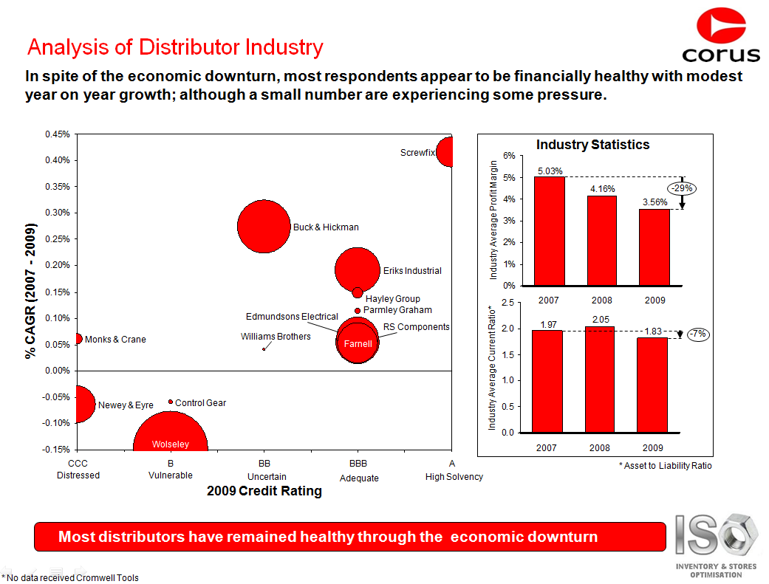
Interpretation
Financial
Commercial
Technical
The interpretation and analysis highlighted the key players in the MRO market and the overall MRO market trends.
1
Company Revenue is represented by bubble size, CAGR (Growth Rate) is plotted on the y-axis and Credit Rating is plotted on the x-axis
1
2
2
Profit margin (Net Profit / Net Sales) and Current Ratio (Assets / Liabilities) were calculated from the supplier responses to build a picture of profitability and liquidity over time

Slide 82
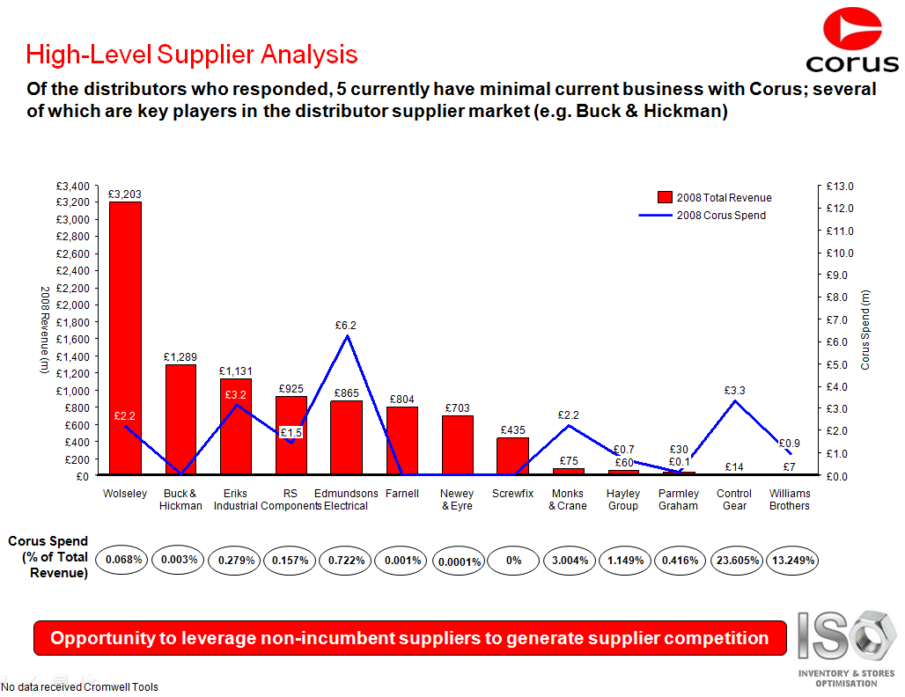
Interpretation
Financial
Commercial
Technical
The comparison of revenue to supplier spend highlighted that there were large players in the market who were not being used.
1
Company revenue was compared to the buyer’s spend to identify small companies who receive a large amount of the buyer’s spend MRO spend
1
2
The percentage of buyer’s spend to total revenue was also calculated to highlight companies relying heavily on the buyer’s spend
2

Slide 83
Commercial Capabilities
Financial
Commercial
Technical
Commercial capabilities provide information on the ability of the supply market to meet the business requirements set out in the initial Sourcing Strategy .
Purpose
To assess whether the supplier market has the commercial capabilities to fulfil business requirements
Areas for Considerations
Categories supplied, Geographic Coverage, Lead Time for supply (RFI Type questions); Rebate Price Model, Non Contract Pricing, Price Increase Mitigation strategies (RFP type questions)

Slide 84
Distributor RFI Example
Financial
Commercial
Technical
The commercial section of the Distributor RFI was designed to assess the cross category supply capabilities of large MRO distributors.
Hypothesis
“There are key MRO distributors which are able to supply multiple MRO categories across the US”
Key Questions
Which categories do companies supply?
Which geographic regions can the market supply to?
Metrics and Measures
MRO Revenue by category (%), Lead time per category (days), Lead time per geographic region (days)

Slide 85
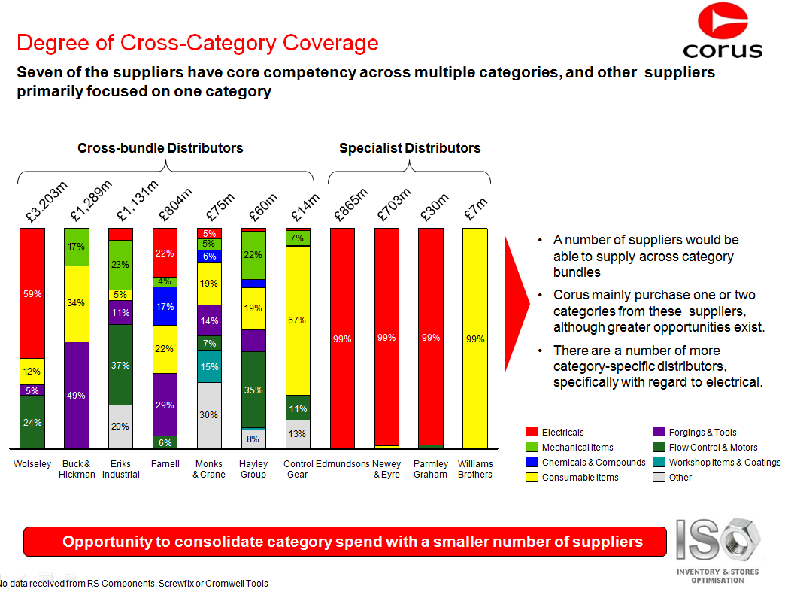
Interpretation
Financial
Commercial
Technical
The interpretation highlighted that there are a number of key players capable of supplying across categories, along with some more specialized electrical distributors.
1
By comparing the relative % of revenue from each MRO category, it is possible to determine that the supply market consists of both large cross-bundle suppliers...
...and specialist distributors mainly in the electricals category
1
2
2

Slide 86
Technical Capabilities
Financial
Commercial
Technical
The evaluation of technical capabilities provides an insight into how a supplier might deliver value to the business beyond basic price negotiations, to form a more strategic relationship.
Purpose
To assess whether the supplier market has the technical capabilities to add value to the relationship beyond price
Areas for Considerations
Repairs & Maintenance services, Consignment stocking models, Vendor Managed Inventory, SAP integration, eCatalogs

Slide 87

Technical Capabilities
Financial
Commercial
Technical
The consignment stock model can offer significant benefits to stores operations and working capital outlay.
Benefits: Increased stock visibility, Reduction in working capital (as supplier owns items until used), Less risk of stock outages
Drawbacks: Additional administrative costs, Mainly suited to high volume low value items
Consignment Stock Example
Invoice Generated for Items Used
Usage is calculated over a time period
Supplier delivers items to labs
Item | Qty.
Screw | 100
Nail | 100
Bolt | 100
Item | Usage
Screw | 50
Nail | 60
Bolt | 40
Consumption is calculated and a replenishment order is placed

Slide 88
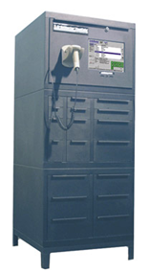
Technical Capabilities
Financial
Commercial
Technical
The Vendor Managed Inventory model is often used with a more strategic supplier relationship.
Benefits: All benefits of consignment stocking, and reduction in transactional processing (as the supplier manages all reordering and replenishment on site)
Drawbacks: Higher prices to account for additional supplier processing
Vendor Managed Inventory Example
Item | Qty.
Screw | 100
Nail | 100
Bolt | 100
Item | Usage
Screw | 50
Nail | 60
Bolt | 40
Minimum Stock Level Reached
Supplier Replenishes Vending Machine
Item usage is tracked over time
Invoice automatically generated for Items Used
Replenishment PO automatically generated

Slide 89
Distributor RFI Example
Financial
Commercial
Technical
Systems integration capabilities, and alternative stocking models were assessed to evaluate how suppliers might add greater value to a MRO distribution contract.
Hypothesis
“A number of key players will be able to provide alternative stocking models, eCatalogs and SAP integration”
Key Questions
Can companies provide Consignment Stocking Models / Vendor Managed Inventory?
Can companies provide SAP integration / eCatalogs?
Metrics and Measures
Yes / No questions

Slide 90
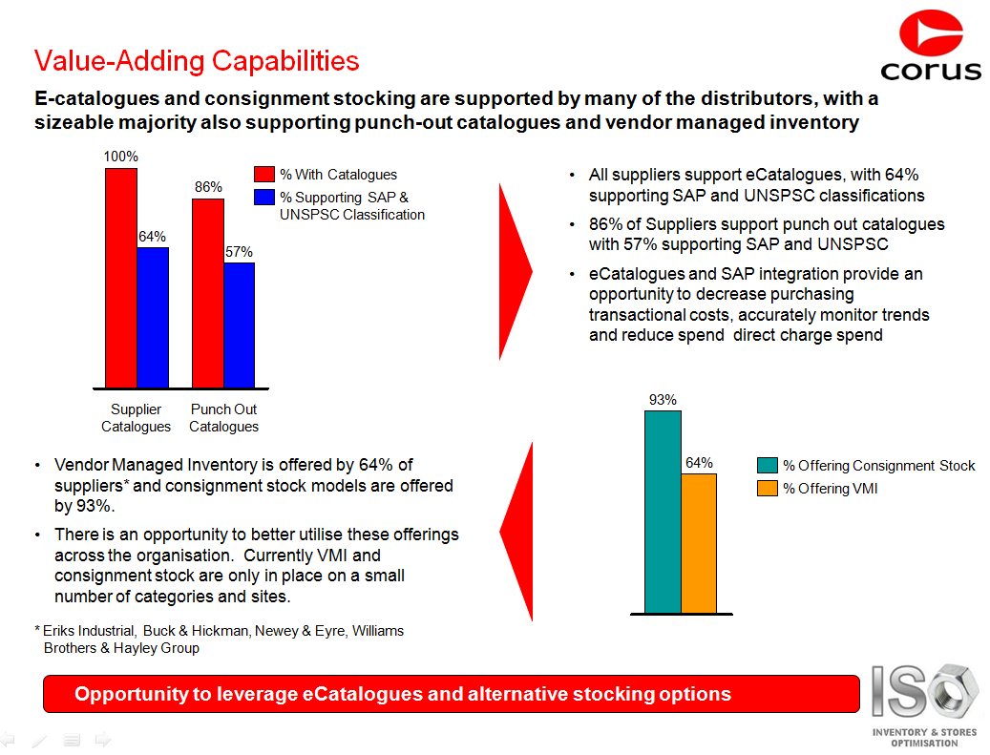
Interpretation
Financial
Commercial
Technical
The interpretation highlighted that many suppliers were able to fulfil the basic technical requirements and add value beyond price alone.
1
By comparing suppliers, it is possible to determine that many of the suppliers have eCatalogs, and some are also able to provide systems integration which will build long term value
Most suppliers offer consignment stocking models, with some able to offer full vendor managed solutions.
1
2
2

Slide 91
Creating & Analyzing RFIs / RFPs
1
What are the key solicitation documents?
How do they fit into the Sourcing Process?
Why use an RFI or RFP?
How do you fit into the process?
2
Typical Document Structure
Hypothesis Driven Analysis
Identifying Selection Criteria
Weighting Selection Criteria
Removing price from negotiations
Supplier Relationship Management
3
Focus on document questionnaires
  Financials Analysis
  Commercial Capabilities
  Technical Capabilities
4
Focus on Contract Award Scenarios

Slide 92
Typical Award Scenarios
Once the responses have been evaluated the contract will be awarded based on a predetermined award scenario which is focused on the category objectives.
Sample Award Scenarios
Description
Considerations
Best price
The combination of lots and bundles which provides the lowest overall price – regardless of supplier
This approach would optimise unit prices, but this may compromise operational efficiency by working with many suppliers
1
Best score
Combination of suppliers with best overall score (technical + price) at lot level
This approach would optimise contract award based on price and long term value and additional services
2
Dual vendor
(best score)
All business is awarded at lot level to the two suppliers with the best price and best score scenarios
This approach will reduce the risk which may occur if you contract with only one supplier
4

Slide 93
Financial Definitions
The following definitions refer to ratios described in the Financial Analysis section.
Term | Definition
Earnings Before Interest & Taxes | Earnings before interest and taxes (EBIT) or operating income is a measure of a firm's profitability that excludes interest and income tax expenses
Cost of Goods Sold | Cost of goods sold refers to the inventory costs of those goods a business has sold during a particular period. Costs of goods made by the business include material, labour, and allocated overhead.
Current Assets | Typical current assets include cash, cash equivalents, accounts receivable, inventory, the portion of prepaid accounts which will be used within a year, and short-term investments.
Current Liabilities | All liabilities of the business that are to be settled in cash within the fiscal year
OEM | Original Equipment Manufacturer
CAPEX | CAPEX (capital expenditure) are used by a company to acquire or upgrade physical assets such as equipment, property, or industrial buildings
OPEX | OPEX (operating expense) is a day-to-day expense such as sales and administration, or research & development
Lead Time | Time from the moment the customer places an order to the moment it is received by the customer

Slide 94
When to Apply Different Processes?
The supplier selection process will differ depending on the complexity of the category and the characteristics of the supply market, and may merit an RFI, RFQ, RFP, or a combination of solicitations.
Decision Process for Supplier Selection
Option 1
RFI
RFP
Site visits to verify capabilities
Negotiations/
Rev.Auctions
Characteristics
Many suppliers
Focus on process efficiency
Dynamic industry structure able to adapt to changing conditions
Option 2
RFI
Site visits to verify capabilities
Negotiations/
Rev.Auctions
Option 3
RFI
Negotiations/
Rev.Auctions
Option 4
RFP
Site visits to verify capabilities
Negotiations/
Rev.Auctions
Option 5
RFP
Negotiations/
Rev.Auctions
Relationship Driven Frameworks
Characteristics
Few suppliers
Focus on objectives
Constrictive industry structure
Can potentially use a brief and less formal RFI that leads into negotiations
Option 6
Site visits to verify capabilities
Negotiations/
Rev.Auctions
Option 7
Begin with
Negotiations/
Rev.Auctions

Slide 95
Agenda
Conducting Sourcing Analysis
Data Management Methods
Creating & Analyzing RFIs & RFPs
Preparing for Fact Based Negotiations
Appendix

Slide 96
What is Fact Based Negotiation?
The Fact Based Negotiating framework differs from traditional negotiating processes.
Fact Based Negotiating vs. the Traditional Approach
Traditional Negotiating Process
Fact Based Negotiation
Desired Outcomes
Buyer and supplier representative have a one-to-one relationship
Outcomes heavily impacted by personal dynamics and style
Objectivity difficult to maintain
Negotiations focused on single issue – price
Buyer often reactive and lacks analytical support
Comprehensive methodology
Buyer and supplier represented by teams having an appropriate range of expertise
Outcomes dependent on data and facts presented
Objectivity promoted by multiple points of view
Negotiations address multiple issues (e.g. Price) and take multiple interests and viewpoints into account
Neutralize any power imbalance
Eliminate ‘hidden’ agendas from negotiations
Stronger relationship with fewer suppliers
Lower buyer cost and higher gross profit

Slide 97
Why Fact Based Negotiation?
Fact Based Negotiation takes a total cost of ownership approach to selecting suppliers, rather than focusing on purchasing price alone.
It leverages all of the information gathered throughout the 7-step process to develop scenarios that expand value for all involved parties and that present opportunities to capture more of that value.
Communication is key so that suppliers can fully understand the requirements and clarify questions.
The RFP & Fact Based Negotiation are comparable to how companies recruit & hire employees…
1. We send out an RFP much like we post a job opening.
2. We get RFP responses/proposals back similarly to how job applicants would submit their resumes and applications.
3. Then we negotiate with a supplier to determine the best agreement much like how we would negotiate with a top candidate to determine the agreement for our company.
Would you want to hire someone solely based on their resume?

Slide 98
How is This Different From the Standard Process?
The FBN process is meant to result in a better overall contract and to facilitate strong, integrated relationships with suppliers.
Standard Process | Enhanced Process
The exceptions taken and alternatives proposed by the highest ranked proponent are identified. These are the points that are negotiated. | The Category Team identifies strategic levers and develops a strategy to address any aspect of the proposal. For each negotiation meeting the strategy is reviewed and used to prompt for a more favorable proposal.
If an agreement can’t be reached with the highest ranked proponent, negotiations begin with the second highest ranked proponent. | Proponents are dropped from the short list until contracts are reached with one or more proponents, depending on the category. Based on the negotiation strategy for each negotiated item, the proponent(s) who provides an overall offer closest to the maximum supportable solution will be successful.

Slide 99
Approach to Fact-Based Negotiations
Industry Analysis can answer several key questions concerning the competitive intensity, profitability trends and best practices in a certain market.
Step 1
Step 2
Step 3
Step 4
Create Negotiations Strategy
Define Negotiations Approach
Plan Negotiations
Execute Negotiations
Finalize organization of facts
Document internal and supplier levers
List internal and potential supplier issues to address and prepare “one-voice” responses
Establish internal and potential supplier goals and contract requirements
Compose key messages
Prepare FBN reference documents
Determine negotiations team roles
Select formats, locations and timing
Prepare and deliver Negotiation Strategy deliverable for review and approval
Conduct negotiations
Prepare and deliver Bid Award Recommendation deliverable for review and approval
Communicate final results

Slide 100
Create Negotiations Strategy
Piecing together the different areas of analysis enables a case to be built justifying the target cost reductions, profitability increases or other business requirements.
Illustrative Assembly of Negotiations Facts
Industry Data
Market Attractiveness
Industry Competition
Five Forces
Economic Data
Freight Changes
Labor Rates
Commodity Prices
Supplier Financial Data
Media Coverage
Annual Reports
Financial Stability
Supplier Relationship
Purchase Volumes
Margins/Profitability
Supplier Compliance

Slide 101
Define Negotiations Approach
Once the levers are determined, then next step is to o develop goals and objectives for the negotiations. Three critical components to negotiation strategy are the negotiation boundaries.
Negotiations Boundaries
Maximum
Supportable
Solution
(MSS)
Objective:
The altogether best proposal
based on overall benefits
and viability of alternative
WANTS
Least
Acceptable
Solution
(LAS)
Bottom Line:
The company’s bottom line
NEEDS
Best Alternative
To Negotiated
Agreement
(BATNA)
Switching Strategy:
Course of action we will pursue if the viable suppliers are not willing to agree to our bottom line
ALTERNATIVES

Slide 102
Define Negotiations Approach
A Maximum Supportable Solution (MSS), a Least Acceptable Solution (LAS), and the Best Alternative to Negotiated Agreement (BATNA) should be developed drawing on information from the analysis completed earlier.
Negotiations Boundaries Guidelines
Maximum Supportable Solution (MSS)
Least Acceptable Solution (LAS)
Best Alternative (BATNA)
We will never get more than we ask for
Aspiration level is one of the most important factors in determining success
Be ambitious, but have a defensible rationale
MSS is independent of what the other party will accept
MSS is an opening, not a closing proposal
Barring the emergence of a better option, settling for anything less than this is not a viable business option
This is the minimum we can agree to without sacrificing our business interests
We should never agree to any solution less than this without very careful consideration of our BATNA
BATNA is not the same as our least acceptable solution or our bottom line
What will we do if we cannot get a mutually acceptable agreement, i.e. alternatives in the event of a deadlock or unsuccessful agreement?
A BATNA is a unilateral action on the company’s part
A BATNA helps the company:
  Assess more realistically your relative power
  Ensure that you do not settle at any cost
  Be more flexible, since it can provide a somewhat different perspective on any of the alternatives presented

Slide 103
Define Negotiations Approach
While the LAS is defined as the minimum needs for the materials or services purchased, the MSS can represent the lowest market price available, a lower volume commitment, or a longer-term contract.
Example Negotiations Boundaries
Least Acceptable Solution (“Needs”) |  | Maximum Supportable Solution (“Wants”)
Maximum acceptable price that meets benefits goals |  | Minimum market price
Volume commitment equal to previous contract |  | Lower volume commitment for the same or better price
Market average delivery time |  | Shortest delivery time possible
Product performance to meet specifications |  | Performance exceeding specifications
Price firm for one year |  | Longer-term price guarantee

Slide 104
Define Negotiations Approach
Determining the MSS and LAS for both the buyer and the supplier allows a Zone of Possible Agreement (ZOPA) to be created.
Creating a ZOPA
– Buyer –
– Seller –
Determine your range
Estimate your supplier’s range
Find the overlap
Negotiate agreement
MSS
$114 per unit
LAS
$118 per unit
ZOPA
LAS
$121 per unit
MSS
$140 per unit

Slide 105
Plan Negotiations
Determination of negotiations team roles beforehand is essential to effectively communicating UC’s goals during the negotiations sessions. Each negotiating team participant should be assigned one or more “roles.”
Role | Responsibility
Team Lead | Overall authority for shaping the negotiation strategy
Principal Negotiator | The ‘One Voice’ for UC; conducts primary negotiations with the supplier
Sourcing Analyst | Has thorough understanding of user requirements, usage volumes, prices, supplier information, supplier competition, and market factors
Strategist | Thorough understanding of strategy and leverage points; provides support in conducting negotiations
Recorder | Provides detailed documentation of all discussions, agreements and unresolved issues

Slide 106
Execute Negotiations
Supplier responses and any additional proposals are then analyzed and carefully considered. Finally, UC and the selected supplier(s) agree to key service levels, OR if no supplier is selected, the team moves on to the Best Alternative to a Negotiated Agreement (BATNA).
Assess the results of the second meeting and review the commercial conditions
Ensure business requirements are signed-off by both parties as agreement on each is reached
Agree on indices and key performance indicators that will become the basis for future negotiations
Establish the frequency of future supplier reviews and SLA meetings
If the minimum business requirements cannot be achieved, be prepared to switch to BATNA

Slide 107
Execute Negotiations
Once a supplier(s) is selected by the strategic sourcing team, a business case is prepared for review with stakeholders and procurement leadership outlining the options resulting from negotiations and a final recommendation.
Scenario 1:
Greatest TCO Benefits
Scenario 2:
Distributor Offering
Scenario 3:
Fewest Suppliers
Team Recommendation

Slide 108
Agenda
Conducting Sourcing Analysis
Data Management Methods
Creating & Analyzing RFIs & RFPs
Preparing for Fact Based Negotiations
Appendix
Key Excel Skills for Analysts
Tools and Templates

Slide 109
Key Excel Skills for Analysts
1
Data Filters
2
Pivot Tables
3
VLOOKUPS
4
‘IF’ Statements
5
Conditional Formatting
6
Excel Working Exercise

Slide 110
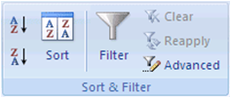
Data Filters
Filtered data displays only the rows that meet criteria that you specify and hides rows that you do not want displayed.
You can filter data by more than one column. Filters are additive, which means that each additional filter is based on the current filter and further reduces the subset of data.
Type
In Excel 2010 it is possible to filter on a number of different criteria:
Text
Numbers
Dates or times
Top or bottom numbers
Above or below average numbers
Blanks or non-blanks
Cell color, font color, or icon set
NOTE: When you use the Find dialog box to search filtered data, only the data that is displayed is searched; data that is not displayed is not searched. To search all the data, clear all filters.

Slide 111
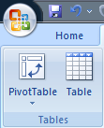
Pivot Tables
Pivot tables can be used to manipulate and display large amounts of data in Excel spreadsheets.
A pivot table can be used to:
    Organize and summarise data
    Reveal and illustrate relationships and trends for analysis
    Perform calculations such as addition, average and minimum / maximum, without needing formulas
    Dynamically compare datasets - you can change fields at any time
However, PivotTables are only effective if data is well-organized!
    Delete any blank rows or columns
    Remove any calculations at the top or bottom of data as well as manually-added sub-totals
    Remember that all hidden rows & columns will be visible in a PivotTable

Slide 112
VLookups
VLookups search for a value in the first column of a table array and returns a value in the same row from another column in the table array.
VLOOKUP(lookup_value, table_array,col_index_num,range_lookup)
Lookup_value The value to search in the first column of the table array. Lookup value can be a value or a reference.
Table_array Two or more columns of data. Use a reference to a range or a range name. The values in the first column of table_array are the values searched by lookup_value. These values can be text, numbers, or logical values. Uppercase and lowercase text are equivalent.
Col_index_num The column number in table_array from which the matching value must be returned. A col_index_num of 1 returns the value in the first column in table_array; a col_index_num of 2 returns the value in the second column in table_array, and so on. If col_index_num is:
Less than 1, VLOOKUP returns the #VALUE! error value.
Greater than the number of columns in table_array, VLOOKUP returns the #REF! error value
Range_lookup A range lookup value of 0 will return only exact matches to the original source column, but a value of 1 will return approximate results
NOTE: HLOOKUPS can be used instead to search horizontally

Slide 113
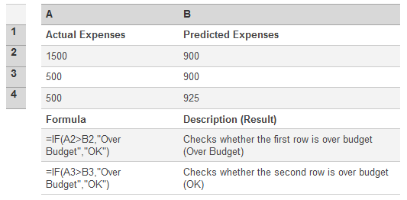
IF Statements
This function returns one value if a condition is TRUE and another value if it is FALSE.
Statement Structure: = IF(logical_test, value_if_true, value_if_false)
Example of an IF Function:
NOTE: Up to seven IF statements can be nested together as one function
=IF(LEFT(A3,1)="C“,1,IF(LEFT(A3,1)="W“,2,IF(LEFT(A3,1)=“E”,3,A3)))

Slide 114

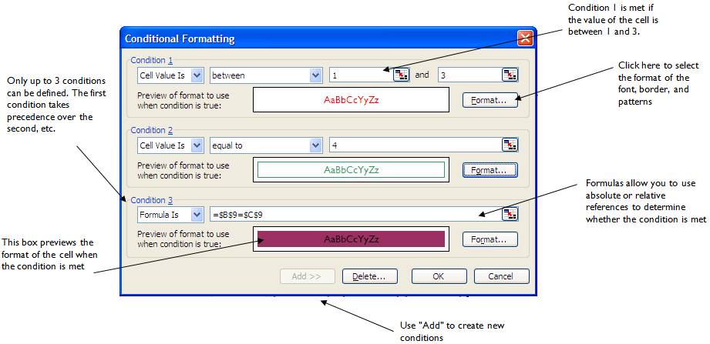
Conditional Formatting
Conditional formatting allows you to define the format of individual cells based on a series of criteria.

Slide 115
Excel – Working Exercise
The following Excel exercise looks at some examples of these key functions.

Slide 116
Agenda
Conducting Sourcing Analysis
Data Management Methods
Creating & Analyzing RFIs & RFPs
Preparing for Fact Based Negotiations
Appendix
Key Excel Skills for Analysts
Tools and Templates

Slide 117
Strategic Sourcing Templates
The following templates are to be used as guides throughout the Strategic Sourcing Process.
Strategic Sourcing Activity | Template Name | Link to Template
1.2 Conduct Project Kick-Off | Kick-Off Meeting | Kick-Off Meeting
1.3 Finalize Project Plan | Sourcing Project Work Plan | Sourcing Project Work Plan
 | Business Case | Business Case
 | Stakeholder Management Toolkit | Stakeholder Management Toolkit
2.1 Conduct Internal Analysis | Data Collection | Data Collection
 | As-Is Procurement Flow | As-Is Procurement Flow
 | Category/Sub-Category Profile | Category/Sub-Category Profile
2.2 Conduct Industry Analysis | Porter’s 5 Forces Analysis | Porter's 5 Forces Analysis
 | Financial Ratio Tools | Financial Ratio Tools
 | Supplier 1-on-1 Questions | Supplier 1-on-1 Questions
 | Supplier Survey | Supplier Survey
 | Category/Sub-Category Profile | See 2.1 Category/Sub-Category Profile to update
2.3 Build TCO Model | TCO Model | TCO Model

Slide 118
Strategic Sourcing Templates
The following templates are to be used as guides throughout the Strategic Sourcing Process.
Strategic Sourcing Activity | Template Name | Link to Template
3.2 Develop To-Be Process Flow | To-Be Procurement Flow | To-Be Procurement Flow
3.3 Develop & Summarize Category Strategy | Category/Sub-Category Strategy | Category/Sub-Category Strategy
4.1 Finalize Supplier Evaluation Criteria | Supplier Evaluation Criteria Matrix | Supplier Evaluation Criteria Matrix
4.2 Develop Scoring Document | Supplier Evaluation Criteria Matrix | See 4.1 Supplier Evaluation Criteria Matrix to update
5.2 Distribute Tender Document | Clarifying Questions | Clarifying Questions
5.3 Evaluate & Score Tender Document | Supplier Evaluation Criteria Matrix | See 4.1 Supplier Evaluation Criteria Matrix to update
6.1 Finalize Fact-Based Negotiation | Fact-Based Negotiation Package | Fact-Based Negotiation
7.1 Develop Category Savings Summary | Business Case | See 1.3 Business Case Template to update
7.2 Develop Implementation Plan | Implementation Plan | Implementation Plan

Slide 119
Other Templates and Tools
Title | Description | Link to Template
COE SharePoint site | The main site for storing COE working documents, meeting notes, deliverables, and coordinating team calendars. Part of the Procurement Services SharePoint | COE SharePoint site
Status Reporting | Status Reporting template to be used for weekly COE status reports | Status Report Template – Life Sciences Status Report Template – MRO
University of California Brand Guidelines | The site contains a number of guidelines for using the UC brand, as well as a number of templates such as PowerPoint | UC Brand Guidelines website
Business Rules | Set of ‘default’ rules when conducting a sourcing project or negotiation | Business Rules

